Slide 1


Machine Learning Hackathon
Team Name- Sparks
Team Leader Name- Paidimarri Nithish
Team Leader Email Address- nithishpaidimarri@gmail.com

Slide 2
Brief Description of the Problem at hand:
The ad server logs contain valuable information such as browser details, IP addresses, geographic locations, search patterns, site url’s, and other relevant data. The objective of the hackathon is to build a robust model that can accurately predict whether a user belongs to the HCP category and its specialization id/taxonomy.
We have to build a robust model to predict whether a user belongs to healthcare professional or not.

Slide 3
Solution proposed and description:
The solution for this model is preparation of steps like data cleaning, preprocessing, Feature selection, model building, model training, model validating finally predicting the test dataset.
So, I have used Random forest classifier instead of decision tree classifier because decision tree is not a better approach for a larger datasets may lead to overfitting.
Next, In Random Forest we have to set the hyperparameters like n_estimators means number of decision trees, max_depth means depth of a tree and random_state which is used for same result for multiple sessions.
Finally, based on majority voting of each sub decision tree and averaging that gives predicted solution.

Slide 4
Approach:
The main approach is to build robust random forest classifier model to classify the user whether the person is healthcare professional or not.
So, I have selected some features by plotting feature importance graph which determines which are the features that will impact on the model for correct classification.
After performing feature selection I have to values to hyperparameters like estimators are 200 trees, depth is 4 and random_state is 0 (constant).
Building model and train with train dataset and predicting with test dataset provided.
Finally, saving the results to csv format.

Slide 5
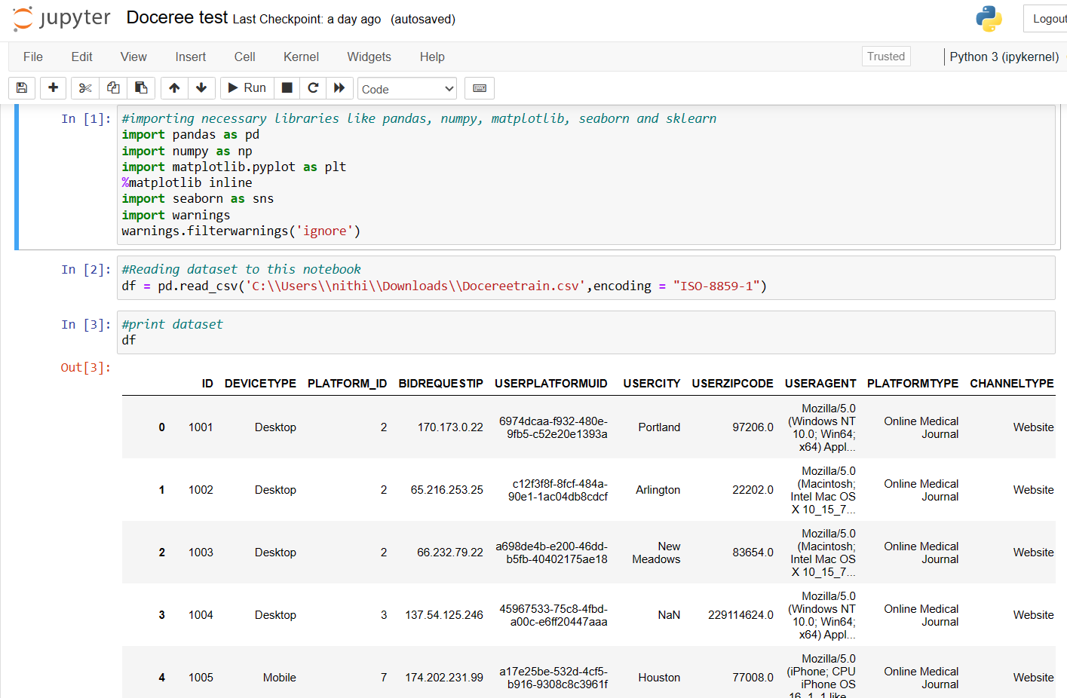
Execution Demo (Video/ Screenshots) of the solution:

Slide 6
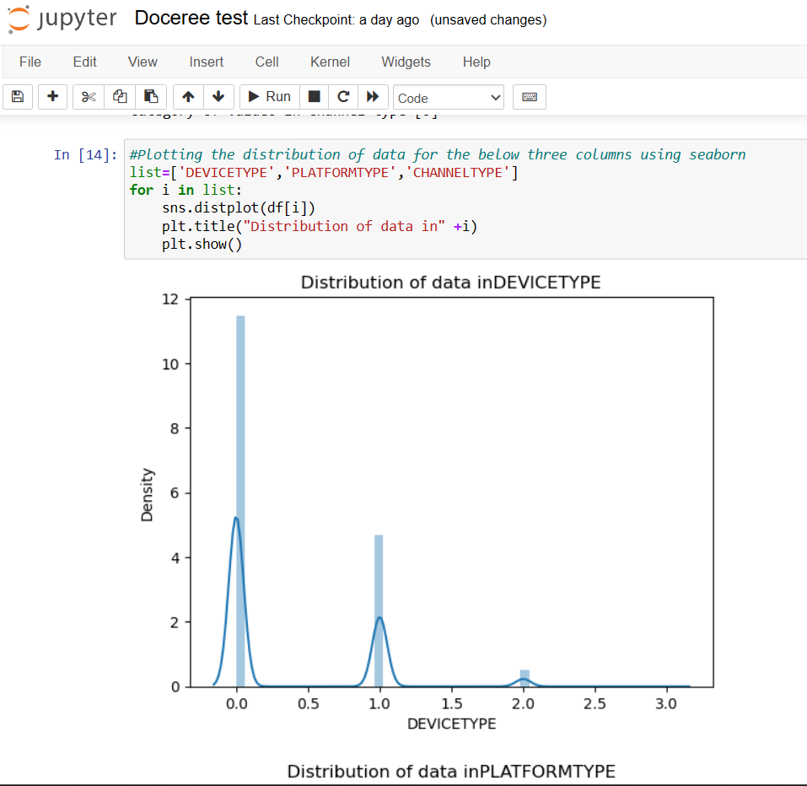
Execution Demo (Video/ Screenshots) of the solution:

Slide 7
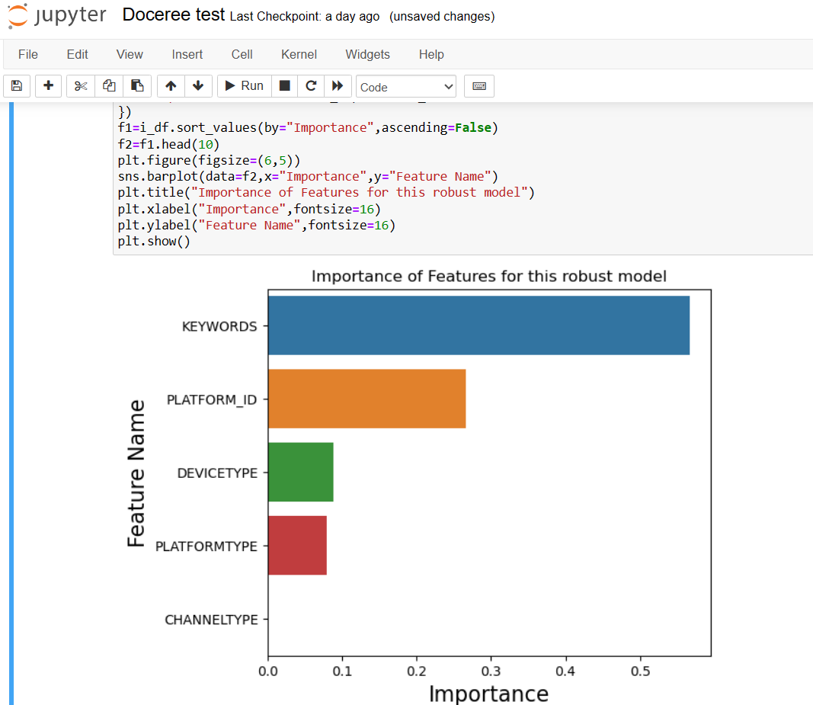
Execution Demo (Video/ Screenshots) of the solution:

Slide 8
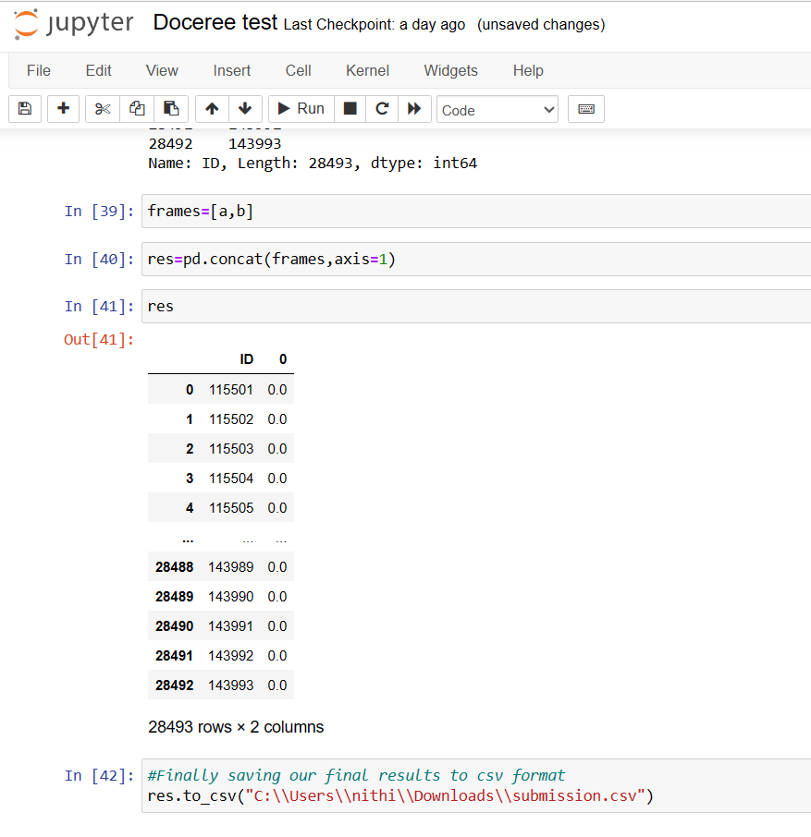
Execution Demo (Video/ Screenshots) of the solution:

Slide 9
Source code in ZIP file/Github URL:
Github url : https://github.com/Nithish-456/Doceree-Hackathon

Slide 10
Additional comments (optional):
Thank you for giving this opportunity to participate in this hackathon. By this hackathon, I have gain knowledge on Machine Learning and its real applications and tools.

Slide 11
THANK YOU!

