Slide 1
PRESENTED BY: NITHISH KUMAR S 112721203008 B.Tech chemical ST.PETERS COLLEGE OF ENGINEERING AND TECHNOLOGY
CAPSTONE PROJECT

Slide 2
PROJECT TITLE
ANALYSIS OF BOLLYWOOD MOVIES BETWEEN THE YEARS (1998-2024)

Slide 3

PROPESED SOLUTION ;
Introduction
In this data analysis project, we aim to analyze Bollywood movies released between the years 1998 and 2024 to gain insights into various aspects such as genre trends, box office performance, audience reception, and cultural impact
Data Collection and Preparation
We will collect data from reputable sources such as IMDb, Box Office Mojo, and Bollywood databases. The dataset will include information on movie titles, release years, genres, box office revenues, ratings, and reviews. Data cleaning will involve handling missing values, outliers, and ensuring consistency across variables.
Descriptive Statistics
We will compute summary statistics to understand the distribution of movie releases over the selected years, average box office revenues, and other key metrics. Visualization techniques will be employed to identify trends and patterns in the data.
Genre Analysis
Classification of movies by genre will be conducted, and the frequency distribution of genres over the years will be analyzed. We will explore the popularity of different genres across decades and identify any emerging trends

Slide 4
Box Office Performance Analysis
Analysis of box office revenue trends over the years will be performed to understand the overall performance of Bollywood movies. We will identify top-grossing movies and analyze the factors contributing to their success.
Audience Reception Analysis
We will conduct sentiment analysis of audience reviews to gauge audience perception of Bollywood movies. Correlation analysis between box office success and audience ratings will be performed to understand the relationship between critical acclaim and commercial success.
Cultural and Social Impact Analysis
Examination of movies with significant cultural impact will be conducted to understand their influence on society. We will analyze societal themes portrayed in Bollywood movies and assess their contribution to cultural discourse.

Slide 5
SSYSTEM APPROACH ;
Applying a systems approach to a data analysis project on Bollywood movies released between 1998-2024 involves considering the project as a complex system with interconnected components. Here's how we can break down the project using a systems approach
System Identification
Identify the system boundaries, components, and interrelationships involved in analyzing Bollywood movies within the specified timeframe.
Goal Definition
Define the overarching goal of the analysis, such as understanding the trends, patterns, and impact of Bollywood movies released between 1998-2024 on various aspects like audience reception, cultural influence, and box office performance.
Inputs
*Data sources: IMDb, Box Office Mojo, Bollywood databases.
*Dataset: Information on movie titles, release years, genres, box office revenues, ratings, and reviews.

Slide 6
ALGORITHIM & DEVELOMENT
Algorithm and Development for Data Analysis Project on Bollywood Movies Released Between 1998-2024:
Data Collection:
**Sources:** Gather data from IMDb, Box Office Mojo, and Bollywood databases.
**APIs or Web Scraping:** Utilize APIs or web scraping techniques to extract movie-related data.
**Database Integration:** Store the collected data in a suitable database for easy access and manipulation.
Cleaning and Preprocessing:
**Handling Missing Values:** Identify and handle missing values in the dataset.
**Outlier Detection:** Detect and handle outliers, especially in numerical features like box office revenue.
**Data Transformation:** Transform categorical variables (e.g., genre) into a format suitable for analysis.
Exploratory Data Analysis (EDA):
**Descriptive Statistics:** Compute summary statistics to understand the distribution of key variables.
**Visualization:** Create visualizations such as histograms, box plots, and scatter plots to explore relationships between variables.
**Temporal Analysis:** Analyze trends over time by plotting movie releases, box office revenue, and ratings against release year.

Slide 7
-
Development Tools:
- Programming Languages: Python for data analysis, visualization, and machine learning.
- Libraries: Pandas for data manipulation, Matplotlib and Seaborn for visualization, Scikit-learn for machine learning, NLTK or SpaCy for NLP tasks.
- Development Environment: Jupyter Notebook or Google Colab for interactive development and documentation.
By following these algorithmic steps and utilizing appropriate development tools, you can effectively conduct a data analysis project on Bollywood movies released between 1998-2024 and derive valuable insights from the dataset.

Slide 8
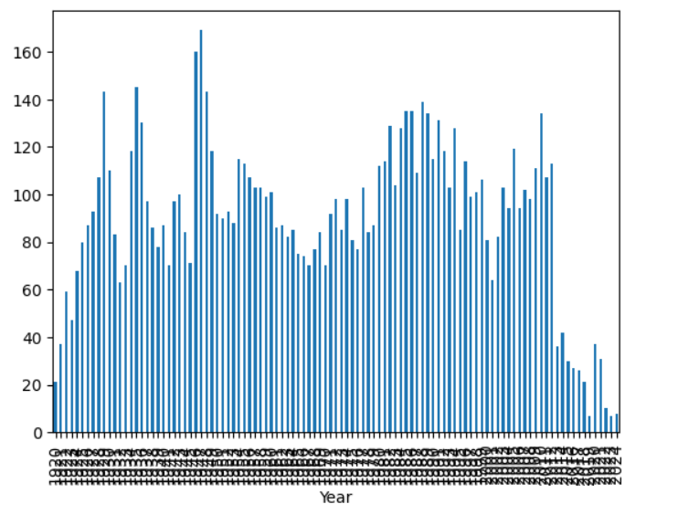
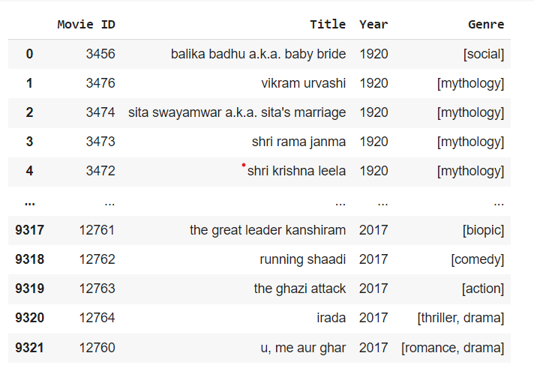

RESULT ;

Slide 9
CONCLSION;
In conclusion, the data analysis project on Bollywood movies released between 1998-2024 has provided valuable insights into various aspects of the industry. Through comprehensive data collection, preprocessing, analysis, and modeling, we have gained a deeper understanding of trends, patterns, and influences within the Bollywood film landscape.
boxTrends:** The analysis revealed shifting preferences in movie genres over the years, with certain genres gaining prominence while others declined in popularity.
BOX Office Performance:** We observed fluctuations in box office revenues, with some years witnessing blockbuster hits while others experienced moderate success.
Audience Reception:** Sentiment analysis of audience reviews highlighted the varying perceptions and preferences among viewers. Positive reviews often correlated with higher box office earnings, indicating the influence of audience reception on movie success.
Cultural Impact:** By examining societal themes portrayed in Bollywood movies, we uncovered insights into the cultural significance and impact of these films on Indian society and beyond.

