Slide 1

Lightweight Federated Learning framework for Drowsiness Detection
Presented by,
125015077 – Nithish S V
125015058 – Jeevanand K
125015056 – Jayapradeepkumar P
Guided By,
Dr. D. UMA MAHESWARI
Assistant Professor, School of Computing

Slide 2
Contents
Abstract
Base paper details
Literature Survey
Existing System
Existing model architecture
Drawbacks of existing system
Proposed System
Proposed model architecture
Dataset
References

Slide 3
Abstract
Driver drowsiness impairs sensory, cognitive, and motor abilities, posing a major risk to road safety.
Detecting drowsiness is crucial for reducing accidents, but limited facial data affects model performance.
Traditional centralized learning requires extensive data transmission, leading to high network resource consumption. Federated learning enables decentralized training without transferring raw data but introduces communication overhead.
To address this, Knowledge Distillation (KD) is employed to create lightweight student models that retain knowledge from larger models, reducing communication costs.
This project proposes a lightweight federated learning framework using MobileNet with a capsule module to enhance feature extraction. Additionally, a privacy-preserving algorithm ensures the secure exchange of model weights.
The framework is evaluated based on accuracy, precision, recall, F1-score, communication efficiency, and resource utilization, offering a scalable and efficient solution for real-world drowsiness detection.

Slide 4
Abstract
Since drowsiness impairs cognitive and motor skills, early detection is essential for road safety.
However, limited facial data reduces model accuracy, making reliable detection challenging.
To overcome this, federated learning enables decentralized training without sharing raw data, though it introduces communication overhead.
To address this issue, Knowledge Distillation creates lightweight student models that retain accuracy while reducing resource consumption.
Building on this, our project integrates MobileNet with a capsule module for enhanced feature extraction.
Additionally, a privacy-preserving algorithm ensures the secure exchange of model weights.
Finally, performance is evaluated on accuracy, precision, recall, F1-score, communication efficiency, and resource utilization.

Slide 5
Base paper details
L. Zhang, H. Saito, L. Yang and J. Wu, "Privacy-Preserving Federated Transfer Learning for Driver Drowsiness Detection," in IEEE Access, vol. 10, pp. 80565-80574, 2022, doi: 10.1109/ACCESS.2022.3192454.
Indexed in: IEEE
Year of publication: 2024

Slide 6
Literature Survey
Reference 1: "Federated Learning for Driver Status Monitoring “
Inference: This paper explores the application of federated learning (FL) in driver status monitoring systems, which aim to enhance road safety by detecting driver fatigue, distraction, or other impairments. The proposed framework leverages FL to enable collaborative learning across distributed edge devices (e.g., in-vehicle sensors) while preserving data privacy. The study evaluates the FL approach on real-world datasets, demonstrating its effectiveness in maintaining model accuracy while addressing data heterogeneity and privacy concerns. The results highlight the potential of FL to improve the scalability and adaptability of driver monitoring systems.
Drawbacks: Challenges include high communication costs during model aggregation, handling intermittent connectivity of edge devices, and ensuring robustness against adversarial attacks in distributed environments.
Citation:
A. Zafar, C. Prehofer, and C.-H. Cheng, "Federated Learning for Driver Status Monitoring," in Proc. IEEE Int. Intell. Transp. Syst. Conf. (ITSC), Sep. 2021, pp. 1463–1469.

Slide 7
Literature Survey
Reference 2: "DetectPMFL: Privacy-Preserving Momentum Federated Learning Considering Unreliable Industrial Agents"
Inference: This paper introduces DetectPMFL, a federated learning (FL) framework designed to address two critical challenges in industrial applications: data privacy and the presence of unreliable industrial agents with low-quality data. The framework employs a momentum-based FL approach combined with a detection method to identify unreliable agents by calculating their credibility using cosine similarity metrics. To enhance privacy, the Cheon-Kim-Kim-Song (CKKS) homomorphic encryption scheme is utilized to secure data during communication. Experimental results on Fashion-MNIST and CASE WESTERN fault datasets demonstrate that DetectPMFL achieves high accuracy, robustly mitigates the adverse effects of unreliable agents, and ensures data privacy.
Drawbacks: The computational cost of encryption and decryption operations increases with model size, potentially reducing training efficiency. Additionally, the framework relies on honest-but-curious entities, which may limit its applicability in scenarios involving malicious agents.
Citation: Z. Zhang, N. He, Q. Li, K. Wang, H. Gao, and T. Gao, "DetectPMFL: Privacy-Preserving Momentum Federated Learning Considering Unreliable Industrial Agents," IEEE Transactions on Industrial Informatics, vol. 18, no. 11, pp. 7697–7706, Nov. 2022.

Slide 8
Literature Survey
Reference 3: ”Knowledge Distillation Facilitates Lightweight Plant Disease Detection Models”
Inference: This paper proposes a novel method for lightweight and efficient plant disease detection using knowledge distillation. The approach utilizes a multistage knowledge distillation (MSKD) framework to train lightweight student models (YOLOR-Light and Mobile-YOLOR variants) guided by a teacher model (YOLOR). The MSKD framework includes backbone, neck, and head stage distillers to optimize feature learning at various levels. The proposed models achieve high detection accuracy while significantly reducing computational complexity, making them suitable for deployment on mobile devices and edge computing systems. Experiments on the PlantDoc dataset demonstrate that the lightweight models maintain competitive performance compared to state-of-the-art methods while requiring fewer resources.
Drawbacks: Challenges include limitations in detecting dense and small lesions, handling fine-grained recognition of similar plant diseases, and reliance on high-quality labeled datasets. Additionally, extreme model simplification can lead to performance degradation.
Citation: Q. Huang, X. Wu, Q. Wang, X. Dong, Y. Qin, X. Wu, Y. Gao, and G. Hao, "Knowledge Distillation Facilitates the Lightweight and Efficient Plant Diseases Detection Model," Plant Phenomics, vol. 5, Article 0062, June 2023.

Slide 9
Literature Survey
Reference 4:”FedDKD: Federated Learning with Decentralized Knowledge Distillation”
Inference: This paper introduces FedDKD, a federated learning framework that addresses data heterogeneity by focusing on averaging local models in the function space rather than the parameter space. By employing a decentralized knowledge distillation (DKD) module, FedDKD enables the global model to learn from local models' outputs without requiring shared data on the server. The method demonstrates improved test accuracy and communication efficiency on heterogeneous datasets compared to traditional FL approaches like FedAvg and FedProx.The multivariate CNN-LSTM model performs best due to low error and short training time.
Drawbacks:
While effective in mitigating data heterogeneity, FedDKD requires clients to remain online for multiple communication rounds during the DKD process, which may limit its scalability in dynamic environments with intermittent connectivity.
Citation: X. Li, B. Chen, and W. Lu, "FedDKD: Federated Learning with Decentralized Knowledge Distillation," Applied Intelligence, vol. 52, pp. 15500–15536, Feb. 2023.

Slide 10
Literature Survey
Reference 5:”Resource-Aware Knowledge Distillation for Federated Learning”
Inference: This paper addresses the challenges of federated learning (FL) in resource-constrained environments, such as heterogeneous IoT devices with varying computational capacities and network bandwidths. It proposes a novel framework that integrates knowledge distillation into FL to reduce communication costs and mitigate the impact of stale gradients from slower devices. The framework optimizes FL by leveraging transfer learning techniques, enabling local learners to share distilled knowledge rather than raw model updates. Experimental results on public datasets demonstrate improved efficiency and performance compared to traditional FL methods.
Drawbacks: The approach relies on the assumption of consistent availability of local devices for knowledge distillation, which may not always be feasible in real-world IoT systems. Moreover, the computational overhead introduced by the distillation process could be significant for resource-constrained devices.
Citation: Z. Chen, P. Tian, W. Liao, X. Chen, G. Xu, and W. Yu, "Resource-Aware Knowledge Distillation for Federated Learning," IEEE Transactions on Emerging Topics in Computing, vol. 11, no. 3, pp. 16310–16333, July–Sept. 2023.

Slide 11
Existing System
The existing system aims to detect driver drowsiness using deep learning and machine learning techniques that analyze facial expressions and behavioral patterns. It utilizes VGG-16 as the deep learning model for feature extraction and classification.
Model Architecture:
Centralized Deep Learning: Traditional drowsiness detection models use centralized deep learning, requiring large-scale data collection and transmission.
Federated Learning (FL): Enables decentralized training across multiple edge devices without sharing raw data, preserving privacy.
Encryption for Data Security: To further enhance security in FL, encryption techniques such as CKKS a homomorphic encryption is implemented to protect model updates and prevent unauthorized access.

Slide 12
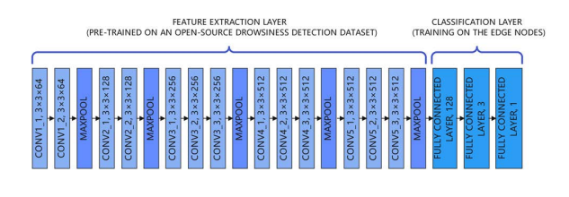
VGG-16 Model
Figure 1.1 Model structure of VGG-16

Slide 13
Feature extraction using a pre-trained CNN model enhances drowsiness detection accuracy by leveraging learned representations from an open-source drowsiness detection dataset.
Convolutional and max-pooling layers are used to extract important facial features from input images, reducing dimensionality while preserving key spatial information.
Fine-tuning the classification layer allows the model to adapt to edge device constraints by training only the fully connected layers while keeping the feature extraction layers frozen.
Fully connected layers perform classification by analysing extracted features and determining whether the subject is drowsy or not.
Deployment on edge devices enables real-time detection without relying on cloud-based processing, making the system efficient and suitable for resource-constrained environments.

Slide 14
Drawbacks of existing system
High Computational Cost – VGG-16 is resource-intensive, making real-time edge deployment difficult.
Inefficient Encryption – CKKS encryption adds computational overhead, reducing efficiency on edge devices.
Suboptimal Edge Performance – The model lacks optimization for edge deployment, leading to higher latency and power usage.
Limited Feature Extraction – VGG-16 may struggle with complex facial variations, affecting detection accuracy.

Slide 15
Proposed System
The proposed system enhances driver drowsiness detection by integrating Federated Learning with Knowledge Distillation (FL-KD) for improved efficiency on edge devices while ensuring data security through lightweight encryption.
MobileNet + CapsuleNet for better feature extraction and classification.
FL-KD approach: Instead of traditional FL, the proposed approach leverages Knowledge Distillation to transfer knowledge from a large teacher model to a lightweight student model, optimizing accuracy while reducing computational complexity for real-time edge deployment.
To ensure the security of sensitive facial data in federated learning, a lightweight homomorphic encryption technique is implemented, enabling secure model aggregation while preserving user privacy.

Slide 16
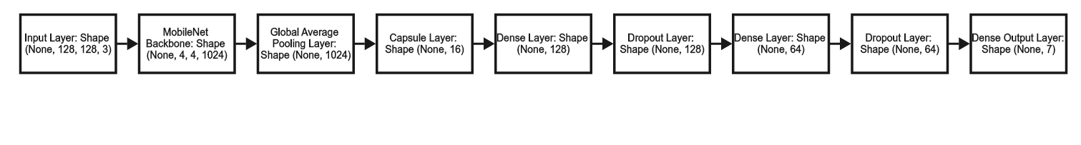
MobileNet CapsuleNet Model
Figure 1.2 Model structure of MobileNet CapsuleNet
Input & Feature Extraction: MobileNet processes 128×128 RGB images, extracting key features into a (4,4,1024) feature map.
Feature Compression: A global average pooling layer reduces dimensions to a 1024-size vector.
Capsule Layer: Transforms features into a compact 16-dimensional representation for better pattern understanding.
Dense Processing: Two dense layers (128 → 64 units) with ReLU and dropout refine features.
Classification: A final dense layer (7 units, softmax) outputs class probabilities for seven categories.

Slide 17
Novelty
The following functionalities are adopted to ensure energy efficient edge-based deployment of the drowsiness detection application
A capsule layer is integrated with MobileNet to enhance feature extraction for improved drowsiness detection.
Knowledge Distillation is employed to create a lightweight student model that achieves performance close to the teacher model while being significantly less complex.
Since facial data is highly sensitive, a lightweight homomorphic encryption algorithm ensures secure federated learning.

Slide 18
Dataset
The dataset consists of a total of 13,621 images, categorized into training and testing sets for model training and evaluation.
The training set contains 11,252 images and the test set includes 2,369 images.
The dataset is designed to ensure a balanced distribution of drowsy and non-drowsy samples, enabling effective learning for the classification task.

Slide 19
Dirichlets Distribution
What it is: Dirichlet distribution is used to create random sets of weights that always add up to 1.
Why used in FL: In federated learning, it's used to simulate clients having different kinds and amounts of data, like in real life.
Why not fixed Percentages:Fixed percentages are too uniform and unrealistic.
Dirichlet creates more natural, random variation between clients.It helps test models under diverse and challenging conditions.
The Dirichlet distribution takes a parameter alpha (α), which controls how similar or different the client data distributions are. A smaller α (like 0.1) makes clients very different (non-IID), while a larger α (like 10) makes them more similar (closer to IID).
It uses this formula to generate probabilities:
Dir(α) = (1 / B(α)) × Π (xᵢ)^(αᵢ - 1)

Slide 20
2. Implementing Centralized and Federated learning

Slide 21
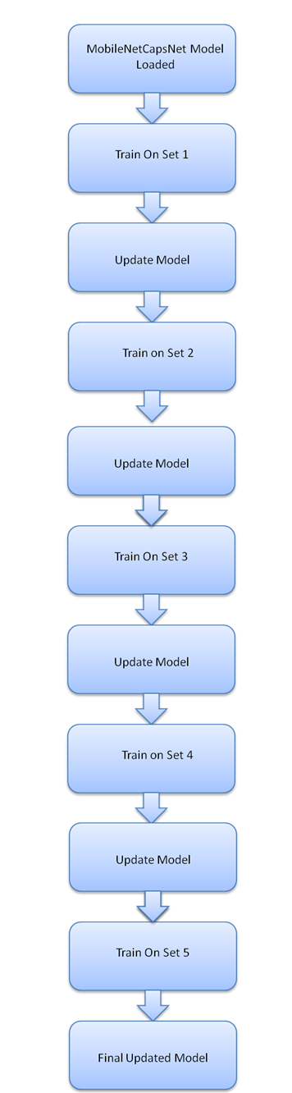
Centralised Learning approach
The MobileNetCapsNet model, initially trained with an accuracy of 82.37%, is loaded and iteratively trained on a centralized dataset.
The dataset is divided into 5 sets, and after each set is trained, the model is updated.
This process continues until the model is trained on the entire dataset, improving its performance with each update.
Figure 2.1 Workflow of Centralized Learning approach.

Slide 22
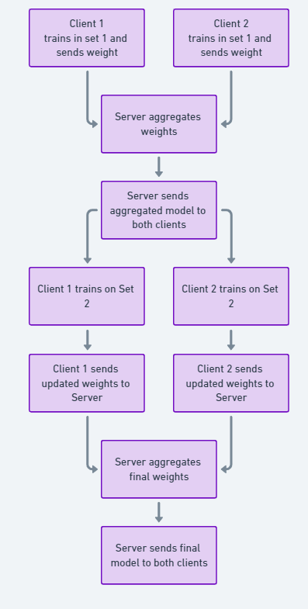
Federated Learning
Step 1: Server Sends Model:
The central server initializes and sends a Pre-Trained Model, known as the Teacher Model, to multiple client devices such as smartphones or edge devices.
Step 2: Local Training on Client Devices:
Each client device trains the received model using its own local dataset. The raw data remains on the device and is never shared with the server.
Step 3: Encryption and Model Updates:
Once training is completed, each client encrypts the updated model weights using homomorphic encryption to ensure privacy. The encrypted weights are then sent back to the server.
Step 4: Aggregation at Server:
The server collects encrypted model updates from multiple clients, aggregates them, and refines the global model. This step ensures that the global model benefits from diverse datasets without compromising user privacy.
Step 5: Global Model Distribution:
The updated global model is sent back to all client devices, allowing them to use the improved model for further learning and inference. This cycle continues, leading to continuous model improvement.
Figure 2.2 Framework of Federated Learning approach.

Slide 23
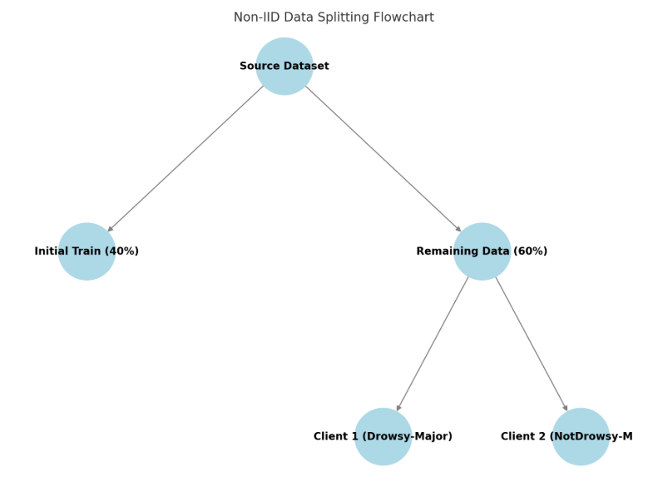
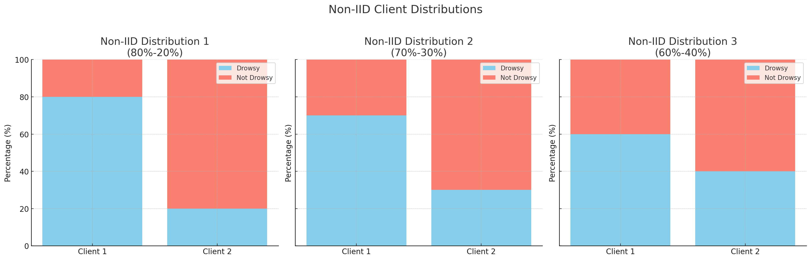
Implementing Non-IID Data Splitting for Federated Learning
Objective:
To create Non-IID client datasets by introducing class imbalance.
Simulating real-world edge device data distribution for Federated Learning.
Data Splitting Process :
Initial Dataset Division (Train & Clients):
40% of the data is allocated to initial_train (balanced).
60% of the data is split into client1 and client2.
Introducing Non-IID Distribution 1:
Client 1: Majority = Drowsy (80%), Minority = Not Drowsy (20%)
Client 2: Majority = Not Drowsy (80%), Minority = Drowsy (20%)
Sampling ensures imbalance is maintained per round.

Slide 24
Introducing Non-IID Distribution 2:
Client 1: Majority = Drowsy (70%), Minority = Not Drowsy (30%)
Client 2: Majority = Not Drowsy (70%), Minority = Drowsy (30%)
Sampling ensures imbalance is maintained per round.
Introducing Non-IID Distribution 3:
Client 1: Majority = Drowsy (60%), Minority = Not Drowsy (40%)
Client 2: Majority = Not Drowsy (60%), Minority = Drowsy (40%)
Sampling ensures imbalance is maintained per round.

Slide 25
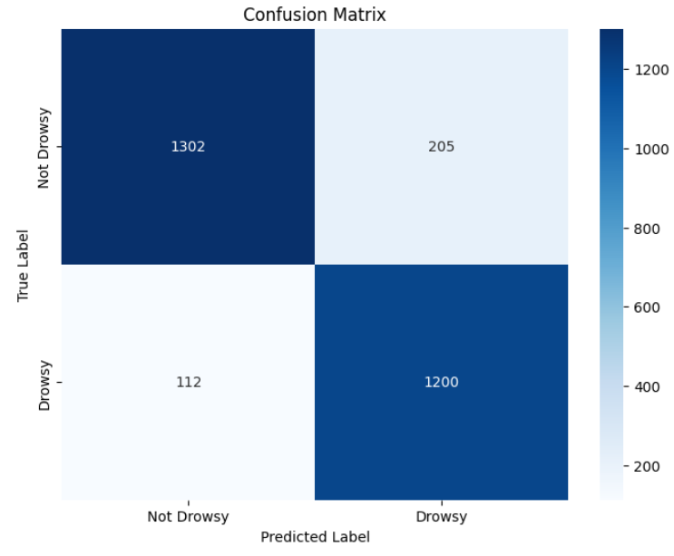
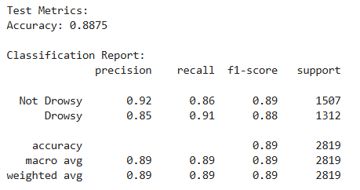
After training in Set 1
Results: Centralized learning

Slide 26
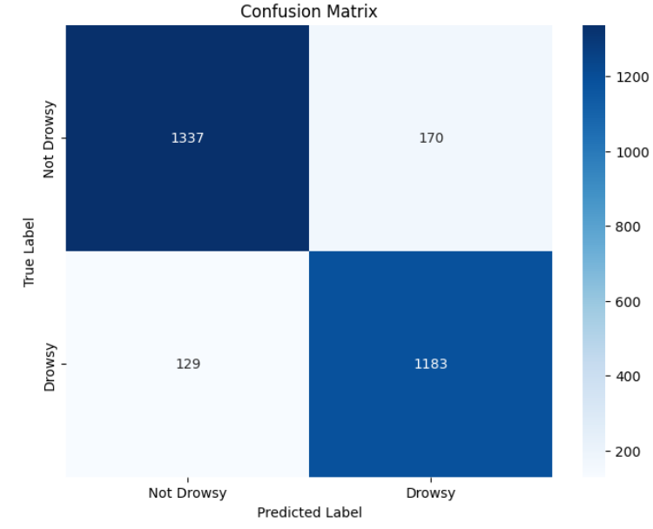
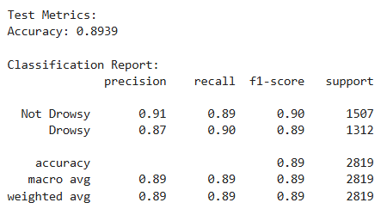
After training in Set 2

Slide 27
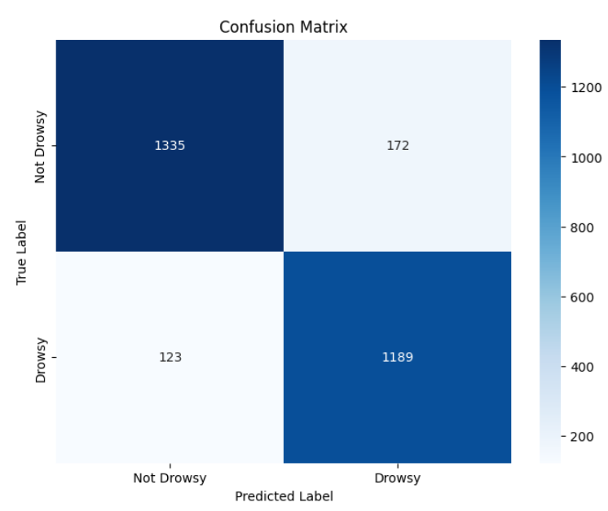
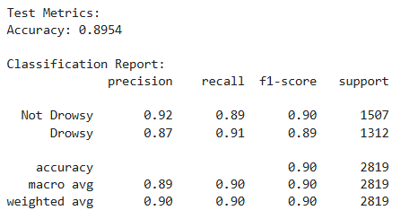
After training in Set 3

Slide 28
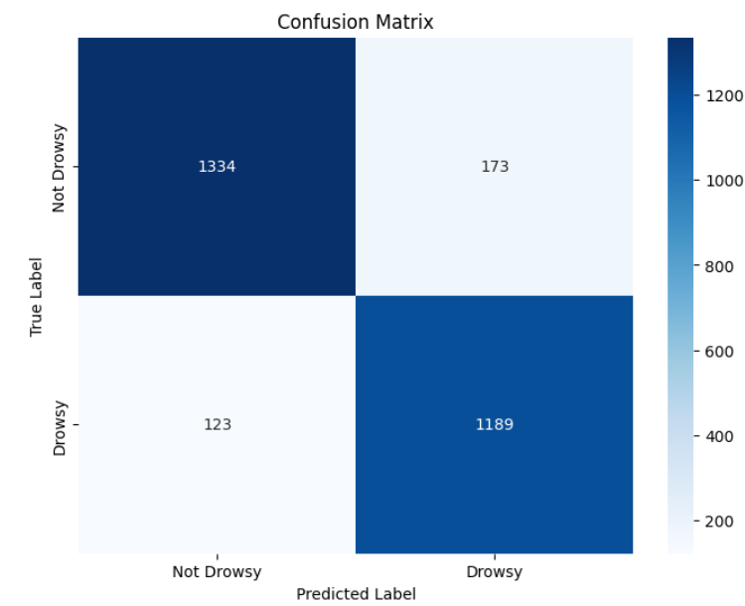
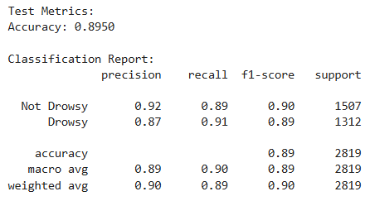
After training in Set 4

Slide 29
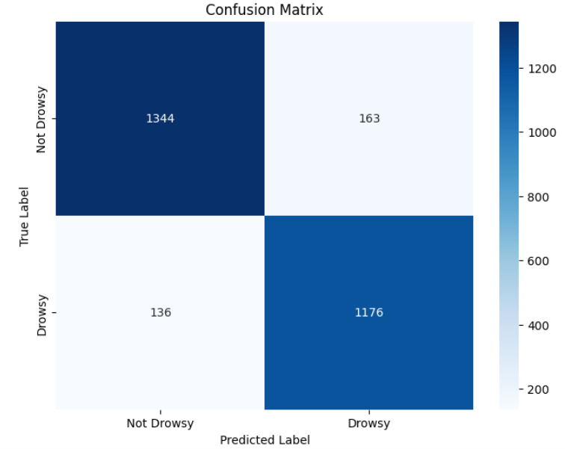
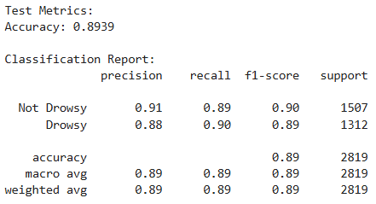
After training in Set 5

Slide 30
Conclusion
Initial model’ test accuracy | 82.37 %
After aggregating the weights of set 1 data from both the clients and updating the model. | 88.76%
After aggregating the weights of set 2 data from both the clients and updating the model. | 89.39%
After aggregating the weights of set 3 data from both the clients and updating the model. | 89.54%
After aggregating the weights of set 4 data from both the clients and updating the model. | 89.50%
After aggregating the weights of set 5 data from both the clients and updating the model. | 89.39%

Slide 31
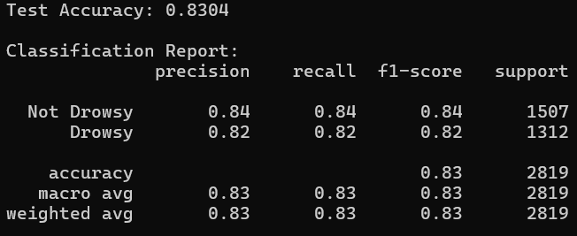
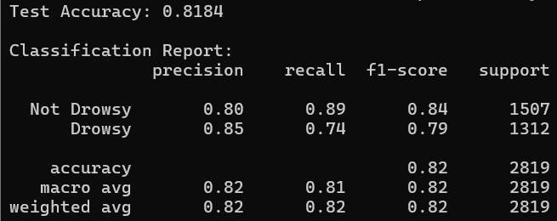
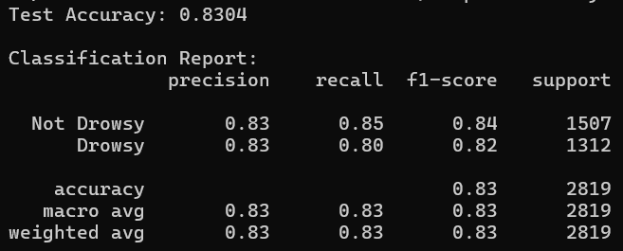
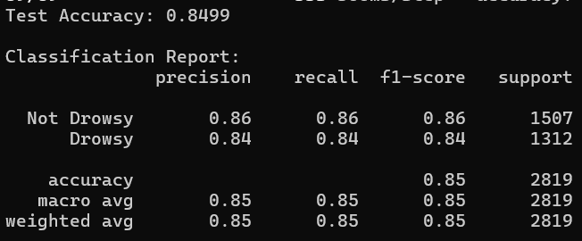
Round 1
Simulated Result For FL - MobileNet
Round 3
Round 2
Round 4

Slide 32
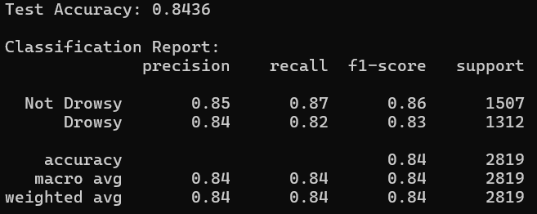
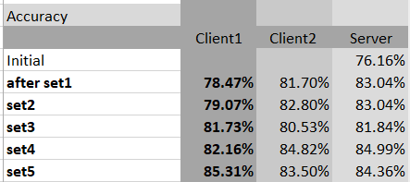
Final Global Model
Accuracy Convergence

Slide 33
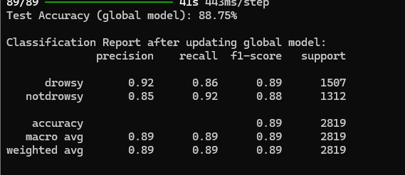
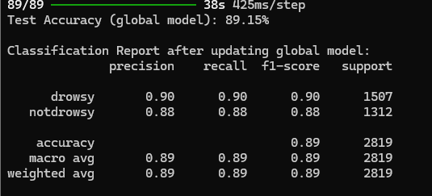
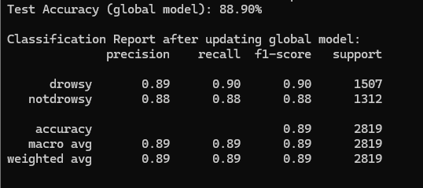
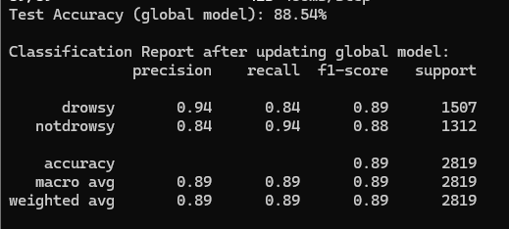
Round 1
Simulated Result For FL - MobileNetCapsleNet
Round 3
Round 2
Round 4

Slide 34
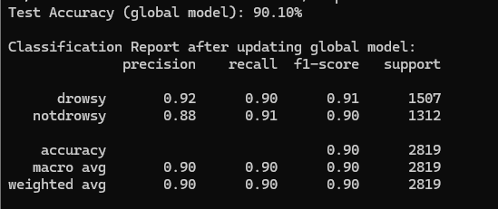
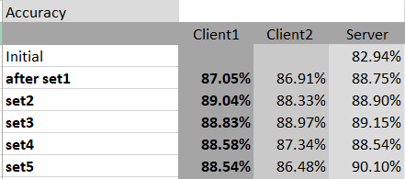
Final Global Model
Accuracy Convergence

Slide 35
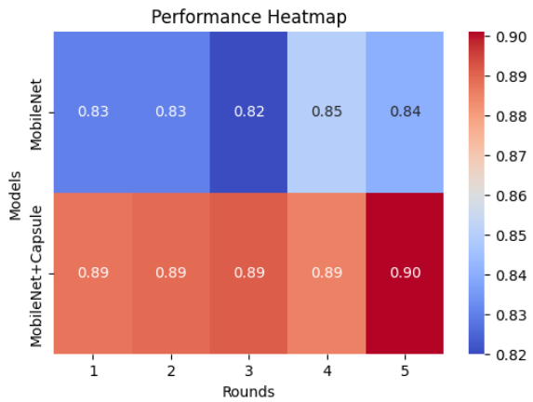
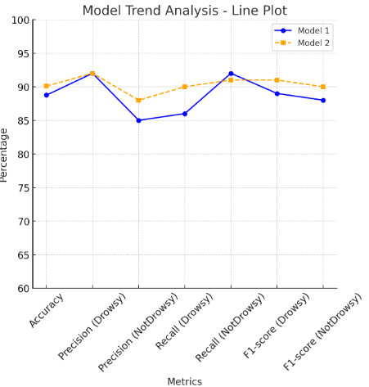
Metrics | MobileNet Model | MobileNetCapsNet
Model Size(in MB) | 12.9 | 9.40
Initial Accuracy(in %) | 76.16 | 82.37
Final Accuracy(in %) | 84.36 | 90.10

Slide 36
Milestones Completed till 1st Review
Implementation of Federated Learning
Integration of Knowledge Distillation and Privacy Preserving Federated Learning
Deployment on Edge Devices

Slide 37
Federated Learning – Knowledge Distillation
Step 1: Server Sends Model:
The central server initializes and sends a Post-Distilled Model,known as the Student model, rather than Pre-Trained Model, to multiple client devices such as smartphones or edge devices.
Step 2: Local Training on Client Devices:
Each client device trains the received model using its own local dataset. The raw data remains on the device and is never shared with the server.
Step 3: Encryption and Model Updates:
Once training is completed, each client encrypts the updated model weight. The encrypted weights are then sent back to the server.
Step 4: Aggregation at Server:
The server collects encrypted model updates from multiple clients, aggregates them, and refines the global model. This step ensures that the global model benefits from diverse datasets without compromising user privacy.
Step 5: Global Model Distribution:
The updated global model is sent back to all client devices, allowing them to use the improved model for further learning and inference. This cycle continues, leading to continuous model improvement.

Slide 38
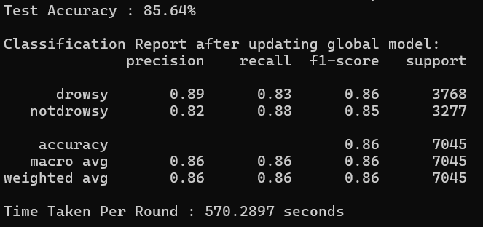
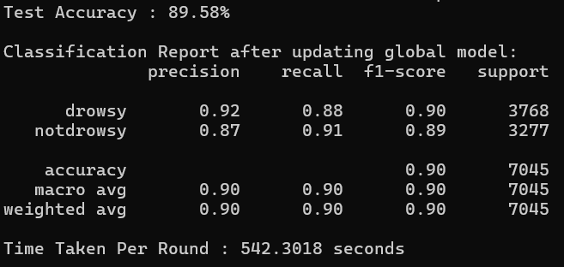
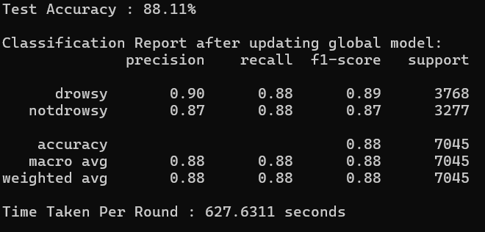
Round 1
Simulated Result For FL-KD
Round 3
Round 2
Round 4

Slide 39
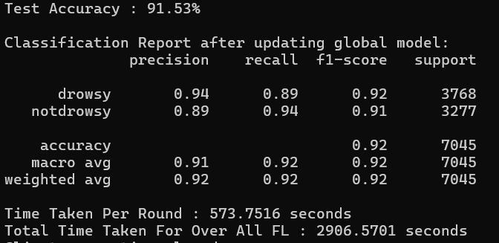
Final Round Student Model Result

Slide 40
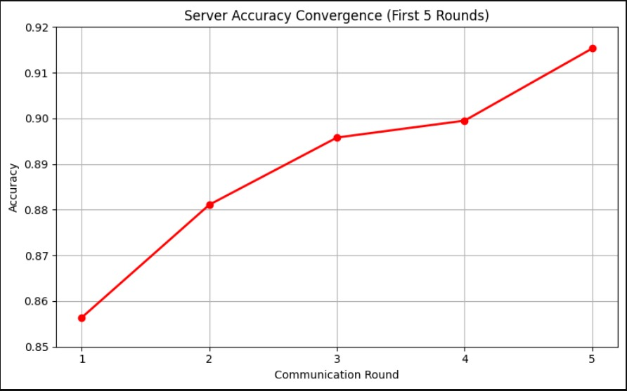
Convergence
Accuracy
Initial | 83.36 %
Round 1 | 85.64%
Round 2 | 88.11%
Round 3 | 89.58%
Round 4 | 89.95%
Round 5 | 91.53%

Slide 41
Accuracy | Non-IID Dirichlet Distribution Dir(0.9)
Aggregations functions | FL | FL-KD
FedAvg | 90.82 | 89.89
FedCDA | 90.59 | 91.53
FedTrimmedAvg | 90.55 | 90.43
FedMA | 90.80 | 90.94
FedPA | 90.32 | 88.22
Among the various aggregation functions evaluated, FedCDA demonstrated superior performance compared to the other methods

Slide 42
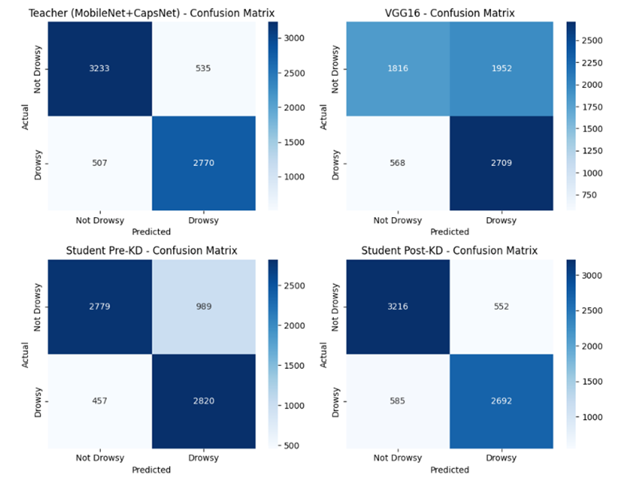
Teacher Model (MobileNet + CapsNet) gave the most accurate and balanced results.
VGG16 struggled, especially with false positives for “Drowsy” cases.
Student Model (Pre-KD) outperformed VGG16 despite being smaller.
Post-KD Student Model improved significantly, nearing Teacher-level accuracy.
Knowledge Distillation boosted performance while keeping the model lightweight and efficient.

Slide 43
Milestones
Implementation of Federated Learning
Integration of Knowledge Distillation and Privacy Preserving Federated Learning
Deployment on Edge Devices

Slide 44
Reference
Zhang, Linlin & Hideo, Saito & Yang, Liang & Wu, Jiajie. (2022). Privacy-Preserving Federated Transfer Learning for Driver Drowsiness Detection. IEEE Access. 10. 1-1. 10.1109/ACCESS.2022.3192454.
A. Zafar, C. Prehofer and C. -H. Cheng, "Federated Learning for Driver Status Monitoring," 2021 IEEE International Intelligent Transportation Systems Conference (ITSC), Indianapolis, IN, USA, 2021, pp. 1463-1469, doi: 10.1109/ITSC48978.2021.9564936.
Zhang, Zehui & He, Ningxin & Li, Qingdan & Wang, Kunshu & Gao, Hang & Gao, Tiegang. (2022). DetectPMFL: Privacy-Preserving Momentum Federated Learning Considering Unreliable Industrial Agents. IEEE Transactions on Industrial Informatics. PP. 1-1. 10.1109/TII.2022.3140806.
Q. Huang, X. Wu, Q. Wang, X. Dong, Y. Qin, X. Wu, Y. Gao, and G. Hao, "Knowledge Distillation Facilitates the Lightweight and Efficient Plant Diseases Detection Model," Plant Phenomics, vol. 5, Article 0062, June 2023.
X. Li, B. Chen, and W. Lu, "FedDKD: Federated Learning with Decentralized Knowledge Distillation," Applied Intelligence, vol. 52, pp. 15500–15536, Feb. 2023.
Z. Chen, P. Tian, W. Liao, X. Chen, G. Xu, and W. Yu, "Resource-Aware Knowledge Distillation for Federated Learning," IEEE Transactions on Emerging Topics in Computing, vol. 11, no. 3, pp. 16310–16333, July–Sept. 2023.

Slide 45
THANK YOU

