Slide 1


ROBO
CARS

Slide 2
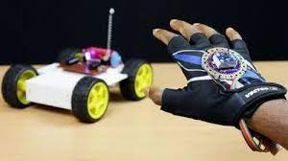


PROJECT OVERVIEW
This project focuses on building a prototype, in which the whole vehicle will be controlled by hand gestures and will be wireless.

Slide 3

COMPONENTS
01
ARDUINO UNO BOARD
02
MOTOR DRIVER
03
GEARED MOTORS AND WHEELS
04
BATTERY HOLDER AND SWITCH
05
JUMPER WIRES
06
LI-ION BATTERIES
07
ADXL345

Slide 4




MAKING PROCESS
Attaching the wheels and the motors on the main chassis, and soldering them up. Programming and attaching the Arduino board and the motor driver onto the chassis and connecting the motors to the driver.
The vehicle will be getting a real-time command of the direction in which it has to travel.
Programming and configuring the ADXL345 and the motors to go in the guided direction.
STEP - 1
STEP - 2
STEP - 3

Slide 5
FUTURE UPGRADES
This fun little project serves as a prototype that we look forward to refining more.
It will be a more user-friendly model and will have much better performance.

Slide 6

THANK YOU

