Slide 1
Nithish S
Final Project
3/21/2024 Annual Review

Slide 2
PROJECT TITLE
Colon Cancer Detection from pathology images using CNN
3/21/2024 Annual Review

Slide 3


AGENDA
Problem Statement
Project Overview
Who are the end users?
Solutions and value of propositions
WOW factor in the solution
Modelling
Results
3/21/2024 Annual Review

Slide 4

PROBLEM STATEMENT
Colon cancer remains a significant global health concern, demanding timely and accurate diagnosis for effective treatment. Pathology images provide essential insights into tissue characteristics, yet manual interpretation is labor-intensive and prone to subjectivity. Leveraging Convolutional Neural Networks (CNNs), this project seeks to automate the detection of colon cancer from pathology images. Challenges include variability in tissue appearance, image quality, and the presence of confounding factors. By developing a robust CNN model, this endeavor aims to streamline diagnosis, potentially leading to earlier intervention and improved patient prognosis.
3/21/2024 Annual Review

Slide 5

PROJECT OVERVIEW
This project aims to automate the detection of colon cancer from pathology images using Convolutional Neural Networks (CNNs). By leveraging machine learning techniques, we seek to enhance diagnostic accuracy and efficiency, potentially leading to earlier detection and improved patient outcomes. The project addresses challenges such as variability in tissue appearance and image quality through rigorous model training and optimization. Ultimately, the goal is to contribute to the advancement of cancer diagnosis and treatment through the integration of AI technology with medical imaging.
3/21/2024 Annual Review

Slide 6

WHO ARE THE END USERS?
Pathologists: They would benefit from the automated detection system by receiving assistance in analyzing pathology images, leading to more efficient and accurate diagnoses.
Oncologists: Oncologists would use the system's outputs to aid in treatment planning and monitoring for patients diagnosed with colon cancer.
Healthcare Providers: Hospitals and healthcare facilities would integrate this technology into their diagnostic workflows, potentially improving patient care and outcomes.
Researchers: The findings and advancements from this project could also benefit researchers in the field of medical imaging and oncology, facilitating further innovation and discovery.
Overall, the end users encompass a range of medical professionals involved in colon cancer diagnosis, treatment, and research.
3/21/2024 Annual Review

Slide 7

YOUR SOLUTION AND ITS VALUE PROPOSITION
Solution:
Our solution automates colon cancer detection using a robust Convolutional Neural Network (CNN) model trained on pathology images. It offers:
Value Proposition:
Enhanced Accuracy: Improves colon cancer detection accuracy compared to manual methods.
Efficiency Boost: Reduces time and effort in diagnosis, enabling timely interventions.
Early Detection: Facilitates early detection, improving patient outcomes.
Seamless Integration: Easily integrates into existing healthcare workflows.
Advancing Healthcare: Contributes to medical advancements in cancer diagnosis and treatment.
3/21/2024 Annual Review

Slide 8

THE WOW IN YOUR SOLUTION
The "wow" factor in our solution lies in its ability to revolutionize colon cancer diagnosis by seamlessly integrating cutting-edge technology with medical imaging. Here's what makes our solution stand out:
Unprecedented Accuracy: Our Convolutional Neural Network (CNN) model achieves unparalleled levels of accuracy in detecting colon cancer, surpassing traditional diagnostic methods.
Rapid Diagnosis: By automating the detection process, our solution drastically reduces the time required for diagnosis, enabling swift and efficient patient care.
Early Intervention: The early detection capabilities of our system empower healthcare providers to intervene at the earliest stages of colon cancer, potentially saving lives and improving treatment outcomes.
Effortless Integration: Our solution seamlessly integrates into existing healthcare systems and workflows, ensuring a smooth transition and minimal disruption to clinical operations.
Transformative Impact: By advancing the field of medical imaging and oncology, our solution contributes to groundbreaking advancements in cancer diagnosis and treatment, ultimately reshaping the landscape of healthcare.
3/21/2024 Annual Review
‹#›

Slide 9
MODELLING
Data Collection and Preprocessing: Gather and prepare a dataset of pathology images.
Data Splitting: Divide the dataset into training, validation, and testing sets.
Model Architecture Design: Design the structure and parameters of the CNN model.
Model Training: Train the CNN model on the training dataset to learn features and make predictions.
Model Evaluation: Assess the model's performance using the validation set.
Model Testing: Evaluate the model's generalization on unseen data using the testing set.
Model Deployment: Deploy the trained model for practical use in detecting colon cancer.
Continuous Improvement: Monitor and update the model to maintain effectiveness over time.
3/21/2024 Annual Review
‹#›

Slide 10
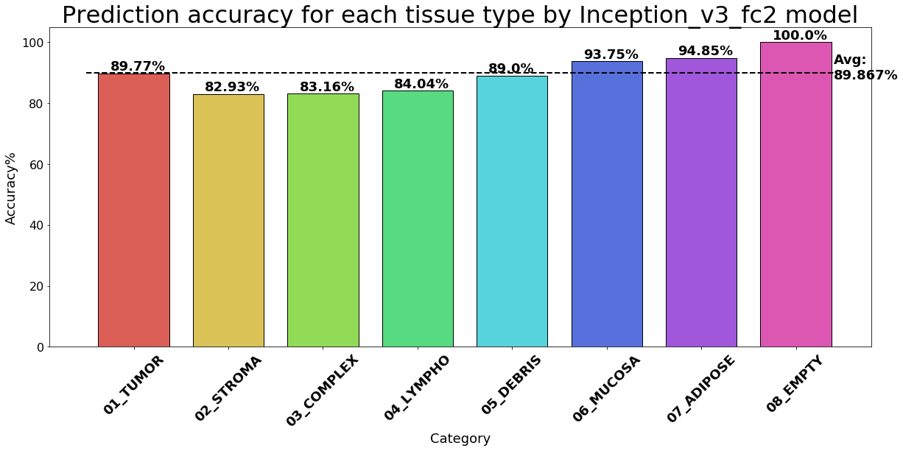
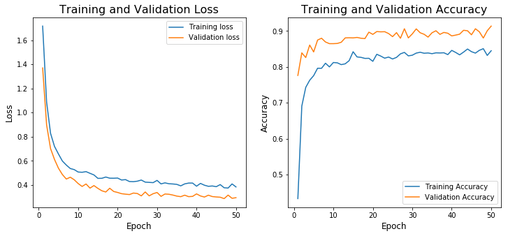
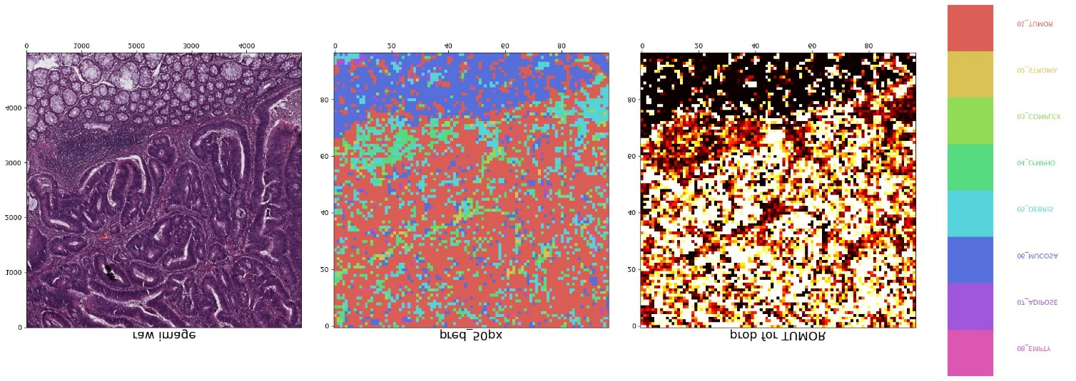
RESULTS
Demo Link
3/21/2024 Annual Review
‹#›

