Slide 1


Nithish
P
W
A
O
S
R
S
D
Vault Manager

Slide 2
Abstract
A simple application for getting to surround with each and every dimensions of passwords.
Basic functionality is to make aware the users to know about the various data breaches occurring in various parts of the big data companies and different possibilities to vault their accounts. An approach towards guiding the users to make strong and uncrackable passwords for their personal needs. This is completely a personal perspective oriented application and highly sensitive information are to be logged here with an encryption technique.

Slide 3
Why this Application ?
As I’ve mentioned earlier that this has been developed completely for a personal need who is unaware of all the dimensions of a single credential {i.e)passwords} in this n-dimensional World.
In this quick changing and adapting remote world with an exponential increase of the passwords in various organisations being provided by the end users requires strong passwords and of course a trusted service to secure their accounts which is what being resolved in a single person perspective(not in a global motive) by this application.

Slide 4
What Dimensions ?
First and foremost comes the type of the password we are using and the frequency count of the similar passwords being used for multiple accounts.
Next comes the type of pattern we are using to register for the accounts to authorize as an end user to get connected with that service.
Then and now getting to know about the ways to secure our passwords through various cyber security experts, newsletter subscriptions, articles, blogs and tutorials.
Knowing the severe and massive data breaches into the dark side of our Internet regarding only the common passwords breach.

Slide 5
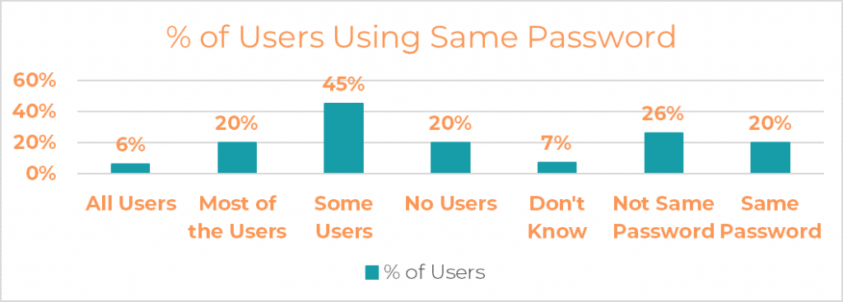
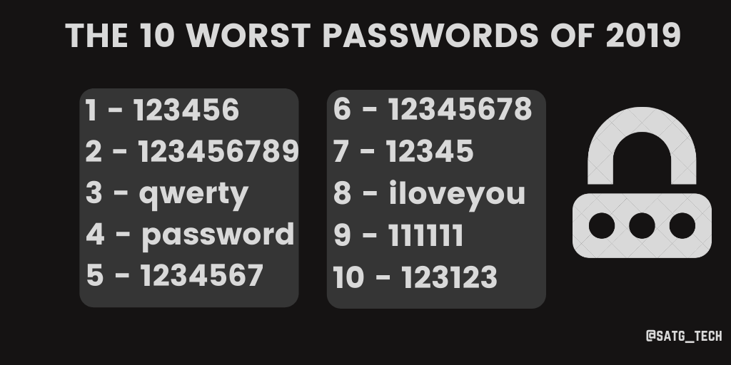
Analytics of the dimensions
Frequency count
Worst Patterns being breached

Slide 6
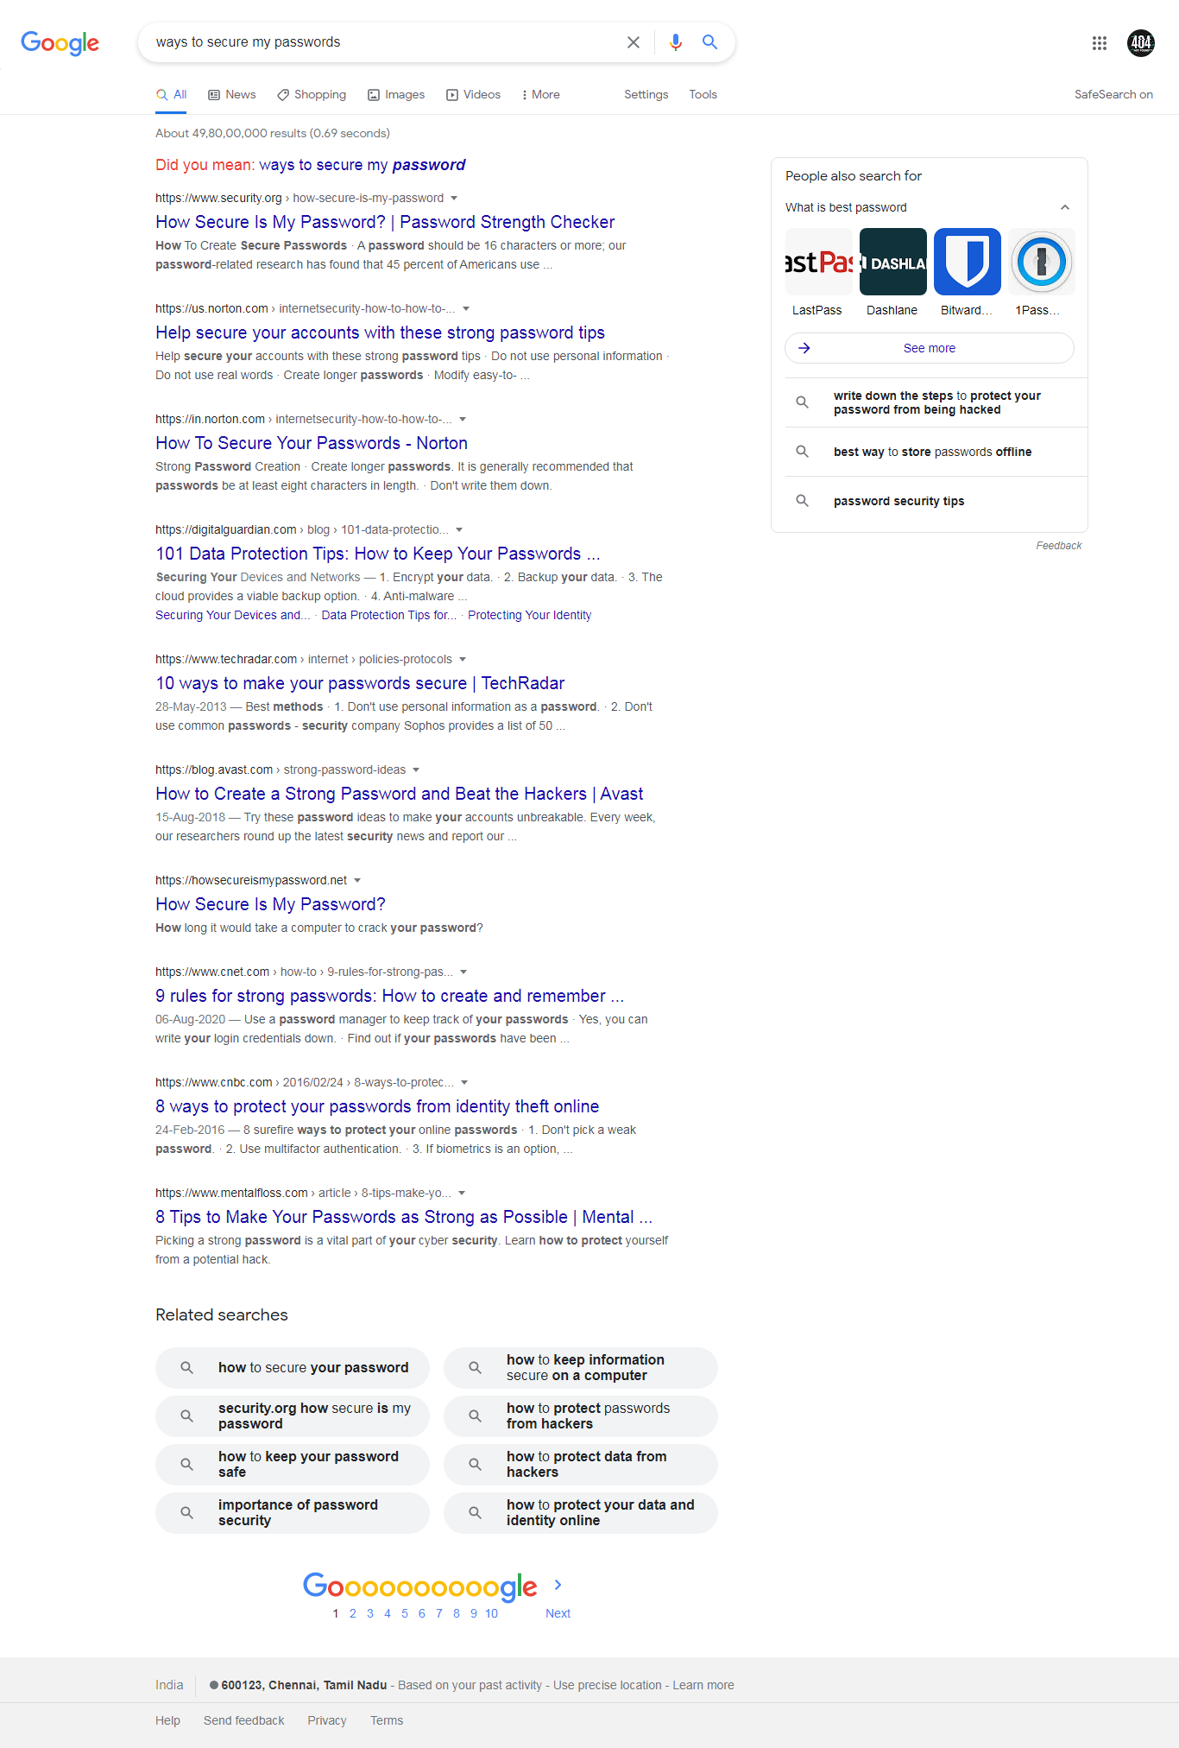
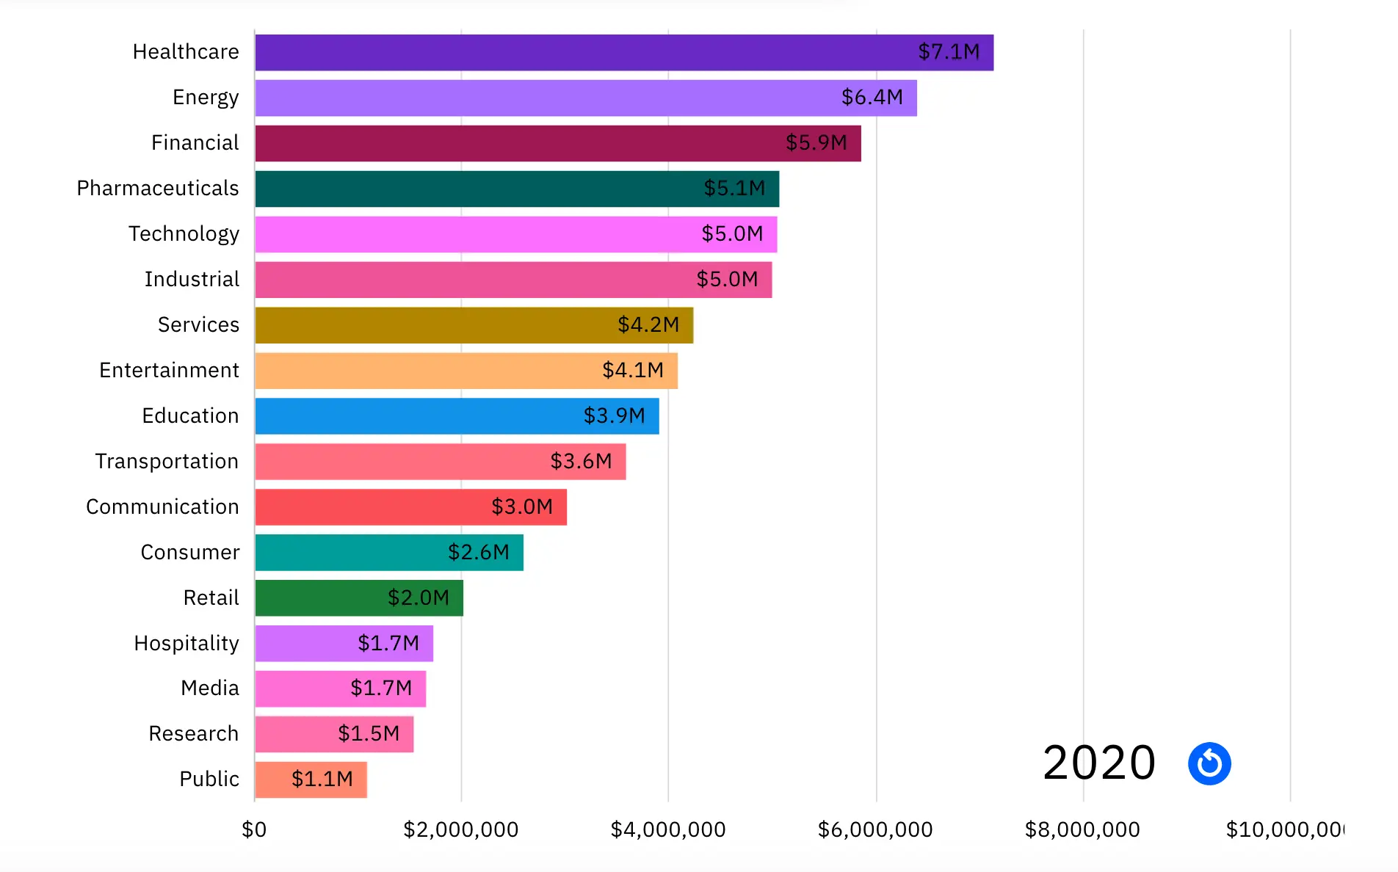
More
Most searched result
Impacts of Data Breach

Slide 7
App’s Feature Flow
Generate
Strong
Passwords
Manage Your credentials
into various categories
Password
Strength
checker
Collections

Slide 8

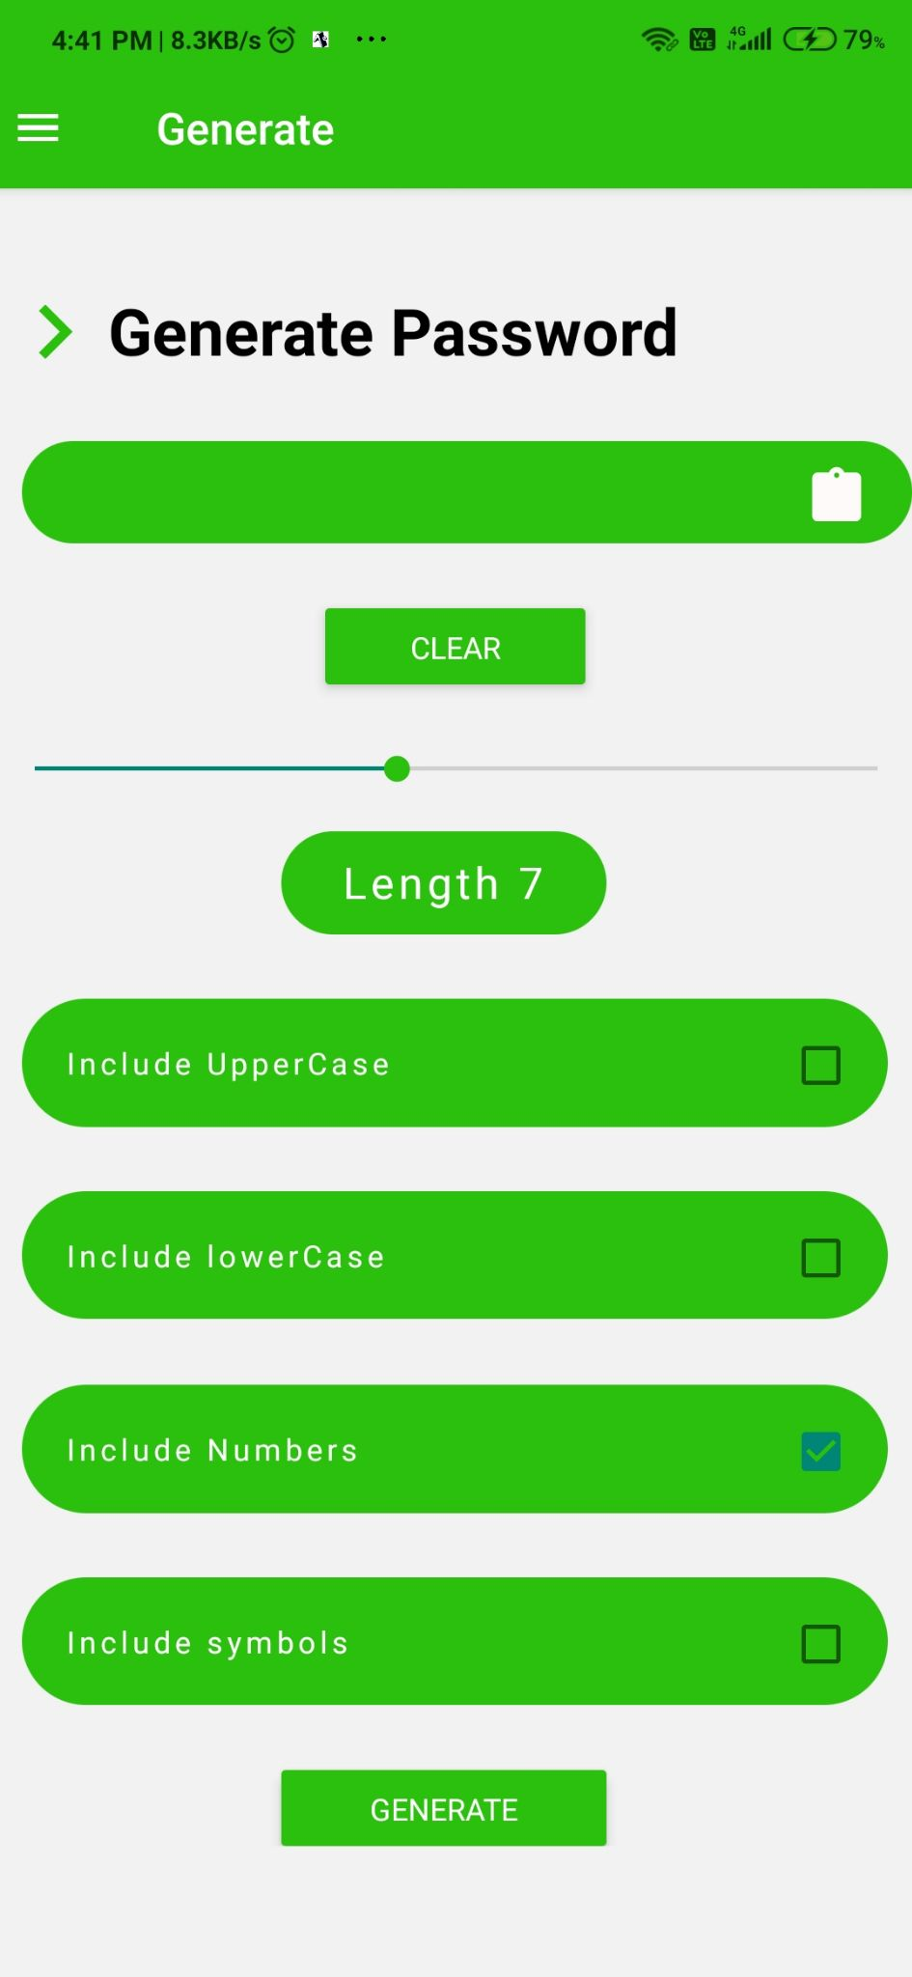
Generate
Stronger generation algorithm with various possible approaches to select and generate a string.
Includes uppercase selection
Includes lowercase selection
Includes number selection
Includes special symbol selection

Slide 9
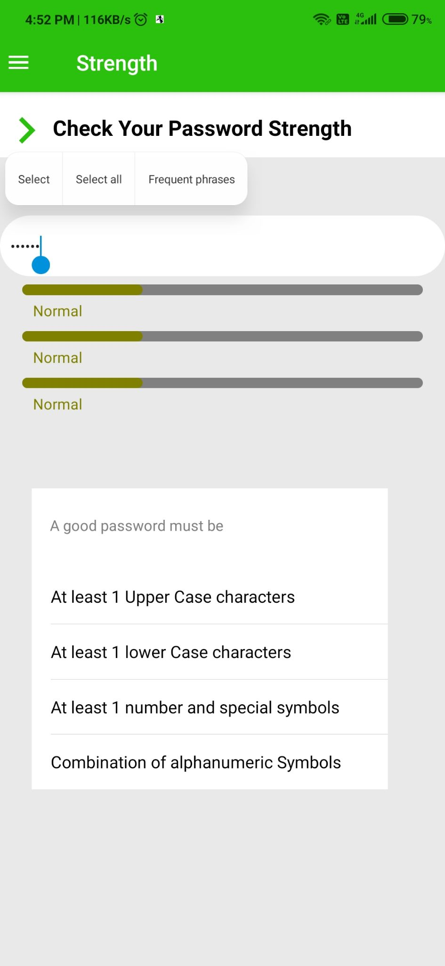
Strength Checker
The Mode where the users can check the strength of their passwords based on the easily vulnerable password matching pattern.
Includes various patterns of regular expressions
Includes strength indicator based on the values of the user inputted string

Slide 10
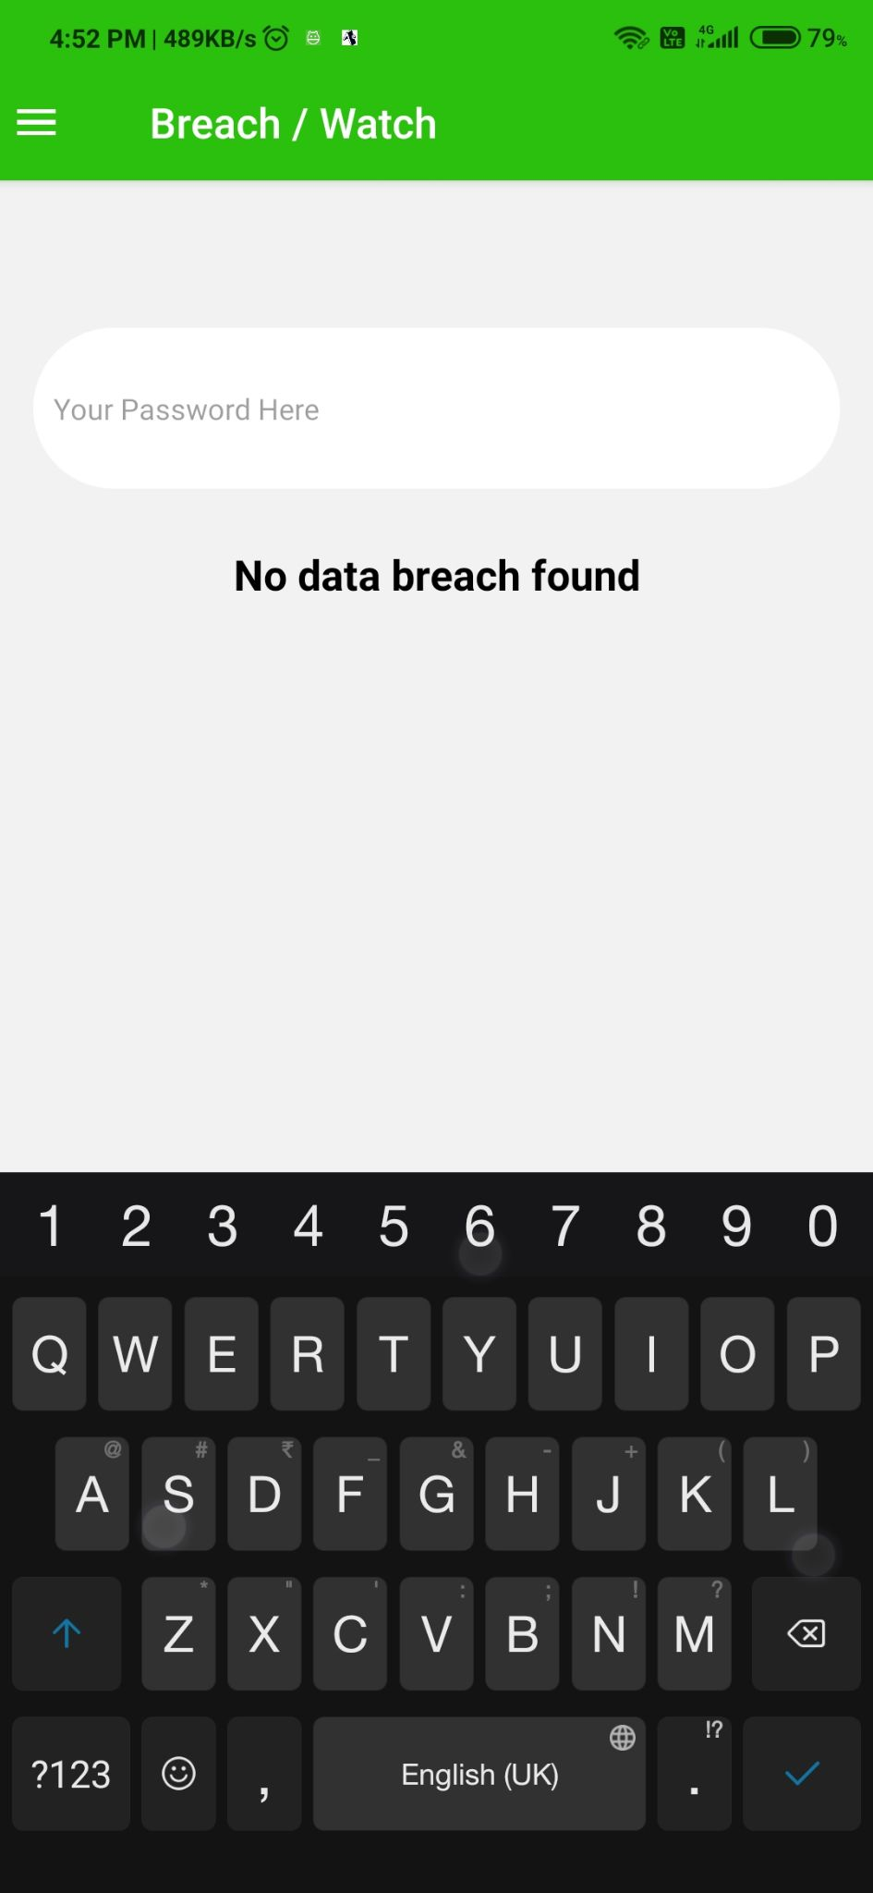
Breach Watch
Here Users can check whether their passwords has been compromised to some other data breaches or not.
Includes API calls and responses with SHA-1 hash algorithm
Includes result of passwords being compromised or not.

Slide 11
Manage
Card
Manage card specific accounts
Websites
Manage website accounts
Other
Manage miscellaneous accounts such as social media applications.

Slide 12
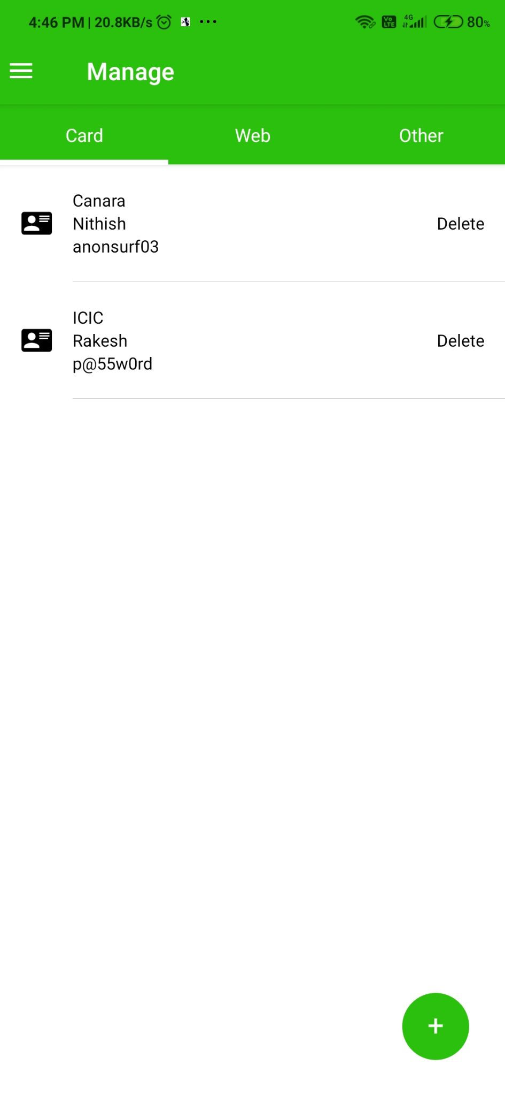
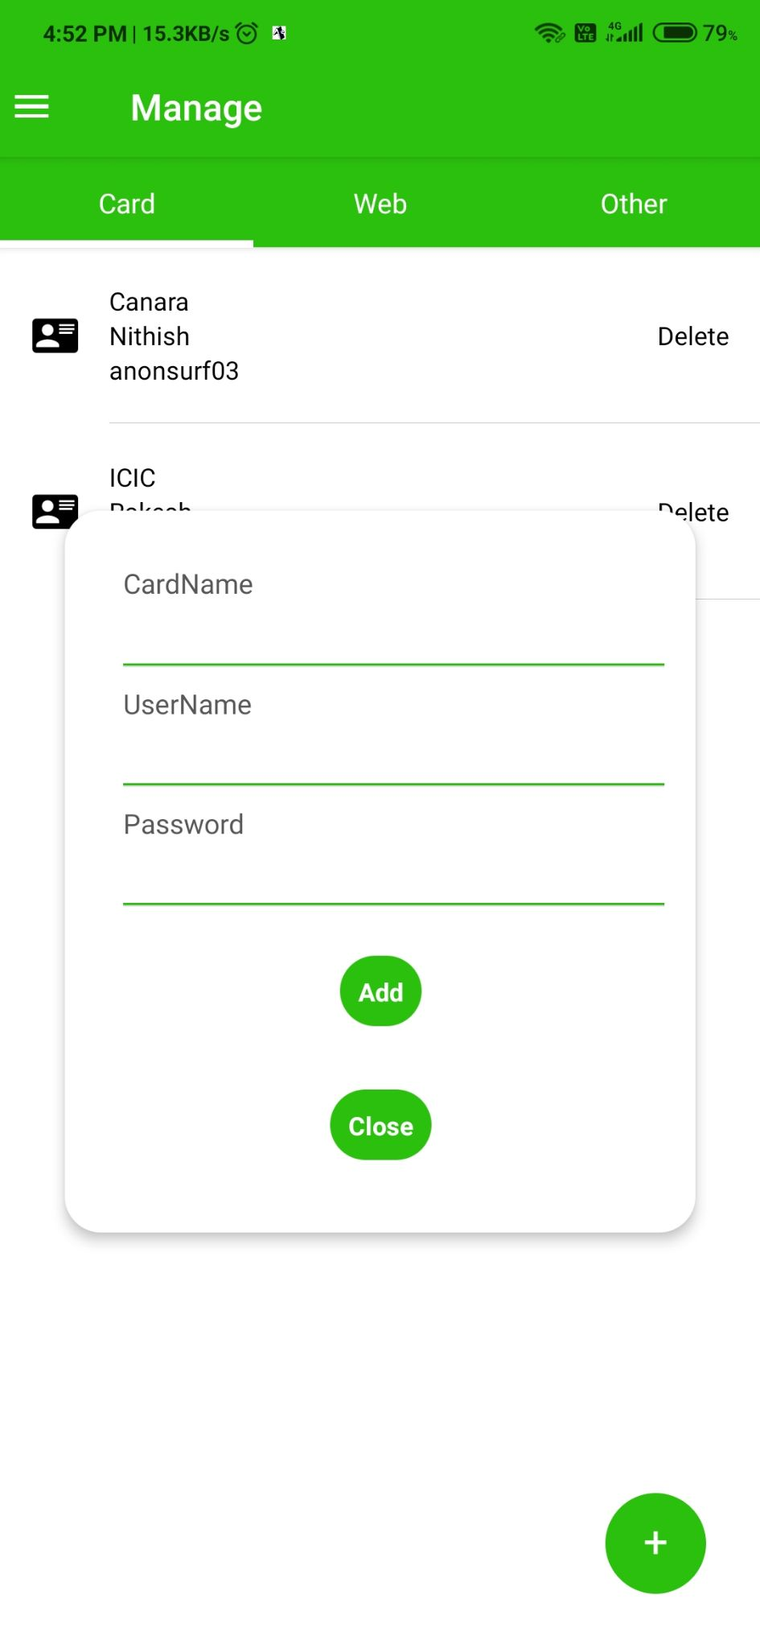

Slide 13
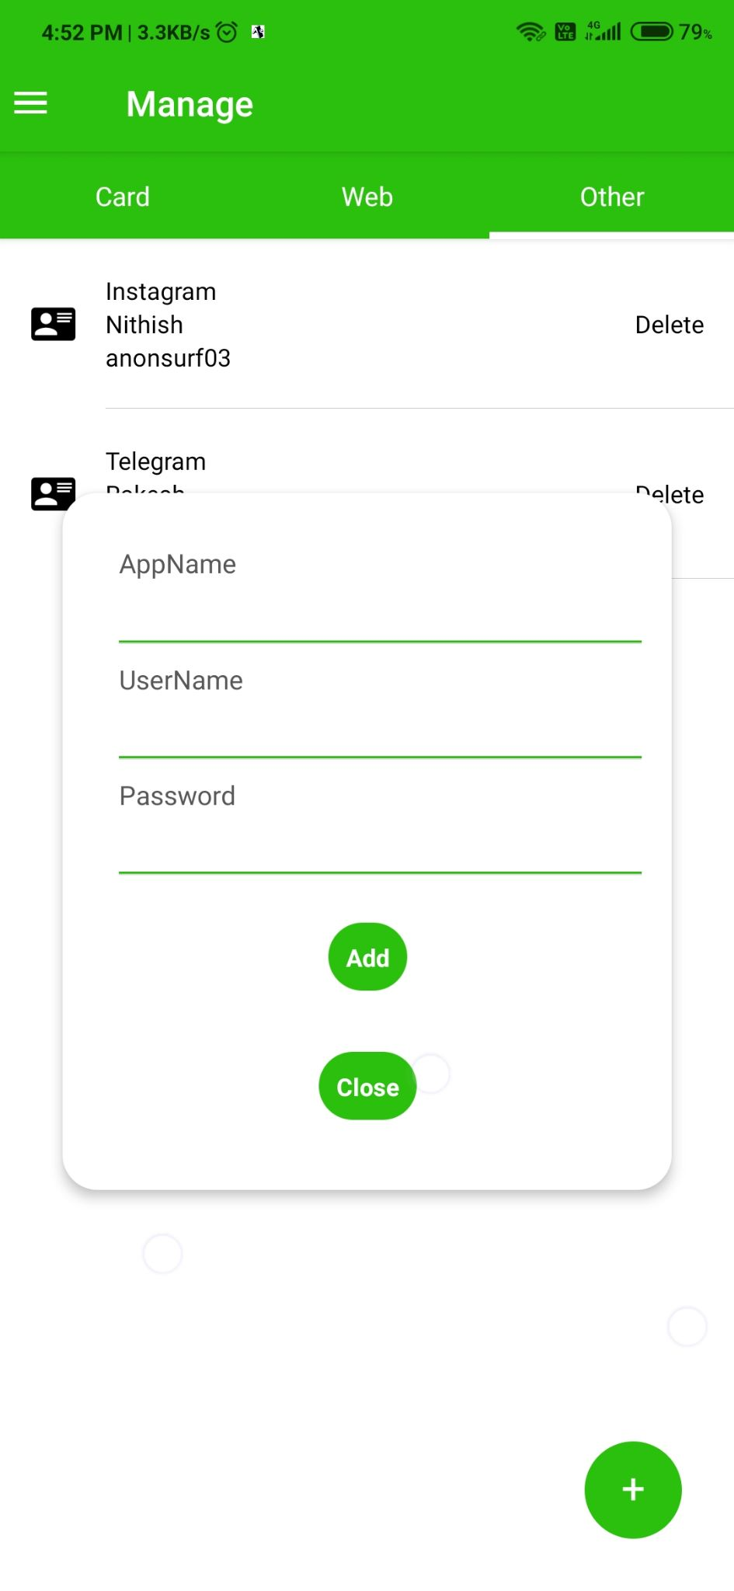
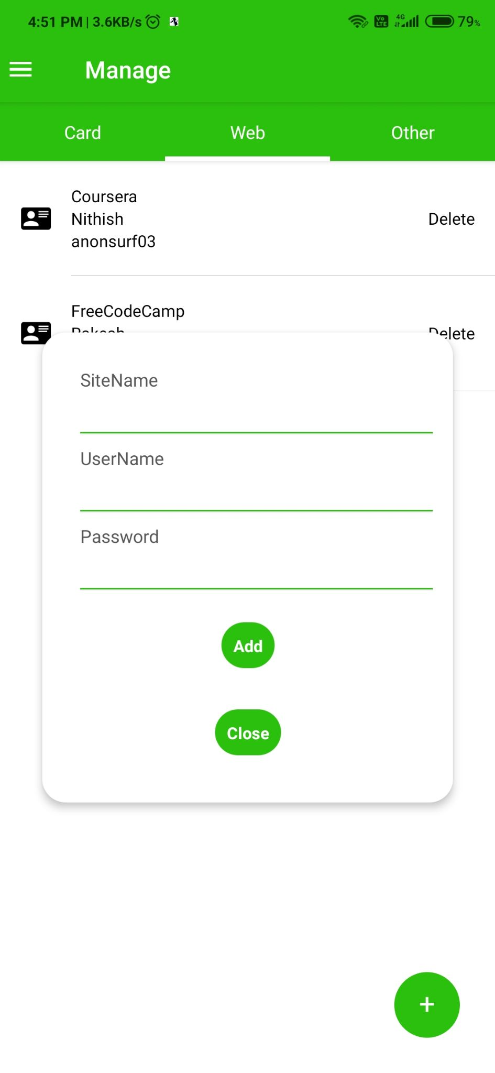

Slide 14
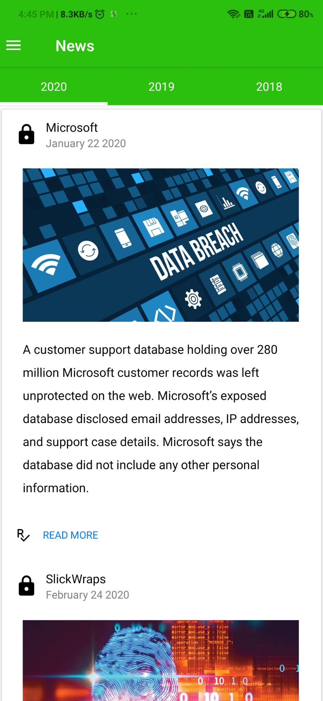
Articles
Collections
Categorized yearly wise attacks and breaches
List of articles related to worst and hard data breaches

Slide 15
Technical Stack
Front End
React
React Native
Libraries
Zxcvbn
Native-base
Have I been pwned(API)
Libraries and EndWise tech
Algorithms
Pattern matching Regular expression algorithm
SHA-1 Hash Algorithm

Slide 16
Stats
Around half of online adults(49%) say that they store their online accounts by writing them down on a piece of paper.
In total people say around 84% online adults do primarily rely on this technique regarding their accounts.
18% of the whole world says that they use to keep track of their passwords using modern built in password management feature.
Using a password management tool outside the browser is the most preferable one -- experts suggestion.

Slide 17

Future Todos
Authentication
Feature to allow authentication and authorized users.
Master Password
To allow users to view their passwords only with the authorized master password.
Notify
Ability to notify the users if their saved credentials get breached.

Slide 18
Thank You

