Slide 1
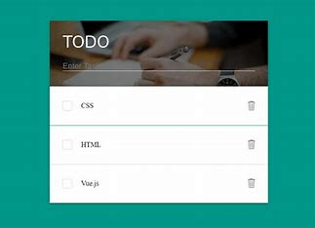

2024 March
TO DO LIST USING
NODE.JS

Slide 2
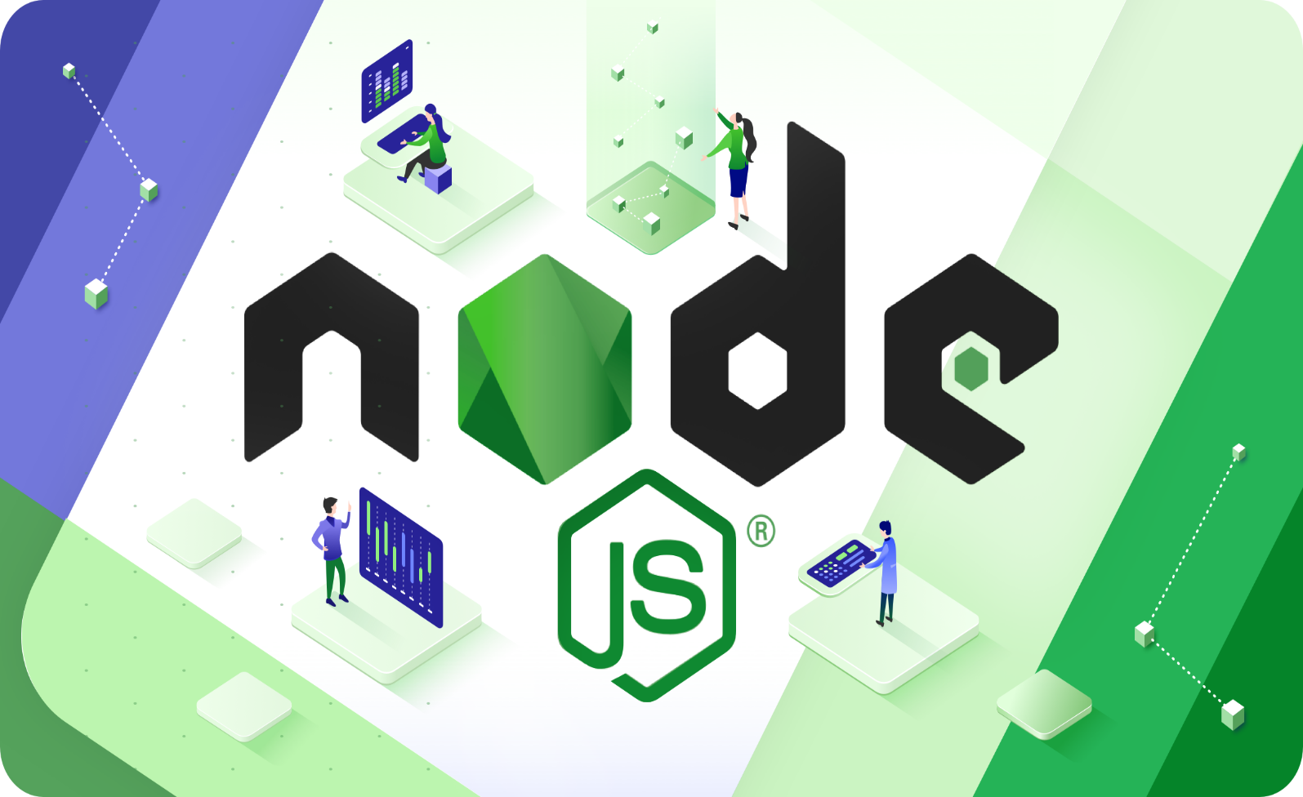
INTRODUCTION
In the fast-paced digital world, staying organized and managing tasks efficiently is crucial. A To-Do List application serves this need by allowing users to keep track of their tasks. This presentation introduces a simple To-Do List application built using Node.js, a popular JavaScript runtime, showcasing the power and simplicity of developing server-side applications.
3

Slide 3
ABOUT SOFTWARE TOOL
Node.js is an open-source, cross-platform, back-end JavaScript runtime environment that runs on the V8 engine and executes JavaScript code outside a web browser.
Express.js is a web application framework for Node.js, designed for building web applications and APIs. It is known for its performance and minimalistic structure.
4

Slide 4
OBJECTIVE
Learn the Basics of Node.js: Understand the fundamentals of Node.js and its event-driven architecture.
Develop a Full-Stack Application: Build a simple yet functional To-Do List application using Node.js and Express for the backend, with HTML, CSS, and JavaScript for the frontend.
Understand Web Development Concepts: Grasp the concepts of routing, handling HTTP requests, and serving static files.
8

Slide 5
TIMELINE OF WORK PROPOSAL
18.01.2024 TO 22.03.24 | Udmey course completion
08.03.24 TO 22.03.24 | Project-To do list using Node.js
20.03.24 TO 24.03.24 | PPT and Report
8

Slide 6
USED ALGORITHM
Add Task
View Task
Update Task
Delete Task
Add Task: Allows users to add a new task to the list. Users can enter the task details, such as the task name, due date, and priority.
View Tasks: Displays all the tasks in the list, including their details and status. Users can see an overview of their tasks and easily track their progress.
Update Task: Enables users to update the details of a specific task, such as changing the task name, due date, or priority. This feature allows users to modify their tasks as needed.
Delete Task: Allows users to remove a task from the list. This feature helps users manage their tasks by allowing them to remove completed or unnecessary tasks.
7

Slide 7
STEPS TO BUILD APPLICATION
Setting Up Your Node.js Environment:
Install Node.js and npm (Node package manager) from the official Node.js website.
Initialize a new Node.js project and create a package.json file by running npm init.
Installing Express:
Use npm to install Express, a fast, unopinionated, minimalist web framework for Node.js, by running npm install express.
Creating the Server:
Create an app.js file where you'll set up your server using Express.
Define routes for displaying the to-do list, adding new tasks, and deleting tasks.
Setting Up the Frontend:
Design a simple UI using HTML for structure, CSS for styling, and JavaScript for dynamic behavior.
Serve your static files HTML, CSS, JS) from a directory, typically named public, using Express.

Slide 8
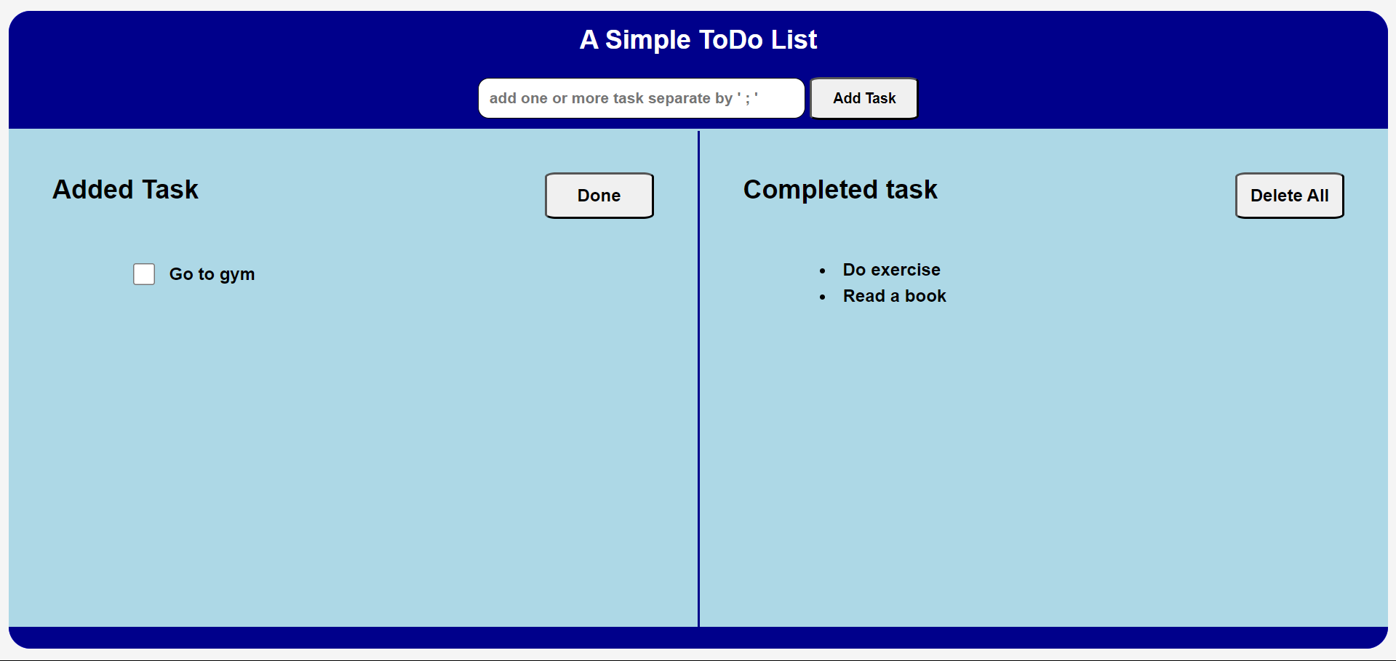
RESULT AND DISCUSSION

Slide 9
CONCLUSION
Building a To-Do List application with Node.js is an excellent project for beginners to get hands-on experience with full-stack development. This project not only teaches the basics of web development and server-side programming but also provides a foundation for building more complex applications. By understanding the steps and tools involved, developers can leverage Node.js and Express to create scalable, efficient web applications.
3

Slide 10
REFERENCE
..Node.js Official Website: https://nodejs.org.
Express Documentation: https://expressjs.com.
Mozilla Developer Network (MDN) Web Docs for HTML, CSS, and JavaScript guides.
3

Slide 11
REPORTED LITERATURE
Title: Building a Todo List App with Node.js and MongoDB
Author: John Smith
Publication Date: June 10, 2023
Publication: freeCodeCamp.org
Link: Building a Todo List App with Node.js
Title: Creating a Todo List App with Node.js and Vue.js
Author: Emily Johnson
Publication Date: September 5, 2023
Publication: Scotch.io
Link: Creating a Todo List App with Node.js
3

