Slide 1
CHAT-BOT Using React JS, Node JS, Mono DB, Python NLP
s Nithishkumar

Slide 2
Flow
Sign Up (User Details)
Sign In (Account Id and Password)
Balance
Fund Transfer (secured using FTpin)
Text content are recognized using (Python NLP)

Slide 3
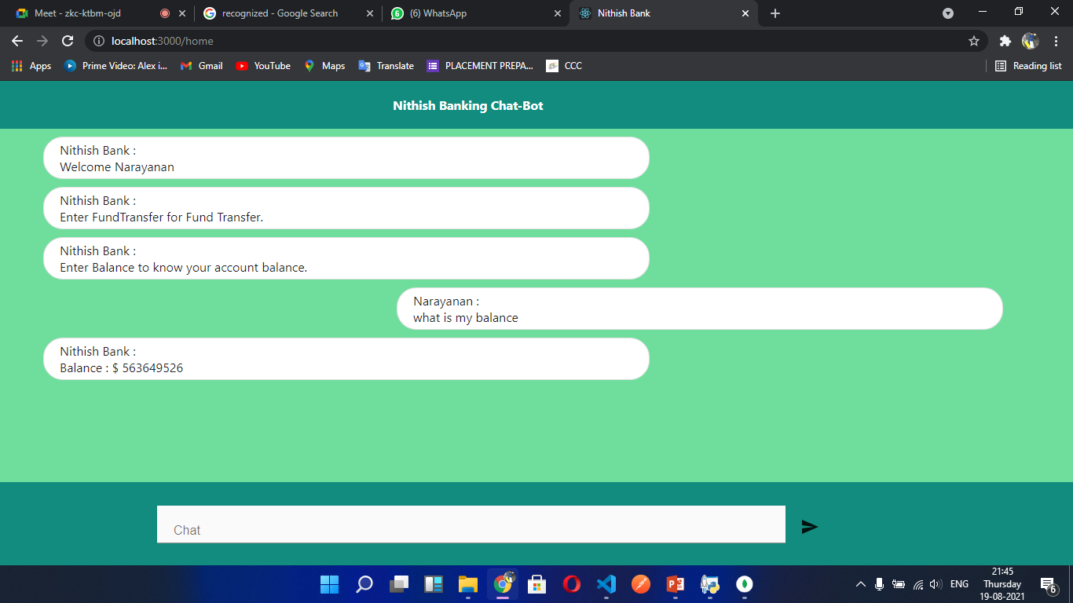
UI Design

Slide 4
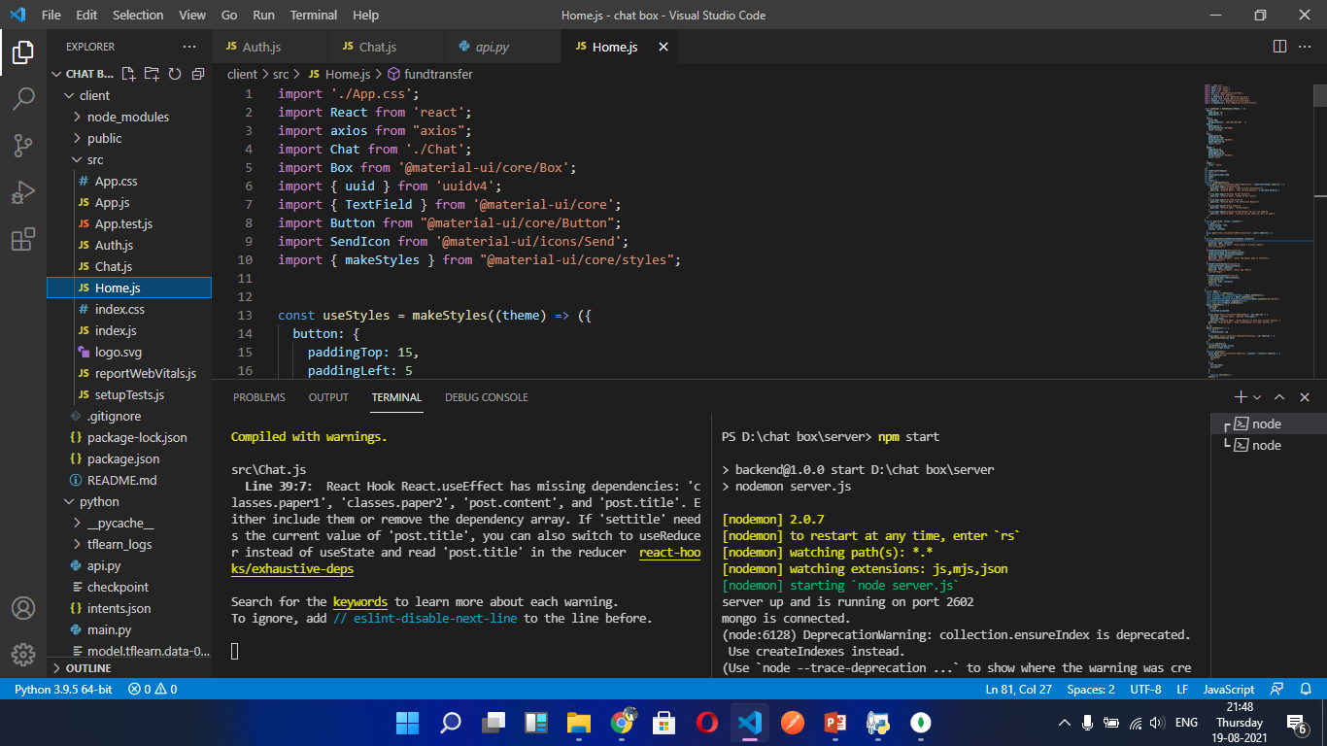
Node Back end

Slide 5
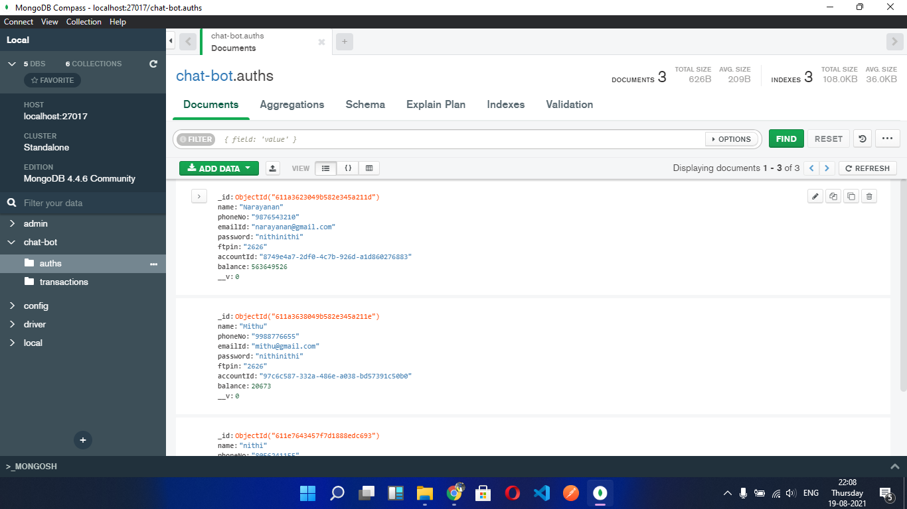
MongoDB (Account Details are saved in MongoDB)(Also Deploying in Azure table is possible)

Slide 6
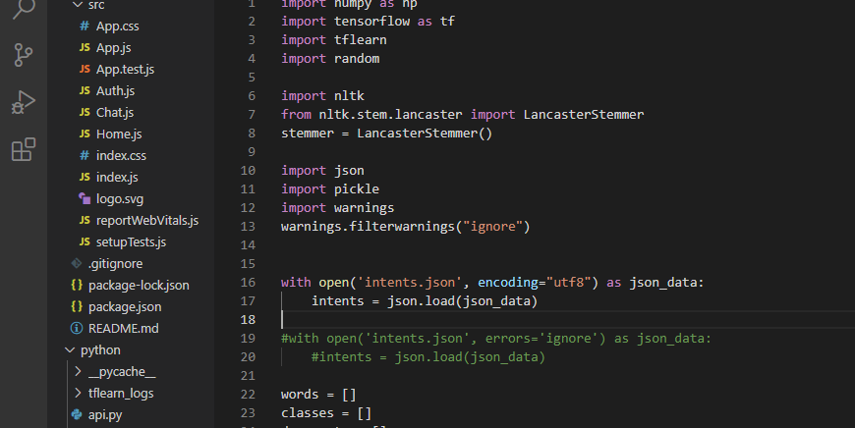
Python NLP

Slide 7
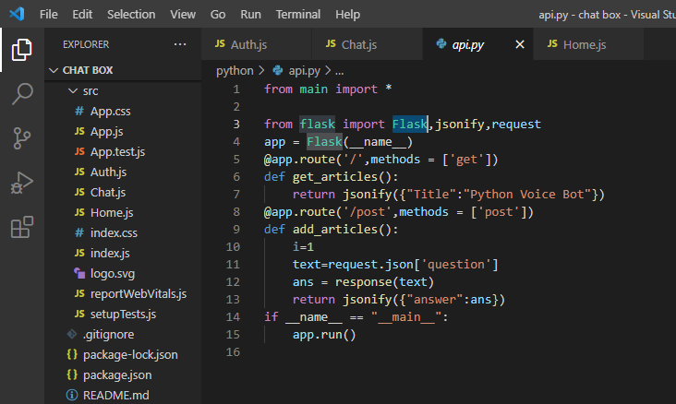
Python Flask

Slide 8
Thank You
https://github.com/Nithish0226/Nithish.git

