Slide 1
INTRUSION DETECTION
Big Data Analytics
Nithish Kumar Senthil Kumar
Subhiksha Murugesan
Rishi Manohar Manoharan
Kunal Ahirrao

Slide 2
Project Overview
In this project, we built a machine learning-based Intrusion Detection System (IDS) using the CSE-CIC-IDS2018 dataset.
The goal was to classify network traffic into one of four categories: Benign, DoS, DDoS, or Brute Force.
This is a multiclass classification problem involving real-world, large-scale network traffic data.

Slide 3
Project Objective
Build a supervised learning model for intrusion detection
Efficiently handle and preprocess 10M+ records
Reduce feature space and handle class imbalance
Train and evaluate multiple models to identify the best one

Slide 4
Dataset Description
The CSE-CIC-IDS2018 dataset matches corporate network environments and includes:
Over 10 million flow records across 10 CSV files
~81 features extracted – May vary file to file
A wide range of attacks like Brute Force, DoS, DDoS, Web attacks, Botnet, and more We focused on four attack types with the most coverage for better balance and cleaner classification.

Slide 5
Raw Data Issues
Loading the full dataset in Google Colab took over 15 minutes and eventually failed due to memory limitations.
Key issues:
Mixed and incorrect data types
'Infinity' and null values stored as text
Very high memory usage due to default data types

Slide 6
Data Cleaning & Optimization
Assigned appropriate and reduced data types based on the highest number(e.g., float32, uint8, uint16)
Replaced text nulls/infinity with proper values
Combined 10 files into one optimized DataFrame
Result: File (.parquet) now loads in ~1.5 minutes with better RAM usage.

Slide 7
Attack Class Harmonization
Initially, the dataset had over 12 attack types. Many were too specific/granular or rare.
So,
Merged similar categories
Dropped underrepresented ones (<2% data)
Final 4 labels used: Benign, DoS, DDoS, Brute Force

Slide 8
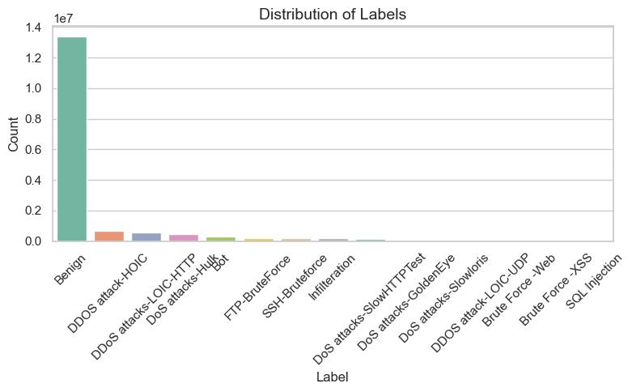
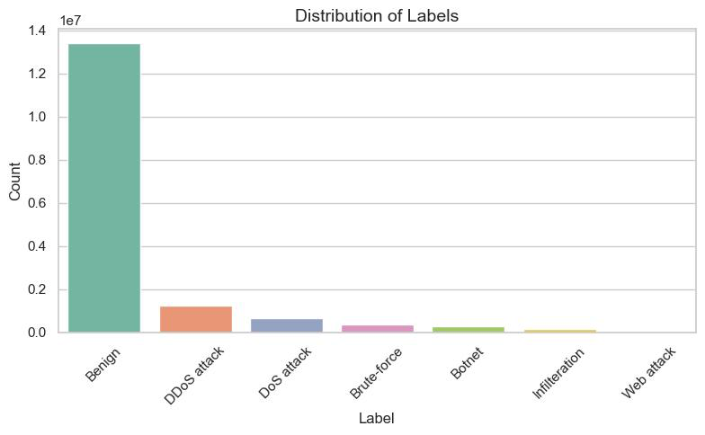
Attack Class Harmonization

Slide 9
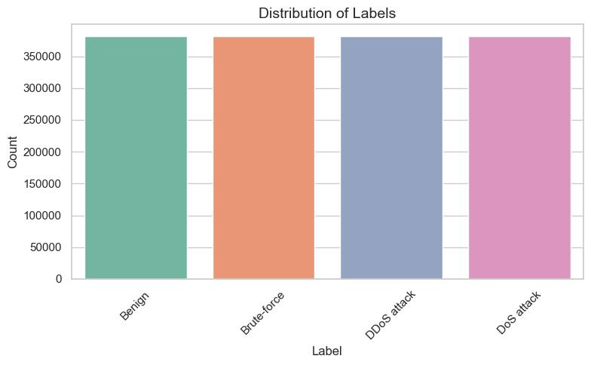
Class Balancing
Originally, benign traffic dominated (>80%). So, we applied random under sampling to balance all four classes:
Final dataset had ~400,000 samples per class, totaling ~1.6 million records.

Slide 10
Feature Selection
To reduce noise and improve model efficiency:
Dropped 8 columns with constant values (using Variance)
Removed 7 repeated/redundant columns
Used Spearman correlation to eliminate 20+ highly correlated features (>0.9)
Final feature set was smaller, faster, and more informative.

Slide 11
Modeling Pipeline
Train-Test Split: 80/20
Scaled data using MinMaxScaler
Tried 3 models:
Decision Tree
Random Forest
XGBoost
Evaluated using accuracy and F1 score.

Slide 12
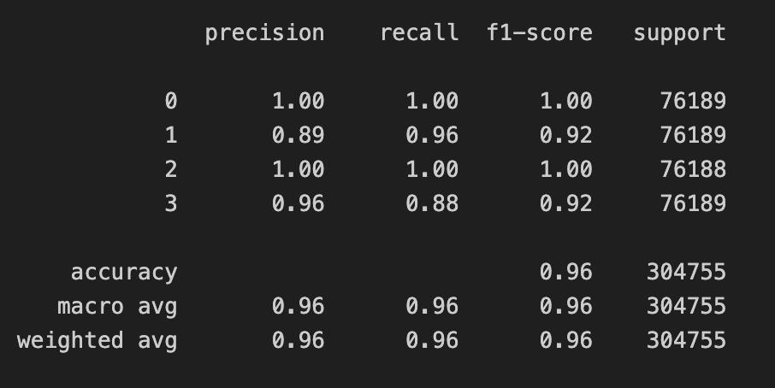
Final Model – XGBoost
XGBoost consistently outperformed others:
Accuracy: ~96%
High F1 scores for all classes
Feature selection and class balancing helped improve results
Tried feature extraction methods but saw no gain — stuck with original features.

Slide 13
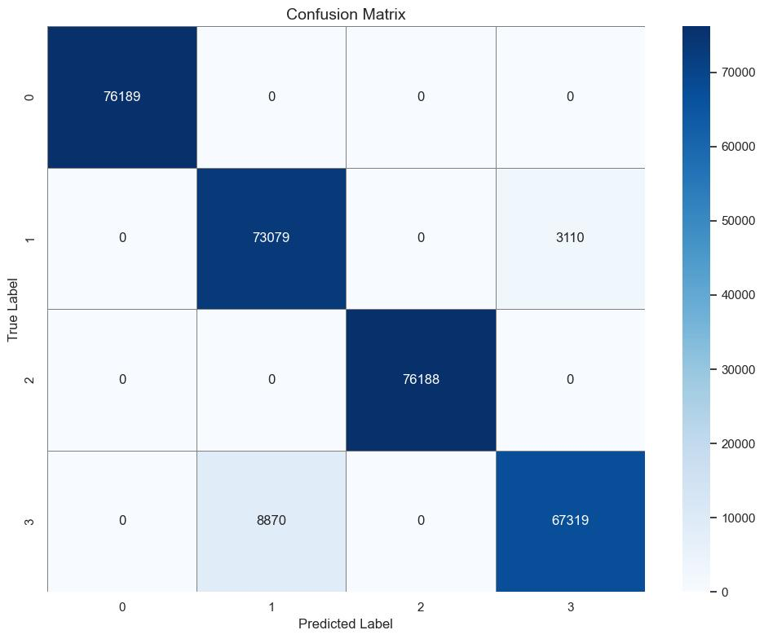
Confusion Matrix
The model performed well across all categories.
No false positives for benign traffic — which is critical for a secure IDS.

Slide 14
Challenges Faced
Handling massive files in limited-memory environments (Colab)
Data was noisy, inconsistent, and required heavy cleanup
Original label imbalance skewed early model results
Lots of experimentation needed to find good preprocessing pipeline

Slide 15
Final Thoughts & Future Work
Met the main goal of accurate intrusion detection
Learned a lot about handling and modeling big, messy data
In future:
Try Binary Classification
Try deep learning or CNN-based models
Deploy in real-time environment

Slide 16
Questions?

