Slide 1
LawDigestAI
An approach to make case referencing easy…
Rishikesh Ramesh
Nithish Kumar Senthil Kumar
Nagul Pandian Chinnasamy Ramkumar
Kunal Ahirrao

Slide 2
The Situation
Understanding the Challenge in the Legal Field
The legal field heavily relies on extensive documentation, including detailed legal case reports with intricate arguments, rulings, and precedents.
Navigating and comprehending these dense documents is time-consuming and challenging, even for seasoned professionals.
Key Issues:
Extracting relevant information quickly from lengthy documents.
Understanding the evolving relationships between legal cases through citations.

Slide 3
Objective
Simplifying Legal Document Analysis: The project aims to enhance efficiency and understanding in legal case analysis through:
Automatic Summarization of Legal Cases:
Develop a model to condense lengthy legal case reports into concise catchphrases.
Provide legal professionals with quick, meaningful insights into key legal principles.
Outcome: Save time, focus on analysis, and improve decision-making.
Citation Class Classification:
Classify the type of citation relationships (e.g., applied, cited, followed).
Provide deeper insights into legal precedents and the interconnectivity of cases.
Outcome: Better understanding of case influence and evolution of legal principles.

Slide 4
Data
Dataset: Federal Court of Australia Legal Case Reports (2006–2009)
This dataset contains legal case reports from the Federal Court of Australia, sourced from AustLII, a free access platform for Australian legal information.
Key Components:
Full text:
Full legal documents with catchphrases summarizing key legal points.
Citations Summ:
Citation details (sentences, legislation references).
Citations Class:
Categorized case relationships (e.g., Applied, Distinguished, Cited).
Dataset Link: UCI Archive: Legal Case Reports

Slide 5
Data Extraction and Cleaning
Dataset Extraction
Source: XML files with broken, encapsulated content.
Processing: Developed two Python scripts to parse and restructure XML data into a usable format.
Data Cleaning: Citation Class Classification
Class Reduction: Reduced 24 citation classes to 4 key categories to address class imbalance to focus on the most frequent classes for better representation.
Token Limit Filtering: Filtered texts to meet 512-token limit for Legal BERT, ensuring clean and compatible inputs.
Data Cleaning: Catchphrase Extraction
Word Count Analysis: Analyzed word count distribution to identify and remove outliers or overly lengthy documents.
Preprocessing: Trimmed long texts to improve computational feasibility for abstractive summarization.

Slide 6
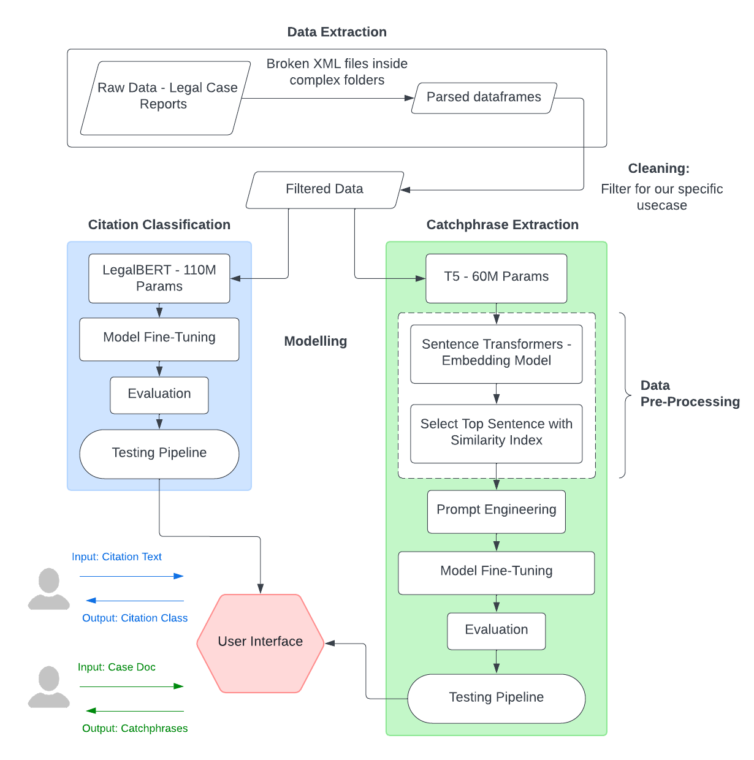
Project Flowchart
Table of Content
Data Extraction and Cleaning
Catchphrase Extraction
Data Preprocessing
Citation Classification
Application

Slide 7
Pre-Processing for Catchphrase Extraction
Preprocessing Steps:
Input Handling: Process sentences exceeding the 512-token limit for compatibility with transformer models.
Embedding Generation: Use sentence transformers to create embeddings for both catchphrases and document sentences.
Cosine Similarity: Compute similarity between catchphrase and sentence embeddings.
Ranking: Sort sentences by similarity and extract the most relevant ones.
Truncation: Retain sentences within the token limit by truncating excess content.

Slide 8
Catchphrase Extraction
Proposed Model: T5 Transformer (“T5-small”).
The T5 model has a 512-token limit, requiring preprocessing to truncate or split input text while retaining key information.
Approach:
T5 Model for Summarization:
Utilized the T5 model fine-tuned for legal text summarization.
The model is trained to convert dense legal text into concise, meaningful catchphrases.
Prompt Engineering:
Designed and refined prompts to ensure the model outputs a list of catchphrases rather than a single shortened paragraph.
Prompt Used: Generate an abstract list of important phrases that summarize the case document:
Output: A list of catchphrases summarizing the key points of legal documents.
Evaluation: Performance measured using ROUGE to ensure output quality.

Slide 9
Citation Classification
Proposed Model: Text Classification Transformer (“LegalBERT”).
About LegalBERT
Pre-trained transformer optimized for legal documents with 110M parameters.
Fine-tuned on legal text to capture domain-specific language, context, and relationships.
Advantages
Excels in handling legal vocabulary and complex sentence structures.
Outperforms generic models (e.g., BERT) in legal text classification, and retrieval tasks.
Approach:
Train a classifier to predict citation types (i.e., applied, cited, followed, referred to).
Output: Categorized citation relationships for understanding legal precedents.
Evaluation: Metrics include accuracy, precision, recall, and F1 score.

Slide 10
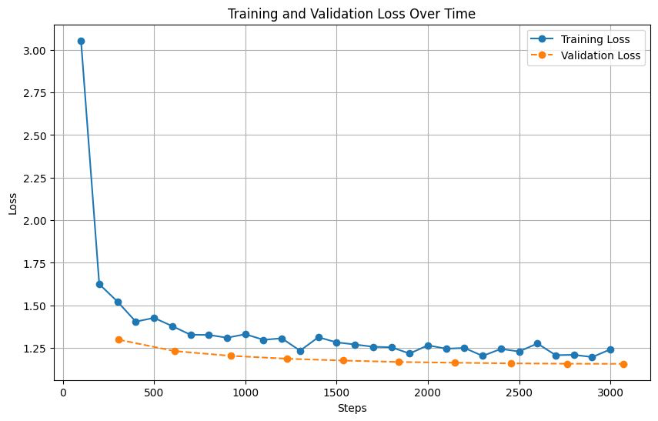
Evaluation Results – Catchphrase Extraction
ROUGE Scores for Summarization Task:
rouge1: 0.351
rouge2: 0.156
rougeL: 0.271
rougeLsum: 0.272s

Slide 11
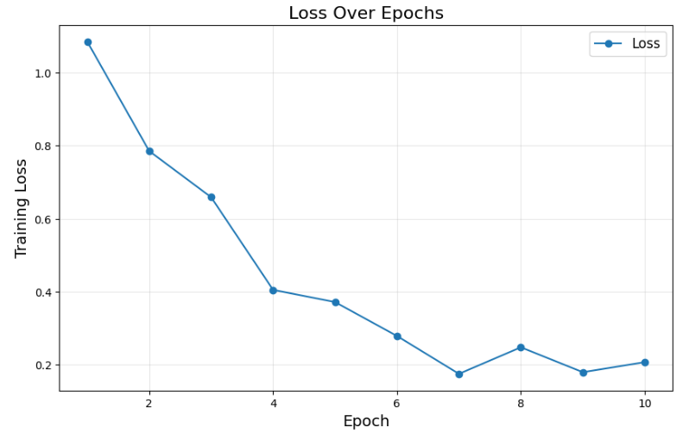
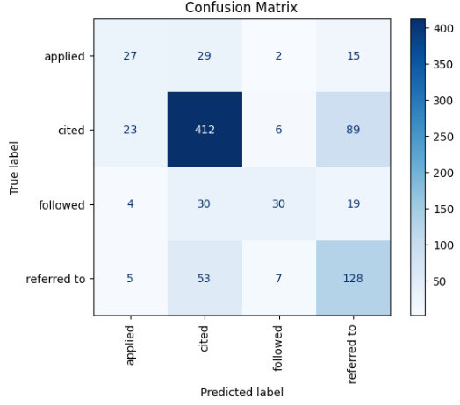
Evaluation Results
F1 Score: 0.693
Accuracy: 0.6985

Slide 12
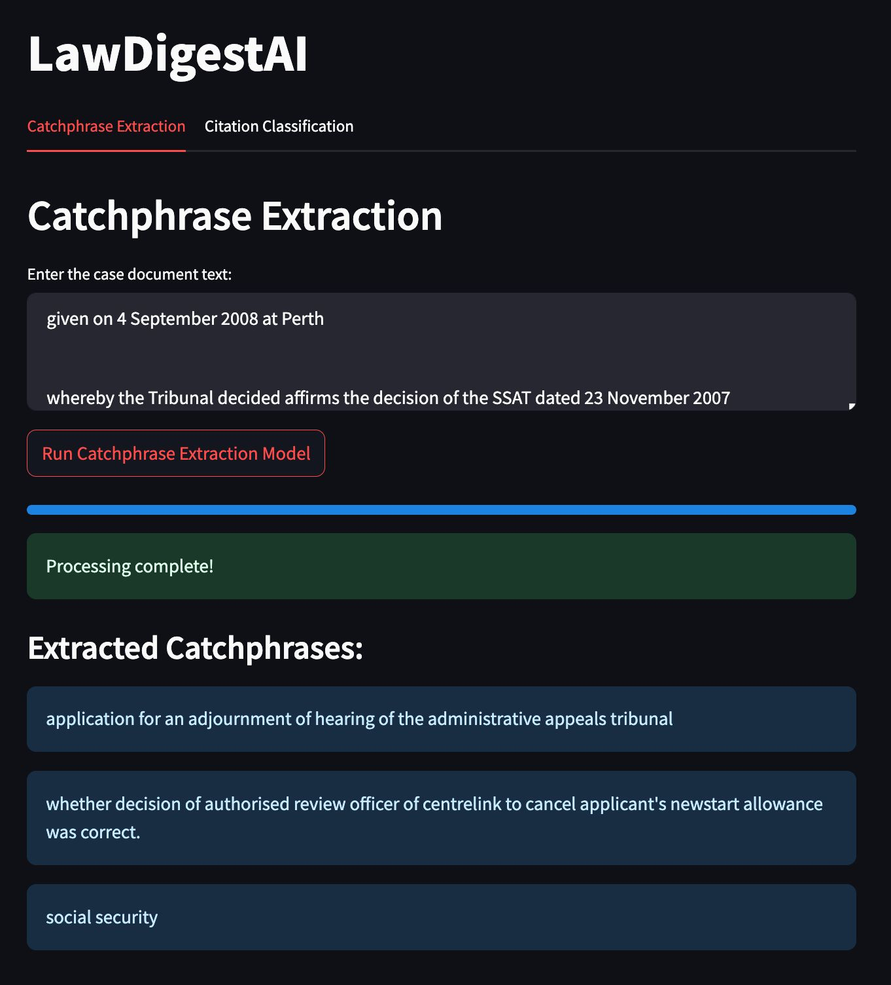
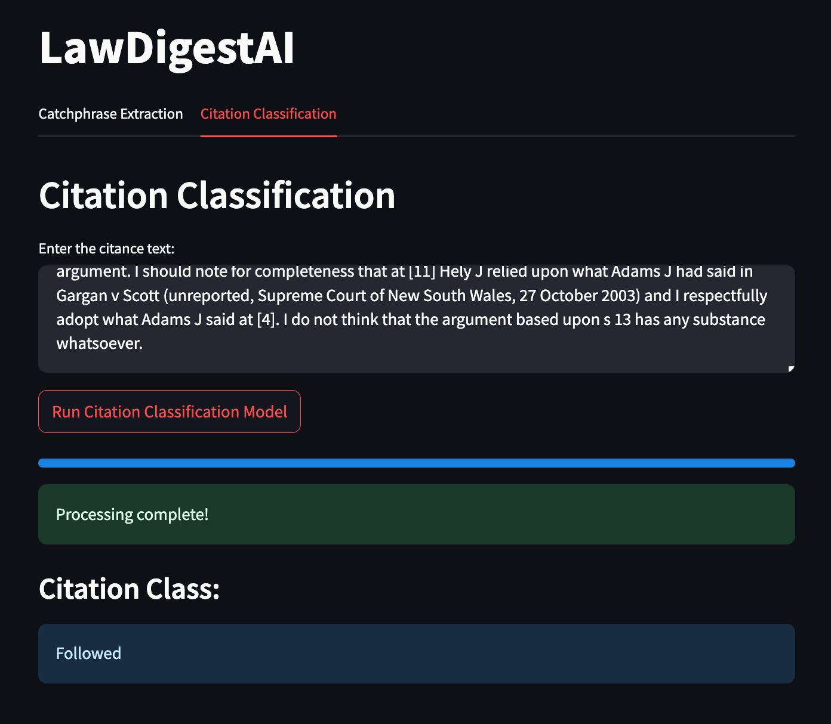
Application - Demo

