Slide 1
RESTAURANT RECOMMENDATION SYSTEM
Nithish Kumar S (217)
Aryan Agarwal (224)
Rohan Aditya Ram (240)

Slide 2
Abstract
Application of Data Mining and Analytics
Recommendation based on many different factors.
Filtering the most important information.
User’s preference and interest.
Similarities between users and items for recommendation.
Both the users and the services provided have benefited from these kinds of systems.
Improved decision-making process.

Slide 3
Objective
Provide accurate restaurant recommendation.
Minimize work for user.
Allow the user to explore restaurants by giving good recommendations.
User-Friendly.

Slide 4
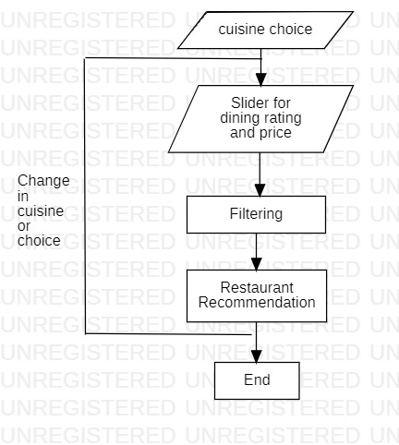
Methodology

Slide 5
Cuisine preference and price taken into consideration.
Collaborative filtering and user-based collaborative filtering method.
Rating wise recommendation.
User can further filter the recommendations based on choice.

Slide 6
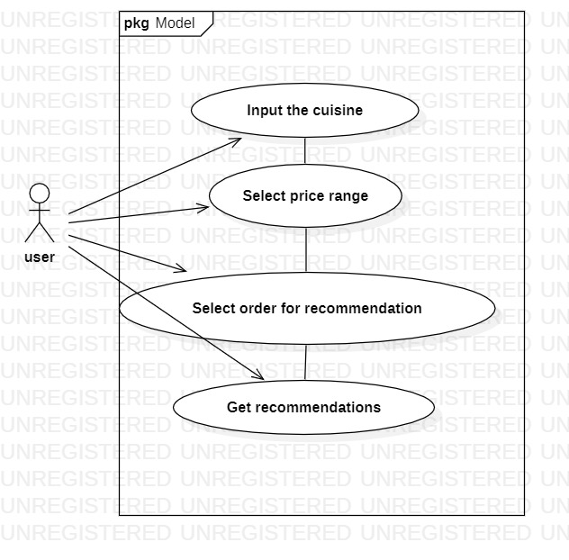
Use Case Diagram
A use case diagram can summarize the details of your system's users (also known as actors) and their interactions with the system.

Slide 7
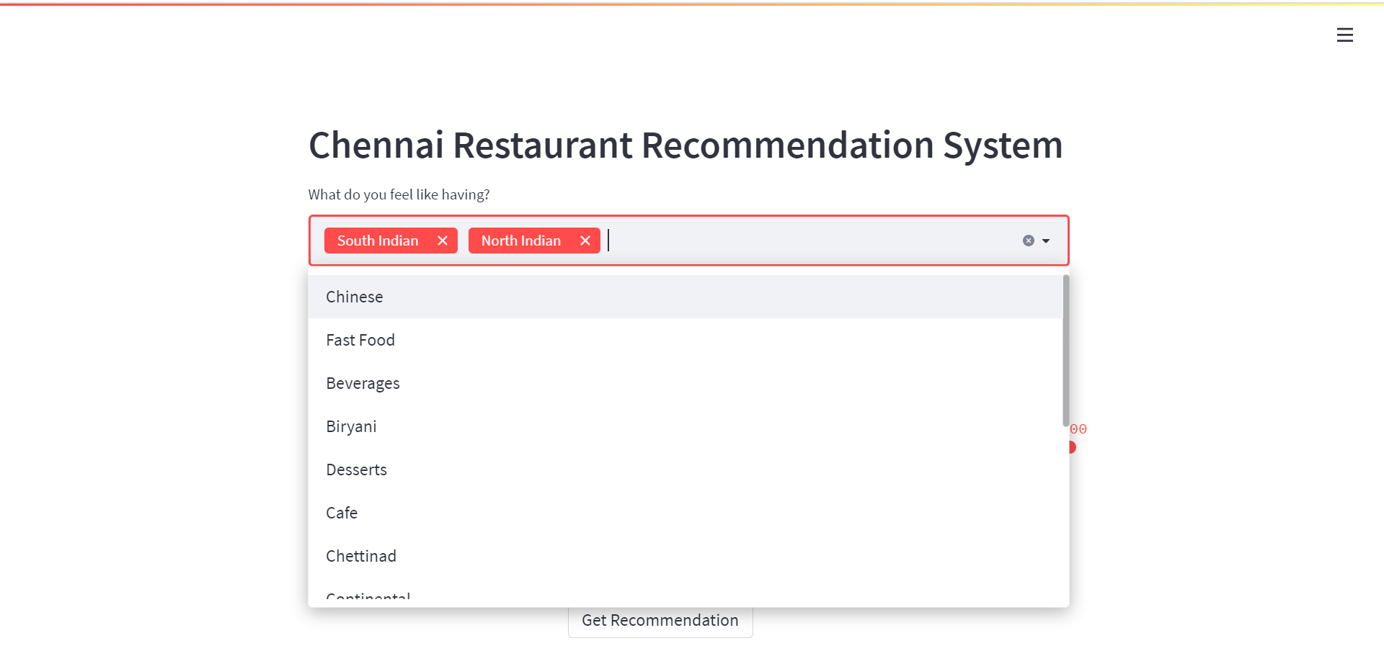
Result

Slide 8
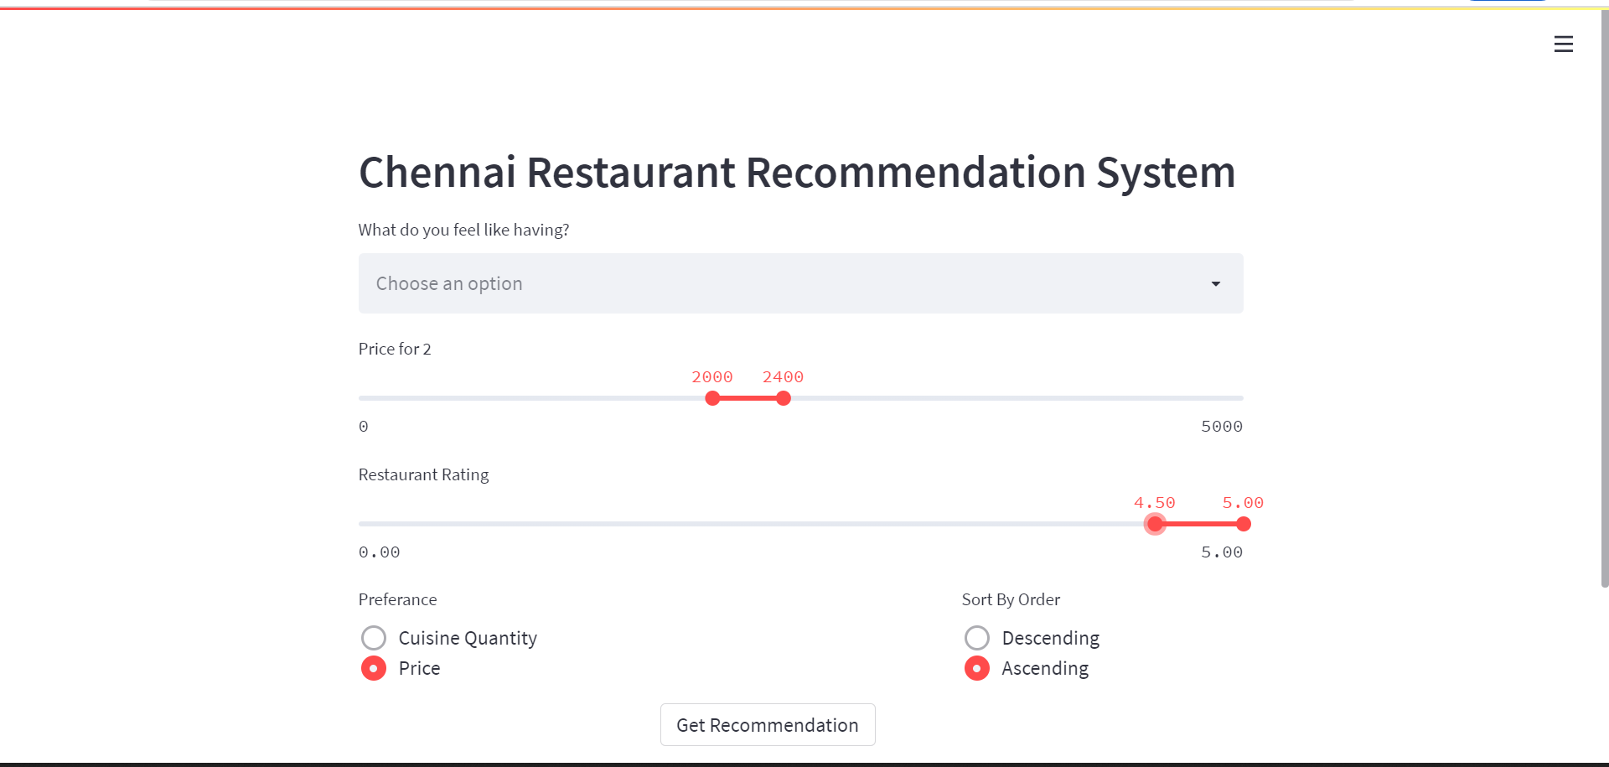

Slide 9
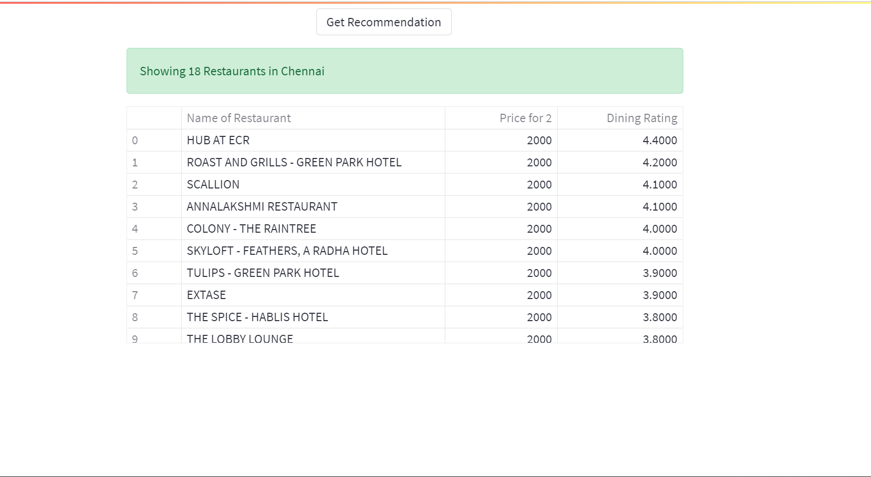
Recommendation Result

Slide 10
Conclusion
Recommendation Systems help the growth of a business.
Good Recommendations can increase customers.
Food is subjective. So, a recommendation system that understand your liking and recommends can be trusted.
Limitation of the project:
Only restaurants in Chennai
Location parameter was not considered for the recommendation.

Slide 11
References
Data Mining class notes
https://towardsdatascience.com/how-to-build-a-restaurant-recommendation-system-using-latent-factor-collaborative-filtering-ffe08dd57dca
https://medium.com/@sumith.gannarapu/restaurant-recommendation-system-b52911d1ed0b
Data set link: https://www.kaggle.com/phiitm/chennai-zomato-restaurants-data

