Slide 1
Vibiksha Bharathi P K
Final Project

Slide 2
PROJECT TITLE
ENHANCING HANDWRITTEN DIGIT RECOGNITION USING CONVOLUTIONAL NEURAL NETWROKS

Slide 3

AGENDA
Introduction
Problem Statement
Project Overview
End Users
Your Solution
The Wow in Your Solution
Modelling
Results
3/21/2024 Annual Review

Slide 4

PROBLEM STATEMENT
The project aims to develop a convolutional neural network (CNN) model for digit recognition using the MNIST dataset. The goal is to accurately classify handwritten digits (0-9) from grayscale images.

Slide 5

PROJECT OVERVIEW
The project involves building a CNN architecture to classify handwritten digits. It includes data preprocessing, model training, validation, and evaluation using the MNIST dataset.

Slide 6

WHO ARE THE END USERS?
End users of the project include:
Developers and researchers interested in deep learning and image recognition.
Educational institutions teaching machine learning and computer vision.
Companies or organizations utilizing image recognition technologies for various applications.

Slide 7
YOUR SOLUTION AND ITS VALUE PROPOSITION
Our solution involves:
Developing a CNN model architecture capable of accurately recognizing handwritten digits.
Training the model using the MNIST dataset, a benchmark dataset for digit recognition tasks.
Providing a reliable and efficient solution for automated digit recognition tasks, which can be integrated into various applications and systems.
Offering a cost-effective and scalable solution for digit recognition compared to traditional methods.

Slide 8
THE WOW IN YOUR SOLUTION
The CNN model offers several advantages:
High accuracy: Achieves state-of-the-art performance in digit recognition tasks.
Robustness: Capable of handling variations in handwriting styles and image noise.
Scalability: Can be easily adapted and deployed in real-world applications.
Efficiency: Provides fast and real-time digit recognition capabilities.

Slide 9
MODELLING
The CNN model architecture consists of convolutional layers followed by max-pooling layers to extract features from input images.
It utilizes ReLU activation functions to introduce non-linearity and improve model performance.
The final layer uses a softmax activation function to output probability scores for each digit class.
Model training is performed using the Adam optimizer and categorical cross-entropy loss function.

Slide 10
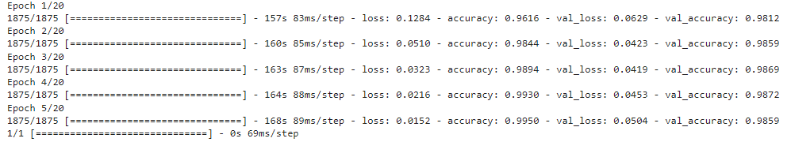
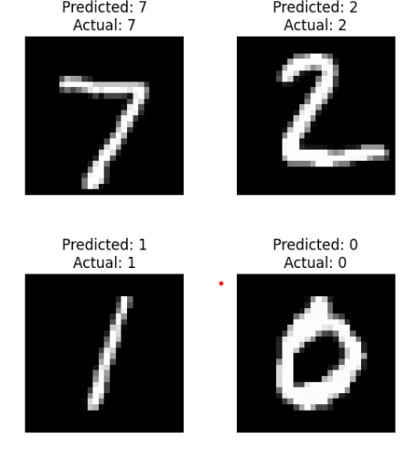
RESULTS

