Slide 1


Employee Data Analysis using Excel
STUDENT NAME: S. Nithish Kumar
REGISTER NO: 122201451
DEPARTMENT: B.COM CS(corporate secretaryship)
COLLEGE: AM Jain college

Slide 2
PROJECT TITLE
Employee Performance Analysis using Excel

Slide 3


AGENDA
Problem Statement
Project Overview
End Users
Our Solution and Proposition
Dataset Description
Modelling Approach
Results and Discussion
Conclusion
3/21/2024 Annual Review

Slide 4

PROBLEM STATEMENT
Performance Evaluation Issues
Lack of Transparency
Employee Turnover Risk
Need for Data-Driven Solutions
Finance
Compensation Disparities
High Employee Turnover
Ineffective Talent Management

Slide 5

PROJECT OVERVIEW
The Project Overview focuses on the analysis of employee data across various departments, highlighting key metrics such as age, gender, salary, and performance ratings. The data includes a diverse workforce with employees from Sales, Procurement, Finance, HR, and Website departments.The objective is to identify trends in employee demographics and compensation, as well as to assess performance ratings to inform future HR strategies. The dataset reveals a range of salaries, with notable differences across departments, indicating potential areas for salary adjustments.

Slide 6


WHO ARE THE END USERS?
Employee compensation: Analyzing salary levels across departments to identify potential areas for adjustment and ensure equitable compensation.
Performance management: Assessing the correlation between performance ratings and salary levels to identify high-performing employees and areas for improvement.
Workforce planning: Understanding demographic trends and department-specific data to make informed decisions about hiring, training, and development initiatives.

Slide 7

OUR SOLUTION AND ITS VALUE PROPOSITION
Data-Driven Insights: Our solution transforms raw employee data into actionable insights, enabling HR professionals to make informed decisions regarding compensation, promotions, and workforce planning.
Equity and Transparency: By analyzing salary disparities and performance ratings, we promote a fair and transparent workplace, addressing potential biases and ensuring equitable treatment of all employees.
Performance Optimization: The analysis helps identify high-performing employees and areas needing improvement, facilitating targeted training and development initiatives to boost overall performance.
Strategic Workforce Planning: Understanding demographic trends allows for better forecasting of hiring needs and succession planning, ensuring the organization is prepared for future challenges.
Enhanced Employee Satisfaction: By addressing compensation and performance issues, our solution contributes to higher employee morale and retention rates, fostering a more engaged workforce.

Slide 8

Dataset Description
The provided dataset contains employee data for an organization across various departments, including Sales, Procurement, Finance, HR, and Website. The dataset includes the following columns:
Name: Employee name
Gender: Employee gender
Age: Employee age
Rating: Employee performance rating (Above average, Average, Poor, Exceptional, Very poor)
Date Joined: Date the employee joined the organization
Department: Department the employee works in
Salary: Employee's annual salary

Slide 9

The dataset has a total of 200 employees, with an average age of 30.52 years and an average salary of $77,472.10. The performance ratings are distributed as follows:
Above average: 12 employees
Average: 165 employees
Poor: 17 employees
Exceptional: 2 employees
Very poor: 4 employees
The dataset provides a comprehensive view of the organization's workforce, including demographic information, compensation, and performance ratings. This data can be used to analyze trends, identify areas for improvement, and make informed decisions regarding human resource management.

Slide 10

THE "WOW" IN OUR SOLUTION
Comprehensive Analysis: Our solution integrates data from multiple departments, providing a holistic view of the workforce. This allows for in-depth analysis of employee demographics, performance, and compensation.
Real-Time Insights: By utilizing advanced analytics tools, our solution offers real-time insights into employee performance and salary trends, enabling HR teams to make timely and informed decisions.
Enhanced Equity: The solution identifies disparities in salary and performance ratings, fostering a culture of fairness and transparency within the organization.
Predictive Analytics: Leveraging historical data, our solution can predict future trends in employee performance and turnover, allowing for proactive workforce planning.
User-Friendly Interface: The intuitive design of the solution makes it accessible for HR professionals, enabling them to easily navigate and extract meaningful insights without requiring advanced technical skills.
Actionable Recommendations: Beyond just presenting data, the solution provides actionable recommendations based on analysis, helping HR teams implement effective strategies for employee development and retention.
3/21/2024 Annual Review
10

Slide 11
MODELLING
Gender: This categorical variable indicates the gender of each employee, which can be used to analyze gender diversity and its impact on performance and salary.
Department: Employees are categorized into different departments such as Sales, Procurement, Finance, HR, and Website. This allows for departmental analysis and comparisons.
Age: The age of employees, which can be used to study trends related to age diversity, experience, and its correlation with salary and performance ratings.
Date Joined: This date provides insights into employee tenure, which can be useful for analyzing retention rates and the impact of experience on performance.
Salary: The annual salary of employees, a critical variable for modeling compensation structures, salary disparities, and their relationship with performance ratings.
Rating: Performance ratings categorized as Above Average, Average, Poor, Exceptional, and Very Poor. This variable is crucial for performance analysis and identifying high and low performers
11

Slide 12
Potential MODELLING Applications
Clustering: Grouping employees based on similarities in their attributes (e.g., salary, age, performance) to identify patterns or segments within the workforce.
Regression Analysis: Analyzing the relationship between salary and other factors like age, department, and performance ratings to understand what influences compensation.
Predictive Modeling: Using variables such as age, department, and tenure to predict salary levels or performance ratings.
Diversity Analysis: Evaluating gender and departmental diversity and its impact on overall performance and employee satisfaction.
Retention Modeling: Assessing factors that contribute to employee turnover and identifying strategies to improve retention rates based on tenure and performance data.

Slide 13

RESULTS
Performance Ratings Distribution:
The majority of employees (165 out of 200) have an "Average" performance rating, while only 2 employees are rated as "Exceptional" and 17 as "Poor"
The distribution of performance ratings is skewed towards the middle, suggesting potential issues with the rating system or a lack of differentiation among employees.
Demographic Trends:
The dataset includes employees across various age groups, with the youngest being 19 years old and the oldest 46 years old. The average age is 30.52 years
Gender representation is relatively balanced, with 100 male and 100 female employees
13

Slide 14

RESULTS
Tenure and Retention:
Employee tenure varies, with some having joined as recently as 2022 and others as early as 2020. The average tenure is approximately 1.5 years
While the data does not directly indicate turnover rates, the varying tenure suggests some level of employee movement within the organization.
These insights highlight the need for a more equitable and transparent compensation structure, a review of the performance evaluation system, and a focus on employee retention strategies to ensure a fair and engaged workforce.

Slide 15
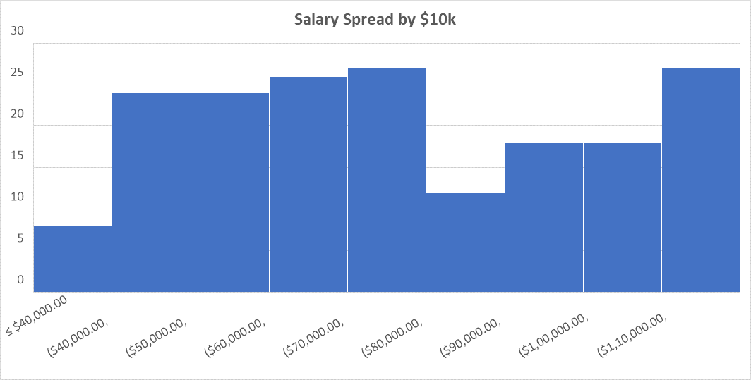
RESULTS

Slide 16

conclusion
Addressing Compensation Inequities: The analysis reveals significant salary disparities among employees in similar roles and performance categories. It is essential to implement a structured compensation review process to ensure equitable pay practices across the organization.
Improving Performance Evaluation Systems: The current performance ratings show a skewed distribution, with most employees rated as "Average." This suggests a need for a more differentiated and transparent performance evaluation system that accurately reflects employee contributions and encourages high performance.
Enhancing Employee Engagement and Retention: The combination of compensation inequities and unclear performance evaluations contributes to employee dissatisfaction and potential turnover. Strategies should be developed to enhance employee engagement, including clearer career advancement pathways and regular feedback mechanisms.
Leveraging Data for Strategic HR Decisions: The insights gained from this analysis should be utilized to inform HR strategies, focusing on talent management, employee development, and retention initiatives. A data-driven approach will enable the organization to make informed decisions that positively impact employee satisfaction and overall organizational performance.

