Slide 1


Multinational Sales Trends and Revenue Analysis Report
NAME: Nithish kumar S
DATE: 12-07-2025
ORGANIZATION: NOESYS SOFTWARE PVT. LTD

Slide 2
Table of contents
S.no: | Contents
1. | Our Company & About Us
2. | Introduction: Sales Trends & Objectives
3. | Key Performance Indicators (KPIs)
4. | Sales Growth Over Time
5. | Top-Selling Countries
6. | Top Product Lines
7. | Buyer Persona Infographic

Slide 3
S.no: | Contents
8. | Sales Concentration (Pareto Rule)
9. | Market Size Overview by Deal Size
10. | What-If Analysis & Simulations
11. | Product Demand Clustering
12. | Product Risk Assessment
13. | Consolidated Dashboard
14. | Conclusion and Recommendations
15. | Thank You

Slide 4

Our company --------------
We are a team specializing in
data automation & decision intelligence.
-------------------------------------
Enabling digital adoption with technology, people and processes to change business performance

Slide 5
About us

Slide 6
WHO WE ARE
Partnering for your success
Result of Analysis, Perception and Thinking
Our Mission
Our Philosophy
Our mission is to be the partner of choice and help create an ecosystem in which business and IT complement each other in customer-centric solutions. We aim to create measurable value-add in the solutions that we implement with an emphasis on high customer delight.
Noesys, means “result of Analysis, Perception and Thinking”, this philosophy is engrained in the way we engage with our customers helping them realize their business objectives.
Technology, Innovation and People
Our Story
Noesys started in 2013 and ever since we have helped non-IT organizations and software product companies reduce time to market and associated risks & improve business performance. A year later, we embarked on a product journey with Infoveave, enabling organizations to dive deep into their data.

Slide 7


What sets us apart?
Data + Intelligence
Digital + Innovation
Data Engineering
------------------------
Digital transformation initiatives promote responsiveness, alignment between teams, and agility within your organization to meet the new demands of doing business.
To realize the full potential of digital transformation, your organization must focus on the below critical areas to realize your business goals.
Analytics and
BI Consulting
-----------------------​
Digital technology initiatives promote responsiveness, alignment between teams, and agility within your organization to meet the new demands of doing business
---------------------------​
Creating a BI center
of excellence
----------------------​

Slide 8

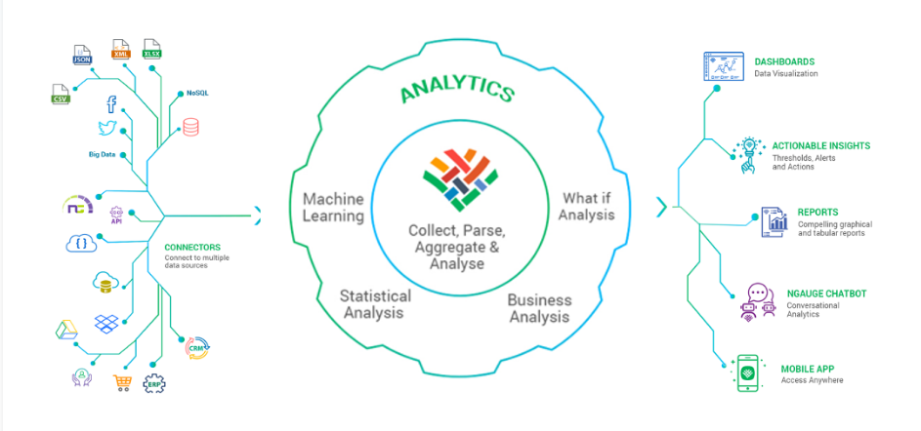
Delivering products that drive your business growth
One unified platform, endless data opportunities

Slide 9
Infoveave Data Automation & Decision Intelligence
Infoveave provides Analytics and Automation solution for businesses, making it easy for companies to manage all their data in one place, keep track of their performance at various levels and automate critical front and back-office processes. Infoveave is ready to use, customizable and extensible platform that can be used to create various point solutions based on the business need.
Automation
Data Analytics
Data Insights
Data Apps
Data Quality
Governance

Slide 10
OUR CLIENTS
Republic Kenya​
Quadgen​
Project Balance​
NHM​
NCDC​
ICAP​
Feedback​
Opel​
CRS​
National Tree
NSRCL
Arc 360
Stanley
Sharp Electronics Singapore
Zipform Digital
Toyota
SDF
Westbury Commerce

Slide 11
INTRODUCTION
Welcome to the Multinational Sales Trends And Revenue Analysis Report presentation. In this analysis, we will explore key trends, patterns, and insights from our sales dataset, which covers performance across various regions and product lines.​
The primary objectives of this analysis are:​
# To understand the sales performance over time and by region.​
# To identify top-performing products and product categories.​
# To evaluate the relationship between deal size, pricing, and discounting.​
# To provide actionable insights that can inform strategic business decisions.​
This presentation will cover exploratory data analysis (EDA), including both univariate and bivariate analyses, and provide recommendations based on the findings.​
​

Slide 12
PRODUCT CATEGORIES
CLASSIC CARS
MOTORCYCLES
SHIPS
VINTAGE CARS
TRAINS
PLNAES
TRUCKS AND BUSES

Slide 13
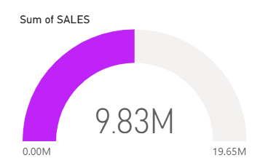
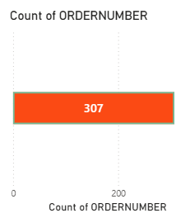

KEY PERFORMANCE
INDICATORS
The Total Sales contributed is 9.83 million
Total orders = 307.
92
Number of Customers 92

Slide 14
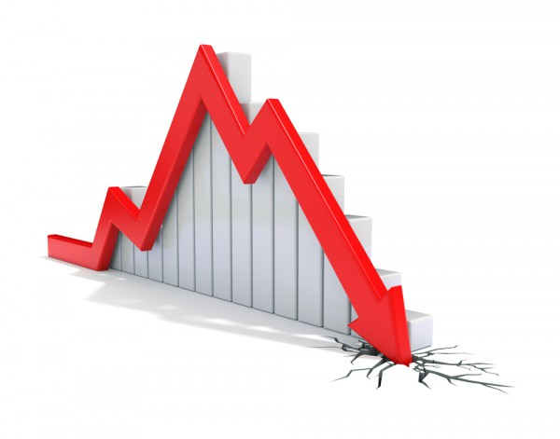
Sales Growth Over Time
1. In 2003 the sales conversion rate is very close to 100% that is 97.5.​
2. Later in 2005 it is down by 22.61 % which made the Sales Conversion rate to 73.2.​
3. The sharp drop to Vintage Cars(21.00K) indicates a 38% decline, suggesting a possible
lack of interest, availability, or marketing effectiveness beyond the top category.

Slide 15
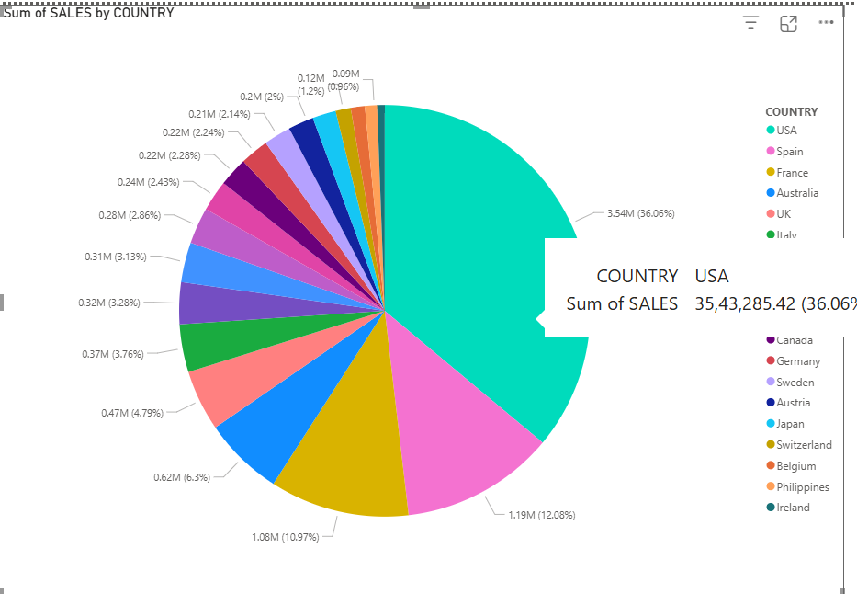
Top-Selling Countries
1.USA Dominates Sales:
The USA leads significantly with 3.54M in sales, making up 36.06% of the total.
It is the largest contributor by far compared to all other countries.
2. Top 5 Countries by Sales:
USA – 3.54M (36.06%)
Spain – 1.19M (12.08%)
France – 1.08M (10.97%)
Australia – 0.62M (6.3%)
UK – 0.47M (4.79%)
3. Long Tail Distribution:
Several countries contribute small shares, such as Ireland (0.09M or 0.96%) and the Philippines (0.12M or 1.2%).

Slide 16
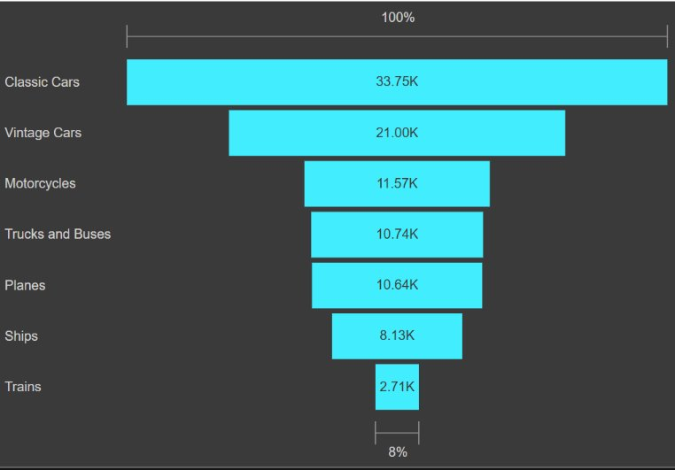
1. High Drop-off After Classic Cars – Conversion Concern
Classic Cars lead significantly with 33.75K, contributing 100% of the funnel.
The sharp drop to Vintage Cars (21.00K) indicates a 38% decline, suggesting a possible lack of interest, availability, or marketing effectiveness beyond the top category.
Businesses should investigate what makes Classic Cars so appealing and try to replicate that strategy for other categories.
Product Lines Analysis
2. Middle Categories Show Close Competition – Opportunity for Promotion
i) Motorcycles (11.57K), Trucks and Buses (10.74K), and Planes (10.64K) are in a tight range (~11K).
ii) This reflects a balanced demand among these mid-tier products and shows potential for cross-promotional offers or bundling strategies
3. Trains Have Lowest Demand – Requires Strategic Decision
i) Trains only account for 2.71K, which is just 8% of the total volume.
ii) This could signal a niche product, low inventory, or poor visibility.
iii) Decision-makers should evaluate whether to discontinue, reposition, or invest in niche marketing to improve performance.

Slide 17

Buyer persona infographic
Name
Motivations
Euro Shopping Channel
1.
Value Optimization
"Smart buying is about more than price—it's about timing and trust."
2.
Bulk Savings
Personality
Bio
Explored 131 medium size deals and bought a total quantity of 5064 only in medium size deals.
Managed to get a discount of about 15% comparing the entire purchase.
Belongs to Spain , Made a Total Sale of RS: 889848.82 within 259 orders
3.
Efficient Procurement
History
Placed a total of 110 orders in year 2004 also the top buyer when comparing the total number of orders among the .

Slide 18
Sales Concentration Analysis (Pareto Rule: 80/20)
These are the 74 of products that contribute to the 80% of the revenue:
The top 5 are below:
1. "S18_3232"
2. "S10_1949"
3. "S12_1108"
4. "S18_2238"
5. "S10_4698"
These product sums an amount of
₹ 887,698.72 contributing the 80 % of revenue that is ₹ 78,209,12.74

Slide 19
Market size overview
OUTER CICLE-DEALSIZE=LARGE
1. Big deals have the highest individual value but the smallest overall market share. 2. They require strategic nurturing and can deliver significant ROI with focused relationship management.
₹1.09M
₹6.08M
MIDDLE CIRCLE-DEALSIZE=MEDIUM
1. Medium deals are the primary revenue driver, accounting for over 60% of total sales. 2. They represent a stable and scalable customer base, ideal for growth and retention strategies.
₹2.6M
INNER CIRCLE-DEALSIZE=SMALL
1. Small deals contribute a modest share of revenue, indicating a
high volume, low-value segment.
2. This tier offers great potential for upselling and customer base expansion.

Slide 20
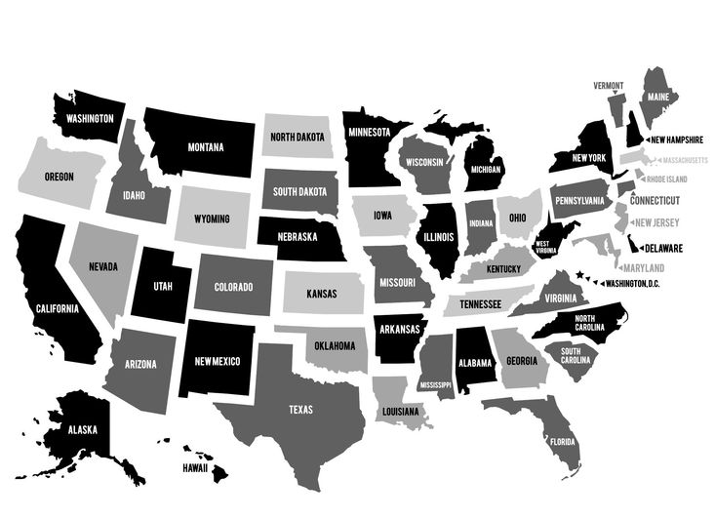
Product stats
Worldwide reach
92
3480.65
2823
Users worldwide
Average Money spent
Number of unique products
38.04 %
13.04 %
Customers in USA
Customers in France

Slide 21
What-If Analysis: Exploring Business
Impact Scenarios
1. We conducted a What-If analysis to simulate the effect of strategic decisions on deal sizes and revenue performance. 2. Key scenarios tested include changes in deal conversion, sales growth, and pricing adjustments.
Key Scenarios Explored:
1) Converting 15% of Small Deals into Medium Deals
2) 10% Sales Growth Forecast through marketing
3) 5% Price Increase for Medium Deals
4) ₹1M Boost in Big Deals from Enterprise Clients
5) 10% Revenue Dip in Top Products (Pareto A)

Slide 22
Scenario Simulation & Revenue Impact
S.no
Scenario | Revenue Impact | Strategic Insight
15% Small ➝ Medium Deal Shift | +₹0.39M in Medium | Upselling can boost mid-tier dominance
10% Overall Sales Growth | ₹9.77M ➝ ₹10.75M | Marketing investment leads to significant gain
5% Medium Deal Price Increase | ₹6.08M ➝ ₹6.38M | Small price tweaks improve margins without churn risk
₹1M Big Deal Acquisition | ₹1.09M ➝ ₹2.09M | Single enterprise deal can double top-tier sales
10% Drop in Pareto Products Revenue | -₹103K | Over-dependence on few products poses risk
1.
2.
3.
4.
5.

Slide 23
Recommendations Based on
What-If Analysis
1. Focus on Medium Deals: This segment holds over 60% of revenue — expand through upselling from Small Deals.
2. Boost Big Deals: A few high-value enterprise wins can significantly uplift total revenue.
3. Secure Pareto Products: Protect top-performing items with pricing control and competitive differentiation.
4. Invest in Marketing: A 10% sales growth scenario suggests excellent ROI potential from promotional efforts.
5. Use Data-Driven Pricing: A modest 5% price increase in Medium Deals can improve margins with minimal risk.

Slide 24
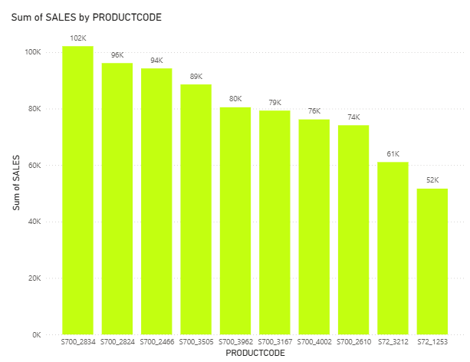
Top Products: Best-selling
Products.
S700_2834 leads the top 10 with 102K sales, followed closely by S700_2824 and S700_2466, showing strong market demand.
The consistent drop in sales indicates a relatively balanced distribution among the top-selling products, suggesting no single-product dependency.
Sales decline gradually across the list, with the 10th product, S72_1253, recording 52K sales, about half of the top performer.

Slide 25
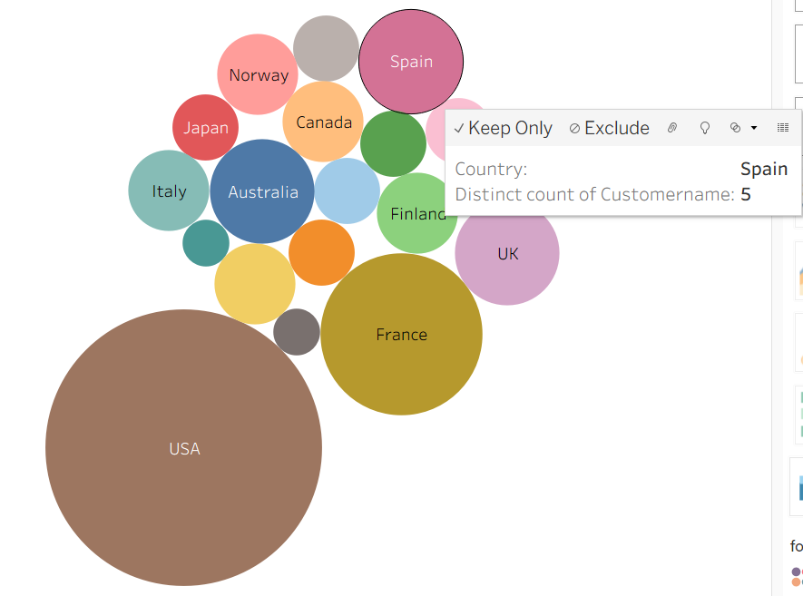
Customer Insights:
Geographic distribution
of customers
i) Distinct customers are counted.
ii) Here USA dominates all
the other countries significantly by holding 35 customer on its own
iii) Total of 307 Customers contribute to the total sale.

Slide 26
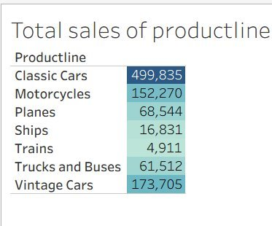
Sales Analysis between different Product lines
Classic Cars lead significantly with 499,835 sales, showing dominant market preference.
Vintage Cars and Motorcycles also perform well, indicating strong interest in retro and dynamic models.
Trains and Ships have minimal sales, highlighting low demand or niche market presence.

Slide 27
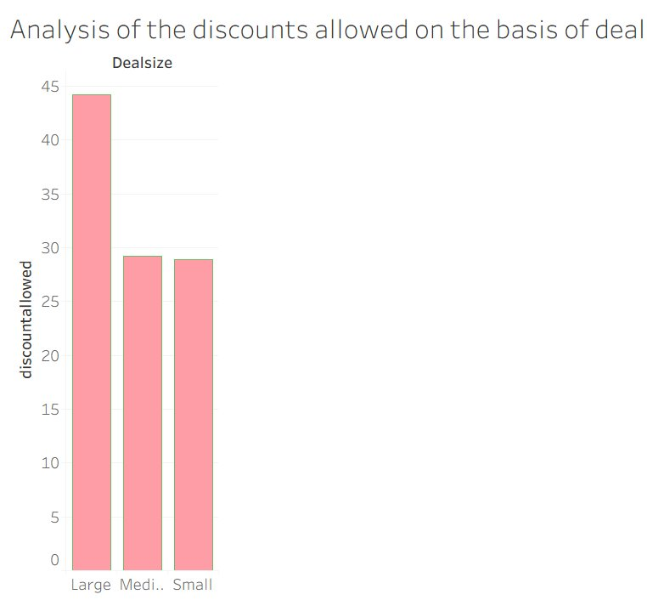
Discount analysis based on deal size
Large deals received the highest discounts, reaching around 45%, indicating strong negotiation leverage.
Medium and Small deals were offered similar discounts, both under 30%, suggesting standardized discounting for lower tiers.
The pattern reflects a strategy to incentivize bulk purchases through more aggressive discounting.

Slide 28
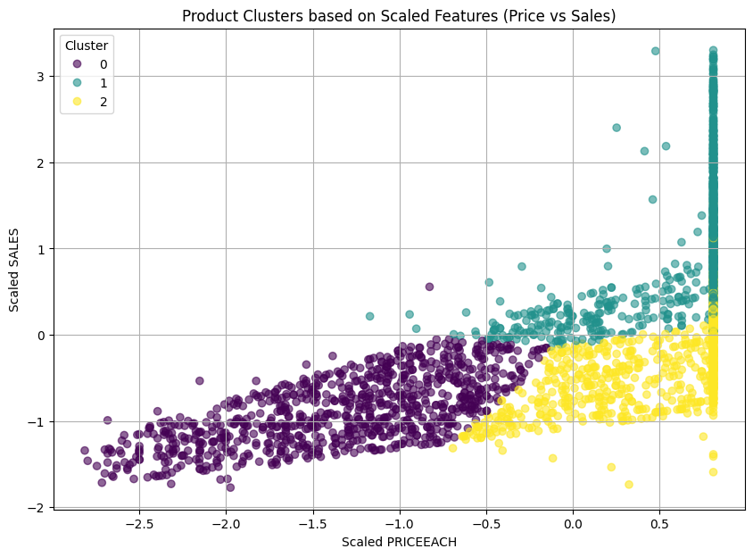
PREDICTIVE MODELLING
Product Demand Clustering
Group 1: The Big Ticket Items - This group includes our high-volume, high-value products. They are bought in larger quantities at higher prices, leading to significant sales revenue. These products are typically part of our medium and large deals. These are the products that drive a large portion of our revenue through bigger transactions.
Group 0: The Everyday Essentials - These products are bought in smaller quantities, have lower prices, and generate lower sales revenue. Most of the deals for these products are also small in size. Think of these as your regular, lower-priced items that customers buy frequently in smaller amounts.
Group 2: The Mid-Range Performers - These products have moderate sales quantities and revenue, but are sold at higher prices. They appear in both medium and small deals. This group represents products that are doing well in terms of price, but the quantity and overall sales are not as high as the "Big Ticket Items".

Slide 29
Product Demand Analysis and Risk Assessment
1.What we found: We identified 16 products where the sales or the number of items sold each month is generally going down. On average, for these "at-risk" products, monthly sales are decreasing by about $200, and the number of items sold is dropping by about 1.5 units.
2.It's not the same for all: The rate at which these products are declining varies a lot. Some are dropping much faster than others.
3.Deal sizes: When these "at-risk" products are sold, they are most often part of medium or small deals, less frequently large deals.
What this means:
These products might be losing customer interest. This could be for various reasons – maybe they are getting old, competitors have better options, or customer tastes are changing.
Next steps:
We should look closer at why these specific products are declining. Once we understand the reasons, we can decide what to do. This might involve trying to boost their sales with promotions, changing how we market them, or eventually deciding to stop selling them if the decline can't be reversed.
We looked at how the sales and quantities of each product have changed over time. We found some products that seem to be losing popularity.

Slide 30

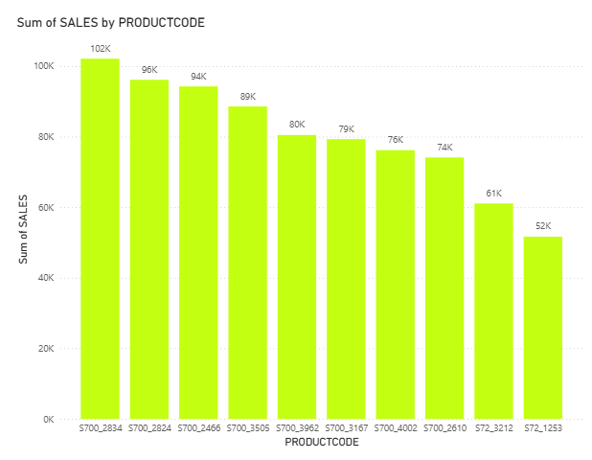
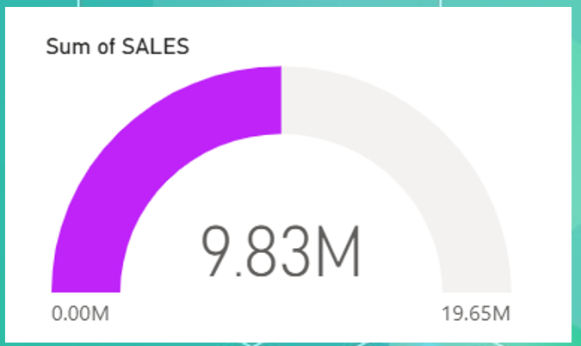

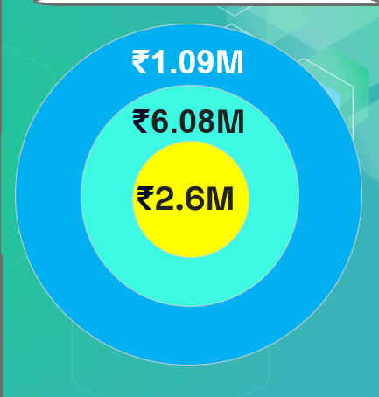
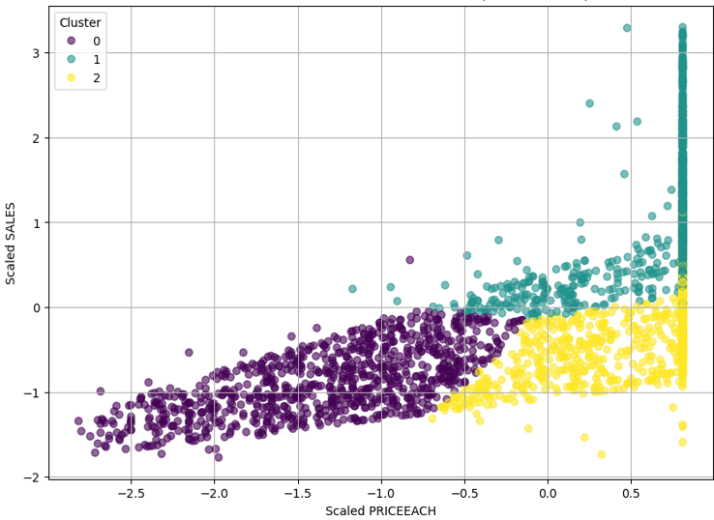

Consolidated Dashboard
Customer Analysis: customers
split among countries
Sales Performance Analysis
Top Products: Best-selling
Products
Sales
Deal size Analysis : Top= Medium
Product Demand Clustering
3 Groups
92 Unique Customers
Productline Analysis

Slide 31
Conclusion and Recommendations
1.Focus on Medium Deals: These account for 60%+ of revenue. Use upselling from small deals to boost them further.
2.Leverage Big Deals: A few high-value enterprise clients can dramatically increase overall revenue.
3.Protect Pareto Products: Secure top-performing products with strong pricing and differentiation strategies.
4.Invest in Marketing: A projected 10% sales growth shows excellent ROI potential from campaigns.
5.Smart Pricing Strategies: A small 5% price increase in medium deals significantly improves margins without high risk.

Slide 32
ANALYSIS LINKS AND MORE
1.Predictive modelling link https://shorturl.at/D7Fon
2.Data Preprocessing : https://shorturl.at/qyuKs

Slide 33
Thanks!
"Smart decisions stem from insightful data."
Let us help you power your business forward with data-driven innovation.

