Slide 1
Insights from BA customer reviews
Summary
By
Nithish Reddy Konakati

Slide 2
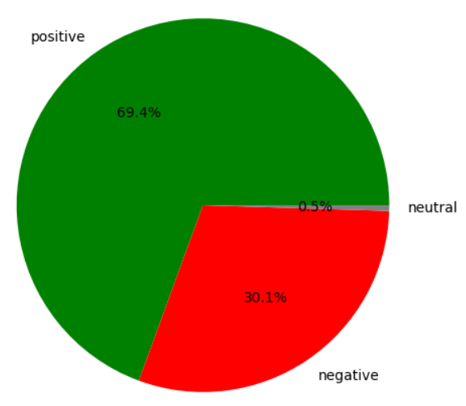
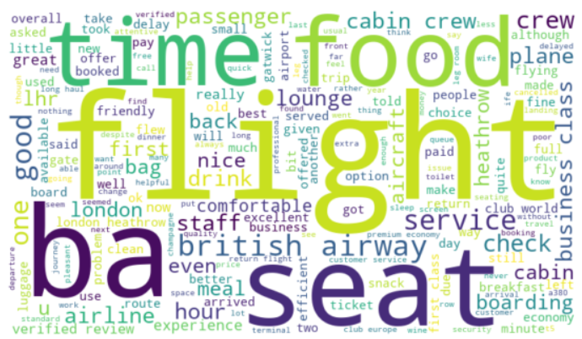
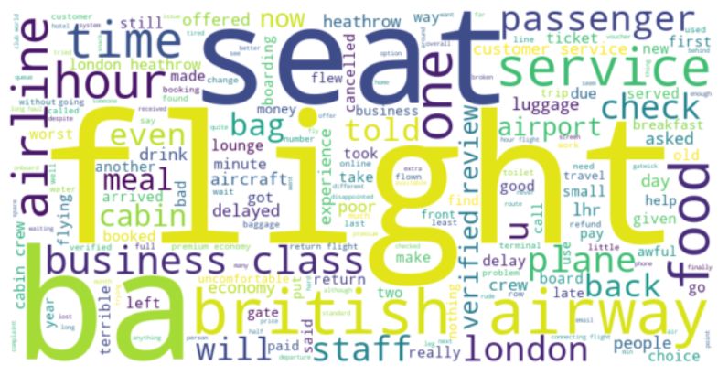
Web scraping Sentiment Analysis Word cloud Topic Modeling
Analysis process
Sentiment Analysis
Sentiment + word cloud/Topic modeling
A total of 3874 reviews are scrapped from the Skytrax website. Below is the distribution of sentiment labels :
Positive Reviews Analysis: BA’s Strengths
Positive Airport and Staff
Ease of Booking and Seat Comfort
Cabin and Crew Service
Smooth Operations(Heathrow airport)
Overall Positive Brand Perception
Negative Reviews Analysis: Areas to improve
Enhance luggage handling and staff service
Improve food quality and meal service
Seating Comfort and Class-Specific Services
Airport Efficiency and Check-in Processes
Sentiment Distribution chart
Mixed reviews highlight inconsistent service delivery across airports/flights, suggesting a need for standardized operations.
To summarize, BA should focus on two important areas to improve the overall customer satisfaction:
Service Standardization
Operational Efficiency
Service standardization
Staff behavior & luggage handling training
Food quality across all cabins
Economy seat comfort focus
Operational Efficiency
Streamlined check-in & boarding
Enhanced flight delay/gate updates
Non-Heathrow operations optimization

