Slide 1
Insights from BA customer booking predictive modeling
Summary
By
Nithish Reddy Konakati

Slide 2
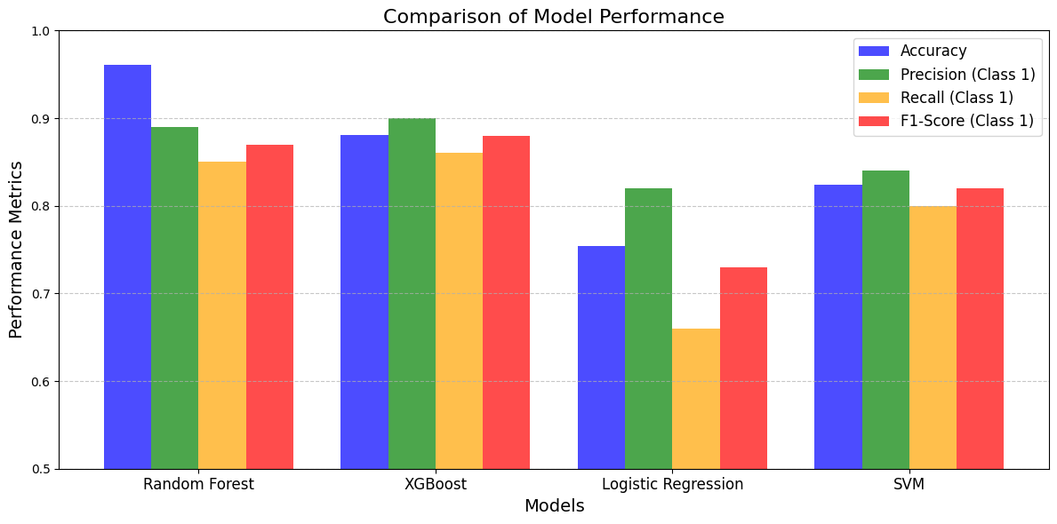
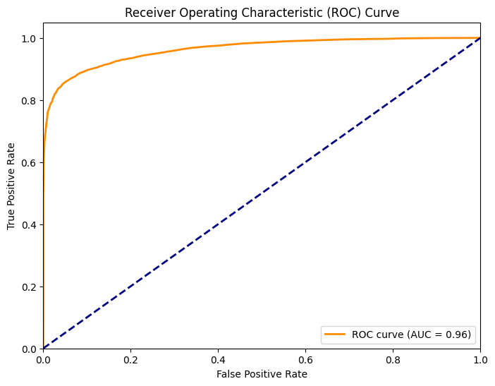
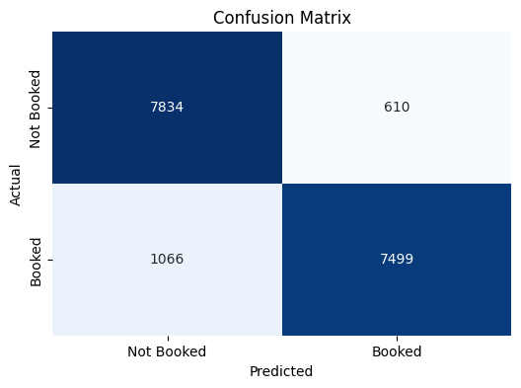
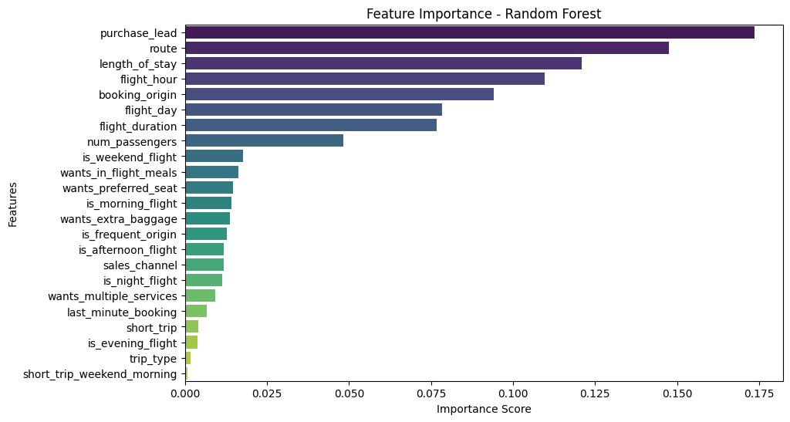
Booking prediction modelling summary
Model evaluation metrics-Random Forest
Evaluated various models for customer booking prediction. Random forest algorithm delivers the best performance for this predictive model.
Model predicts with an accuracy of 0.9014 and F-1 score of 0.90 indicating its overall performance.
Below are the features most relevant to the models prediction: Purchase_lead, route, length_of_stay, flight_hour, booking_origin,flight_day_flight_duration,num_passengers

