Slide 1
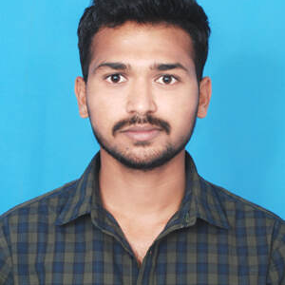
S Nithish
Bachelor of Technology
ECE 2017 - 2021
Analyst/Software Engineer
Mumbai
Skills
s-nithish.s-nithish@capgemini.com
Java | Java Basics, OOPS, Generics, Collections, Array, Loops
React | Components, Hooks, Virtual DOM, Routing, Forms & Validation
Database | Mongo DB ,Oracle SQL Server
UI Tech | HTML 5 & CSS 3,bootstrap,javaScript, React js
Tools | Git, Postman, Swagger, Eclipse, Visual Studio Code
Add On skills | Immersive learning
+91 7396240271
A4
Hands on experience on Core Java, SpringBoot Framework, Sql Server.
Proficient in creating Single page Web Application in React with Authentication and Routing.
Hands on experience in developing web pages using HTML5, CSS3,Bootstrap , java Script Reactjs. Good understanding of Document Object Model (DOM) and DOM Functions.
Having knowledge in Manual Testing.
Ready to learn new technologies and implement them for the future knowledge improvement.
Completed Case study on Movie Ticket Booking along with API, Swagger, responsive UI with HTML5, CSS, Bootstrap and React used as User Interface.
Completed Case study on Deals and Coupon Finder App along with API, Swagger, responsive UI with HTML5, CSS, Bootstrap and React used as User Interface.
Degreed: Successfully completed Git&Github, MongoDB.

