Slide 1

ReconGuard
Team Name: Fantastic Four
Team Members:
Nithish P
Pandiyan R
Lokeshnarayanan D
Mahakavi S
SKP Engineering College
Problem Statement: Build a tool that automates external recon (subdomains, open ports, tech stack, exposed panels) against a target you own/are authorized on.

Slide 2
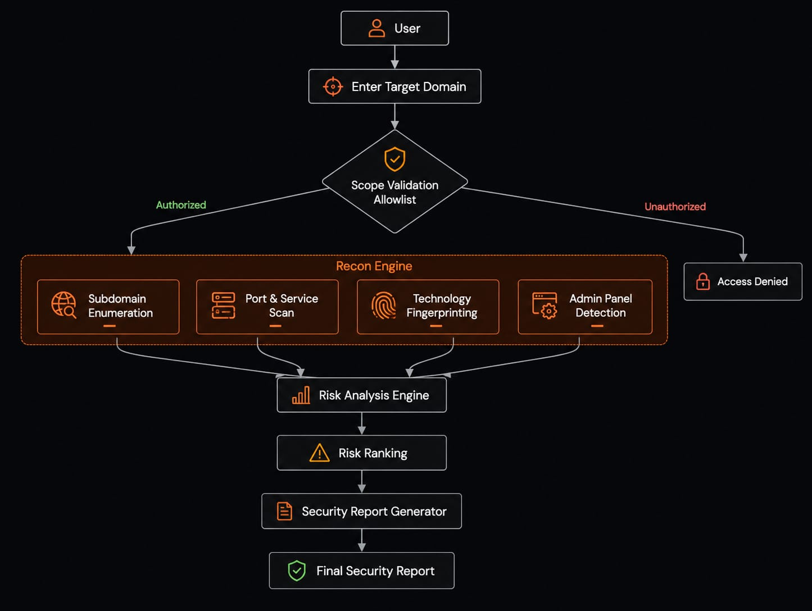
Architecture

Slide 3
Abstract
Automated Reconnaissance
Asset Discovery
Ethical Practices
The tool discovers subdomains, scans open ports, identifies the technology stack, detects exposed admin panels, and generates a risk-ranked security report.
It follows ethical cybersecurity practices by enforcing scope validation and respecting rate limits.
The project is an automated external reconnaissance tool designed for authorized domains.

Slide 4
Purpose
Automate external reconnaissance.
Reduce manual security assessment effort.
Discover publicly exposed assets.
Identify technologies used by the target website.
Detect accessible admin panels.
Generate a risk-prioritized security report.
Ensure ethical scanning through authorized scope validation and rate limiting.

Slide 5
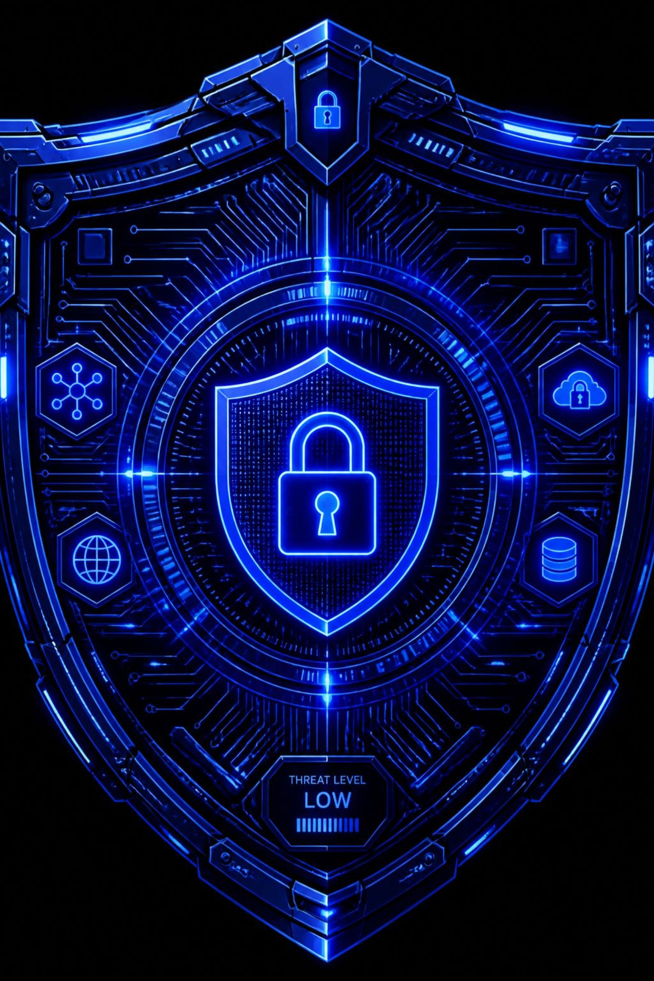
Thank You !

