Slide 1
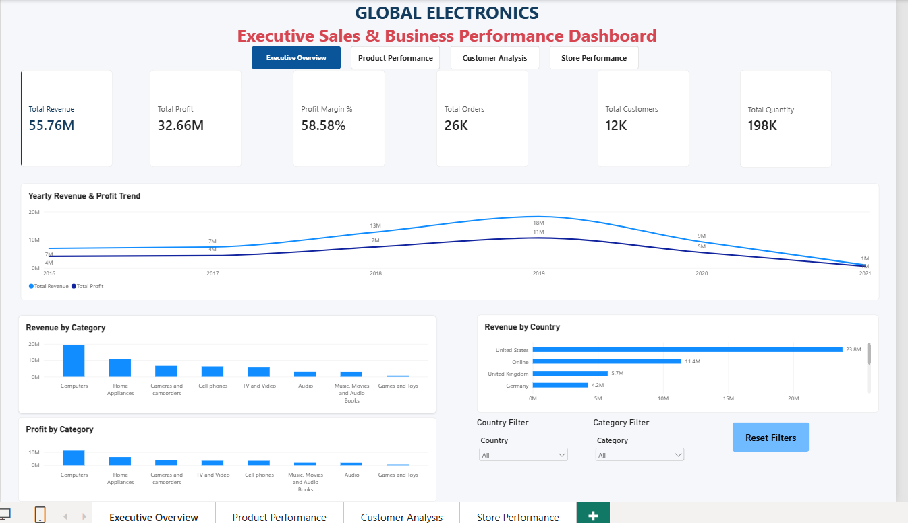
GLOBAL ELECTRONICS
Sales & Business Performance Dashboard
End-to-End Enterprise Analytics: MySQL • Power BI • DAX
Prepared by: Nithish G. | MCA Graduate (2026)

Slide 2
GLOBAL ELECTRONICS RETAIL DASHBOARD
Project Overview & Key Objectives
Executive Summary
This project presents a multi-tier retail business intelligence platform for a global consumer electronics retailer. It tracks end-to-end sales transactions across regional retail stores and direct online channels to give stakeholders full operational visibility.
Core Project Objectives
• Analyze core commercial metrics: Revenue ($55.76M), Profit ($32.66M), and Margin (58.58%).
• Benchmark revenue contributions across physical outlets versus online sales channels.
• Identify high-margin categories and track product demand across global regions.
• Deliver an executive dashboard with drill-down pages for Products, Customers, and Stores.

Slide 3
GLOBAL ELECTRONICS RETAIL DASHBOARD
Business Problem & Operational Challenges
01. Decentralized Transaction Data
Transaction logs, inventory costs, and foreign currencies were stored in disconnected CSV flat-files without relational integrity.
02. Lack of True Margin Visibility
Top-line revenue tracking masked product categories that delivered high gross volume but poor operating profitability.
03. Physical Store Sizing Uncertainty
Management lacked clarity on whether large-footprint retail stores generated proportional sales compared to compact stores.
04. High Reporting Latency
Periodic static spreadsheet updates delayed strategic inventory and regional allocation decisions.

Slide 4
GLOBAL ELECTRONICS RETAIL DASHBOARD
Technology Architecture & Analytical Stack
MySQL 8.0
Data Storage & Relational ETL
• Relational schema design
• Bulk CSV ingestion
• Date parsing & validation
• Analytical SQL queries
Power BI
Data Modeling & Reporting
• Star Schema modeling
• Interactive canvas pages
• Category & Country slicers
• Custom theme formatting
DAX
Business Calculations
• Dynamic SUMX measures
• Cost & Profit formulas
• Profit Margin % DIVIDE logic
• Distinct counter logic
Excel & Git
Validation & Versioning
• Data dictionary audits
• Pre-import validation
• Repository versioning
• Project documentation

Slide 5
GLOBAL ELECTRONICS RETAIL DASHBOARD
Dataset Scale & Star Schema Architecture
Customers[CustomerKey]
Sales[CustomerKey] (Active, Single)
Products[ProductKey]
Sales[ProductKey] (Active, Single)
Stores[StoreKey]
Sales[StoreKey] (Active, Single)
Dataset Breakdown
Sales.csv (Fact Table)
62,884 rows
Customers.csv (Dimension)
15,266 rows
Products.csv (Dimension)
2,517 rows
Stores.csv (Dimension)
67 rows
Exchange_Rates.csv (Lookup)
11,215 rows
1:*
1:*
1:*

Slide 6
GLOBAL ELECTRONICS RETAIL DASHBOARD
Data Preparation & SQL Ingestion Pipeline
Key Pipeline Steps
• Windows CRLF (_x000D_
) handling during bulk LOAD DATA INFILE execution.
• Character set mapping to latin1 to preserve international characters.
• Sanitized currency strings by stripping '$' and commas into DECIMAL values.
• Used STR_TO_DATE() to transform variable date formats into ISO standard.
• Preserved NULL values in Delivery_Date to identify pending orders.
SQL Ingestion Sample
LOAD DATA INFILE '.../Products.csv'
INTO TABLE products
CHARACTER SET latin1
FIELDS TERMINATED BY ',' ENCLOSED BY '"'
LINES TERMINATED BY '\r\n' IGNORE 1 ROWS
(
ProductKey, Product_Name, Brand, Color,
@Cost, @Price, SubcategoryKey, Subcategory,
CategoryKey, Category
)
SET
Unit_Cost_USD = REPLACE(REPLACE(@Cost, '$', ''), ',', ''),
Unit_Price_USD = REPLACE(REPLACE(@Price, '$', ''), ',', '');

Slide 7
GLOBAL ELECTRONICS RETAIL DASHBOARD
Power BI Modeling & Analytical DAX Measures
Centralized DAX Repository
Created an isolated _All_Measures table containing all KPIs:
• Total Revenue: SUMX over Sales with RELATED(Price)
• Total Cost: SUMX over Sales with RELATED(Cost)
• Total Profit: [Total Revenue] - [Total Cost]
• Profit Margin %: DIVIDE([Total Profit], [Total Revenue], 0)
• Total Quantity: SUM('global_electronics sales'[Quantity])
• Total Orders: DISTINCTCOUNT(Order_Number)
• Total Customers: DISTINCTCOUNT(CustomerKey)
Key DAX Implementations
Total Revenue =
SUMX(
'global_electronics sales',
'global_electronics sales'[Quantity] *
RELATED('global_electronics products'[Unit_Price_USD])
)
Profit Margin % =
DIVIDE(
[Total Profit],
[Total Revenue],
0
)

Slide 8
GLOBAL ELECTRONICS RETAIL DASHBOARD
Dashboard Page 1: Executive Overview
Total Revenue
$55.76M
Total Profit
$32.66M
Profit Margin
58.58%
Total Orders
26K
Customers
12K
Quantity Sold
198K
Executive Highlights
• Revenue & Profit Peak: Performance peaked in 2019 at $18M Revenue and $11M Profit.
• Category Leaders: Computers generated ~$20M in Revenue, followed by Home Appliances at ~$11M.
• Geographic Outliers: United States accounts for $23.8M of retail sales; the Online store drove $11.4M.
• Interactive Filtering: Country & Category slicers allow dynamic cross-filtering across all visuals.

Slide 9
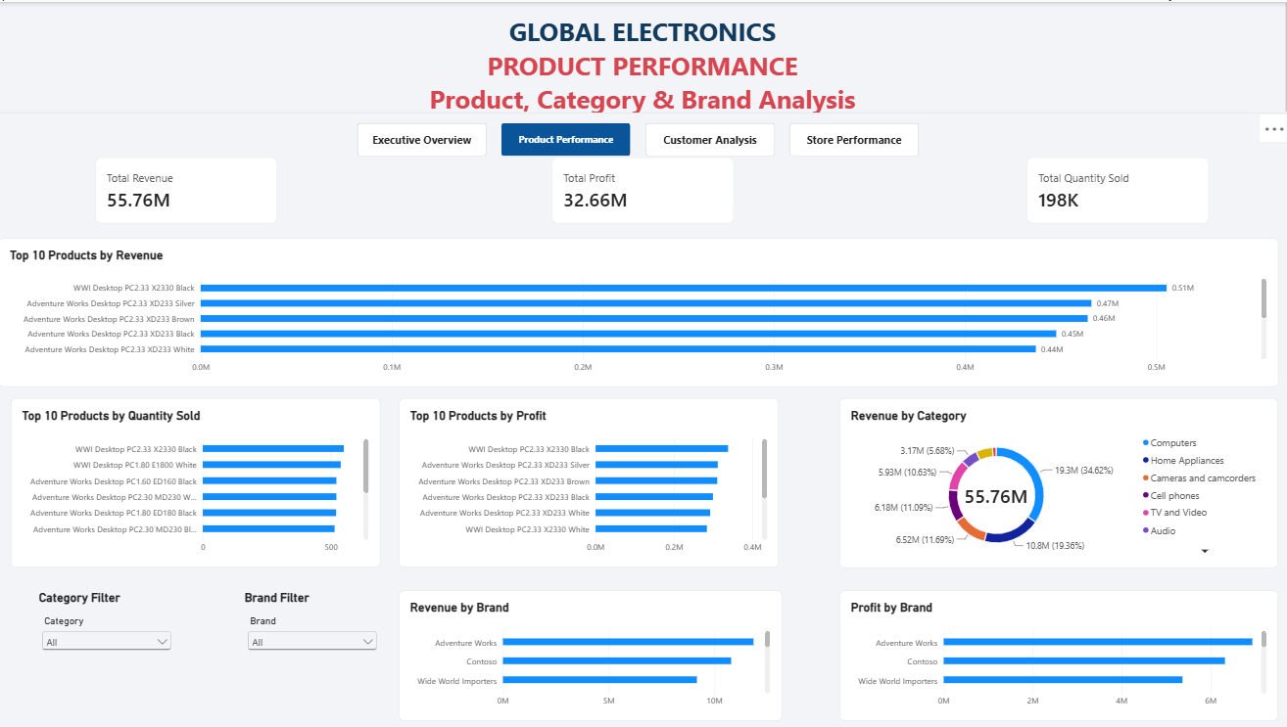
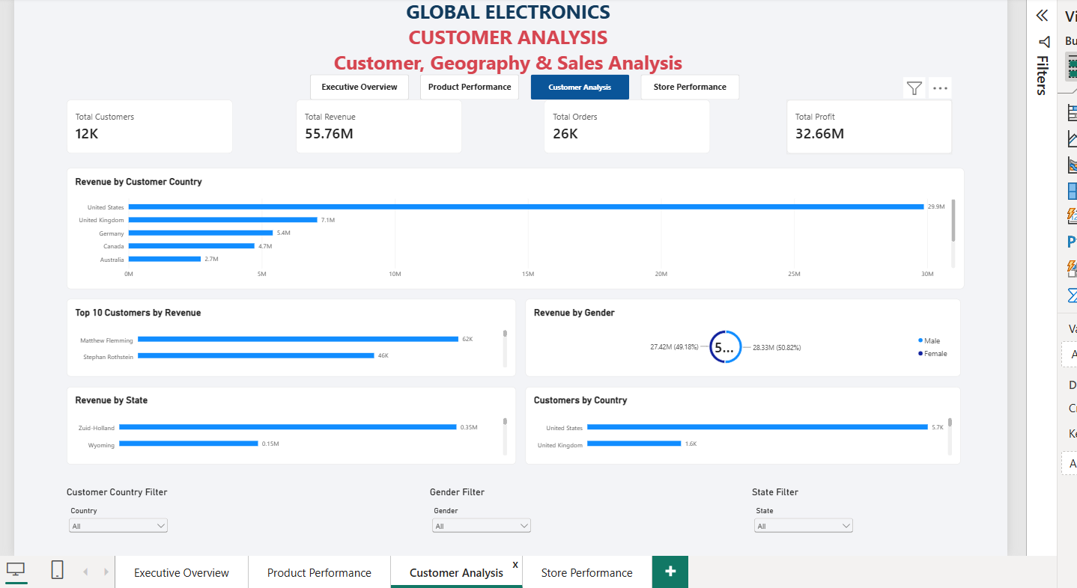
GLOBAL ELECTRONICS RETAIL DASHBOARD
Dashboard Pages 2 & 3: Product & Customer Analytics
Product Performance
• Top Revenue Drivers: Desktop PCs (e.g., Adventure Works Desktop PC models) led gross dollar earnings.
• Volume Leaders: Compact accessories generated high transaction counts with lower gross ticket prices.
• Category Contribution: Computers contributed over 35% of total sales revenue.
• Brand Profitability: Contoso and Adventure Works drove the highest net profit contributions.
Customer Demographics
• Geographic Concentration: United States ($29.9M), United Kingdom ($7.1M), and Germany ($5.4M).
• Gender Split: Balanced distribution: 50.82% Female ($28.33M) vs 49.18% Male ($27.42M).
• High-Value Accounts: Top individual customers generated up to $62K in lifetime gross orders.
• Demographic Spread: Over 12,000 unique purchasing customers active across 4 primary continents.

Slide 10
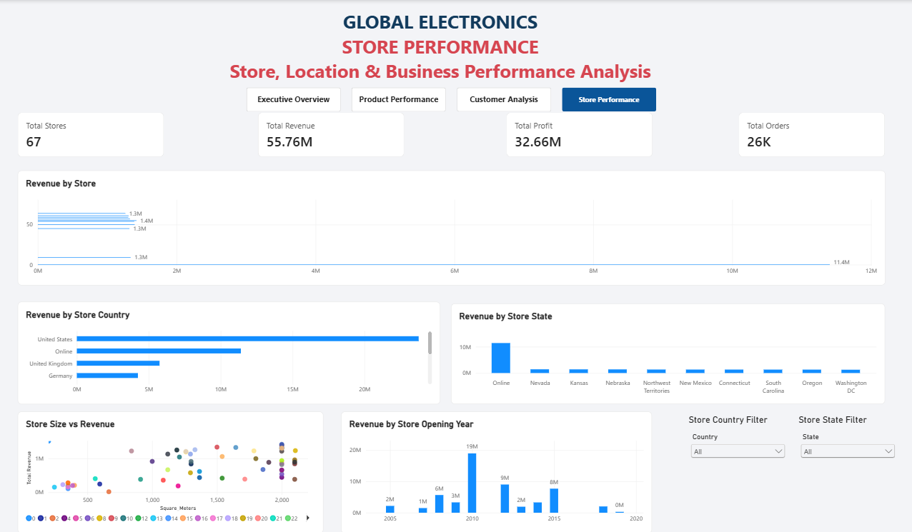
GLOBAL ELECTRONICS RETAIL DASHBOARD
Dashboard Page 4: Store & Footprint Performance
Physical Store Insights & Operations
• Online Channel Dominance: StoreKey 0 (Online Store) is the single highest individual outlet, generating $11.4M.
• Store Size vs Revenue Correlation: Scatter analysis showed that store size (Square Meters) does not directly drive revenue; geographic location density is the primary performance factor.
• Opening Cohort Analysis: Stores launched during the 2010 expansion cycle delivered the highest historical revenue ($19M).
• Store Network Scale: 67 retail locations distributed across North America, Europe, and Australia.

Slide 11
GLOBAL ELECTRONICS RETAIL DASHBOARD
Key Business Insights & Findings
01. Dominant Category
Computers
Generated ~$20M Revenue and ~$10M Profit, making it the primary financial pillar.
02. Robust Profit Margin
58.58% Overall
Maintained healthy commercial margins through disciplined wholesale purchasing.
03. Primary Geographic Market
United States
Produced $29.9M in customer purchases, outpacing all other international territories.
04. Top Performing Channel
Online Direct ($11.4M)
The digital storefront generated significantly more revenue than any single brick-and-mortar outlet.

Slide 12
GLOBAL ELECTRONICS RETAIL DASHBOARD
Conclusion & Future Enhancements
Project Summary
Successfully unified fragmented retail data into an analytical Star Schema, delivering self-service analytics with automated financial KPIs and geographic drill-downs.
Future Scope
• Predictive Demand Forecasting using Python & Time-Series algorithms.
• RFM (Recency, Frequency, Monetary) Customer Segmentation via DAX.
• Automated Data Refresh via Microsoft On-premises Gateway.
• Inventory Stockout & Buffer Reorder Alerts.
GitHub: github.com/Nithish-G/global-electronics-sales-dashboard

