Slide 1

CostLens
Platform cost is growing faster than usage. CostLens shows why, and what to switch off.
Hackathon · Track 04 · The Work Behind the Work | Nithish Khanna Solaiyalagu
Notes:
Hi, this is CostLens. Our track is The Work Behind the Work, and the problem we chose is platform cost growing faster than usage.

Slide 2



Cloud bills grow faster than the work they pay for
The bill shows cost, not value
Billing exports say what was charged, not whether the warehouse ran more queries or anyone used the GPU box.
29%
Problems surface weeks late
A resize "for one big job" or a runaway pipeline is noticed on the next invoice. The money is already gone.
of public cloud spend is wasted, up from 27% a year earlier
No owner, no fix
Untagged and forgotten resources sit outside every team's budget, so nobody switches them off.
Source: Flexera 2026 State of the Cloud Report
Notes:
Flexera's 2026 State of the Cloud report estimates about 29 percent of cloud spend is wasted, and it went up this year. Three reasons: the bill shows cost, not value; problems show up on the invoice weeks later; and resources without an owner never get fixed.

Slide 3




Four people feel this every month
Platform lead
Finance / FP&A
Data, analytics & ML teams
CTO / CFO
"Finance wants to know why the bill went up 30%. I can't map cost lines to the work they do."
"Cloud is one fast-growing line. I can't tell growth from waste, so I cut everyone or no one."
"We spin things up for real needs. Nobody tells us when they've sat idle for six weeks."
"Give me one number: how much can we remove without hurting anyone?"
Notes:
Platform leads, finance, the data and ML teams who create the resources, and the CTO and CFO who need one number. Each has part of the picture; none has cost and usage side by side.

Slide 4




CostLens puts cost next to usage for every resource
1 Connect
2 Detect
3 Act
Daily cost + usage per resource (one CSV)
Billing exports (FOCUS columns) mapped automatically
Usage: queries, task runs, reads, seats, utilisation
Cost index vs usage index shows the gap
7 transparent waste detectors
Spike detection that ignores lasting resizes
Each finding: evidence, owner, action, $ saved
Claude writes the summary and answers questions
Nightly CLI posts to Slack and CI
Notes:
Three steps. Connect: one daily table of cost and usage per resource. Detect: a cost-versus-usage index plus seven detectors and spike detection. Act: every finding comes with evidence, an owner, an action and a dollar figure.

Slide 5
Demo platform: cost +38%, usage -2% in six months
138
cost index
98
usage index
The red-over-teal gap is spend that usage does not explain. CostLens breaks it down to the resource that caused it.
Notes:
This is the included demo platform: 13 resources, 5 teams, 180 days. Cost tracked usage until August, then cost jumped while usage flattened and then fell. That gap is what CostLens explains.

Slide 6
$22.5k a month of fixable waste, each with evidence
ANALYTICS_WH resized in August
Cost +300%, queries +8%, utilisation 67% → 17%
$7.8k/mo
GPU training box idle 45 days
0 training jobs, 1.5% utilisation, still $6.4k/mo
$6.1k/mo
120 BI seats, 41% used on busy days
Reclaim inactive seats at renewal
$3.8k/mo
Notes:
Nine findings in total. The biggest: a warehouse resized for one job that never came back down, a GPU box idle for 45 days, and BI licences bought for 120 people when 41 percent are used even on busy days. Also a dev cluster running all weekend, cold data on hot storage and a VM with no owner.

Slide 7
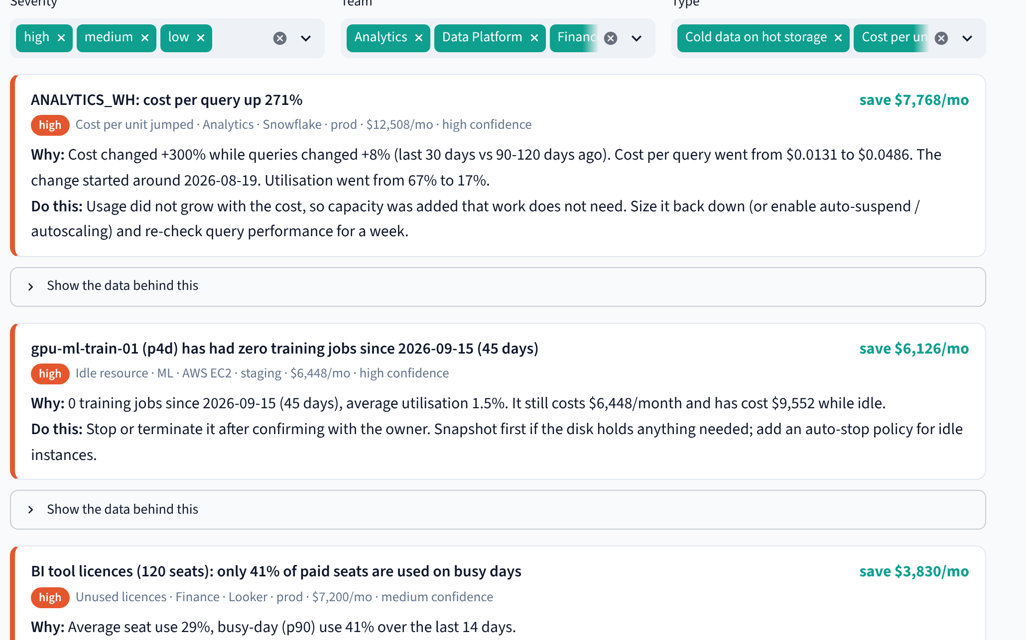



Every finding is ready to become a ticket
What
the resource and the problem in one line
Why
the numbers behind it, with a chart
Who
owner team, service and environment
Do this
a concrete, safe next action
Worth
monthly saving and confidence
Notes:
This is the Findings screen. Each card is a ticket: what, why, who owns it, what to do and what it's worth. Filters by severity, team and type, and CSV or Markdown export.

Slide 8
Transparent rules do the maths. Claude only explains
Inputs
Engine
Narrator
Outputs
Billing export (AWS, GCP, Azure, Snowflake, Databricks)
Usage counts per resource
Utilisation and seat use
Cost vs usage index
7 waste detectors
Robust spike detection
90-day forecast
Claude: summary + Q&A from computed numbers only
Offline rule-based fallback, no key needed
Streamlit web app
CLI for cron / Airflow / GitHub Actions
Slack, CSV, Markdown, JSON
Notes:
Pure Python: pandas for the engine, Streamlit for the UI. Every number comes from a readable rule. Claude writes the summary and answers questions but only from the computed snapshot, and if there is no key it falls back to an offline engine.

Slide 9

What it's worth on the demo platform
$22.5k
$270k
37%
$55.9k
per month of fixable waste
per year
of current spend
avoided next quarter, fixes phased in
9 findings across 13 resources and 5 teams, found in seconds.
The same review by hand is days of spreadsheet work, done quarterly at best.
Notes:
On the demo, 22.5 thousand dollars a month, 270 thousand a year, 37 percent of spend. Phasing fixes in over 30 days still avoids about 56 thousand dollars next quarter.

Slide 10





Built to be trusted by finance and engineering
Explainable
No double counting
Fewer false alarms
Plain rules with the evidence on every card. No black-box score.
One saving per resource: idle beats resize beats over-provisioned.
A permanent resize is a cost-per-unit finding, not 12 days of spikes.
Works offline
Tested
Open and portable
Every feature runs without an API key; Claude is an upgrade.
20 automated tests: every planted problem found, healthy resources quiet.
MIT licence, Docker image, runs on Streamlit Cloud or any VM.
Notes:
Why teams can act on it: explainable rules, no double counting, spikes separated from step changes, works offline, tested, and open source under MIT.

Slide 11


Next: from findings to realised savings
Native connectors
Snowflake ACCOUNT_USAGE, AWS CUR + CloudWatch, Databricks system tables
One-click tickets
Create a Jira or GitHub issue per finding, assigned to the owner team
Track realised savings
Confirm each fix in the next run and report dollars actually saved
Try it in 2 minutes: pip install -r requirements.txt && streamlit run app.py
Code, demo video and deployment guide: github.com/<your-username>/costlens
Notes:
Next we'd add native connectors, one-click tickets and tracking of realised savings. Everything is open source; the README gets you running in two minutes. Thank you.

