Slide 1
Prompt Engineering: Unleashing the Power of AI
Optimizing AI Interactions
Presented by :
B. NITHISHA
Htno : 2203A52004
Batch : 33
Guided by :
Dr. MAMATA PANDEY
Asst. Professor of CSE
SR University

Slide 2
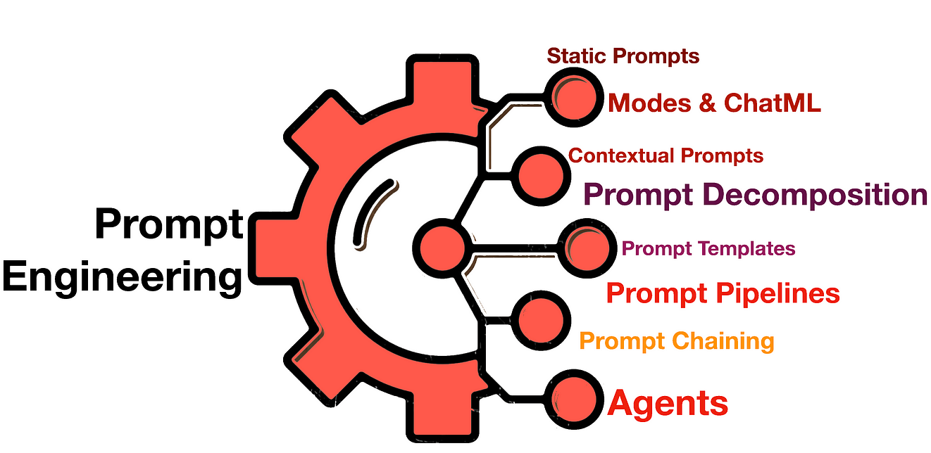

Slide 3
Introduction
Prompt engineering shapes AI interactions. It involves crafting precise instructions to optimize model responses, making it pivotal in AI development and fine-tuning outcomes."
Effective prompts are the cornerstone of AI interaction. They direct model behavior, ensuring accurate, relevant responses, and mitigating biases. Well-designed prompts are pivotal for AI's reliability and performance.

Slide 4
What is Prompt Engineering?
Prompt engineering is the process of crafting tailored instructions or queries for AI systems, influencing their behavior and optimizing outcomes in various applications and industries.
Prompt engineering guides AI behavior with tailored instructions, mitigating biases and producing more accurate, relevant results, vital for reliable and effective AI interactions in diverse applications

Slide 5
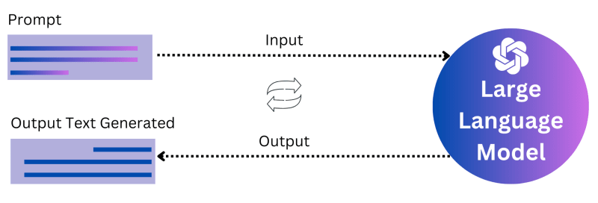
How Prompt Engineering works

Slide 6
The Significance of Prompt Design
Prompt design significantly influences AI outcomes. Well-crafted prompts lead to more accurate, relevant, and reliable responses, improving the overall effectiveness and usefulness of AI systems across applications.
Well-Designed Prompt : Clear, specific, and contextual instruction that guides AI effectively, resulting in accurate and relevant responses for user queries.
Poorly-Designed Prompt : Vague, ambiguous, or lacking context, making it difficult for AI to understand and generate relevant responses to user queries.

Slide 7
Examples on prompt designing
Here are examples of well-designed and poorly-designed prompts for an AI chatbot tasked with providing information about travel destinations:
Well-Designed: "Can you recommend budget-friendly travel options in Paris?"
This prompt is specific, clear, and provides context, making it likely to yield a relevant and helpful response.
Poorly-Designed: "Paris travel"
This prompt is vague and lacks context. It may result in a generic response or require additional clarification.

Slide 8
Types of AI Models
GPT (Generative Pre-trained Transformer) :Generative Pre-trained Transformer (GPT) is a powerful AI model for natural language processing and text generation.
Chatbots : Chatbots are computer programs designed to simulate human conversation, often used for customer service and support
Image recognition systems : Image recognition systems identify and interpret objects, patterns, or features in images through computer algorithms
Recommendation engines : Recommendation engines suggest products, services, or content based on user preferences and behavior analysis

Slide 9
Design Principles
Key principles for effective prompt design:
Clarity
Specificity
Contextualization
Ethical considerations

Slide 10
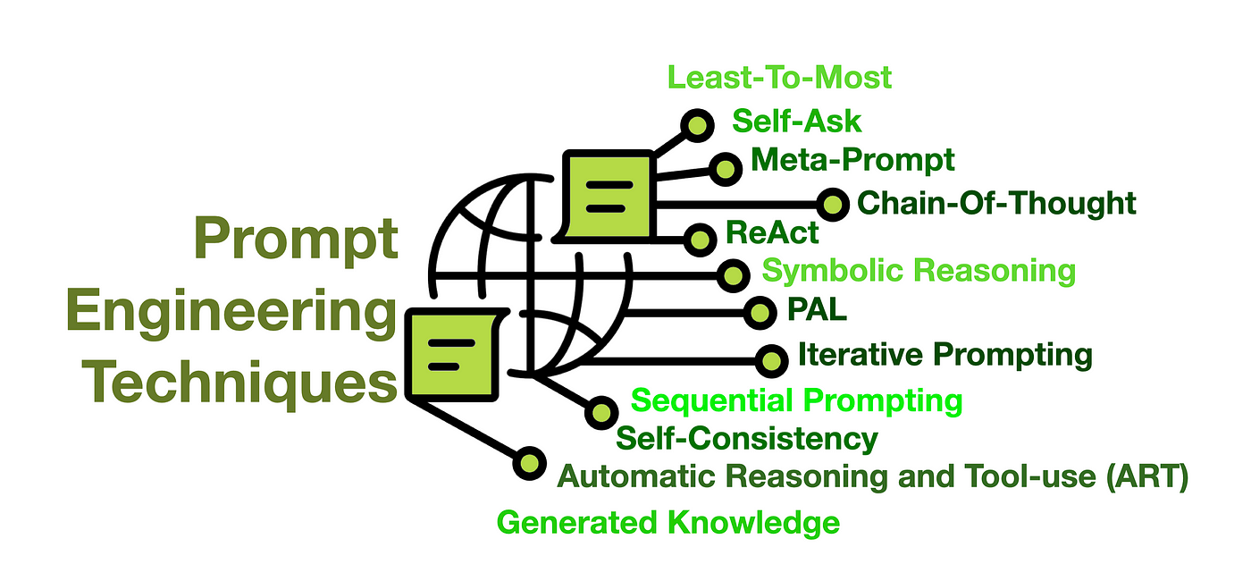

Slide 11
Ethical Considerations
Ethical implications of prompt engineering :Prompt engineering poses ethical concerns, including potential biases, manipulation of information, and shaping user perspectives. It demands responsible design to ensure fair, transparent, and unbiased AI interactions.
Bias: Prompt engineering can inadvertently introduce prejudices, leading to skewed or discriminatory AI outputs.
Misinformation: Poorly designed prompts may contribute to the generation or perpetuation of false or misleading information.
Harmful Content: Inadequate prompts can result in the production of offensive, inappropriate, or harmful content.

Slide 12
Tools for Prompt Engineering
Tools and platforms for prompt engineering include OpenAI's GPT API, Hugging Face's Transformers library, Google's TensorFlow, and custom API integrations for tailored AI interactions.
Popular tools for AI development include TensorFlow, PyTorch, scikit-learn, Hugging Face's Transformers, OpenAI's GPT API, and Microsoft Azure's Cognitive Services, among others, enabling diverse AI applications.

Slide 13
Best Practices
Iterative refinement :Process of progressively improving prompts through feedback, testing, and adjustments for optimal AI performance.
Collaboration with AI models :involves fine-tuning, using pre-trained models, and iteratively adjusting prompts based on model-generated outputs, enhancing performance and relevance of responses.
User feedback incorporation: User feedback incorporation in prompt engineering is the process of integrating user input to refine prompts, ensuring more accurate, relevant, and user-friendly AI responses over time, enhancing overall performance.

Slide 14
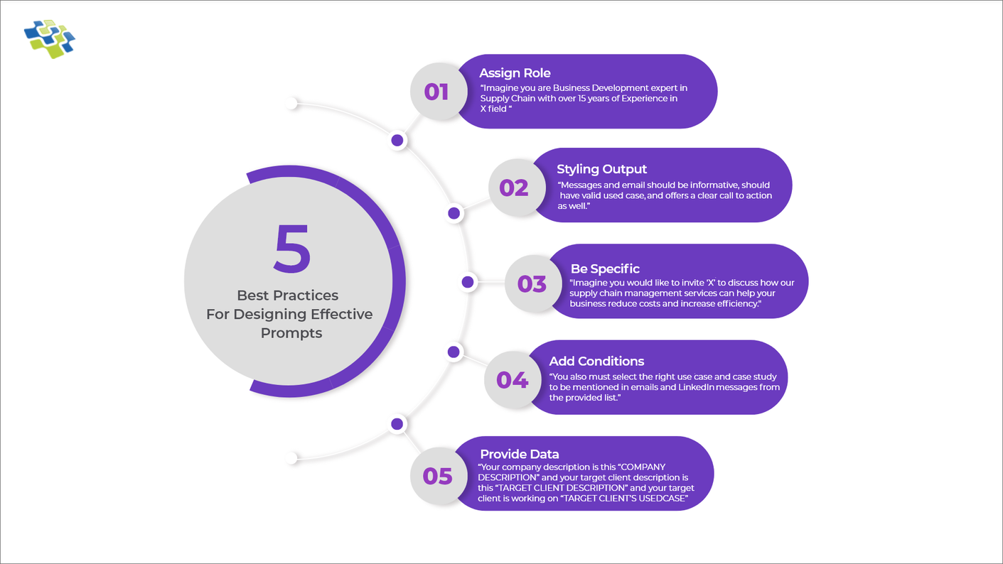

Slide 15
Real-world Applications
Healthcare :Crafting precise instructions for AI to generate accurate, contextually relevant medical information
Customer service : Crafting instructions for AI to provide accurate and helpful support responses."
Content generation :Crafting instructions for AI to create specific, relevant and engaging textual material."
Education :In education, prompt engineering involves creating tailored instructions for AI to deliver relevant and effective learning content

Slide 16
Challenges
Data Limitations: Insufficient or biased training data can lead to suboptimal performance and biased outputs.
Ambiguity and Vagueness: Ambiguous prompts may result in inaccurate or irrelevant responses from the AI.
User Intent Understanding: Deciphering complex or nuanced user intents can be challenging for AI models.
Ethical Considerations: Ensuring prompts align with ethical guidelines to avoid biases, misinformation, or harmful content.

Slide 17
Case Studies
Case Study 1: E-commerce Recommendation Engine
A major online retailer employed prompt engineering to refine product recommendation prompts. Context-rich instructions resulted in a 30% boost in click-through rates, driving higher sales and customer satisfaction.
Case Study 2: Healthcare Triage Chatbot
A hospital implemented prompt engineering for a triage chatbot. Clear, contextually-aware prompts led to a 25% reduction in unnecessary visits, optimizing healthcare resources and improving patient experience.

Slide 18
Future Trends
Multi-Modal Interactions: Combining text, images, and audio for more immersive and comprehensive AI interactions.
Continual Learning: Models refining prompts based on user feedback and real-time data for dynamic responses.
Ethical Prompt Guidelines: Stricter standards for prompt design to ensure responsible, unbiased AI behavior.
AI-Generated Prompts: AI systems suggesting prompts for improved user interactions and outcomes.
Contextual Adaptation: Models understanding and adapting to changing contexts for more nuanced responses.

Slide 19
Conclusion
Precision Matters: Well-crafted prompts are crucial for accurate, relevant, and reliable AI responses.
Iterative Refinement: Continual adjustments based on feedback lead to optimized prompts and interactions.
Ethics and Transparency: Responsible prompt engineering ensures fairness, accountability, and user trust in AI interactions.
Responsible prompt engineering safeguards against biases, misinformation, and harm, ensuring ethical, accurate, and trustworthy AI interactions for all users

Slide 20
THANK YOU

