Slide 1





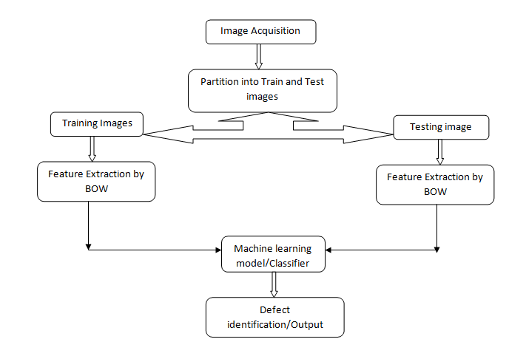
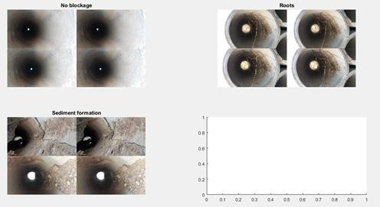
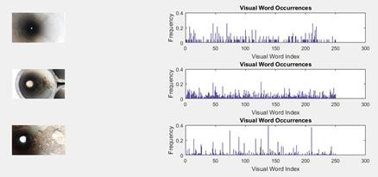
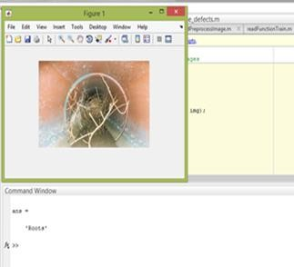




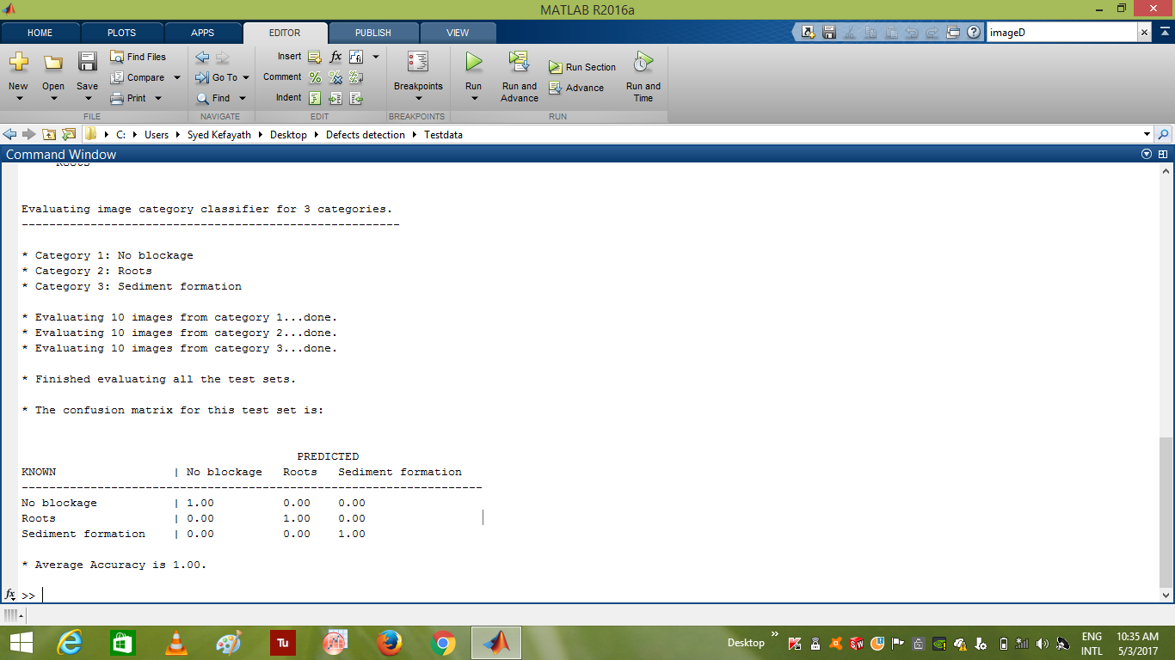



x AXXXXXX XXXXXXXXXXXXX XXXXXXXXXXXXXXXXXXXX XXXXXXXXXXX XXXXXXXXXX XXXXXXX XXXXXXX XXXXXXXXXXXX XXXXXXXXXXXXXXX XXXXXX XXXXXX
XXXXXXXXXXX XXXXXX XXXXXXXXXX XXXXXXX XXXXX XXXXX XXXXX XXXXXXXXXXXXXXXXXXXXXX XXX XXXXXXXXXX XXXXXXXXXX XXXXXXXXXX
SEWAGE PIPELINE BLOCKAGE DETECTION USING FEATURE EXTRACTION
` Automated Sewage D
RESULTS
ABSTRACT
rain Block Identification System
METHODOLOGY
All over globe, technologies are being developed for various detection of obstacles and specially when it comes to block identification in sewage systems, numerous advancements and varieties are being observed in acoustic, ultrasonic, infrared rays, etc. But all these leads to block identification only by size and position but not exactly what the block is all about. In this project, we discuss how to identify and classify what block is being detected specially in Indian sewage system. Advanced technologies like image processing and artificial intelligence algorithms will be used to achieve this goal considering suitable load environments.
PROBLEM STATEMENT
Sewer blockage problem is a big issue with huge population and poor sewer planning.
Frequent choking of lines leads to sewage accumulation, foul smell and health hazards.
A cheap and feasible system is required to identify area and nature of block.
To automate the identification system for better comfort of operator.
CONCLUSION
CONFUSION MATRIX
The identification of the block on a sewage pipeline can be done using feature extraction technique and the input mage is classified as no blockage, roots and sediments using SVM algorithm.
OBJECTIVES
By
NITHISHA BOYAPATI
To develop a simple system for object identification in sewer lines.
To facilitate cheap and best system for Indian sewage pipes.
To reduce load on operator and achieve results without compromising on work quality.
To automate the process of block identification
.

