Slide 1






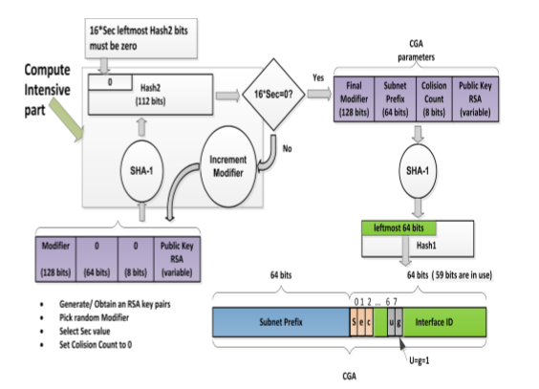


SECURED AUTO-CONFIGURATION USING IPv6 ADDRESS GENERATION
UNER THR GUIDANCE OF : By
Dr. Neelanarayanan V Nithisha Boyapati
`
ABSTRACT
ALGORITHM FOR CRYPTOGRAPHICALLY GENERATED ADDRESSES
CGA GENERATION IN SeND
The usage of Internet Protocol Version (IPv6) is drastically increasing now a days due to the scarcity of addresses for existing protocol. Several threats for security is faced by this protocol and is also under research for many years. IPsec does not support communication over link local though it is compulsory to communicate in end-to- end for IPv6 security. While dealing with auto-configuration security issues over link local are said to be important. SeND an existing mechanism provides security for auto-configuration also faced some issues that are related to complexity of an algorithm, functionality implications of a router and generation of key. Security problems in IPv6 not only effects auto-configuration but also causes disturbances in most of the networks during service delivering.
Modifier is to be set to a 128 bit value of random or pseudo random bits.
The messages that are sent by each neighboring node is analyzed by new node.
The public key that is encoded, any chosen fields that are extended and nine zero octets are to be concantenated from left to right in the modifier. Execution of SHA-1 algorithm on concatenation is done. Collect 112 leftmost bits of SHA-1 hash value which is the result of hash2.
Comparision of 16*sec left most bits of hash2 with zero is done. If the output is zero, continue with same step else modifier incrimination by one I done ad return to step2.
Collision count of 8 bit is set to Zero.
Prefix of subnet, public key that is encoded, count of collision and chosen fields of extension are to be concatenated in the final modifier from right to left. SHA-1 algorithm on concatenation is executed. Collect leftmost 64 bits of SHA-1 hash value which is the
output of Hash1.
Interface identifier is formed from hash1 by writing the sec value to three left most bits and setting sixth and seventh bits to zero.
To form 128 bit address of IPv6 with the prefix of subnet to the left and interface identifier in the right 64 bit interface identifier and 64 bit prefix of subnet should be concatenated which gives standard IPv6 addresses.
Return to step5 by incrementing count of collision to one if any detection of address collision is found on preforming duplicate detection for addresses. Report and stop the error after three collisions.
By concatenation of left to right, the prefix of subnet, final value of collision count, public key that is encoded final value of modifier and any opted extended fields data structure for CGA parameters are formed.
INTROUCTION
In order to deal with the problem of limited address size
Internet Engineering Task Force (IEFT) developed IPv6. The addresses are not enough because of 4-byte addresses. The address length in IPv6 is increased to 128 bits, which will be sufficient to have a different address for every person, thing or place practically. IPSec an end to end mechanism provides security and integrity for data which is lagging in IPv4.
There is a belief that IPSec will take care of issues regarding security over transmission of packets, thus while developing protocol mechanisms of security for different layers were ignored including security of link local that uses neighbor discovery protocol is the main concern of this project.
CONCLUSION
IPv6 has a method for secured auto configuration of their own
addresses via cryptographically generated addresses (CGAs)
for devices. Without depending on any trusted authority the
necessary ownership proof for IPv6 address is provided by
CGAs. By the security parameter used for high level security
the computation of CGA is very high. Due to the high cost in
generation of addresses the usage of high sec values is
refrained in this technique by challenging the CGA usage for
secured auto configuration in several systems. Thus the
HAVEGE algorithm has been implemented to overcome the
challenges posed by the CGA. Through minimized
computations high rate of randomness is possessed by
HAVEGE by ensuring high secured auto configuration
process for stateless addresses.

