Slide 1
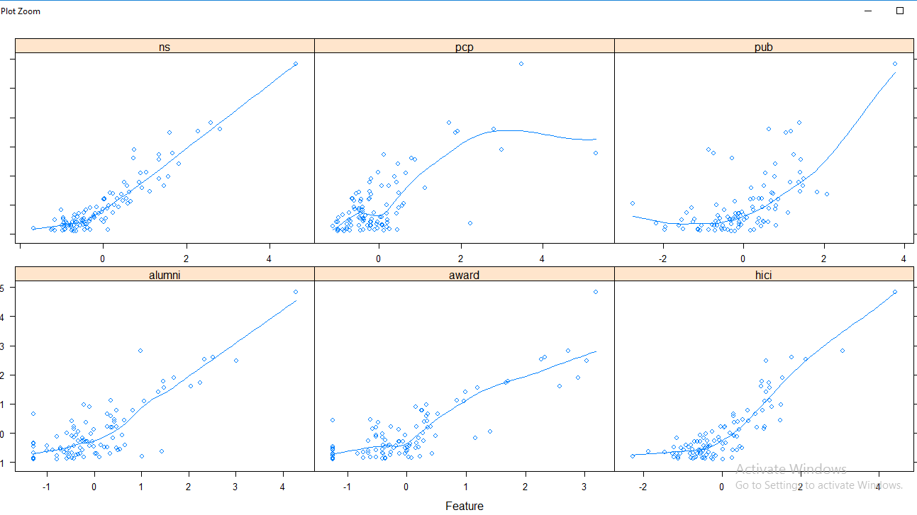
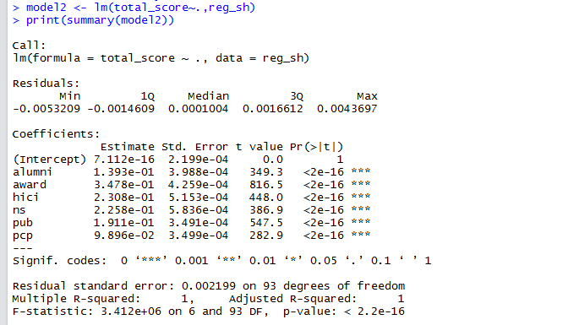
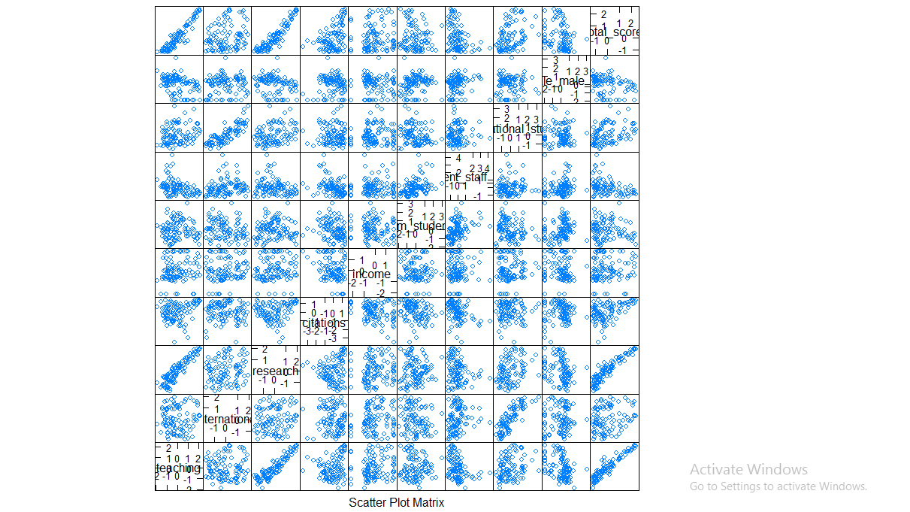
WORLD UNIVERSITY RANKINGS
NITHISHA BOYAPATI
Objective
TOOL USED
Ranking universities is a difficult, political, and controversial practice. There are hundreds of different national and international university ranking systems, many of which disagree with each other.
The objective is to find out the factors that really make an educational institution ranks higher than the other institution. This can be done by performing exploratory and regression analysis on the different ranks of world universities.
Tool used: R Studio
Work Flow:
Preprocessing of data.
Normalizing each variable in data frame to obtain more scientific result.
Regression summary
Creation of plots.
Report
RESULTS
Introduction
GRAPHS
The dataset chosen contains three global university rankings from very different places.
University Ranking Data
The Times Higher Education World University Ranking is widely regarded as one of the most influential and widely observed university measures. It has been criticized for its commercialization and for undermining non-English-instructing institutions.
The Shanghai Ranking, is an equally influential ranking. It was criticized for focusing on raw research power and for undermining humanities and quality of instruction.
The Center for World University Rankings, is a less well know listing that comes from Saudi Arabia.
CONCLUSION
By applying regression and exploratory analysis, the factors that make an education institute ranks higher can be found out.

