Slide 1
Digital Portfolio
STUDENT NAME:Nithisha.D
REGISTER NO AND NMID: asunm2401111033026
DEPARTMENT:BCA
COLLEGE:L.N.government college Madras University

Slide 2
PROJECT TITLE
Digital Portfolio

Slide 3


AGENDA
Problem Statement
Project Overview
End Users
Tools and Technologies
Portfolio design and Layout
Features and Functionality
Results and Screenshots
Conclusion
Github Link
3/21/2024 Annual Review

Slide 4

PROBLEM STATEMENT
Describes the issue the project is trying to solve. It explains why the problem is important and relevan

Slide 5

PROJECT OVERVIEW
Gives a summary of the project’s objectives. Explains how the project will address the problem and what its goals are.

Slide 6

WHO ARE THE END USERS?
Identifies who will benefit from or use the project. These could be students, companies, clients, or other target groups.

Slide 7

TOOLS AND TECHNIQUES
Lists the programming languages, frameworks, tools, or software used. May include development environments, databases, cloud services,

Slide 8
POTFOLIO DESIGN AND LAYOUT
Covers how the project is structured and presented. Focuses on UI/UX, navigation, responsiveness, and aesthetic appeal.
8

Slide 9
FEATURES AND FUNCTIONALITY
Explains what the project can do. Highlights user interactions, key modules, and value propositions.

Slide 10
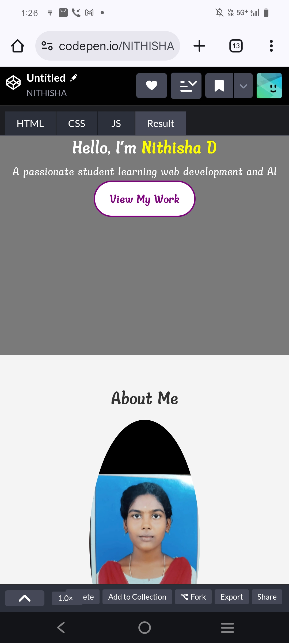
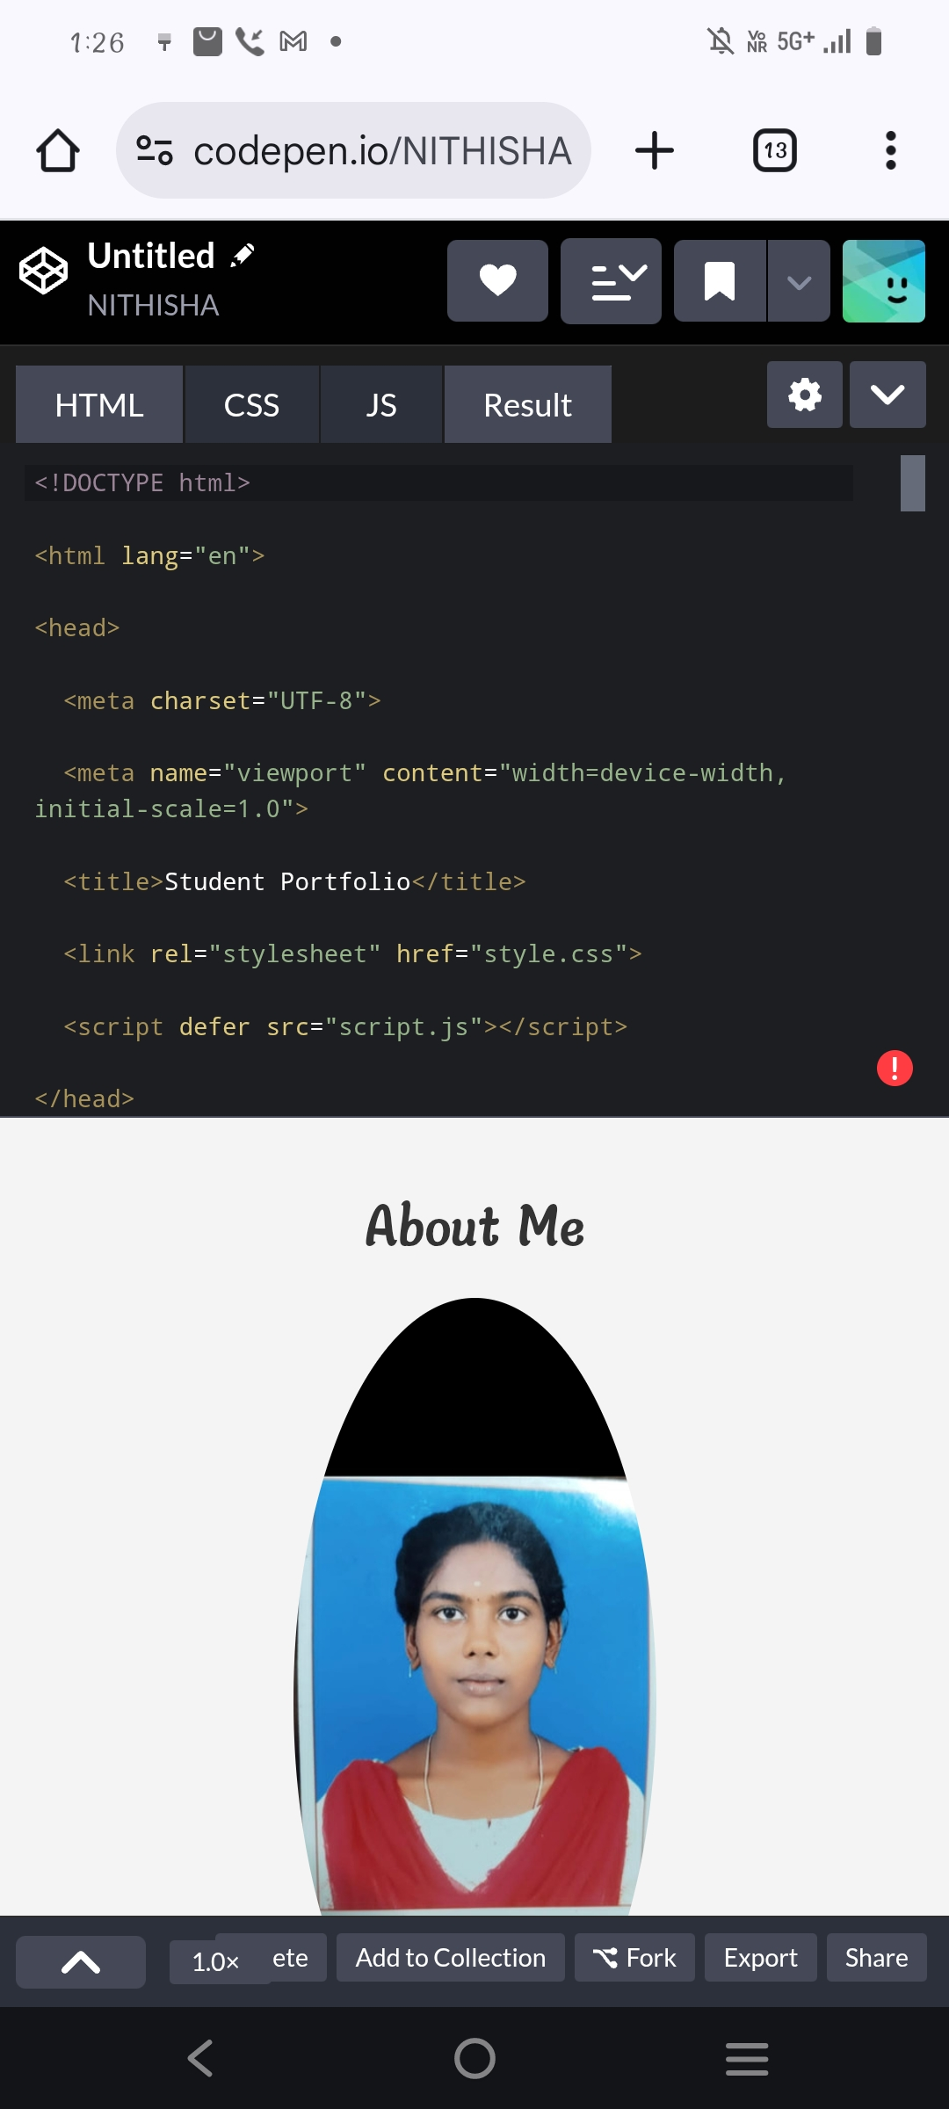

RESULTS AND SCREENSHOTS
3/21/2024 Annual Review
10

Slide 11
CONCLUSION
Summarizes what has been achieved.
Discusses learnings, challenges, improvements, and possible future directions.
11

Slide 12
Github link
https://nithishad2007.github.io/Nithisha/

