Slide 1
Nithish D B.Tech AI&DS SINCET
Naan Mudhalvan Project

Slide 2
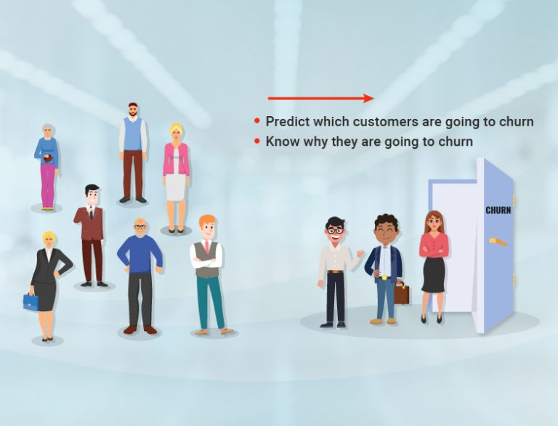
CUSTOMER CHURN PREDICTION USING ANN

Slide 3


AGENDA
Data Collection: Gather comprehensive customer data including demographics, transaction history, service usage, and feedback.
Feature Engineering: Extract relevant features such as customer tenure, frequency of interactions, and recent activity to build predictive variables.
Model Selection: Employ machine learning algorithms like logistic regression, random forests, or gradient boosting to train predictive models on historical churn data.
Evaluation Metrics: Assess model performance using metrics such as accuracy, precision, recall, and F1-score to ensure robustness and reliability.
Deployment: Implement the chosen model into operational systems to continuously monitor and predict churn, enabling proactive retention strategies.
Iterative Improvement: Regularly update the model with new data and refine strategies based on feedback to enhance predictive accuracy and maintain effectiveness over time.
3/21/2024 Annual Review

Slide 4

PROBLEM STATEMENT
The rise of e-commerce platforms has revolutionized the way consumers shop, providing convenience and accessibility like never before. However, one of the critical challenges faced by these platforms is customer churn, where customers cease to engage with the platform, leading to revenue loss and diminished market share. Understanding the factors contributing to customer churn and developing predictive models to anticipate and prevent churn is paramount for sustaining business growth and fostering customer loyalty.

Slide 5

PROJECT OVERVIEW
Customer churn prediction using Artificial Neural Networks (ANN) involves training a deep learning model on historical customer data to forecast potential attrition.
ANN analyzes patterns, behaviors, and interactions to predict churn, aiding businesses in proactively implementing retention strategies and improving customer satisfaction

Slide 6

WHO ARE THE END USERS?
Telecommunications Companies
Subscription-Based Services
Retailers
Financial Institutions
Insurance Companies
E-commerce Platforms
Utilities Companies
Gaming Industry

Slide 7
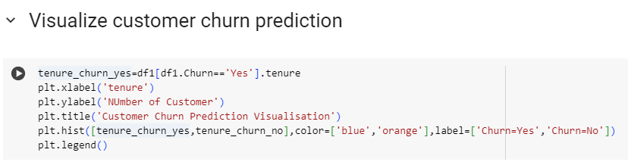
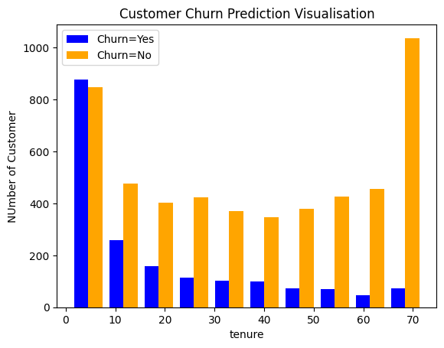
YOUR SOLUTION AND ITS VALUE PROPOSITION

Slide 8
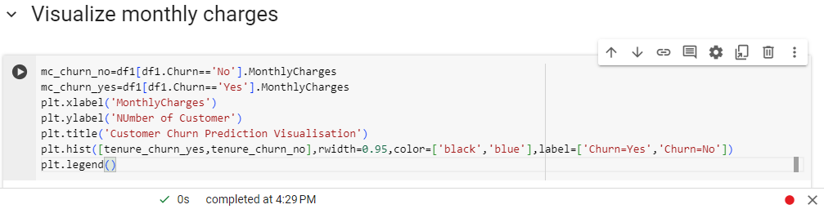
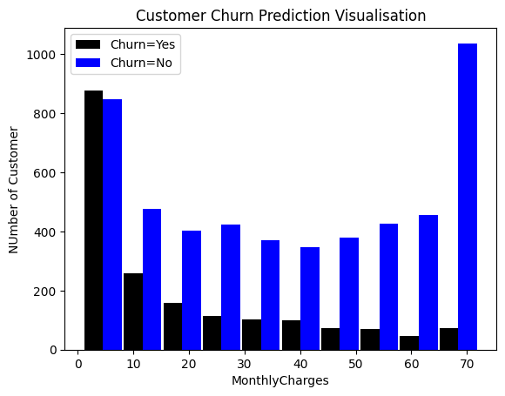
THE WOW IN YOUR SOLUTION
Monthly charges:
8
Notes:
Monthly charges

Slide 9
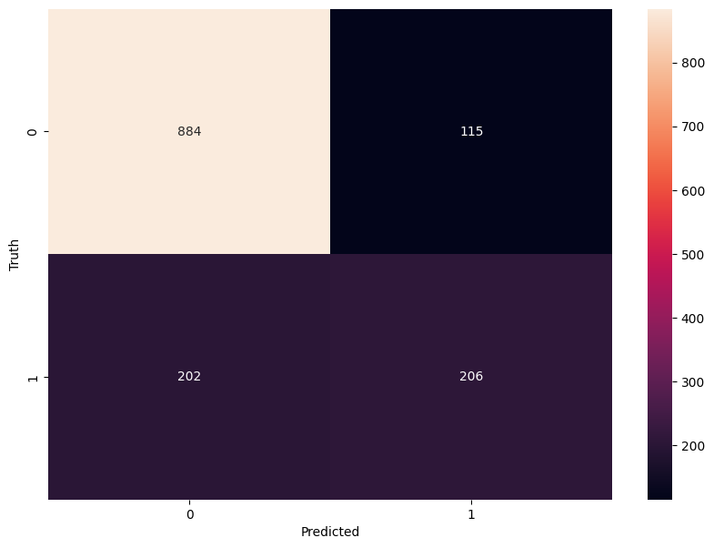
FINAL RESULTS
Implementing confusion matrix:
9
Notes:
Implementing confusion matrix

