Slide 1
CAUSAL INFERENCE PROJECT
Movie Revenue Driver Analysis Using Causal Models
What actually drives box-office revenue: budget, franchise status, or something else?
NITHISHKUMAR P github.com/Nithishey
Python | Causal inference | Streamlit | Power BI
Notes:
Introduce the project: the goal is to separate the true effect of budget and franchise status on revenue from the effect of other factors that move together with them.

Slide 2
Why causal analysis, not just prediction?
Correlation says big-budget movies earn more.
But big budgets also come with franchises, recent release years, English-language films and certain genres. Those raise revenue on their own.
Causal analysis asks: how much would revenue change if only the budget changed?
Q1 Budget
How much does a higher budget change revenue?
1
2
Q2 Franchise
How much does being part of a collection change revenue?
3,000
movies
23
columns
2
causal questions
NITHISHKUMAR P | Movie Revenue Driver Analysis
Notes:
Key idea: correlation mixes the budget effect with other effects. Causal methods adjust only for the right variables.

Slide 3
Data audit and cleaning
27% of budgets are 0
Set to missing, kept a budget_missing flag
2-digit years (2/20/15)
Corrected to 1921 to 2017, no 2060s dates
Nested JSON-like text
Parsed genres, cast, crew into counts, flags, dummies
Revenue heavily skewed
log(1 + revenue): skew 4.5 down to -1.6
57 movies report revenue under $1,000 (likely errors); sensitivity tested later.
NITHISHKUMAR P | Movie Revenue Driver Analysis
Notes:
These cleaning decisions matter: treating zero budgets as missing and fixing the 2-digit years prevent biased results.

Slide 4
EDA: what the raw data shows
0.66
correlation of log budget and log revenue
$67.4M vs $11.4M
median revenue, franchise vs standalone
Dec, Jun, Jul
strongest release months
Descriptive only: correlation, not causation.
NITHISHKUMAR P | Movie Revenue Driver Analysis
Notes:
These are descriptive comparisons. They motivate the causal question but do not prove causation.

Slide 5
Causal graph: what to adjust for
confounders also affect revenue directly
Confounders: adjust
Era (release year)
Genre
Budget
(treatment)
Revenue
(outcome)
Language / country
Franchise
Cast size
Popularity
Grey nodes are consequences of budget (and popularity of revenue). Adjusting for them biases the budget effect, so they are excluded.
NITHISHKUMAR P | Movie Revenue Driver Analysis
Notes:
Blue variables cause both budget and revenue, so we adjust for them. Cast size and popularity are consequences of budget, so adjusting for them would bias the estimate.

Slide 6
Methods
1
Backdoor adjustment
2
Weighting (IPW)
OLS of log revenue on log budget plus confounders (era, genre, language/country, franchise). Robust (HC1) standard errors.
Propensity score for franchise status; re-weight so groups look alike. 200-sample bootstrap confidence interval.
3
Balance check
4
Refutation tests
Standardised mean differences before and after weighting; maximum about 0.11 after weighting.
Placebo treatment, random common cause, 80% subsets and revenue-filter sensitivity. Optional DoWhy cross-check.
NITHISHKUMAR P | Movie Revenue Driver Analysis
Notes:
Two different estimators agree on the franchise effect, which makes the result more trustworthy. Refutation tests try to break the estimate.

Slide 7
Results: budget and franchise effects
Budget
0.70
95% CI 0.57 to 0.83. A 10% higher budget goes with about 6.9% higher revenue.
Franchise
about 4x
Raw gap 1.81 falls to 1.38 log points after adjustment; IPW gives 1.35.
NITHISHKUMAR P | Movie Revenue Driver Analysis
Notes:
Adjusting for confounders lowers the budget estimate from 0.78 to 0.70. Adding consequences of budget lowers it further to 0.56, which is biased.

Slide 8
Do the results survive stress tests?
Test | Result | Verdict
Placebo (shuffle budget) | -0.001, range -0.047 to 0.043 | Pass: effect near 0
Random common cause added | 0.703 unchanged | Pass
80% random subsets (200x) | 0.700, range 0.653 to 0.773 | Pass: stable
Revenue filter: $1 / $1,000 / $100,000 | 0.82 / 0.70 / 0.59 | Sensitive: report a range
Bad controls (+ popularity, cast size) | 0.56 | Biased: excluded by design
Heterogeneity: the budget effect is larger for films released in 2000 or later (0.79) than before 2000 (0.54).
NITHISHKUMAR P | Movie Revenue Driver Analysis
Notes:
Placebo, random-confounder and subset tests pass. The revenue filter changes the estimate, so we report a range. Bad controls bias the estimate, which is why the DAG matters.

Slide 9
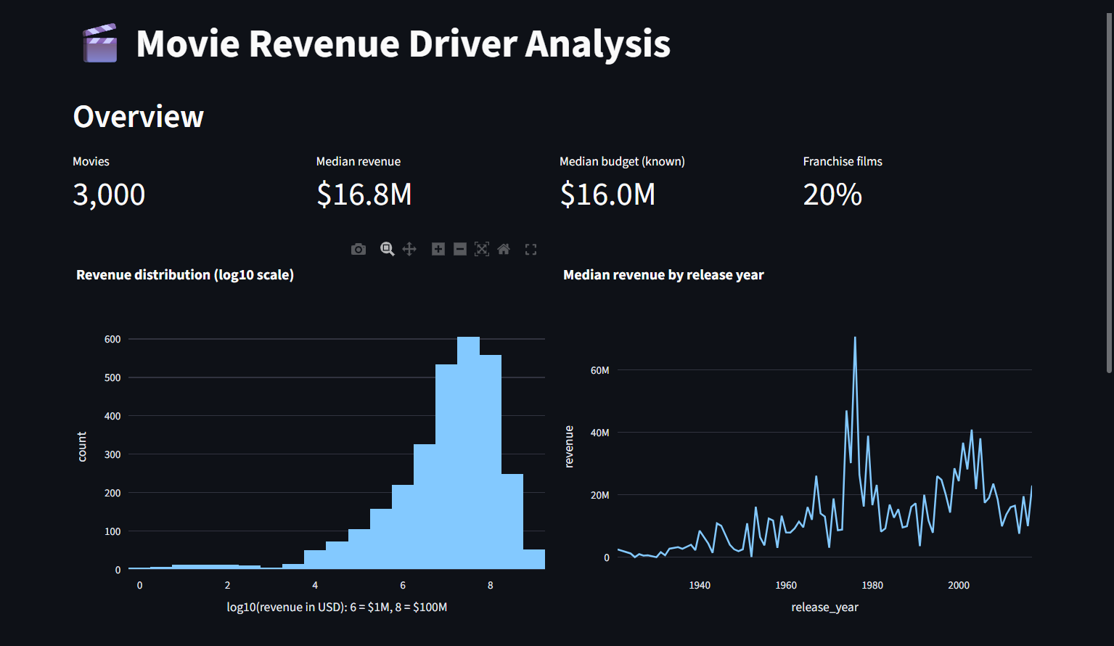
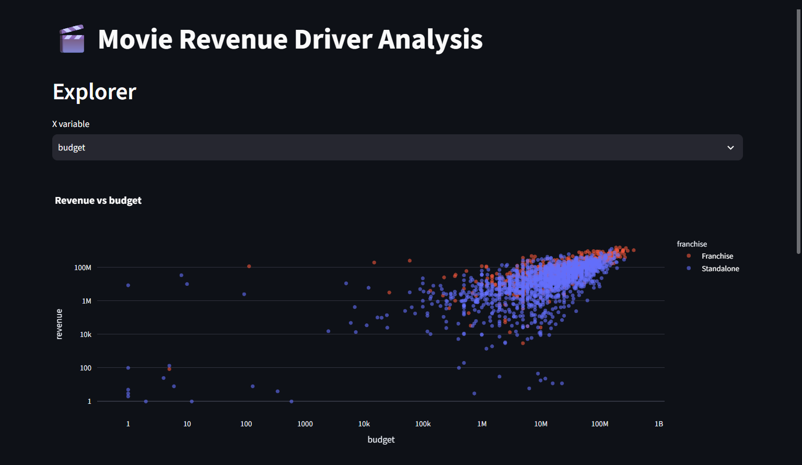
Streamlit: Overview and Explorer
Overview: KPIs, revenue distribution (log10), median revenue by year
Explorer: revenue vs budget on log axes, franchise (red) vs standalone (blue)
4 pages
Sidebar filters
Extras
Stack
Overview, Explorer, Causal results, Budget what-if
Years, genres, known budget, franchise
Top 10 table, CSV download
Streamlit, Plotly, pandas, caching
NITHISHKUMAR P | Movie Revenue Driver Analysis
Notes:
The app has four pages with sidebar filters. It loads the cleaned data once using caching. The histogram bins revenue in log10 space so the skew is visible.

Slide 10
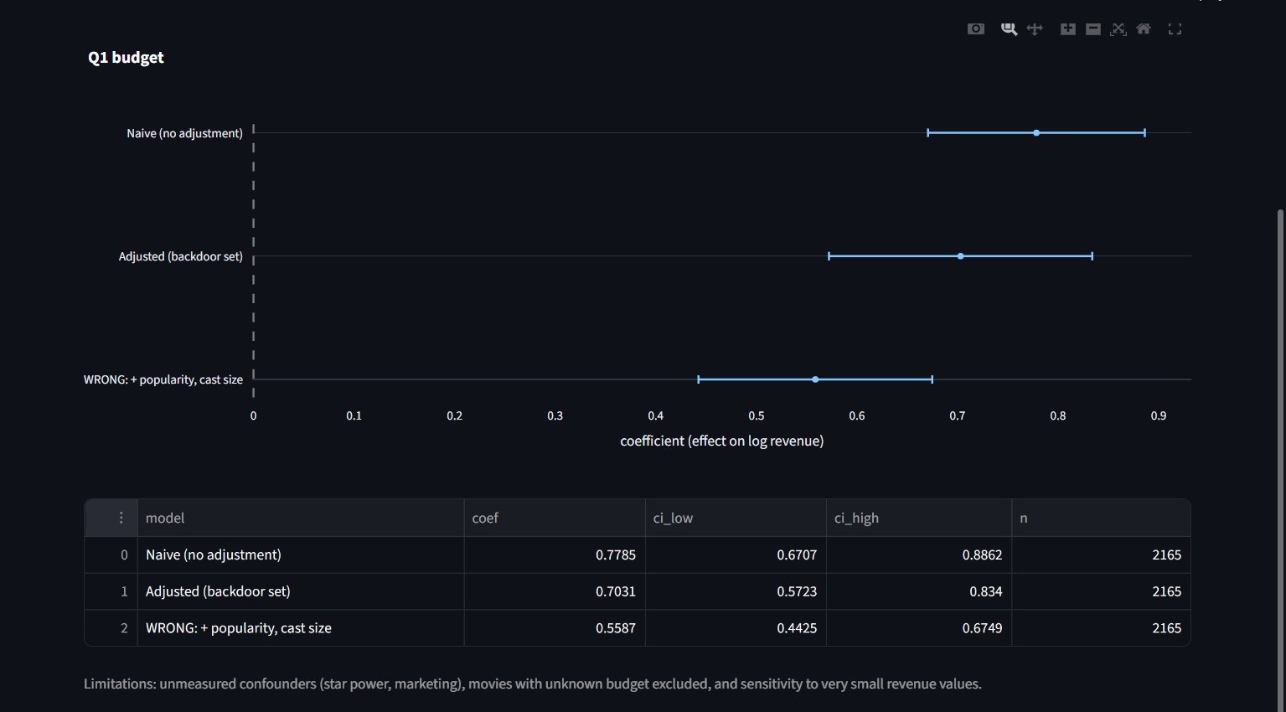

Streamlit: causal results and what-if
Budget what-if: $20M to $30M gives about +33% (26% to 40%)
How the what-if works
Revenue change = (new budget / current budget) ^ 0.70 - 1
The interval uses the elasticity limits 0.57 to 0.83.
Causal results: forest plot (x-axis = coefficient on log revenue) and table
NITHISHKUMAR P | Movie Revenue Driver Analysis
Notes:
The what-if page converts the adjusted budget elasticity into an expected revenue change with a 95% interval. It is an average effect, not a guarantee.

Slide 11
Power BI dashboard
Overview
Drivers
Causal results
4 KPI cards, 3 slicers, median revenue by year, genre and budget band
Budget vs revenue scatter (log axes), franchise vs standalone, release month
Estimates table and chart, budget what-if slider, interpretation notes
Data model
Key DAX
movies (3,000 rows)
movie_genres (7,511 rows) linked one-to-many, filters both ways
causal_results (14 rows), standalone
Median Revenue (M) =
DIVIDE(MEDIAN(movies[revenue]), 1000000)
Revenue Change % =
(1 + [Budget Change %] / 100) ^ [Elasticity] - 1
NITHISHKUMAR P | Movie Revenue Driver Analysis
Notes:
Three report pages built on a small data model. The what-if parameter links directly to the causal estimate from the notebook.

Slide 12
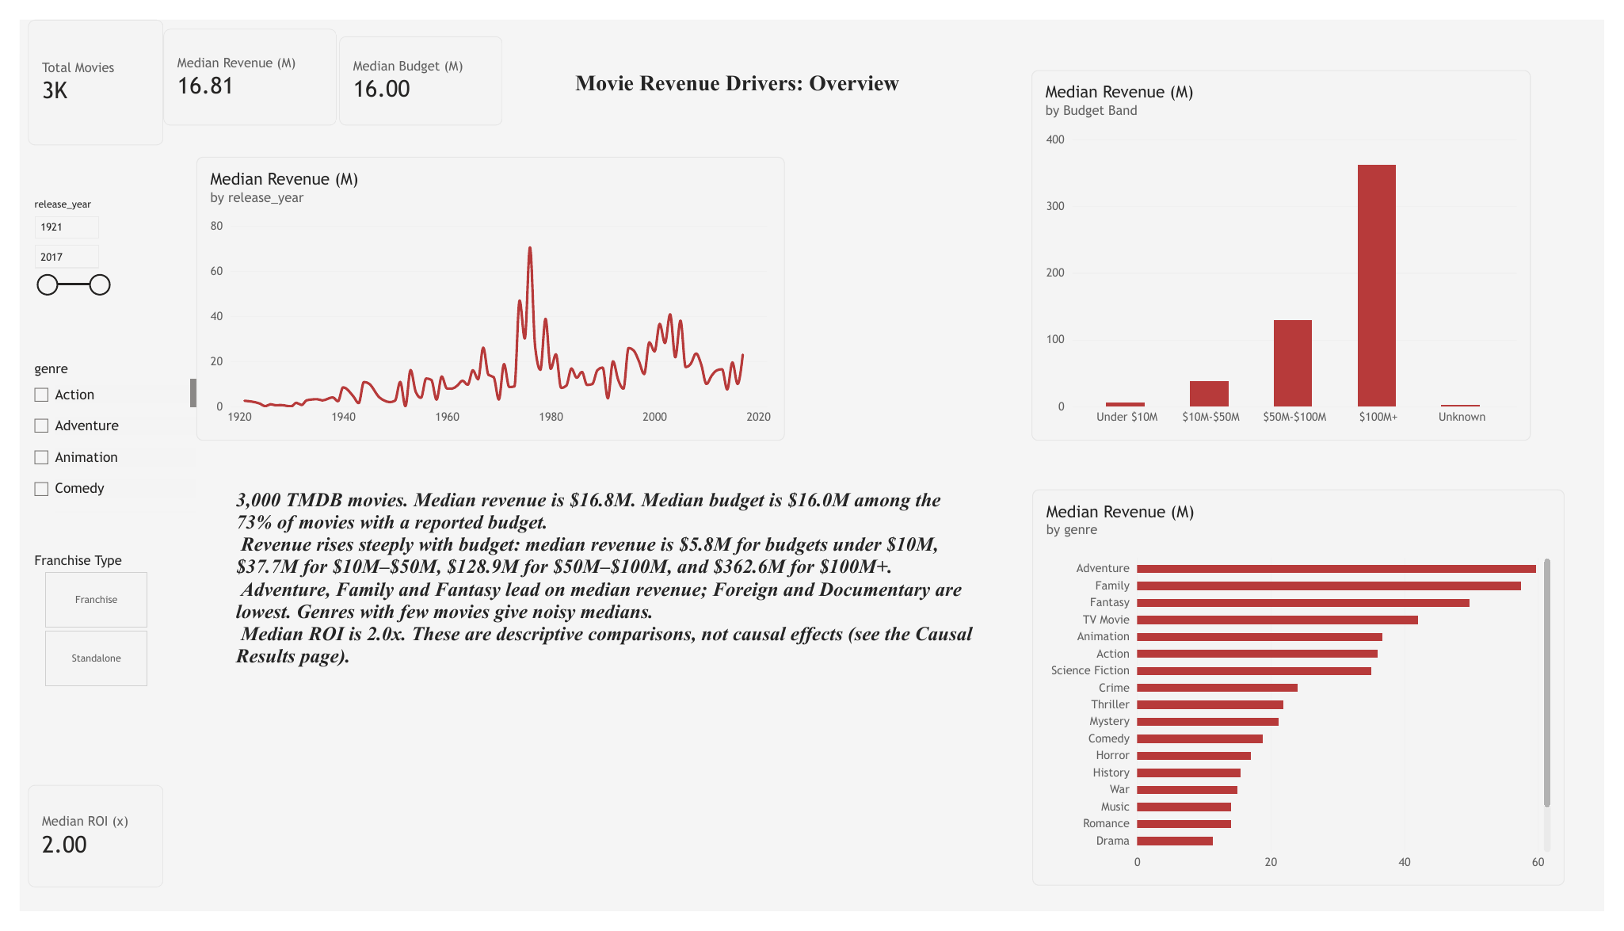
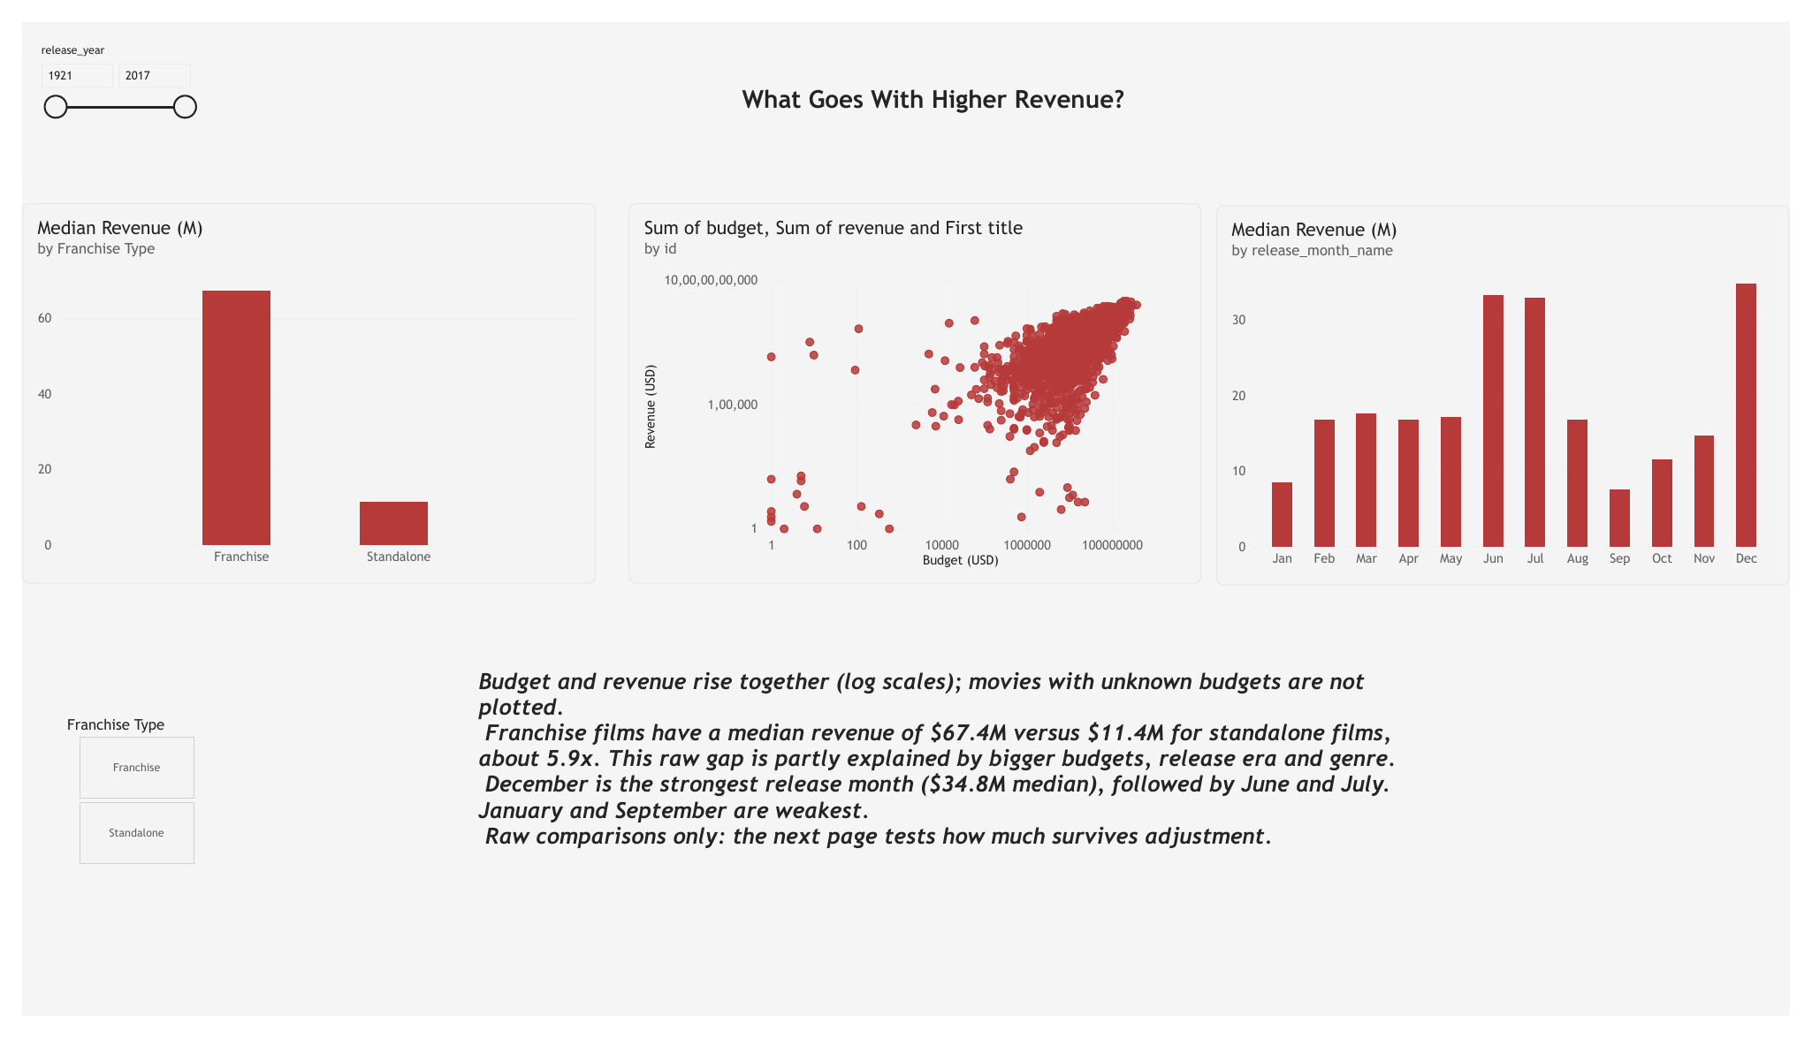
Power BI: Overview and Drivers pages
Overview: KPIs, slicers, revenue by year, genre, budget band
Drivers: budget vs revenue, franchise, release month
Raw findings: median revenue $16.8M overall; franchise $67.4M vs standalone $11.4M (5.9x); December, June and July are the strongest months. The next page tests how much of this survives adjustment.
NITHISHKUMAR P | Movie Revenue Driver Analysis
Notes:
Both pages use the full dataset (all slicers cleared). Franchise films have a much higher median revenue than standalone films, and December, June and July are the strongest release months. These are descriptive comparisons.

Slide 13
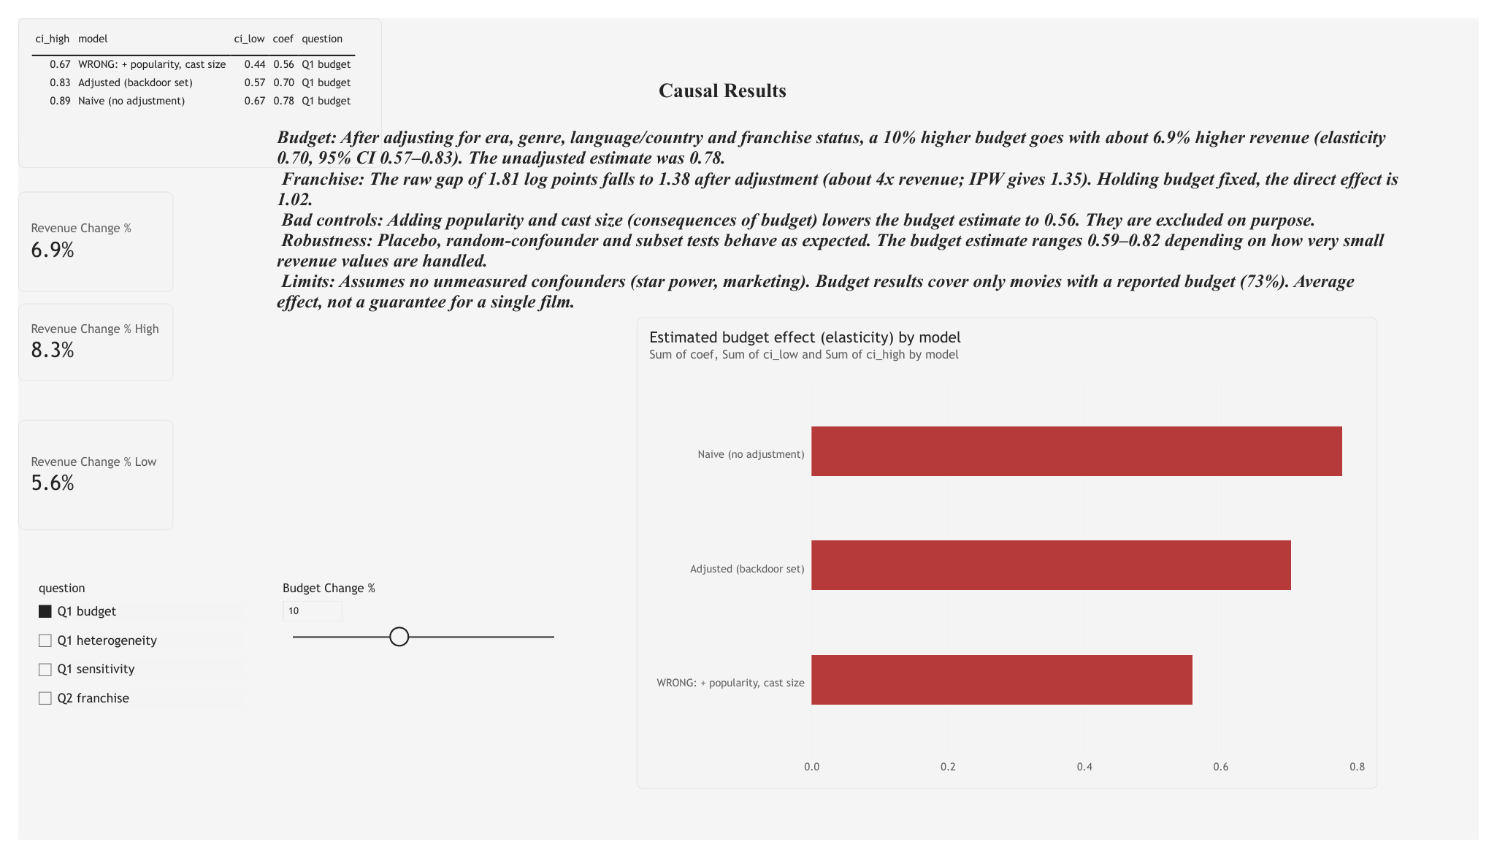
Power BI: Causal Results page
On this page
Table and chart of estimates, filtered by question
Budget Change % slider
Cards: 6.9% central, 5.6% to 8.3% range at +10%
Notes on assumptions and limits
Power BI Desktop export, Causal Results page (budget change slider at +10%)
NITHISHKUMAR P | Movie Revenue Driver Analysis
Notes:
This page links the notebook's causal estimates to an interactive what-if slider. At +10% budget change the central estimate is 6.9% revenue change, with a range of 5.6% to 8.3%.

Slide 14
Conclusion
1
Budget matters, less than raw numbers suggest
Adjusted elasticity 0.70, down from 0.78 unadjusted.
2
Franchise status is a large driver
About 4x revenue after adjustment (raw medians show 5.9x).
3
What you adjust for changes the answer
Controlling for popularity and cast size biases the estimate.
Limitations: unmeasured confounders (star power, marketing), 27% of budgets unknown, sensitivity to tiny revenue values, and results rest on the assumptions in the DAG.
Notes:
Close with the three takeaways, then state the limitations honestly. Offer to demo the Streamlit app and Power BI dashboard.

