Slide 1
Image Classification using Convolutional Neural Networks Presented by A Nithish kumar

Slide 2
Agenda
Introduction
What we see vs. What computers see (MNIST and CIFAR Datasets)
Hand-Crafted Features for Image Classification
Deep Learning
Convolutional Neural Networks (CNNs)
Architecture (Convolutional, Pooling, and Fully Connected Layers)
Successful CNN Architectures
Training
Backpropagation
Overfitting, Regularization and Dropout
Slide 2

Slide 3
Agenda
Introduction
What we see vs. What computers see (MNIST and CIFAR Datasets)
Hand-Crafted Features for Image Classification
Deep Learning
Convolutional Neural Networks (CNNs)
Architecture (Convolutional, Pooling, and Fully Connected Layers)
Successful CNN Architectures
Training
Backpropagation
Overfitting, Regularization and Dropout
Experiments Transfer Learning Complex Networks
Slide 3

Slide 4
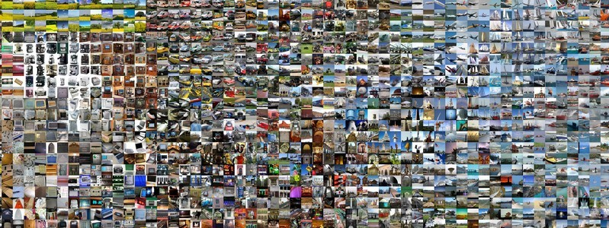
Introduction
Image classification is the task of taking an input image and outputting a class or a probability of classes that best describes the image
For humans, this task is one of the first skills we learn and it comes naturally
and effortlessly as adults
Being able to quickly recognize patterns, generalize from prior knowledge, and adapt to different image environments are difficult tasks for machines
Slide 4

Slide 5
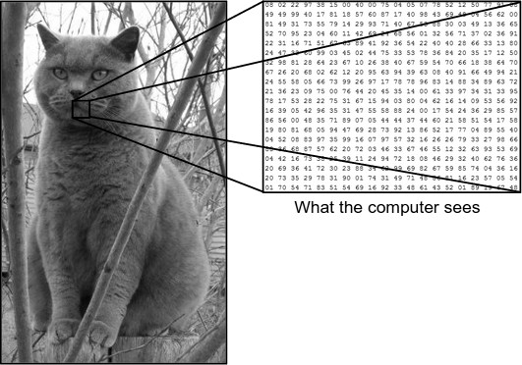
Introduction
What we see vs. What computers see
Slide 5

Slide 6
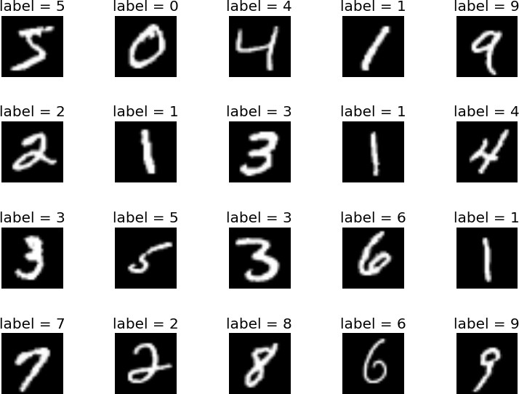
Introduction
MNIST Dataset (http://yann.lecun.com/exdb/mnist/)
60,000 training examples
10,000 test examples
Rank of best Classifiers and Errors
Currently Best Accuracy:
Ciresan et al. CVPR 2012 ➔ 99.77%
Slide 6

Slide 7
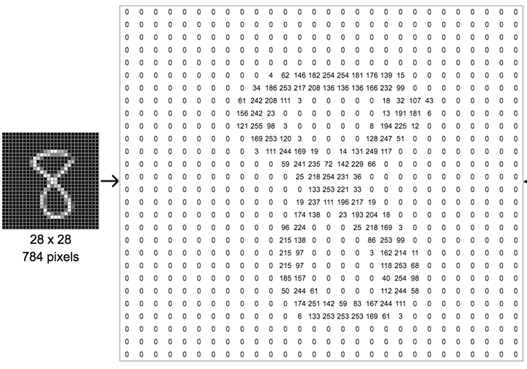
Introduction
MNIST Dataset
Slide 7

Slide 8
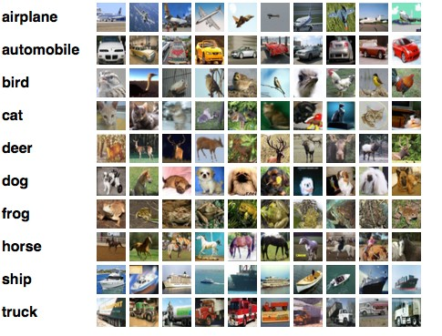
Introduction
CIFAR-10 Dataset (https://www.cs.toronto.edu/~kriz/cifar.html)
Consists of 60,000 32x32 color images in 10 classes, with 6,000 images per class. There are 50,000 training images and 10,000 test images.
Slide 8

Slide 9
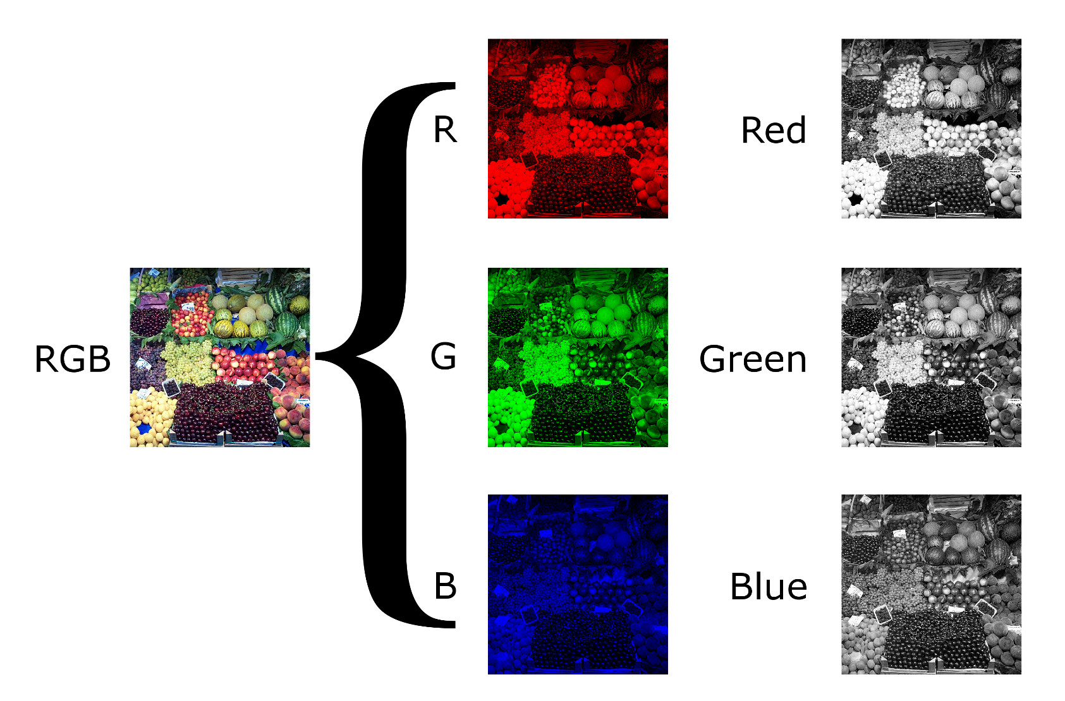
Introduction
Color Images

Slide 10
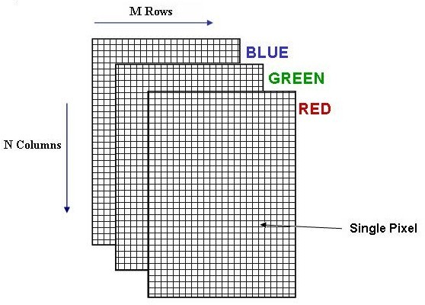
Introduction
Color Images

Slide 11
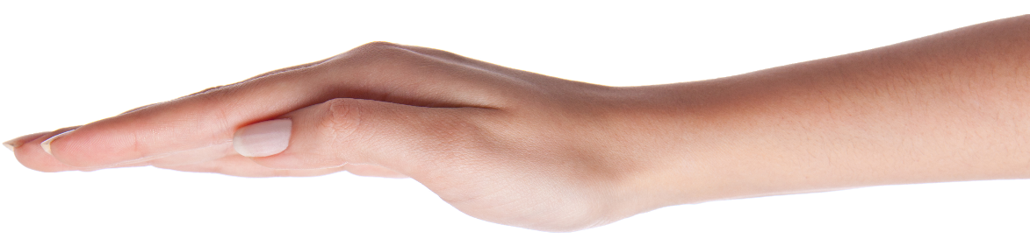
Introduction
Image Classification (previous Deep Learning)
Hand-Craft Features
Texture Features: Histogram based, Entropy, Haralick features (Co- occurrence matrix), Gray-level run length metrics, Local Binary Pattern, Fractal, etc.
Morphological Features: Hu's moments, Shape features, Granulometry, Bending Energy, Roundness ratio, etc.

Slide 12
Agenda
Introduction
What we see vs. What computers see (MNIST and CIFAR Datasets)
Hand-Crafted Features for Image Classification
Deep Learning
Convolutional Neural Networks (CNNs)
Architecture (Convolutional, Pooling, and Fully Connected Layers)
Successful CNN Architectures
Training
Backpropagation
Overfitting, Regularization and Dropout
Experiments Transfer Learning Complex Networks

Slide 13
Deep Learning (DL)
"Deep Learning is a new area of Machine Learning, which has been introduced with the objective of moving Machine Learning closer to
one of its original goals: Artificial Intelligence.”
http://deeplearning.net/
Key Concepts of Deep Neural Networks
Deep-learning networks are distinguished from the more common single-hidden- layer neural networks by their depth
More than three layers (including input and output) qualifies as “deep” learning
In deep-learning networks, each layer of nodes trains on a distinct set of features based on the previous layer’s output
The further you advance into the neural net, the more complex the features your nodes can recognize, since they aggregate and recombine features from the previous layer
Slide 13

Slide 14
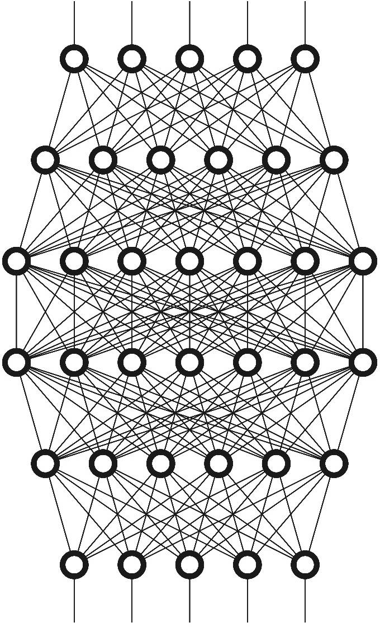
Deep Learning (DL)
Different DL Models:
Deep Neural Network
Deep Boltzmann Machine
Restricted Boltzmann Machine
Deep Belief Networks
Deep Autoencoders
Recurrent Neural Networks
Convolutional Neural Networks

Slide 15
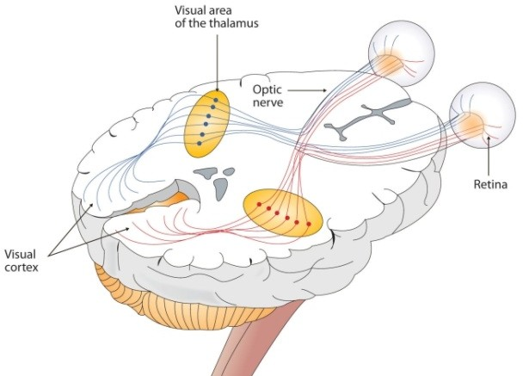
Convolutional Neural Networks (CNNs)
CNNs take a biological inspiration from the visual cortex
The visual cortex has small regions of cells that are sensitive to
specific regions of the visual field
For example, some neurons fired when exposed to vertical edges and some when shown horizontal or diagonal edges
Having the neuronal cells in the visual cortex looking for specific characteristics is the basis behind CNNs

Slide 16
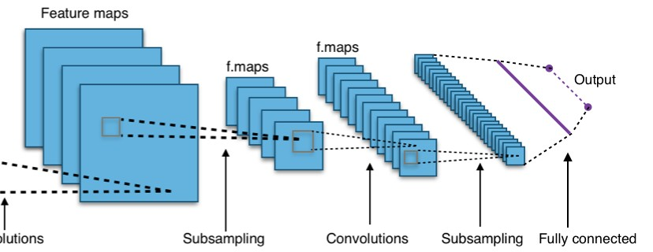
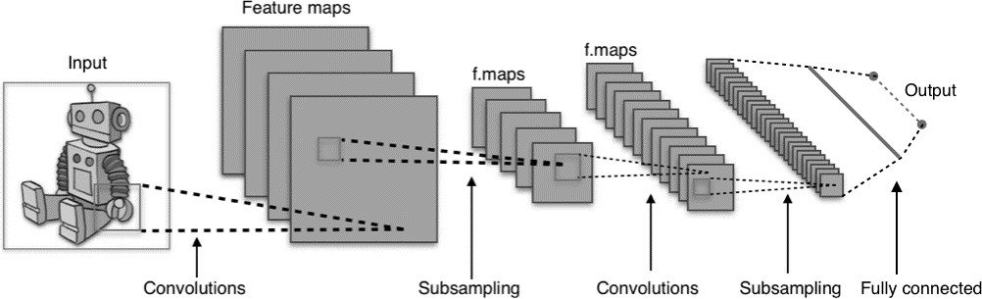
Convolutional Neural Networks (CNNs)
Network Architecture
Convolutional Layer, Pooling Layer, Fully Connected Layer

Slide 17

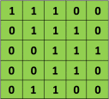
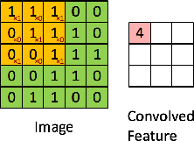

Convolutional Neural Networks (CNNs)
Convolution Operator
x
=
Input Image (I)
Filter (K)
The 3×3 matrix (K) is called a ‘filter‘ or ‘kernel’ or ‘feature detector’ and the matrix formed by sliding the filter over the image and computing the dot product is called the ‘Convolved Feature’ or ‘Activation Map’ or the ‘Feature Map‘.
Slide 17

Slide 18
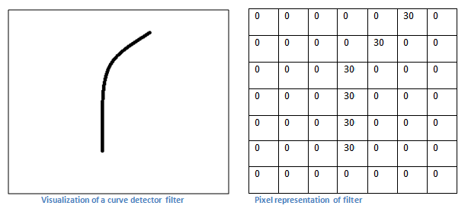
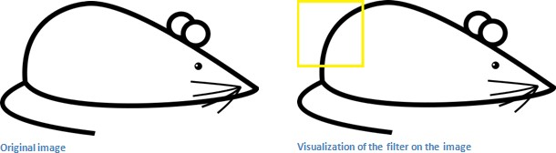
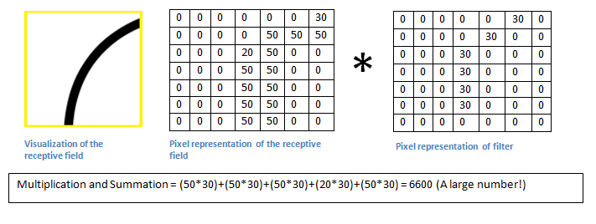
Convolutional Neural Networks (CNNs)
Slide 18

Slide 19
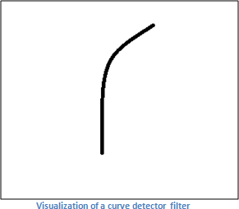
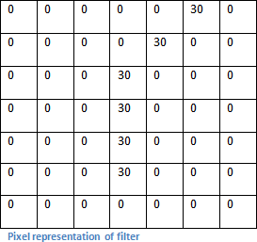
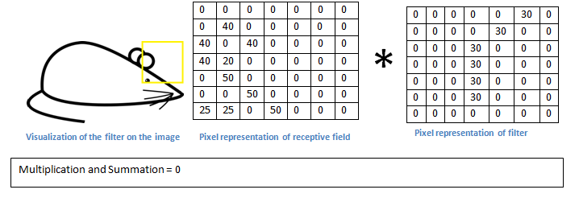
Convolutional Neural Networks (CNNs)
Slide 19

Slide 20
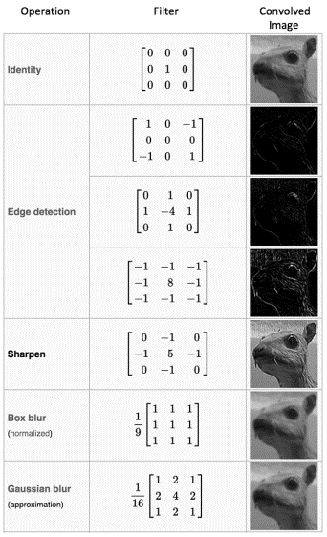

Convolutional Neural Networks (CNNs)
Convolution Operator
Different different
filters
Feature
will produce
Maps for the
same input image. For example:
Input Image
Slide 20

Slide 21
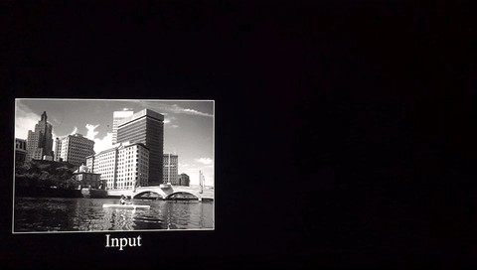
Convolutional Neural Networks (CNNs)

Slide 22
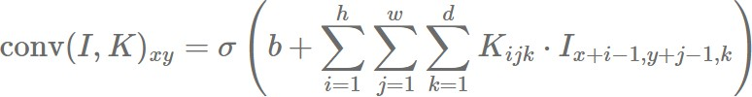
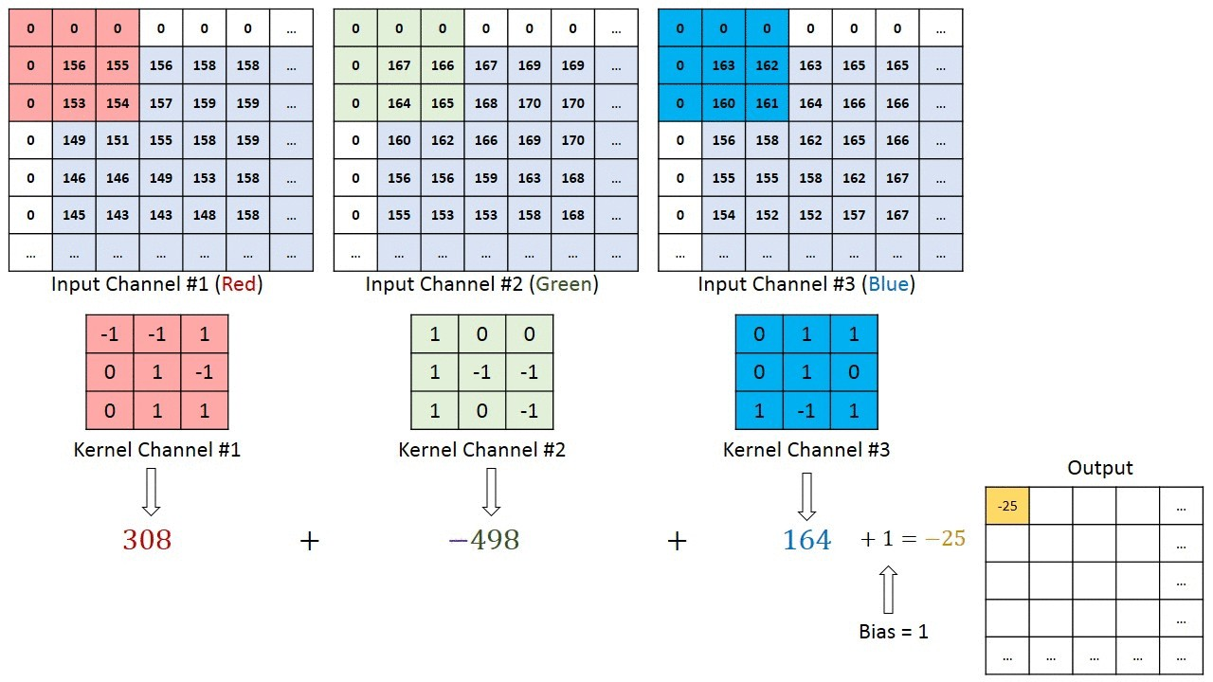
Convolutional Neural Networks (CNNs)

Slide 23
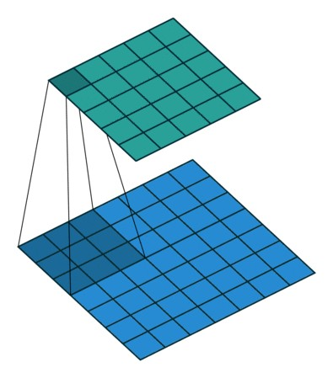
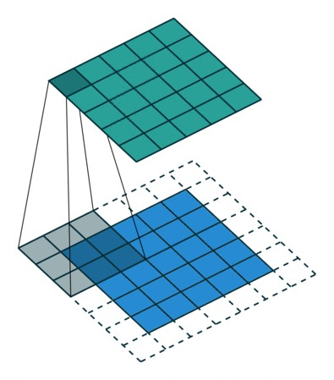
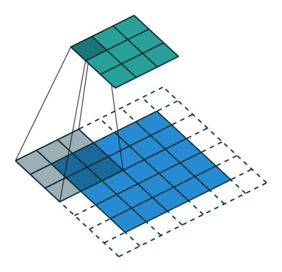
Convolutional Neural Networks (CNNs)
Convolutional Layer
In practice, a CNN learns the values of these filters on its own during the training process
Although we still need to specify parameters such as number of filters, filter size, padding, and stride before the training process
Slide 23

Slide 24
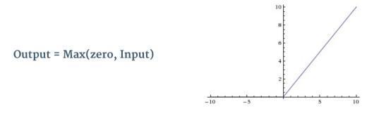
Convolutional Neural Networks (CNNs)
Activation Layer (ReLU)
An additional operation called Rectified Linear Unit (ReLU) has been used after every Convolution operation
Basically, ReLU is an element wise operation (applied per pixel) and replaces all negative pixel values in the feature map by zero
The purpose of ReLU is to introduce non-linearity to the network
Slide 24

Slide 25
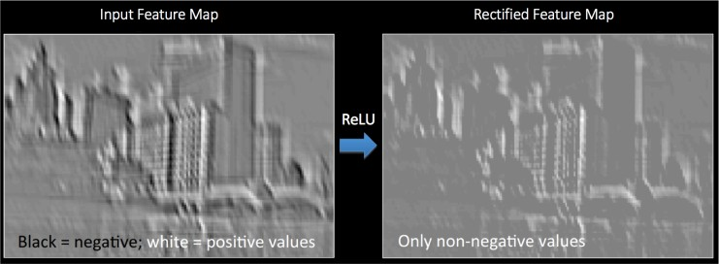
Convolutional Neural Networks (CNNs)
Activation Layer (ReLU)
Other non linear functions such as tanh or sigmoid can also be used instead of ReLU, but ReLU has been found to perform better in most situations.
Slide 25

Slide 26
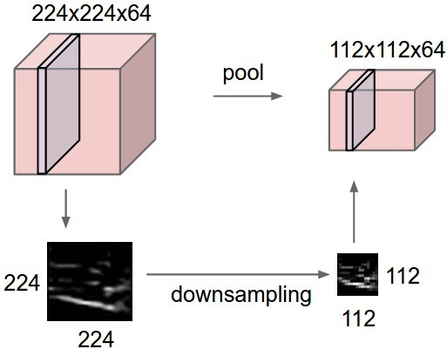
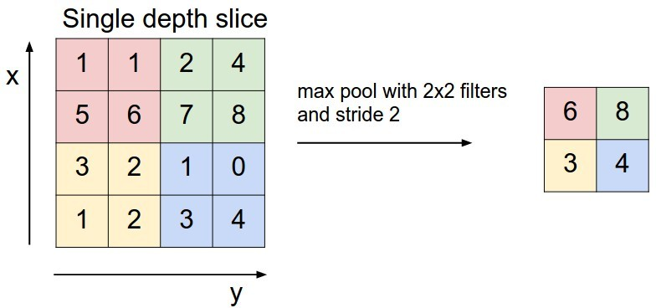
Convolutional Neural Networks (CNNs)
Pooling Layer
Pooling layer downsamples the volume spatially, independently in
each depth slice of the input
The most common downsampling operation is max, giving rise to max pooling, here shown with a stride of 2
Slide 26

Slide 27
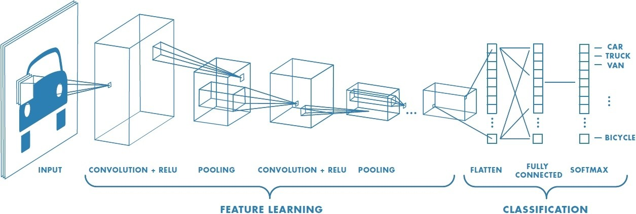
Convolutional Neural Networks (CNNs)
Fully Connected Layer
Neurons in a fully connected layer have full connections to all activations in the previous layer, as seen in regular neural networks

Slide 28
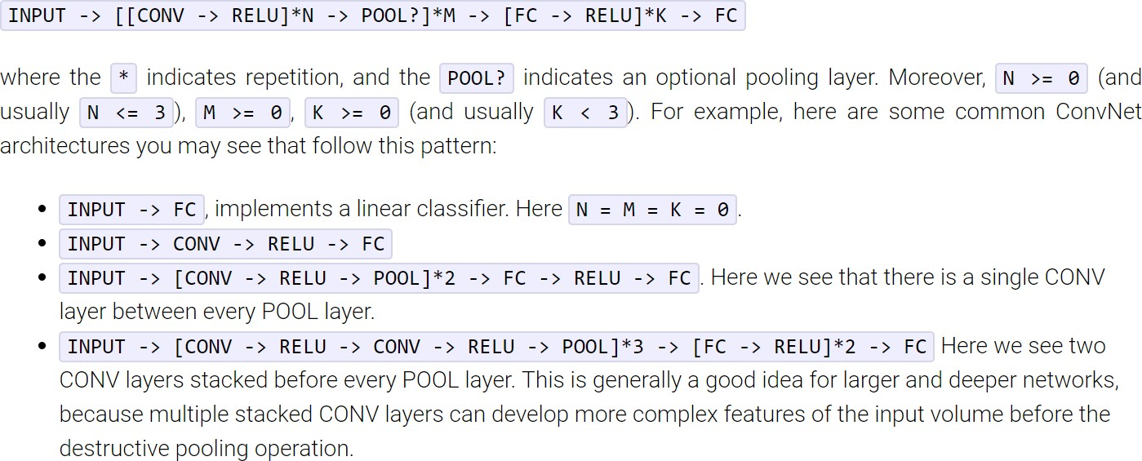
Convolutional Neural Networks (CNNs)
Architectures

Slide 29
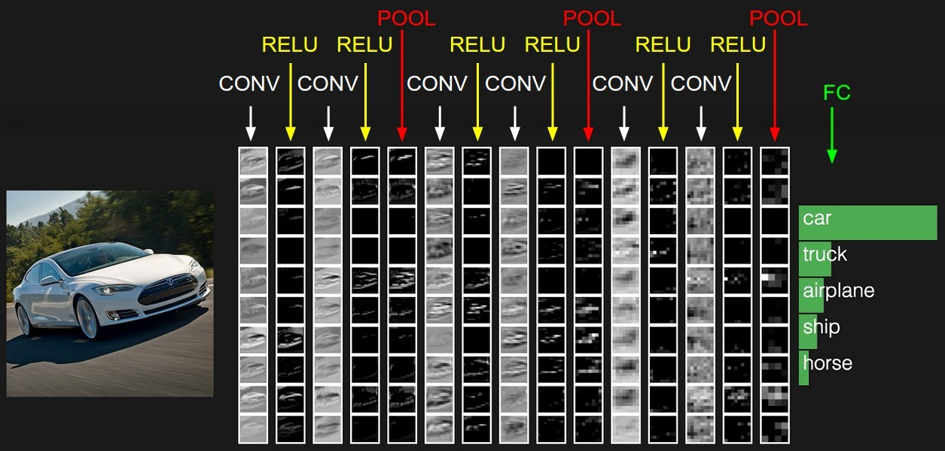
Convolutional Neural Networks (CNNs)
Example: Input >> [ [ Conv >> ReLU ] * 2 >> Pool ] * 3 >> FC

Slide 30
Convolutional Neural Networks (CNNs)
In summary:
A CNN is in the simplest case a list of Layers that transform the image volume into an output volume (e.g. class scores)
There are a few distinct types of Layers
(e.g. CONV/RELU/POOL/FC are by far the most popular)
Each Layer may or may not have parameters (e.g. CONV/FC do, RELU/POOL don’t)
Each Layer may or may not have additional hyperparameters (e.g. CONV/FC/POOL do, RELU doesn’t)

Slide 31
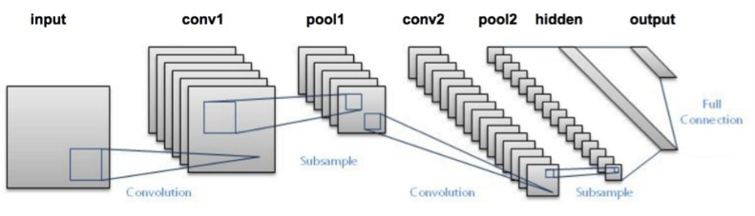
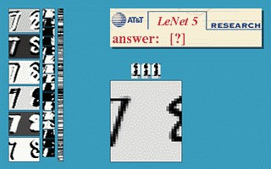
Successful CNN architectures
LeNet-5
This architecture is an excellent “first architecture” for a CNN
Slide 31

Slide 32
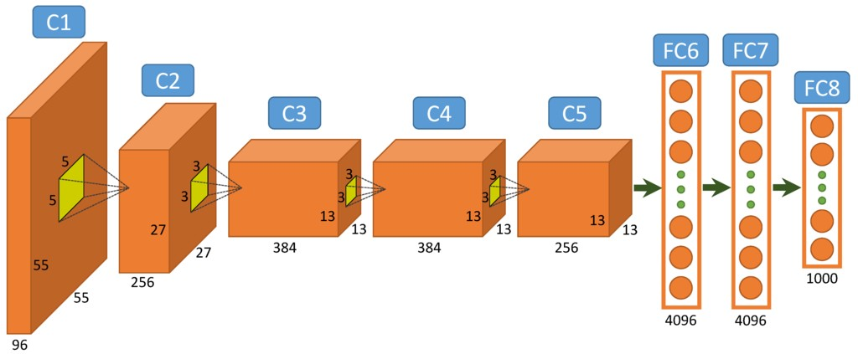
Successful CNN architectures
AlexNet
Famous for winning the ImageNet Large Scale Visual Recognition Challenge (ILSVRC) in 2012
Slide 32

Slide 33
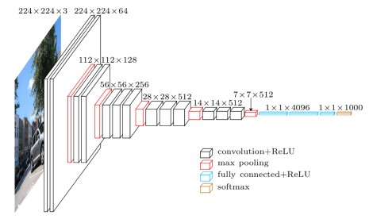
Successful CNN architectures
VGGNet
Slide 33

Slide 34
Features:
Choose a Dataset.
Prepare Dataset for Training.
Create Training Data.
Shuffle the Dataset.
Assigning Labels and Features.
Normalising X and Converting Labels to Categorical Data.
Split X and Y for Use in CNN.

Slide 35
Thank you

