Slide 1
Brick Breaker Game in Java
Name :Nithishkumar S
Enrollment Number :EBEON03251076632
Batch :2024-14789

Slide 2
Project Overview
This project replicates the popular Brick Breaker game.
The player controls a paddle to bounce a ball and break all the bricks.
Built using Java Swing and Object-Oriented Programming concepts.
Demonstrates GUI programming and game loop logic.

Slide 3
Objectives
Understand and implement:
Input handling using Scanner
Conditionals (if/else)
Loops (do-while)
Methods and classes
Object-oriented concepts (inheritance)

Slide 4
Project Architecture
Class GameMain.java:
Purpose: The entry point of the game.
Key Responsibilities:
Initializes the game window (JFrame).
Sets up the game panel (GamePlay).
Controls the main game loop and window settings.
Key Methods:
main(String[] args) - Starts the game by initializing the window.
setupGameWindow() - Configures the JFrame settings.

Slide 5
Project Architecture
Class MapGenerator.java:
Purpose: Generates and manages the layout of the game bricks.
Key Responsibilities:
Creates a grid of bricks using a 2D array.
Handles brick destruction when the ball hits a brick.
Key Methods:
generateMap() - Initializes the map with a set number of rows and columns of bricks.
draw(Graphics g) - Renders the bricks on the game screen.
destroyBrick(int row, int col) - Marks a brick as destroyed when hit by the ball.

Slide 6
Project Architecture
Class GamePlay.java:
Purpose: The heart of the game logic.
Key Responsibilities:
Handles all gameplay features including ball movement, paddle control, brick collisions, scoring, and win/loss conditions.
Continuously updates the game state.
Key Methods:
paintComponent(Graphics g) - Draws the game elements (ball, paddle, bricks) on the screen.
moveBall() - Updates the ball's position and checks for collisions.
keyPressed(KeyEvent e) - Handles paddle movement based on user input.
checkCollisions() - Detects collisions between the ball, paddle, and bricks.

Slide 7
Key Features
1. Interactive Paddle Control
2. Dynamic Brick Layout
3. Collision Detection Logic
4. Win/Loss Restart

Slide 8
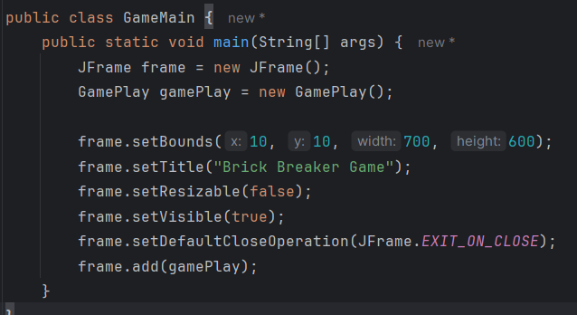
Code Snippets
GameMain.java - main method:

Slide 9
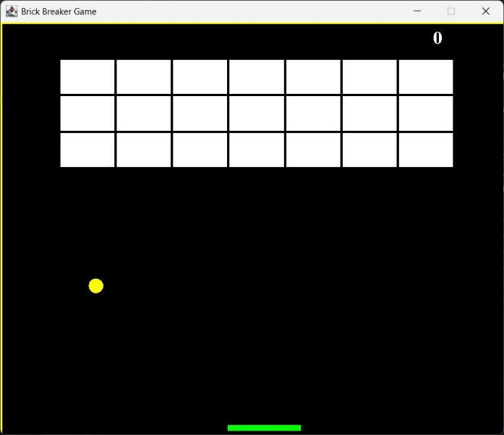
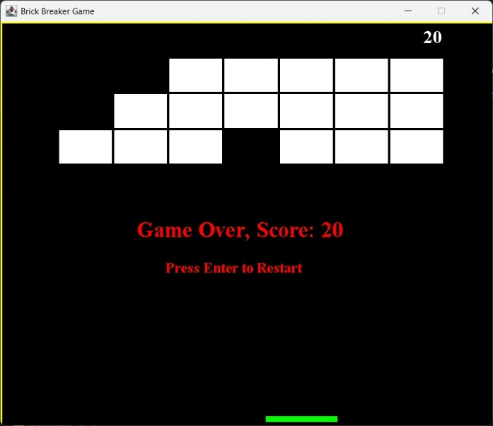
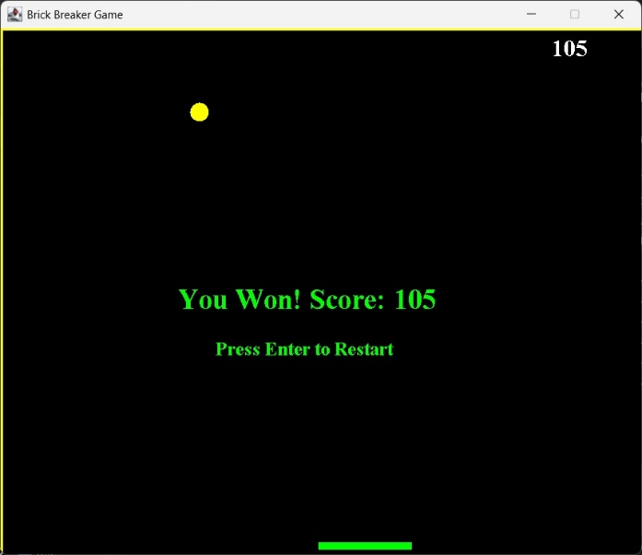
Output Demo

Slide 10
Learning Outcomes
Improved understanding of:
- Java syntax and control structures
- Object-oriented design
- Real-world application logic

Slide 11
Future Enhancements
1. Multiple Difficulty Levels
2. Power-ups & Special Items
3. Enhanced Graphics & Animations
4. Leaderboard & Scoring System

Slide 12
Conclusion
- A simple project with powerful impact for Java learners.
- Demonstrates the power of object-oriented programming in real applications.

