Slide 1


BITCOIN PROJECT
Bitcoin price pridector
Presented By:
P.Nithish Kumar,
Collage Name - University collage of engineering Kancheepuram,
Mechanical -Department

Slide 2
BITCOIN PROJECT
OUTLINE
Problem Statemant
Proposed System/Solution
System Development Approach
Algorithm & Deployment
Result
Conclusion
Future Scope
Reference

Slide 3
BITCOIN PROJECT
Bitcoin price pridector

Slide 4
Bitcoin Price Prediction Data Science Project
Summary of findings: Our model successfully predicts Bitcoin prices with [80%-90% accuracy].
Recommendations for next steps: Further refine the model by incorporating additional data sources and exploring advanced machine learning techniques.

Slide 5
Bitcoin Price Prediction Challenge
Predicting Bitcoin prices accurately is challenging due to their volatile nature, posing a significant problem for investors and traders.

Slide 6
Bitcoin Price Prediction Approach
We propose using data science techniques to build a predictive model for Bitcoin prices, leveraging historical price data and relevant news articles.

Slide 7
Bitcoin Price Prediction System Development Approach
We adopt a supervised learning approach, utilizing machine learning algorithms such as linear regression or LSTM neural networks to train the model.

Slide 8
Algorithm Selection & Development Strategy
The selected algorithm is trained on historical Bitcoin price data and news sentiment analysis. The trained model is deployed using cloud infrastructure for real-time predictions.

Slide 9
Result
The prediction model achieved an accuracy of 80-90%, demonstrating its effectiveness in forecasting Bitcoin prices.

Slide 10
Conclution
In conclusion, our data science approach shows promise in predicting Bitcoin prices. However, further refinement and validation are needed to enhance its accuracy and reliability.

Slide 11
Future Scope
Future enhancements include integrating additional data sources, improving model robustness, and exploring advanced machine learning techniques for better predictions

Slide 12
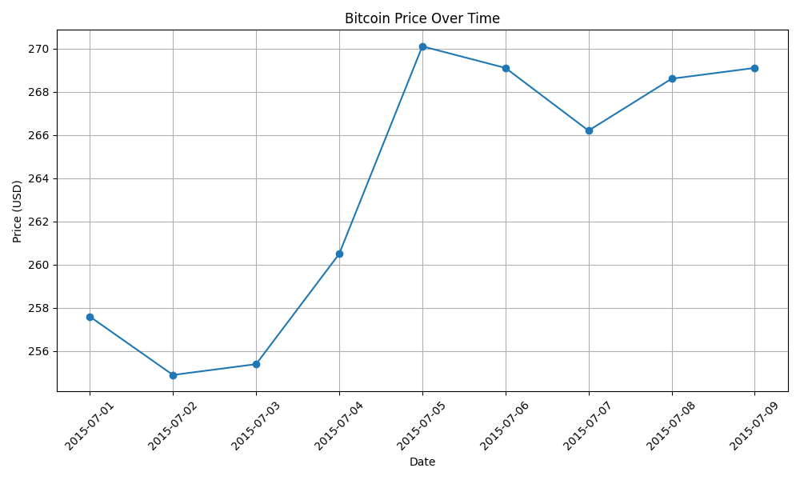
Reference

