Slide 1
NAAN MUTHALVAN
DATA SCIENCE
Tittle:
Customer Segmentation using Data Science
Nithishkumar.P
Register.no:712221104012
Park College of Engineering And Technology

Slide 2

DATA SCIENCE

Slide 3
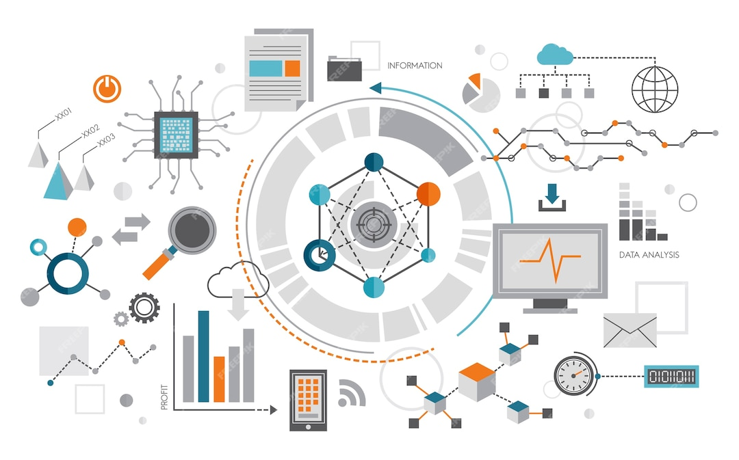
Problem Definition :
*The problem is to implement data science techniques to segment customers based on their behavior, preferences, and demographic attributes. The goal is to enable businesses to personalize marketing strategies and enhance customer satisfaction. This project involves data collection, data preprocessing, feature engineering, clustering algorithms, visualization, and interpretation of results.

Slide 4

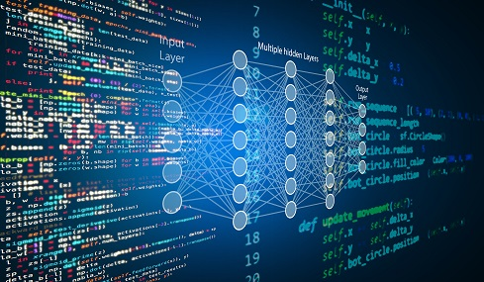
Design Thinking
Data Collection: Collect customer data, including attributes like purchase history, demographic information, and interaction behavior.
Data Preprocessing: Clean and preprocess the data, handle missing values, and convert categorical features into numerical representations.
DesignClustering Algorithms: Apply clustering algorithms like K-Means, DBSCAN, or hierarchical clustering to segment customers.

Slide 5

Data set:
https://www.kaggle.com/datasets/akram24/mall-customersClustering

