Slide 1



AI-Based Crop Recommendation System
Name: NITHISH. S
Email id: nithishsubramani2006@gmail.com
AICTE Student ID: STU683728e5d1d8e1748445413
AICTE Internship ID: INTERNSHIP_17513641056863b20937d78

Slide 2

Learning Objectives
Understand how AI/ML techniques can be applied in agriculture.
Learn to preprocess agricultural data and apply EDA (Exploratory Data Analysis).
Build and evaluate machine learning models for crop prediction.
Deploy a user-friendly application (Streamlit) for real-time crop recommendation.
Contribute towards sustainable agriculture by improving crop yield and farmer decision-making.
GOAL
Source :
www.freepik.com/

Slide 3
Tools and Technology used
Programming Language: Python 3.13.7
Libraries:
NumPy - Used for numerical computations and handling arrays
Pandas - Data manipulation and analysis tool (working with CSV/Excel datasets).
Matplotlib, Seaborn - For data visualization (graphs, plots, heatmaps).
scikit-learn - Machine Learning library for training models and evaluation.
Pickle - Used to save and load trained models.
Frameworks:
Streamlit - To build interactive and user-friendly web applications for machine learning and data science.
IDE/Environment: Jupyter Notebook , VS Code
Dataset: Crop Recommendation Dataset (Kaggle)

Slide 4
Methodology
1. Data Collection:
The dataset is obtained from Crop Recommendation Dataset, which contains soil nutrients (Nitrogen, Phosphorus, Potassium) and environmental factors (Temperature, Humidity, pH, Rainfall).
Each record is labeled with the most suitable crop, making it a supervised learning problem.
2. Preprocessing:
Data Cleaning: Removing missing values, duplicates, and inconsistencies.
Label Encoding: Converting categorical crop names into numerical values for ML algorithms.
Feature Scaling: Normalizing input features using StandardScaler to ensure uniformity.
3. EDA (Exploratory Data Analysis):
Statistical summaries and visualizations (histograms, boxplots, heatmaps) are used to identify patterns, trends, and relationships in the dataset.
4. Model Training:
Splitting dataset into Training Set (80%) and Testing Set (20%).
Train multiple models (Logistic Regression, Support Vector Machine, Random Forest).

Slide 5
Methodology
5. Model Selection & Evaluation:
Metrics: Accuracy, Confusion Matrix, Classification Report.
Random Forest chosen (best accuracy ~99%).
6. Deployment:
Save model with pickle and deploy using Streamlit app for user input & prediction.
Data Collection → Use Crop Recommendation Dataset.
Preprocessing → Handle missing values, encode target labels, scale features.
EDA (Exploratory Data Analysis) → Visualize nutrient distributions, correlation, class balance.
Model Training → Train multiple models (Logistic Regression, Support vector Machine, Random Forest).
Model Selection → Choose Random Forest (best accuracy & stability).
Evaluation → Use Accuracy, Confusion Matrix, and Classification Report.
Deployment → Save model with pickle and deploy using Streamlit app for user input & prediction.

Slide 6
Problem Statement:
Farmers often struggle to decide which crop is best suited for their land based on soil nutrients (N, P, K), weather, pH, and rainfall. Wrong crop choices lead to low productivity, resource wastage and financial loss.
Why It Is Important?
Ensures higher crop yield by recommending the most suitable crop.
Reduces crop failure risk caused by wrong crop selection.
Promotes efficient use of soil nutrients and natural resources.
Helps farmers make data-driven and scientific decisions.
Minimizes financial losses and increases farmer profitability.

Slide 7
Solution:
The proposed system applies Machine Learning to analyze soil nutrients (N, P, K) and environmental parameters (temperature, humidity, pH, rainfall). Based on these inputs, the model predicts the most suitable crop for cultivation.
Model Performance:
Algorithm Used: Random Forest Classifier
Accuracy: ~99% (high reliability in predictions)
Precision: High (model predicts crops correctly with fewer false positives)
Recall: High (model captures most correct crops, fewer false negatives)
F1-Score: Balanced precision and recall across crop categories
Confusion Matrix Analysis: Demonstrates strong classification with minimal misclassifications
GitHub Link:
https://github.com/Nithishofficial06/AI-Based-Crop-Recommendation-System.git

Slide 8
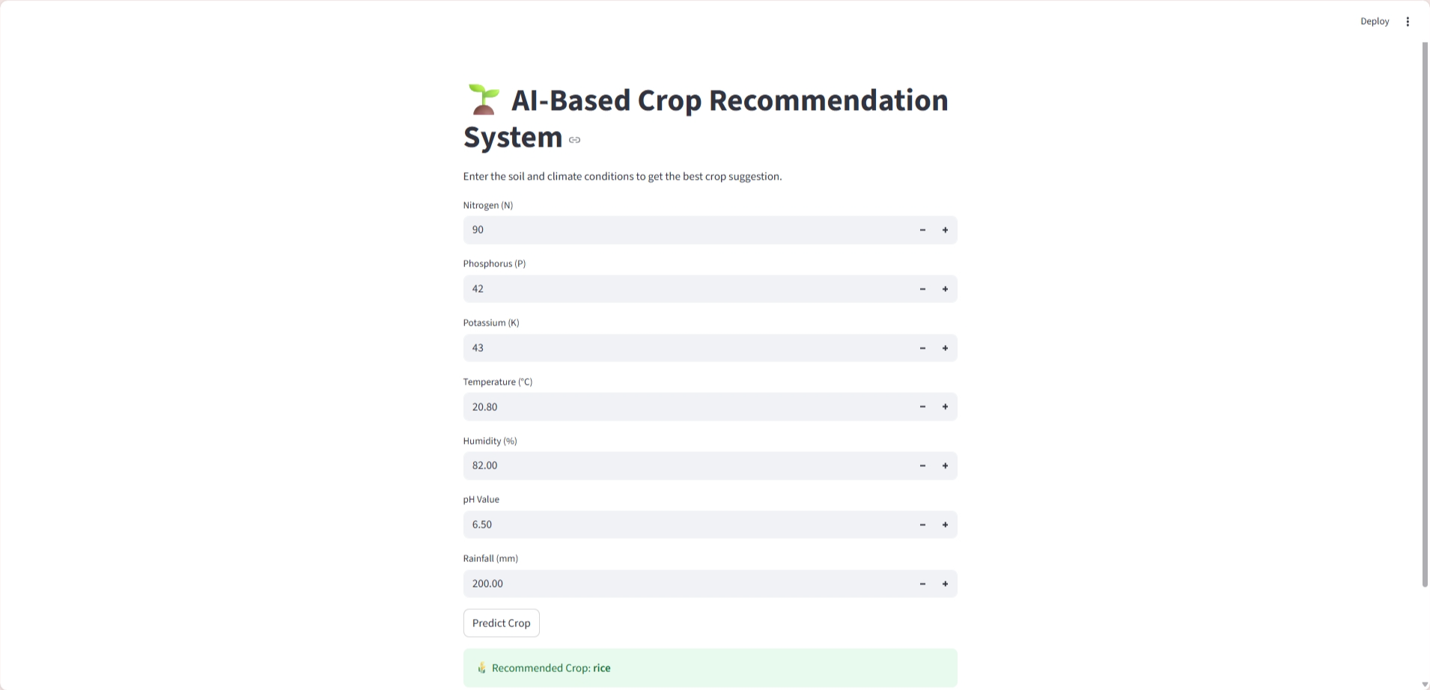
Screenshot of Output:

Slide 9
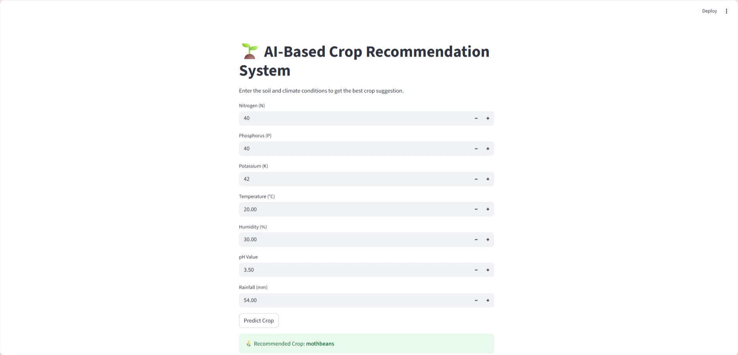
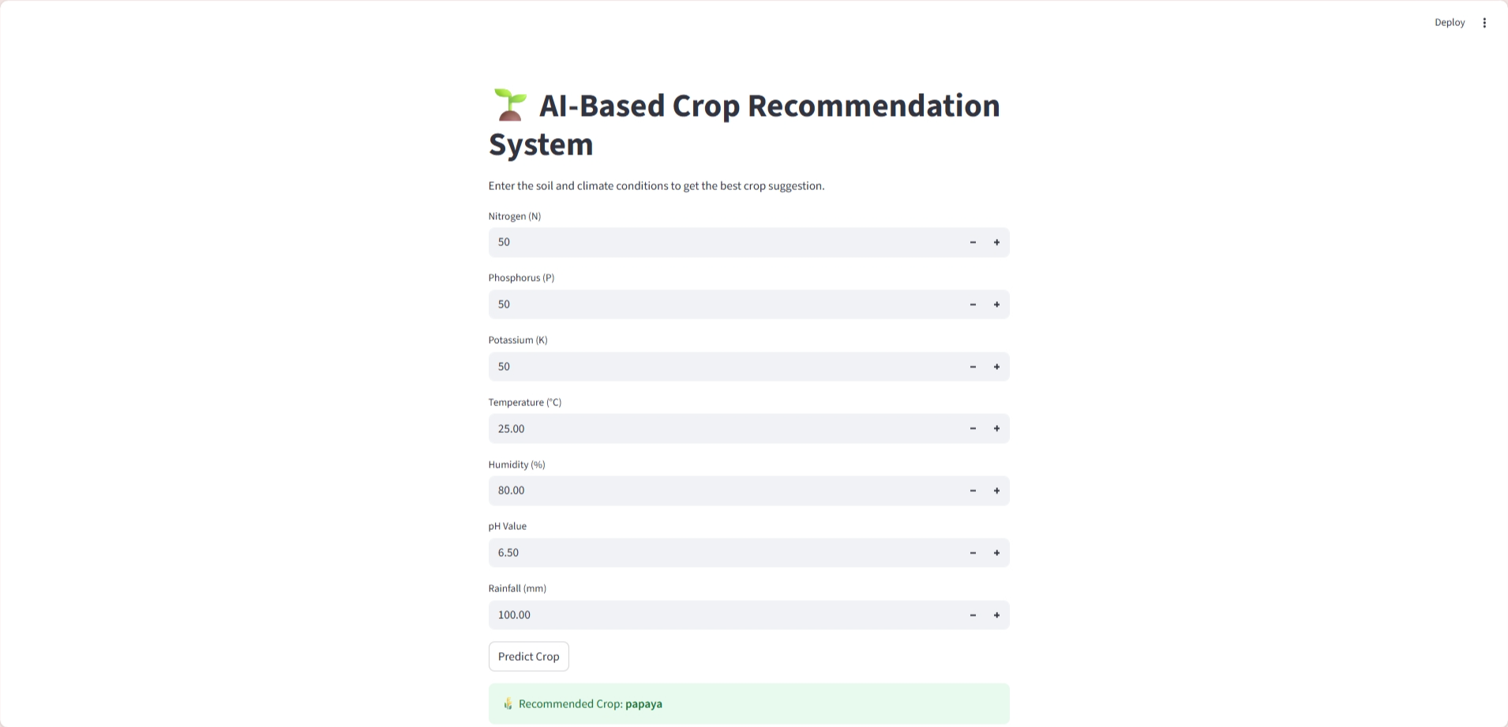
Screenshot of Output:

Slide 10
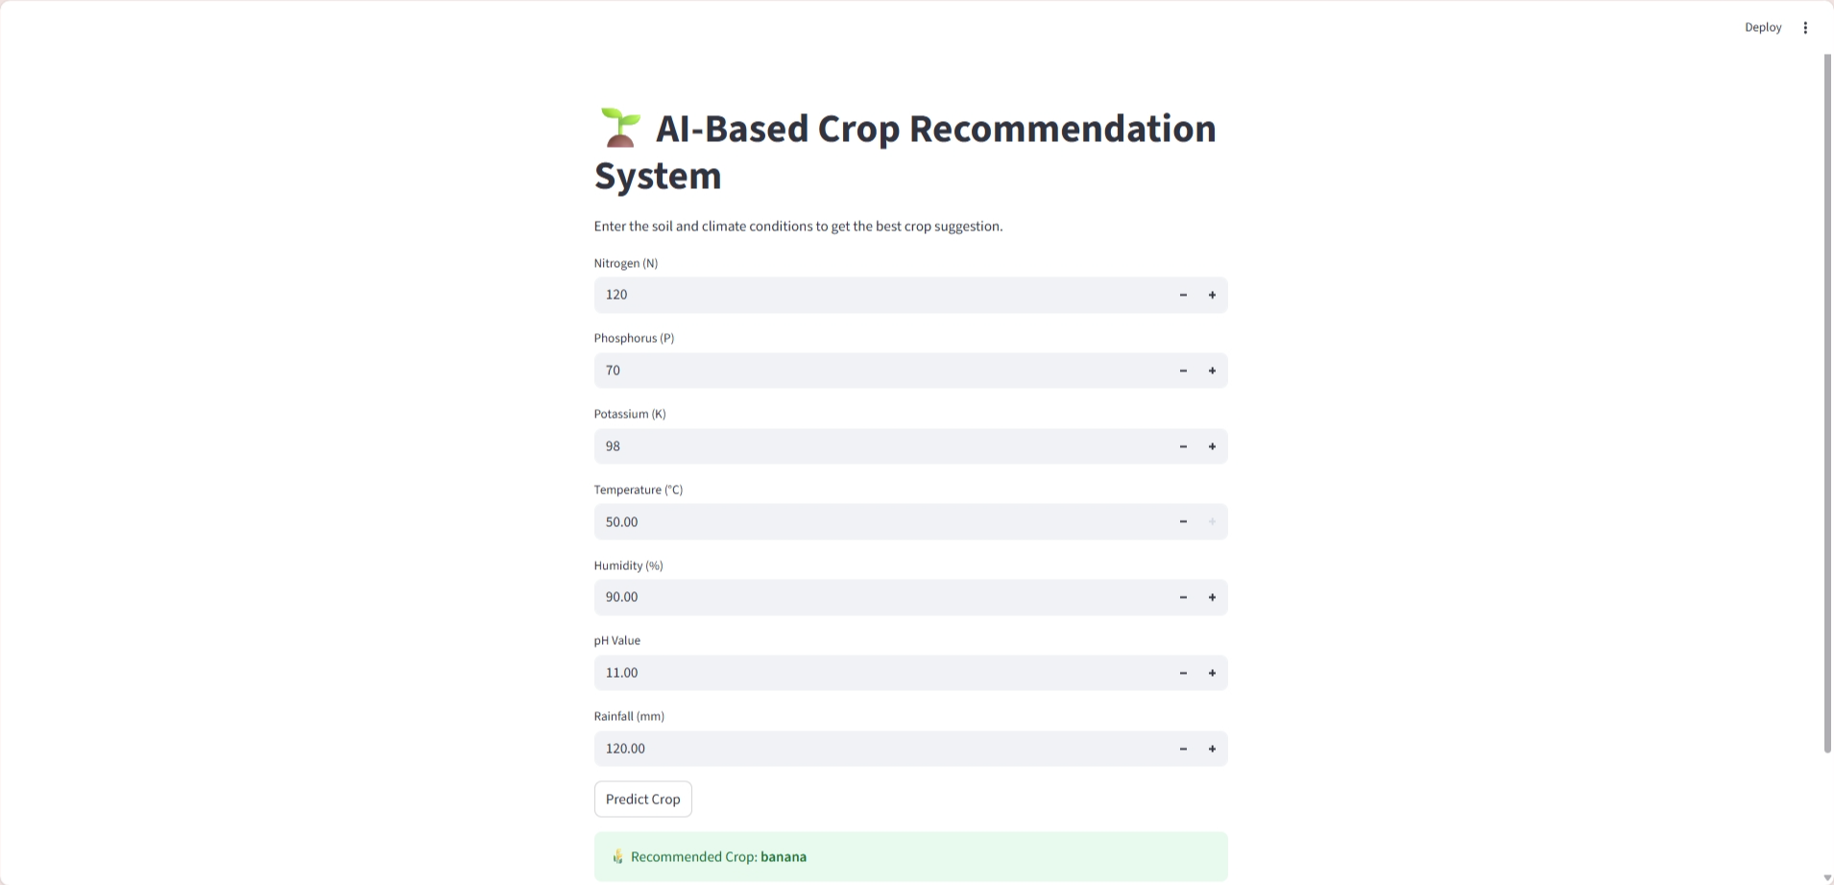

Screenshot of Output:

Slide 11
Conclusion:
The system successfully predicts the best crop based on soil and climate conditions.
Random Forest Classifier achieved high accuracy and is robust for real-world prediction.
Helps farmers reduce risks, improve productivity, and support sustainable agriculture.
Can be further enhanced by integrating IoT sensors and real-time weather data for live predictions.
Future Enhancements:
Integration with IoT Devices - Collect real-time soil and weather data from sensors for live crop predictions.
Fertilizer & Pesticide Recommendation - Extend the system to suggest suitable fertilizers and pest control methods.
Weather API Integration - Fetch live climate data (temperature, rainfall, humidity) for dynamic predictions.

