Slide 1

GradientBoosting

Slide 2

Gradient boosting involves three elements:
A loss function to be optimized.
A weak learner to make predictions.
An additive model to add weak learners to minimize the loss function

Slide 3
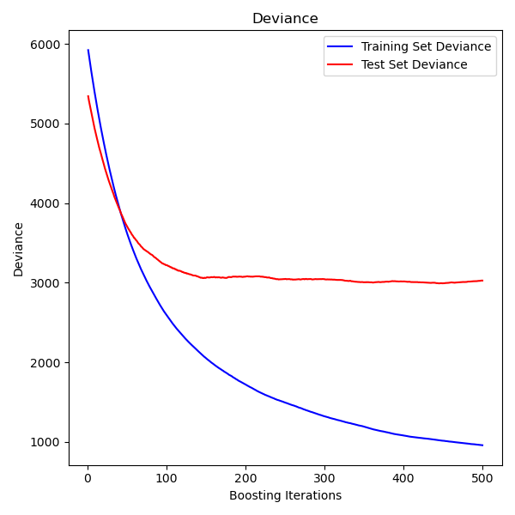

Slide 4
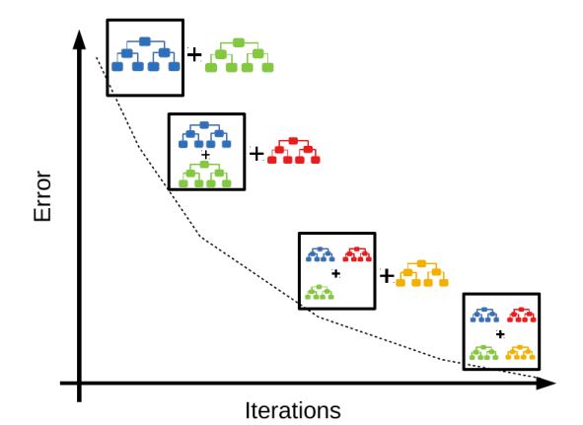

Slide 5

The gradient of the loss function is computed iteratively:

