Slide 1
Smart ID Card Detection
and Authentication
Using Deep Learning and Computer Vision
Vinoparkavi D • Mythily V • Dharun Raj R • Deepika Y • Nithwin V M
Department of Computer Science and Engineering
Nandha Engineering College, Erode, India
IEEE CONFERENCE PRESENTATION
1 / 15

Slide 2
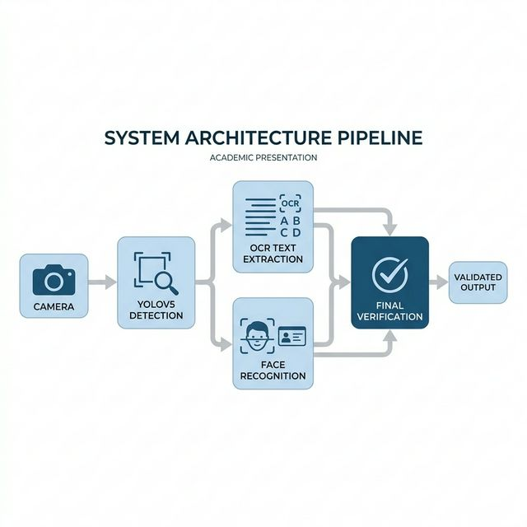
Background & Introduction
Why automated identity verification matters
▸ Identity verification is a critical security checkpoint across banking,
education, and government institutions worldwide.
▸ Manual verification remains the dominant protocol despite its known
inefficiencies and error-prone nature.
▸ Rapid advancements in AI, particularly Convolutional Neural Networks
(CNNs), have demonstrated superhuman pattern recognition capabilities.
▸ OCR systems have evolved to extract text from challenging sources,
including damaged documents and micro-printed text.
2 / 15

Slide 3
The Challenge: Manual ID Verification
Critical bottlenecks in current systems
2–5 min
15–20%
90–180s
Variable
Average verification time per person
Human error rate under high volume
Peak-hour delay per individual
Inconsistent judgment across staff
▸ Errors go both ways — genuine IDs get rejected, fake IDs get accepted.
▸ Security risks compound with fatigue, poor lighting, and inconsistent judgment.
3 / 15

Slide 4
Limitations of Existing Solutions
Why current commercial systems fall short
☁️ Cloud Dependency
Most solutions require constant internet connectivity, making them unreliable in areas with poor network infrastructure.
💰 High Operational Costs
Specialized hardware, premium APIs, and per-use pricing create barriers for smaller organizations with limited budgets.
📋 No Universal Standard
ID cards vary dramatically in size, orientation, material, and layout across states, organizations, and countries.
🔆 Environmental Sensitivity
Performance degrades severely under inconsistent lighting, odd camera angles, and background noise.
4 / 15

Slide 5
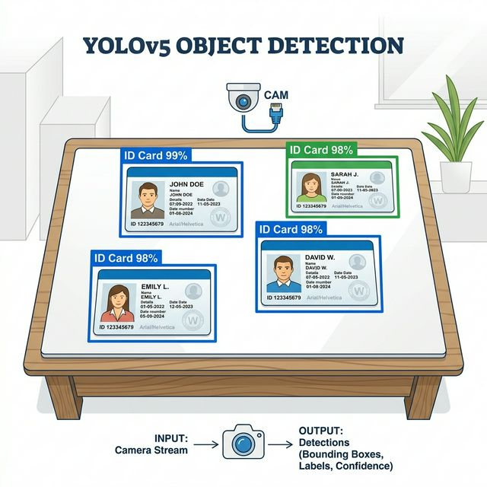
Our Proposed Solution
A fully offline, multi-stage AI verification framework
▸ Integrated Multi-Stage Pipeline combining YOLOv5
detection, template-based OCR, and FaceNet recognition.
▸ Runs entirely offline on standard computing
hardware — no cloud, no special equipment needed.
▸ Processes complete verifications in under 2 seconds
with accuracy above 94% across all components.
▸ Handles 12 different ID card formats with automatic
lighting adaptation and built-in anti-spoofing.
5 / 15

Slide 6
System Architecture & Workflow
End-to-end processing pipeline — under 2 seconds
01
Scene Capture
Live webcam video stream analyzed frame by frame
02
Card Detection
YOLOv5 identifies and extracts ID card region at 25-30 FPS
03
Correction
Perspective correction and image enhancement applied
04
Parallel OCR + Face
Template-based text extraction runs alongside FaceNet
05
Final Verdict
Pass/Fail decision with confidence scores displayed via GUI
6 / 15

Slide 7
Dataset Construction & Training
Building a robust detection model
15,000
Total training images
100
Training epochs
8,000
Synthetic templates
640×640
Input resolution
7,000
Real campus captures
18 hrs
Training duration
Data Augmentation: ±15° rotation • 0.8–1.2× zoom • ±30% brightness • Mosaic
7 / 15

Slide 8
Card Detection: YOLOv5
Real-time object detection for ID card localization
▸ YOLOv5 chosen for optimal balance of real-time speed
and detection precision — single-pass architecture.
▸ Trained for 100 epochs with Adam optimizer
(β₁=0.9, β₂=0.999), learning rate 0.001.
▸ Final Performance Metrics:
• mAP@0.5: 96.8%
• Precision: 94.7%
• Recall: 97.2%
▸ Processing speed: 25–30 FPS on standard hardware.
8 / 15

Slide 9
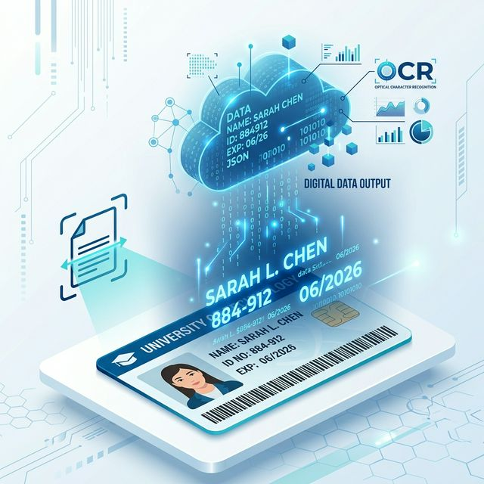
Template-Based OCR Extraction
Extensible JSON-driven text recognition system
▸ Innovative JSON configuration system replaces
hardcoded ROI coordinates — fully extensible.
▸ New card types added in under 10 minutes
without any programming knowledge required.
▸ Tesseract 4.1 with LSTM neural networks for
substantially improved character-level accuracy.
▸ Built-in regex validation automatically flags
OCR results that don't match expected formats.
9 / 15

Slide 10
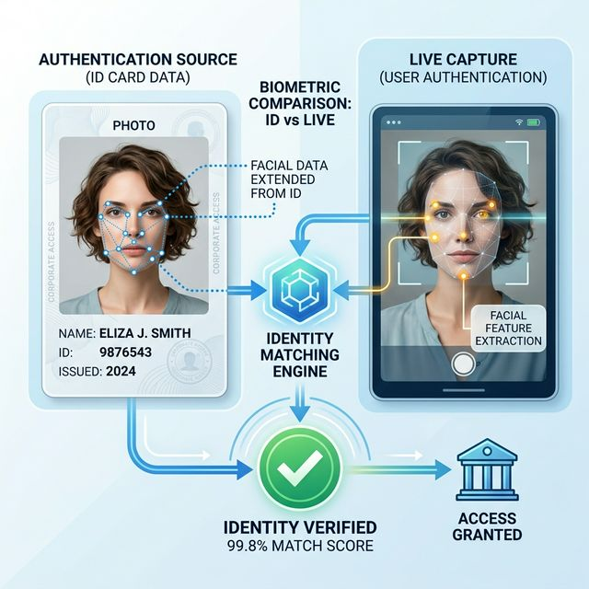
Facial Recognition: FaceNet
128-dimensional embedding-based identity matching
▸ Pre-trained FaceNet on VGGFace2 dataset —
millions of facial images for robust performance.
▸ Converts facial images into 128-D mathematical
embeddings where similar faces cluster together.
▸ Calibrated similarity threshold at 0.6 — balancing
security (2.1% FAR) against usability (3.7% FRR).
▸ 98.2% accuracy validated on Labelled Faces
in the Wild (LFW) benchmark dataset.
10 / 15

Slide 11
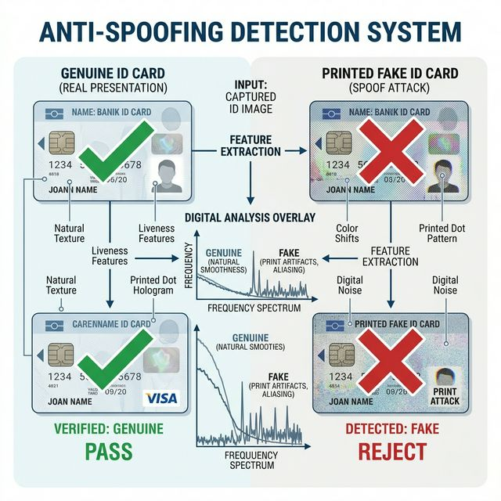
Two-Tier Anti-Spoofing Mechanisms
Multi-layered defense against fraudulent reproductions
▸ Tier 1 — Frequency Domain Analysis:
Uses Fourier Transform to detect printer grid patterns
and halftone screening artifacts invisible to the human eye.
▸ Tier 2 — Passive Liveness Detection:
Applies Local Binary Patterns (LBP) to differentiate real
human skin micro-textures from photographic reproductions.
▸ Combined efficacy: 85.8% detection of fraud attempts
with only 4.2% false positive rate on genuine cards.
11 / 15

Slide 12
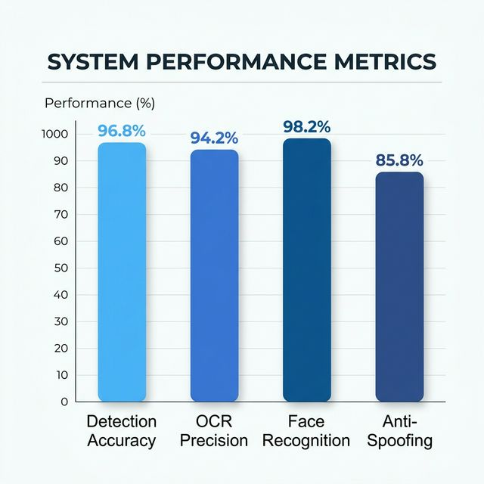
Experimental Results & Evaluation
Comprehensive testing across multiple operational scenarios
98.4%
Indoor detection accuracy
92.0%
Challenging outdoor accuracy
94.2%
OCR text extraction precision
98.2%
Face recognition (LFW benchmark)
85.8%
Anti-spoofing detection rate
12 / 15

Slide 13
Processing Speed & Comparative Analysis
Performance vs. commercial and baseline solutions
Metric
Our System
Cloud APIs
OpenCV Baseline
Detection Accuracy
96.8%
97.5%
84.3%
OCR Precision
94.2%
96.1%
87.1%
Processing Speed
25–30 FPS
Network-dependent
15–20 FPS
Internet Required
No ✓
Yes ✗
No ✓
Hardware Cost
Standard PC
Cloud + Premium
Standard PC
Anti-Spoofing
85.8%
Varies
None
13 / 15

Slide 14
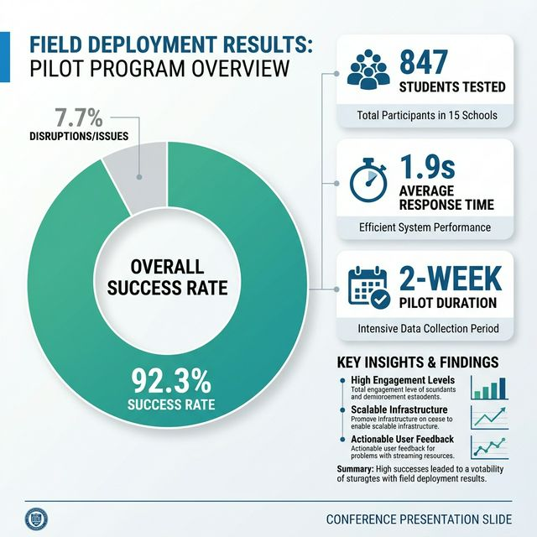
Real-World Field Deployment
Two-week pilot at Nandha Engineering College
▸ 847 student verifications processed during
the college registration period.
▸ 92.3% automated verification success rate —
782 students verified without manual intervention.
▸ Average processing time: 1.9 seconds per student
(vs. 90–180 seconds for manual inspection).
▸ Only 1.5% true technical failures requiring rescan.
Estimated 8.5 hours of staff time saved.
14 / 15

Slide 15
Conclusion & Future Scope
KEY CONTRIBUTIONS
FUTURE DIRECTIONS
▸ Demonstrated a highly accurate, fully offline, and affordable
verification pipeline running on generic hardware.
▸ Template-based OCR architecture allows rapid system expansion
without programming — new cards added in under 10 minutes.
▸ Multi-layer anti-spoofing identifies 85.8% of fraud attempts.
▸ Upgrade to Transformer-based OCR architectures
for enhanced text recognition accuracy.
▸ Implement 3D depth analysis for advanced
anti-spoofing beyond texture analysis.
▸ Community-contributed JSON templates for
expanded international card format support.
Thank You — Questions Welcome
dharunraju7@gmail.com • vmnithwin@gmail.com
15 / 15

