Slide 1

BeClear : Blur Detector
Raviteja Kompalli(190330202) V.NITYA SANTHOSHINI(190330249)

Slide 2
Abstract
With the availability and usage of digital cameras in today’s world, the number of digital images increases gradually which increases the demand for automatic image quality assessment. One of the major checks in image quality is detecting blurriness in the image. There are many methods to detect blurriness in the image where some of them are using OpenCV and multi-layer perceptron. These methods give less accuracy models on the dataset which may not be feasible for applying in real-time applications. Hereby, we proposed a solution which uses convolutional neural networks whi­ch predict whether the image is blurry or not.

Slide 3
Objective
To build a model for a mobile as well as desktop application which predicts if the input image is blurred or not blurred based on the model which is trained using convolutional neural networks.

Slide 4
Requirements
Processor: 64-bit, 4 core, 2.5 GHz minimum per core
RAM: 16 GB
Hard Disk: 10 GB for installation

Slide 5
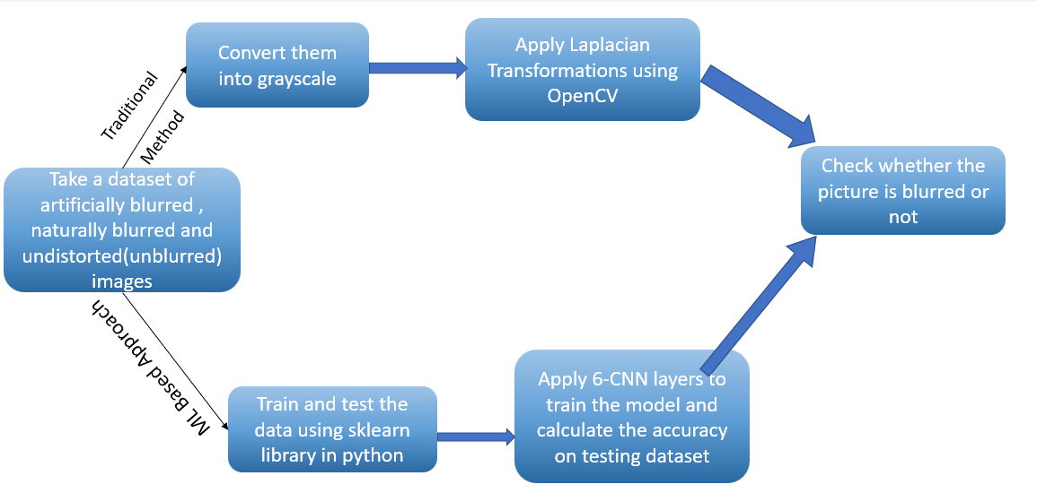
Approach

Slide 6
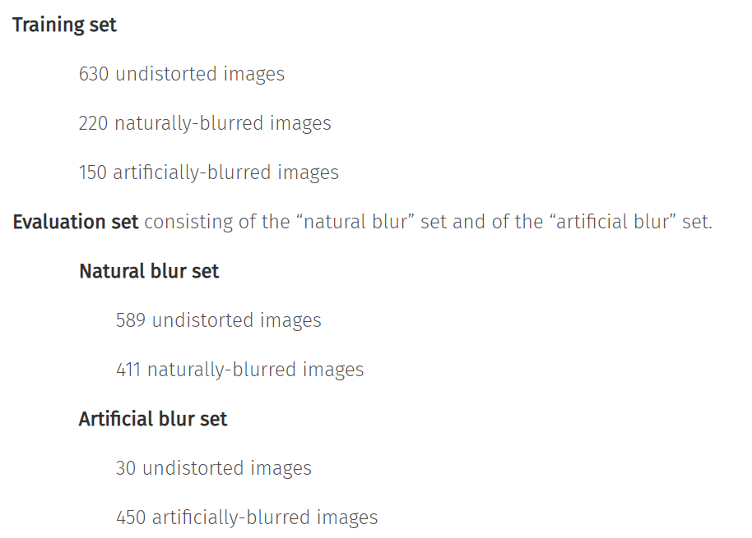
Dataset
Name : Certh Image Dataset
Link : http://mklab.iti.gr/files/imageblur/CERTH_ImageBlurDataset.zip
It contains 2450 digital images.
It contains training and evaluation directories in which there exists other two directories namely Naturally-blurred, artificially-blurred and undistorted image directories in training set and Naturally blurred and artificially blurred directories under evaluation set of Certh image blur dataset.
Naturally Blurred Directory : When there is any disturbance in the movement of the camera while clicking the picture, the image obtained is said to be naturally blurred
Artificially Blurred Directory : If the lens of the camera is not focused, then the image obtained is said to be artificially blurred.
Undistorted Directory : If the image is clear without any disturbance, then it is said to be undistorted.

Slide 7
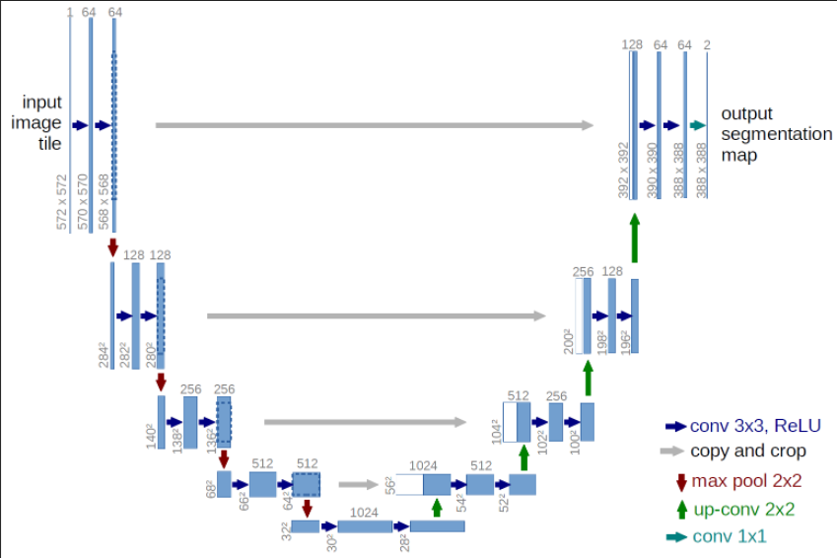
Architectural Design

Slide 8
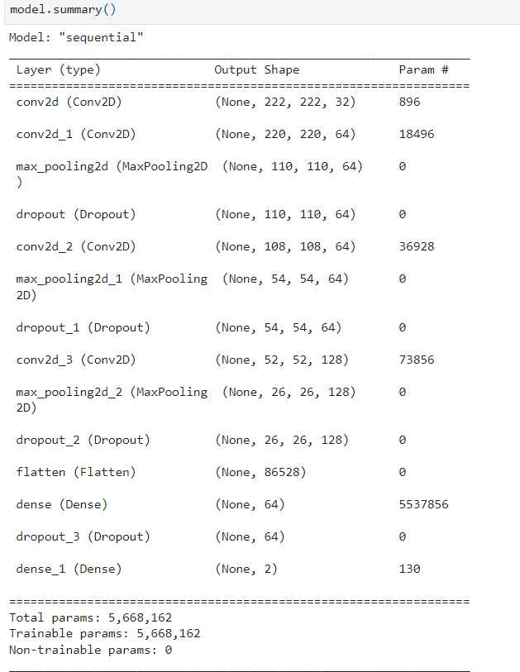
Implementation
The very first thing that we have to do in this project is data collection - we have collected data from GitHub
Next, we have done the data cleaning – we have checked whether the image is corrupted or not and then we have cross verified whether the images are placed correctly in there respective directories or not.
Now we have used Sequential technique – CNN to train our model. We have added 3 pooling layers, 3 dense layers, 3 dropout layers, 3 convolution layers, 1 flatten layer and, the activation functions used to train our model is ReLU and Soft Max. ReLU is used in Hidden Layers and SoftMax is used in the output layer

Slide 9
Implementation
The architecture is as follows
Input Layer <-> Conv-pool <-> Conv-Pool-dropout <-> Conv-pool-flatten <-> Dense-Dropout <-> Dense-Dropout <-> Dense(Output Layer)
Using the above architecture we have trained the model. And then we have achieved a good accuracy.
Then we have added a generic user interface where the user gives an image as an input to the model and our trained model predicts whether the input image is blurred or not.

Slide 10
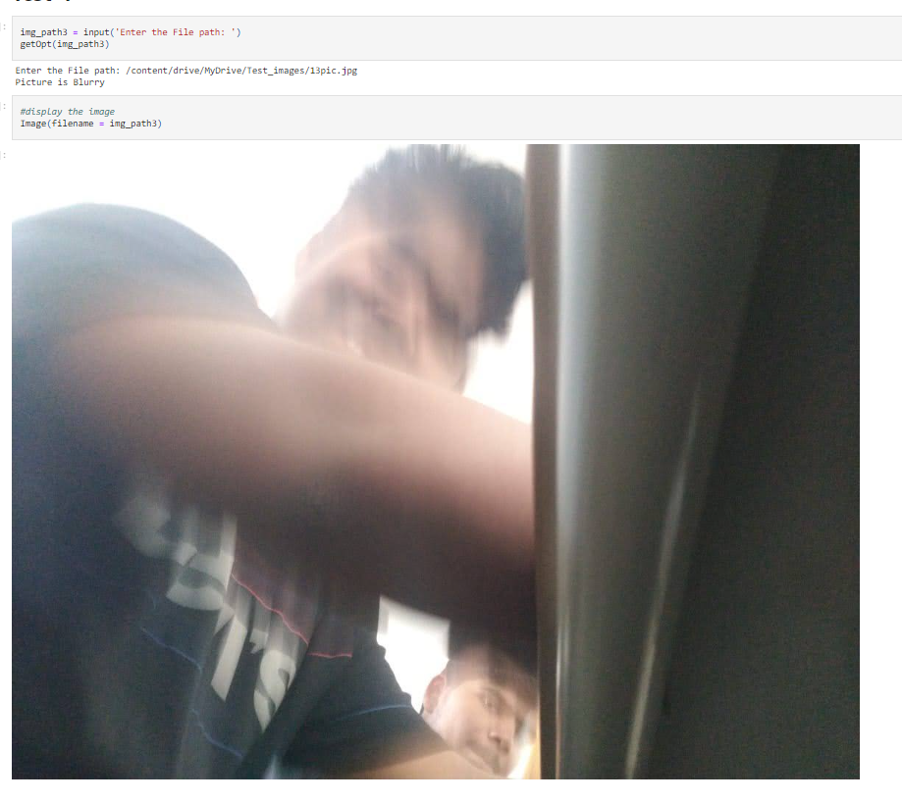
Input/Output
The input to the model is an image :

Slide 11
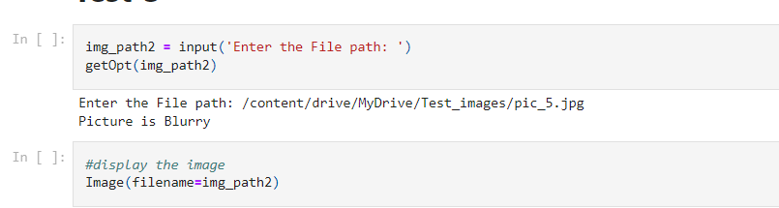
Input/Output
Output should predict whether an image is blurry or not

Slide 12
Conclusion
BeClear is a mobile or a desktop application where an image of any kind is given as an input to the system and it tells us whether the image is blurred or clear. This application is installed in the cameras, where if the picture which is clicked is blurry, it gives a warning that the picture clicked is blurry.
In future, we would like to extend this project and deblur the picture which is detected as blur and convert it to a clear picture using GAN’s in deep learning.

Slide 13
References
[1] https://github.com/ILasya/Image-Quality-Detection/blob/main/CNN-Model-Evaluation.ipynb
[2] https://www.youtube.com/watch?v=nHQDDAAzIsI
[3] https://github.com/priyabagaria/Image-Blur-Detection
[4] Tomasz Szandała, Convolutional Neural Network for Blur Images Detection as an Alternative for Laplacian Method,2021.
[5] Xiaoli Sun, Qiwei Wang, Xiujun Zhang, Chen Xu and Weiqiang Zhang, Deep blur detection network with boundary-aware multi-scale features, June 2021.
[6] Kai Zeng , Yaonan Wang, Jianxu Mao, Junyang Liu. Weixing Peng, and Nankai Chen, A Local Metric for Defocus Blur Detection Based on CNN Feature Learning,2018.
[7] Beomseok Kim, Hyeongseok Son, Seong-Jin Park , Sunghyun Cho , and Seungyong Lee, Defocus and Motion Blur Detection with Deep Contextual Features,2018.
[8] Caglar Senaras, M. Khalid Khan Niazi, Gerard Lozanski, Metin N. Gurcan, DeepFocus: Detection of out-of-focus regions in whole slide digital images using deep learning, October 2018.

Slide 14
THANK YOU

