Slide 1


Knowledge Based Article Portal

Slide 2

Knowledge Base Portal
Teams often struggle to find and share the right information when it's needed. Content is scattered across emails, personal notes, and local drives, making it difficult to maintain consistency and accessibility. Without a standardized process for creating, reviewing, and managing knowledge articles, documentation becomes disorganized and inefficient. This leads to repeated efforts, miscommunication, and reduced overall productivity.
Knowledge Base Article Management System:
A centralized and streamlined platform designed to simplify the way teams create, manage, and access information across the organization.

Slide 3
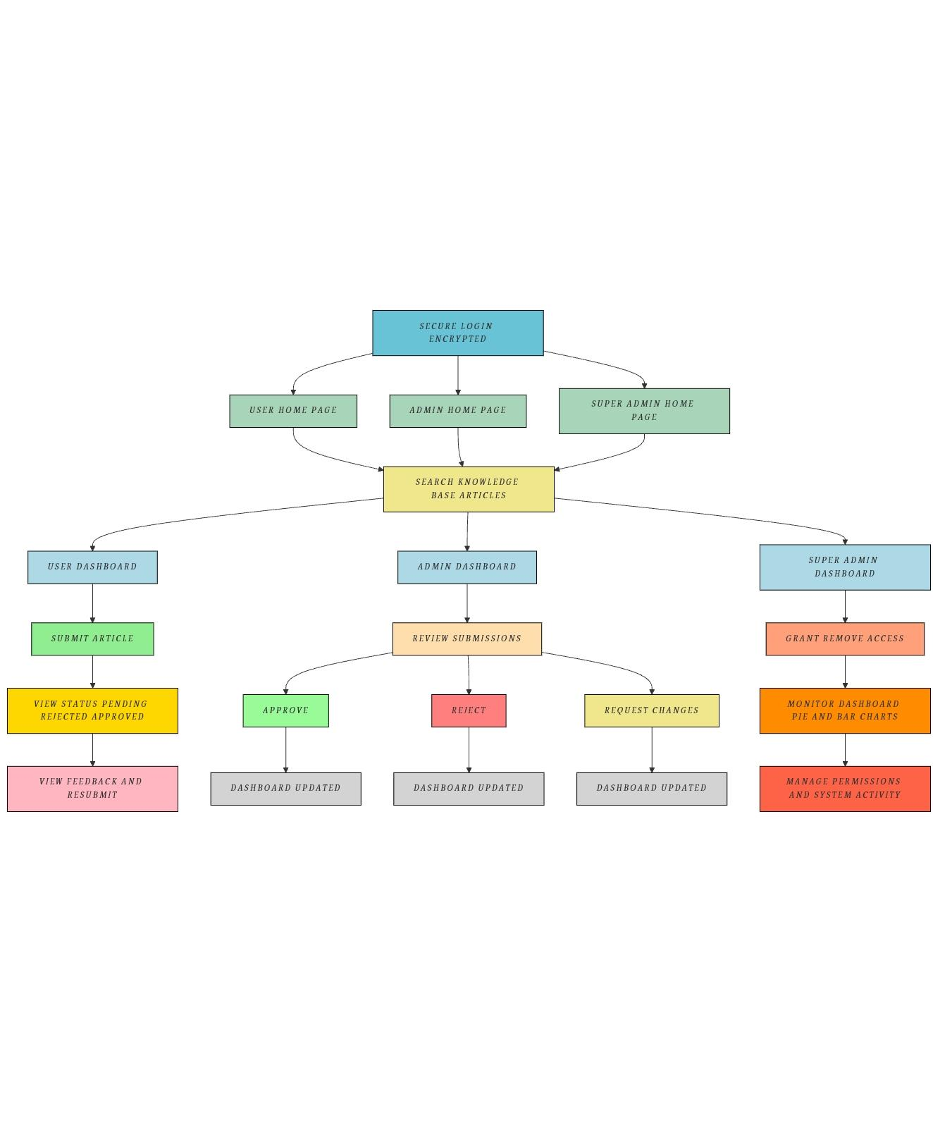
The KB Article is designed with role-based workflows
Workflow

Slide 4

Technology Used
Frontend Technologies
HTML
CSS
JavaScript
Bootstrap
Backend Technologies
Framework: Flask
Database: MySQL
Programming Language: Python

Slide 5
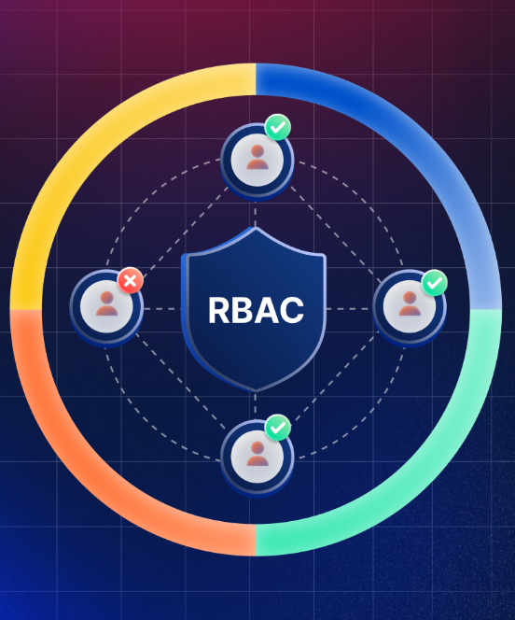
How does It Work - Role-Based Flows
Role-based flows
User Can submit new articles, track their status (Pending, Approved, Rejected), view feedback on rejected articles, edit and resubmit them, and see a breakdown of their submissions by technology.
Admin Can approve, reject with comments, or request changes.
Super Admin Can grant/revoke user permissions, oversee all user activities, and monitor system-wide metrics using advanced dashboards with visual insights.

Slide 6

Benefits Of The KB Article Portal
Centralized Knowledge Access: A unified platform for storing and accessing all articles, ensuring consistency and easy retrieval across teams.
Efficient Search Mechanism: Articles can be searched using either the Article ID or Title, allowing users to quickly locate relevant content and saves time.
Comprehensive Article Submission: Users can submit articles with detailed descriptions and attach supporting documents such as PDFs or Word files for added context.
Improved Knowledge Sharing: Verified articles help new employees ramp up faster and reduce dependency on individual team members by offering reliable self-service content.

