Slide 1
SECOND REVIEW

Slide 2

Project Title: AI-Powered Contract Intelligence & Compliance Suite
Team Members : NITHYA SRI A
RANJANI S
Guide Name : Mr. ELANGOVAN C
Project coordinator name: Mrs. JAICHITRA VASUDEVAN N I
Batch No : 5
SDG Goal : SDG 16 – Peace, Justice, and Strong Institutions

Slide 3
BASE PAPER
Hybrid Legal Clause Classification: Integrating Supervised BERT with Reinforcement Learning 2025
Author Name : Shruthi Bhushan,Hemaditya AVS,Arpita Verma
Conference : IEEE 5th Conference Publication
Year : 2025
Publisher : IEEE

Slide 4
ABSTRACT
Problem Statement:
Legal professionals, businesses, and startups often deal with complex regulations that require extensive review, comparison, and compliance analysis. Manual contract analysis is time-consuming, error-prone, and prelegal legal documents such as contracts, agreements, and policy expertise. Additionally, understanding historical case relevance and ensuring regulatory compliance across industries remains ires a daunting challenge for non-lawyers and small legal teams.
Objectives:
92% of legal professionals say manual contract review is one of the most time-consuming tasks. — EY Law Survey 2021
Average lawyer review cost per contract: \$450 to \$1,500 , depending on complexity. — Thomson Reuters Legal Cost Survey
65% of small business owners in the U.S. couldn’t define "indemnity", "liability", or "force majeure" correctly. — Stanford Legal Design Lab (2022)
70% of legal professionals say comparing contract versions manually leads to missed clause changes . — ContractPodAI Report, 2023
62% of Indian MSMEs are unaware of key legal obligations , including labor, environmental, and data laws. — NASSCOM India MSME Legal Compliance Survey, 2023

Slide 5
Significance Of The Project:
Automates tedious legal reviews by breaking down contracts into machine-readable components.
Helps law firms, legal tech platforms, and businesses ensure contract compliance faster.
Reduces human error and increases consistency in clause interpretation.
Enables downstream tasks like risk detection, obligation tracking, and contract comparison.
Can serve as a base for intelligent contract analytics, AI legal assistants, or legal audit tools.

Slide 6
SOCIAL RELEVANCE
How the Project Benefits Society:
Democratizes legal knowledge – Makes contracts easier for all to understand.
Promotes transparency & trust – Highlights obligations, risks, and key terms.
Saves time & cost – Faster and more affordable legal reviews.
Supports justice & accountability (SDG 16) – Encourages fair agreements and compliance.
Drives digital transformation (SDG 9) – Brings AI innovation to legal services.
Empowers vulnerable communities – Reduces exploitation from lack of awareness.
Link to UN SDGs:
SDG 16 – Peace, Justice & Strong Institutions (access to justice, accountability).
Real-World Importance:
Speeds up contract reviews & compliance checks.
Prevents disputes by flagging risks early.
Enables faster, data-driven legal decisions.

Slide 7
INTRODUCTION
In the modern legal and business environment, contracts and agreements play a vital role in defining rights, obligations, and risks between parties. However, these documents are often lengthy, complex, and filled with technical legal language, making them difficult for non-experts to understand. Manual review of such documents is time-consuming, costly, and prone to human error, especially when dealing with large volumes in corporate, governmental, or NGO contexts. The increasing demand for faster, more accurate, and accessible legal analysis has driven the need for automation in the legal domain. This project leverages Artificial Intelligence (AI) and Natural Language Processing (NLP) techniques to automatically extract, segment, and classify clauses from legal documents, providing clear and structured insights. By doing so, it aims to enhance transparency, reduce review time, minimize disputes, and make legal understanding accessible to individuals, small businesses, and organizations, thereby contributing to a more inclusive and efficient legal system.

Slide 8
LITERATURE SURVEY
LEGAL-BERT: Pretrained Transformers for Legal NLP – 2020
This work adapts BERT to the legal domain by pretraining it on a large corpus of legal documents (like court opinions, contracts, legislation). The goal is to improve downstream legal NLP tasks such as classification, named entity recognition, and question answering with domain-specific understanding.
LEDGAR: A Large-Scale Legal Clause Dataset – 2020
LEDGAR is a benchmark dataset containing millions of labeled clauses extracted from legal contracts. It's widely used to train and evaluate models on clause classification tasks and has become foundational for legal clause-level NLP research.
ClauseRec: Clause Recommendation for Legal Contracts – 2021
ClauseRec proposes a system that recommends relevant clauses to legal professionals during contract drafting. It uses context-aware retrieval and ranking techniques, including NLP embeddings, to suggest clauses that are legally appropriate based on existing contract content.

Slide 9
ConReader: A Transformer-Based Contract Understanding Model – 2022 ConReader is a transformer-based model specifically designed to comprehend contracts. It tackles tasks like clause segmentation, entity recognition, and Q&A within contracts, offering improved interpretability and accuracy over generic models.
Long Legal Documents: Modelling Long-Form Legal Texts with Transformers – 2022 This research explores how transformers (like Longformer, BigBird) can handle very long legal documents that exceed the standard input length of BERT. It addresses challenges in scaling NLP models to entire contracts, legal briefs, or case law documents.
LegalPro-BERT: Improving Clause Classification with Domain-Specific Training – 2024 LegalPro-BERT improves clause classification by fine-tuning a legal-domain model with more precise clause-level supervision and legal-specific features. It emphasizes high accuracy and generalizability across various contract types.

Slide 10
Getting Started with Google BERT: Build and train state-of-the-art natural language processing models using BERT - 2021 Getting Started with Google BERT (2021) introduces the BERT architecture, its pre-training methods, and practical fine-tuning for tasks like sentiment analysis, NER, QA, and summarization. It also covers BERT variants, lightweight models, multilingual versions, and domain-specific adaptations for real-world NLP.
Financial Text Sentiment Analysis Based on DK-BERT Model and Its Application in Market Forecasting - 2025 The model improves sentiment classification accuracy in financial news and reports, and its predictions are applied to enhance stock market trend forecasting.
Bert-BiLSTM Model for Sentiment Analysis Using Contextual Embeddings and Bidirectional Dependencies – 2024 This hybrid approach improves sentiment classification accuracy by leveraging both deep semantic representation from BERT and sequential context modeling from BiLSTM.

Slide 11
Network Public Opinion Sentiment Analysis based on Bert Model – 2022 Applies BERT to analyze sentiment in large-scale online public opinion data, such as social media posts and forums. By leveraging BERT’s contextual understanding, the model achieves higher accuracy in detecting positive, negative, and neutral sentiments, aiding in timely monitoring of public opinion trends
BERT-IAN Model for Aspect-based Sentiment Analysis – 2020 Integrates BERT for rich contextual embeddings with the Interactive Attention Network (IAN) to model the relationship between aspect terms and their surrounding context. This combination enhances the accuracy of identifying sentiment polarity toward specific aspects within a sentence or document.
Unlocking Data with Generative AI and RAG: Enhance generative AI systems by integrating internal data with large language models using RAG – 2024 how Retrieval-Augmented Generation (RAG) can integrate internal, domain-specific data with large language models to improve relevance and accuracy. It explains the RAG pipeline—retrieving relevant documents, combining them with model prompts, and generating informed responses—showing applications in enterprise knowledge management and decision-making.

Slide 12
RAG Powered LLMs for QA: Evolution, Challenges, Applications, and Future Directions – 2025 reviews the evolution of Retrieval-Augmented Generation in question answering systems, detailing how combining document retrieval with large language models improves answer accuracy and reduces hallucinations. It discusses current challenges such as retrieval quality, context integration, and scalability, and outlines future directions for more robust, domain-adapted QA solutions.
Implementation of RAG Based Question-Answering Application - 2025presents a practical system that combines a retriever to fetch relevant documents with a generator (LLM) to produce context-aware answers. It details the architecture, data preprocessing, and integration steps, demonstrating improved accuracy and relevance compared to standalone language models.
A Comprehensive RAG-Based LLM for AI-Driven Mental Health Chatbot – 2025 designs a mental health support chatbot that uses Retrieval-Augmented Generation to combine large language models with curated mental health resources.

Slide 13
PROPOSED SYSTEM
ARCHITECTURE:AI-powered legal document analysis pipeline.
User Uploads a Legal Document
The user uploads a PDF or DOCX file through the React UI.
The document is sent to the backend via the API Gateway.
Document Ingestion & Pre-Processing
The system accepts the uploaded document.
If the document is scanned or contains images, OCR (Optical Character Recognition) is applied to extract text.
Language detection runs to identify the language of the document.
Long documents are split into smaller, logical chunks called clauses.
The raw text and metadata are stored in object storage (like S3) for easy retrieval.
Clause Segmentation & Metadata Extraction
Using rules (e.g., headings, numbering) and a sentence-boundary model, the system marks where each clause starts and ends.
It identifies important metadata such as definitions, parties involved, dates, and obligation verbs in the clauses.
This creates a detailed JSON array that acts as the "source of truth" for the document's structure.
.

Slide 14
Risk Assessment Service
The classified clauses are evaluated against a three-tier risk model: Low, Medium, High.
Risk scoring uses rules (e.g., missing termination notice → High risk), machine learning features (clause
length, modal verbs), and LLM prompt scoring for complex cases.
The system generates a risk heatmap showing the risk profile of the entire contract.
Contract Version Comparator
If the user compares different versions of a contract, the system aligns clauses between old and new documents.
It detects added, deleted, or modified clauses using semantic similarity and Levenshtein distance.
The changes are highlighted in the UI with color badges for easy review.
LawGPT Conversational Interface
The system embeds all clause texts into a vector database (like Milvus).
When the user asks questions, their query is embedded, relevant clauses retrieved and ranked, and then
an LLM (like GPT-4o or Llama-3) generates a natural language answer referencing specific clauses.
The chat supports follow-up questions by preserving context.

Slide 15
Compliance Checklist Builder
Based on industry-specific YAML rule packs (e.g., FinTech, Healthcare), the system generates checklists.
It produces statutory obligations, filing requirements, document templates, and deadlines.
Users can mark checklist items as Done, Pending, or Overdue via the dashboard.
Human-in-the-Loop Feedback Loop
Reviewers can manually override clause labels or risk scores in the UI.
Corrections are logged and periodically used to fine-tune the classification models, keeping the system updated with new legal language and firm-specific standards.
API Gateway & Security Layer
All user requests go through the API Gateway, which handles authentication (JWT/OIDC), role-based access control (Lawyer, Reviewer, Admin), and request tracing.
Ensures secure and controlled access to services, rate limiting, and consistent error handling.

Slide 16
Precedent & Case-Law Retriever
Users can input case summaries or clauses to retrieve relevant court decisions.
The system searches an Elastic Search index with k-NN for similar precedents.
It returns similar cases along with a short AI-generated summary of outcomes, helping lawyers assess litigation risks.

Slide 17
HARDWARE / SOFTWARE SPECIFICATIONS
Hardware:
CPU: 8+ cores (e.g., Intel i5 or server-grade)
GPU: NVIDIA RTX 3060+ for small use; A100/4090+ for large-scale
RAM: 16 GB+ (more for bigger datasets)
Storage: Fast SSD, 1 TB+
Software:
OS: Windows
Language: Next js ( React ) , Tailwind css , Javascript ,
Libraries: Hugging Face Transformers, Neon DB (vector DB), LangChain
Backend: Express JS

Slide 18
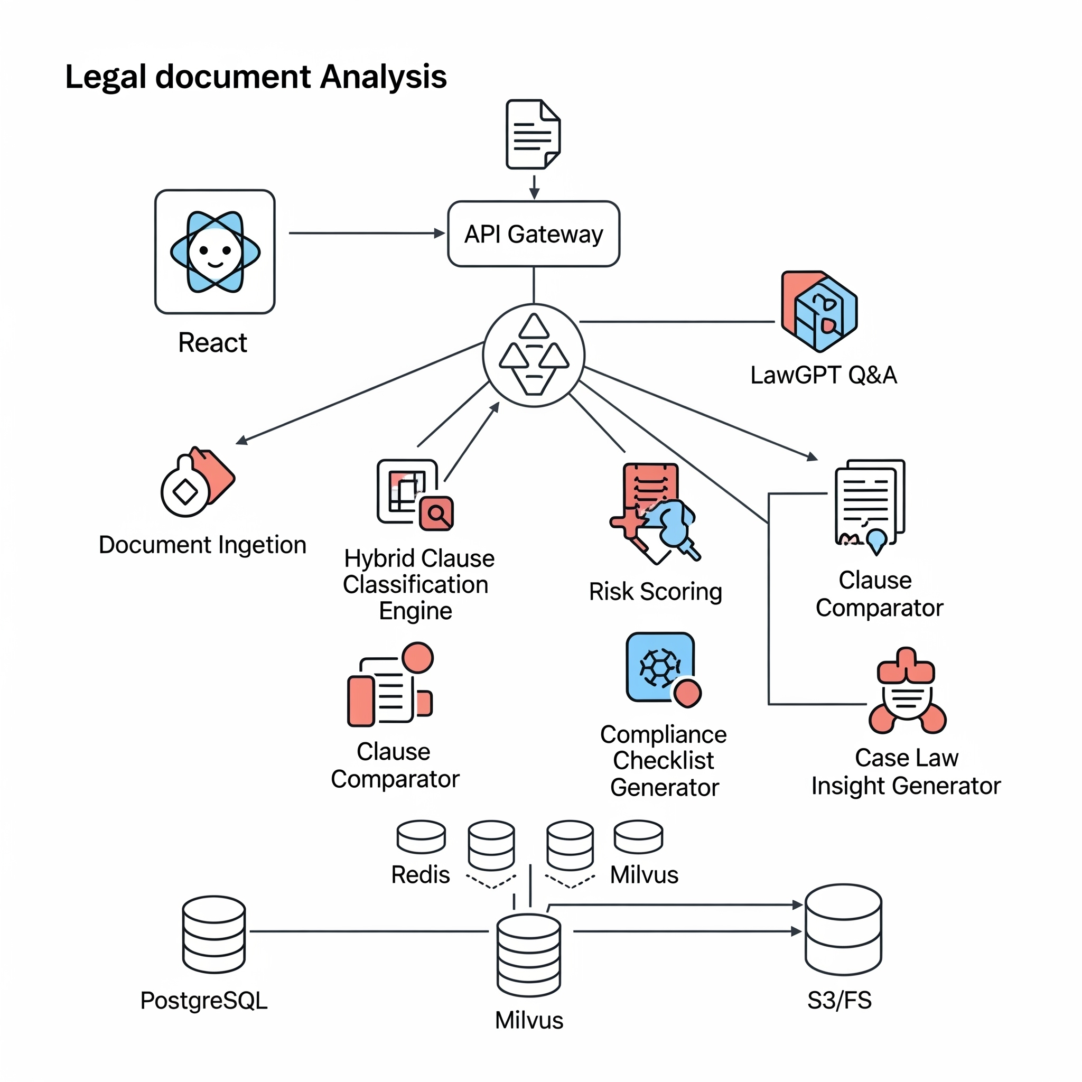
ARCHITECTURE DIAGRAM

Slide 19
MODULES EXPLANATION
ARCHITECTURE:AI-powered legal document analysis pipeline.
MODULES :
Document Ingestion & Pre‑Processing Accepts PDF/DOCX uploads from the UI, performs OCR when needed, detects language, and splits long files into logical clause‑sized chunks. Results (raw text + metadata) are sent to downstream services and stored in an object bucket (e.g., S3) for re‑use.
Clause Segmentation & Metadata Extractor Uses rule‑based cues (headings, numbering) plus a BERT sentence‑boundary model to mark clause start/end, identify definitions, parties, dates, and obligation verbs. Outputs a JSON array—one record per clause with positional offsets—forming the “source of truth” for all later tasks.
Hybrid Clause Classification Engine Fine‑tuned Legal‑BERT supplies initial clause labels (e.g., Indemnity, Termination). A lightweight Reinforcement‑Learning head then refines predictions by rewarding document‑level coherence and any human corrections delivered through the feedback UI. Produces the final label, confidence score, and feature embeddings for each clause.

Slide 20
Risk Assessment ServiceMaps classified clauses to a three‑tier risk model (Low / Medium / High) using an ensemble of:rule look‑ups (e.g., missing termination notice → High),gradient‑boosted tree features (clause length, modal verbs count), and LLM prompt scoring for edge cases.Returns a heat‑mapped risk profile for the entire contract.
Contract Version ComparatorTakes two clause lists (old vs. new), aligns them with semantic similarity and Levenshtein distance, then flags added / deleted / modified segments. The diff is streamed to the front‑end viewer, where color badges (green = added, red = deleted, yellow = edited) highlight the precise wording changes.
Law GPT Conversational Interface Embeds all clause texts into a vector store (Milvus / Qdrant). A user query is embedded, top‑k clauses retrieved, re‑ranked with a cross‑encoder, and passed—along with citations—to an LLM (Llama‑3 or GPT‑4o) that generates a natural‑language answer with inline clause references. Supports follow‑up questions by preserving chat context tokens.

Slide 21
Precedent & Case‑Law Retriever When given a case summary or a clause, computes its embedding and searches a court‑decision index (stored in ElasticSearch with k‑NN). Returns the most similar precedents plus a Gen AI‑written 5‑line outcome abstract, allowing lawyers to assess litigation risk quickly.
Compliance Checklist Builder Loads YAML rule packs per industry (FinTech, SaaS, Healthcare). On user selection, produces:statutory obligations,required filings,document templates, andcalendarised deadlines.Integrates with the Dashboard so legal ops teams can mark items as Done, Pending, or Overdue.
Human‑in‑the‑Loop Feedback LoopFront‑end reviewers can override a clause label or risk level. Every correction is logged in an “RL Reward Buffer” table and periodically used to fine‑tune the RL policy network—keeping the classifier current with evolving legal language and firm‑specific standards.
API Gateway & Security Layer All services sit behind a single GraphQL (or REST) gateway that enforces JWT/OIDC authentication, role‑based access (Lawyer, Reviewer, Admin), request tracing, and rate limiting. Provides consistent error messages and simplifies future integration with external tools (e.g., CLM, e‑sign).

Slide 22
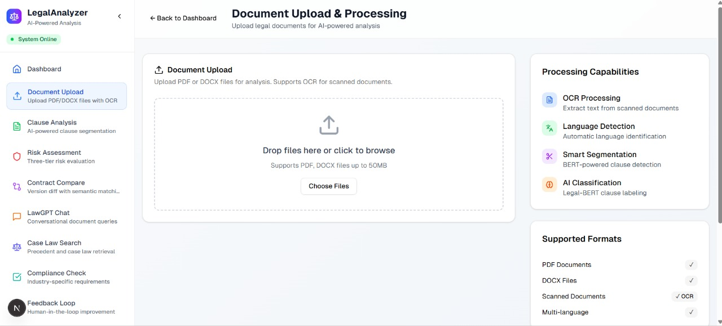
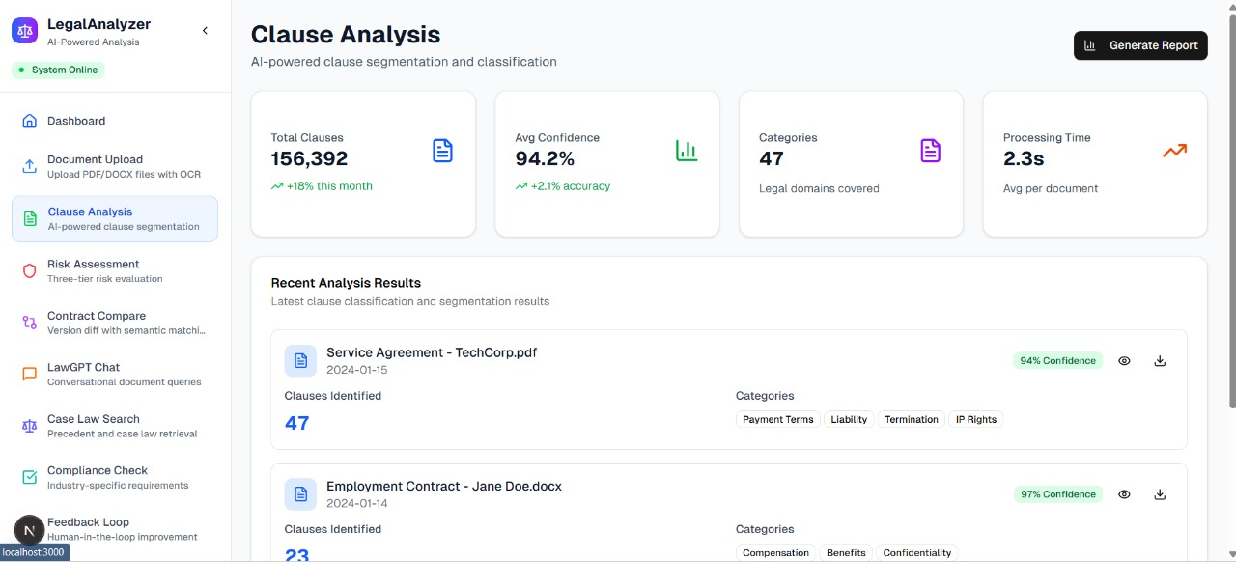
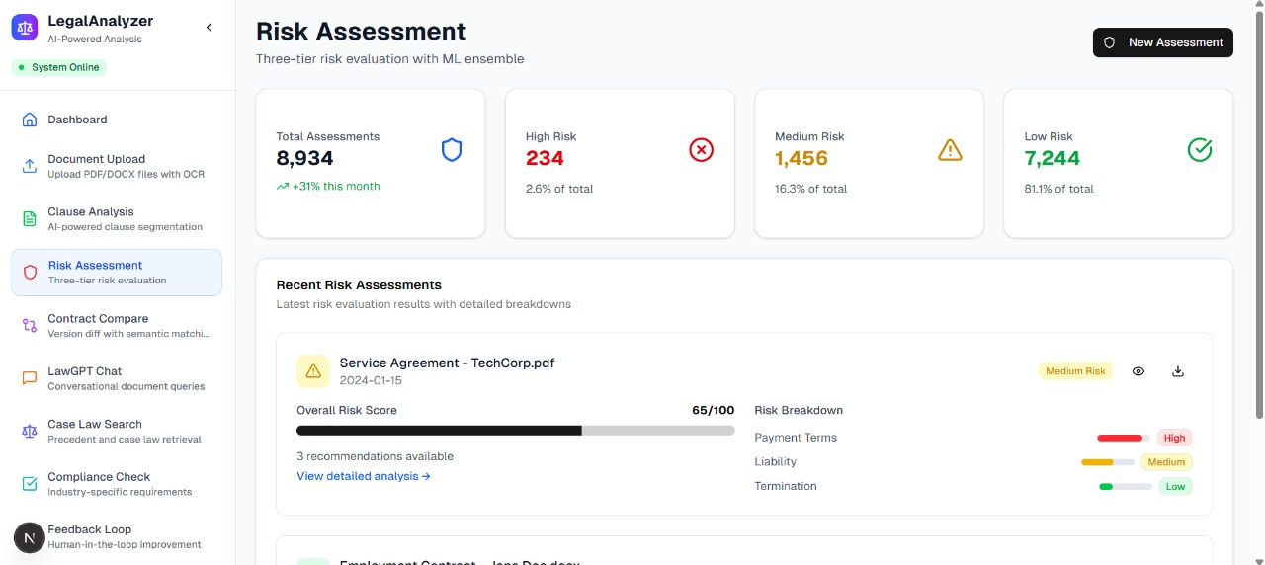
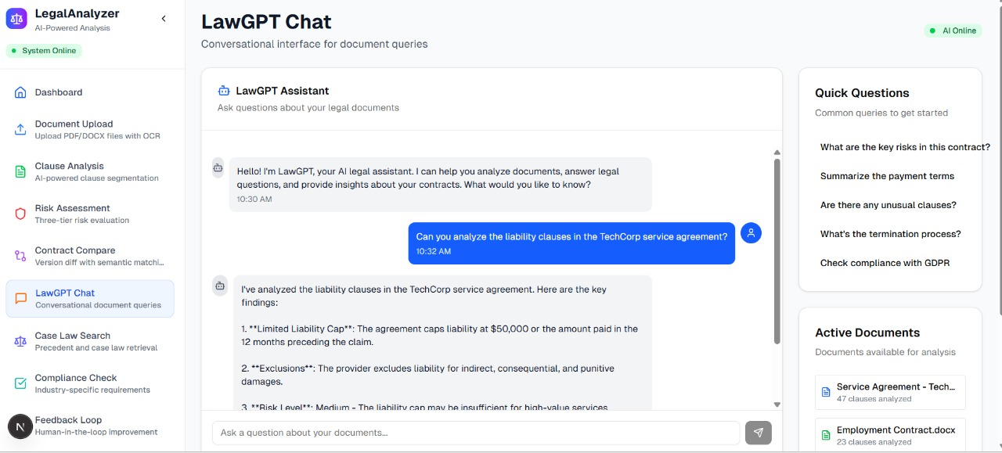
SCREENSHOTS/SIMULATION

Slide 23
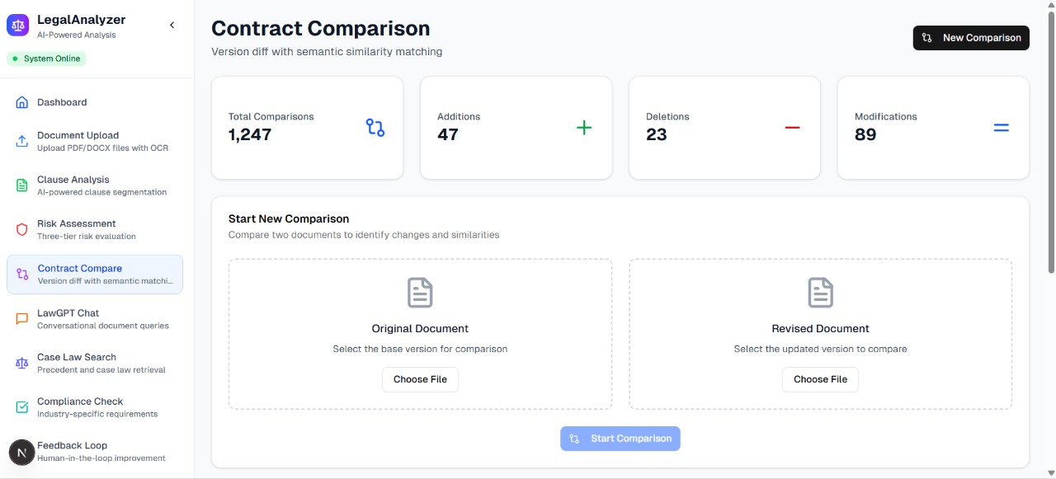
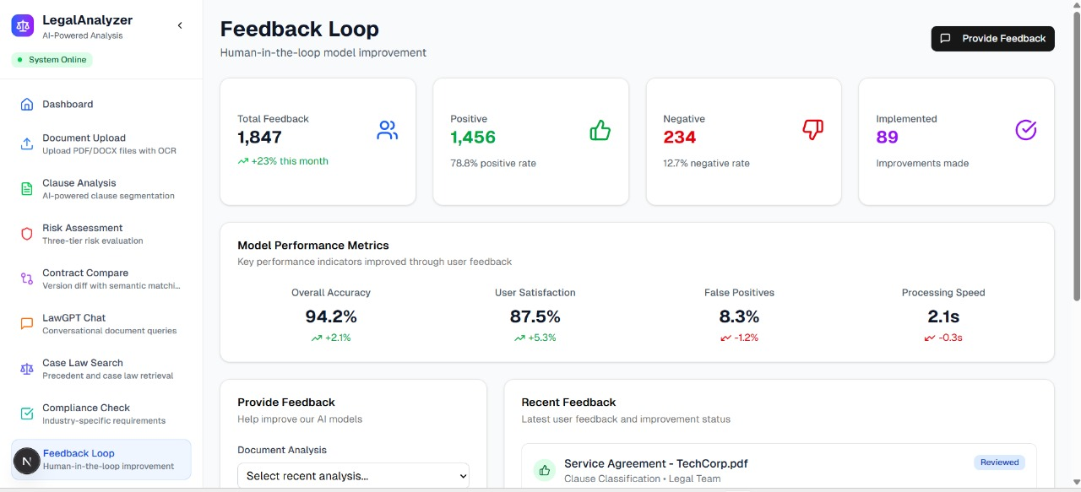
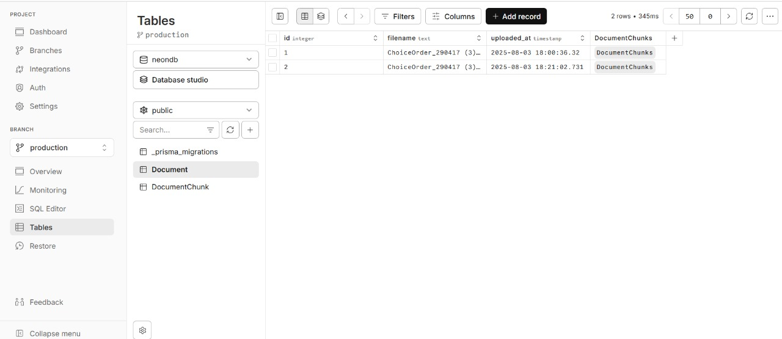
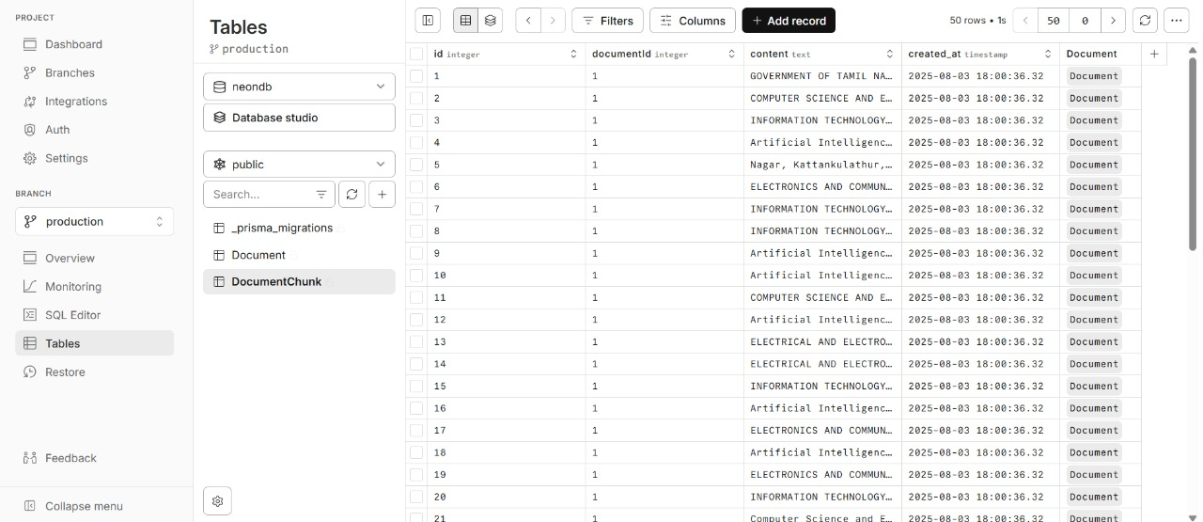

Slide 24
CONCLUSION
This project successfully demonstrates how Artificial Intelligence and Natural Language Processing can automate the extraction, segmentation, classification, and risk assessment of legal clauses from contracts and agreements. By significantly reducing the time, cost, and effort required for legal reviews, the system enhances transparency, minimizes human error, and makes legal understanding accessible to a wider audience. The integration of a user-friendly web interface ensures that both legal professionals and non-experts can benefit from quick and accurate document analysis.

Slide 25
FUTURE SCOPE
Integration with OCR – Support for scanned images of legal documents to handle non-digital contracts.
Multi-language Support – Expansion to handle contracts in multiple regional and international languages.
Advanced Risk Analytics – Incorporation of predictive analytics to forecast potential legal disputes.
Cloud Deployment – Hosting the system online for global accessibility and real-time collaboration.
Blockchain Integration – For secure, tamper-proof storage and verification of processed contracts.
Custom Clause Libraries – Allowing users to create and train models on their own organization-specific clauses.

Slide 26
REFERENCES
Hybrid Legal Clause Classification: Integrating Supervised BERT with Reinforcement Learning| IEEEConference Publication | IEEE Xplore
A Collaborative Human-AI Guided Decision Framework - Gen-Edge-AI | IEEEConference Publication | IEEE Xplore
Crime Pulse: Crime hot-spot detection using Machine Learning and Gen-AI* | IEEEConference Publication | IEEE Xplore
A Legal Judgment Prediction Model Based on BERT, Attention, and Graph Convolutional Network| IEEEConference Publication | IEEE Xplore
Self Supervised Bert for Legal Text Classification | IEEEConference Publication | IEEE Xplore

