Slide 1

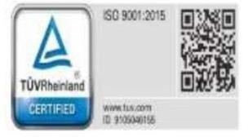
VIVEKANANDHA COLLEGE OF ENGINEERING FOR WOMEN
(Autonomous)
DEPARTMENT OF COMPUTER SCIENCE AND ENGINEERING
CROWD SOURCED CIVIC ISSUE REPORTING AND RESOLUTION SYSTEM
DOMAIN : FULL STACK DEVELOPMENT
BATCH NO : 05
TEAM MEMBERS:
NITHYA R | - IV/CSE B (612922101072)
SUBASRI M | - IV/CSE B (612922101116)
SUPRITHA R | - IV/CSE B (612922101119)
Project Guide
Mrs.N.SUDHA B.Tech.,M.E.,
AP/CSE

Slide 2
ABSTRACT
The Crowdsourced Civic Issue Reporting and Resolution System is a mobile-first digital platform designed to bridge the gap between citizens and local authorities by enabling real-time reporting of civic issues such as potholes, damaged streetlights, waste overflow, and sanitation problems. Citizens can easily submit reports with photos, GPS-based location details, and brief descriptions, which are displayed on a centralized, interactive dashboard for municipal officials. The system automatically categorizes, prioritizes, and routes complaints to the appropriate departments, ensuring faster response and improved accountability. Citizens can track the status of their reports and receive notifications at every stage of resolution. Supported by a scalable backend and analytics-driven insights, the platform enhances operational efficiency, promotes transparent governance, and contributes to cleaner and greener cities in alignment with the Clean & Green Technology theme.

Slide 3
INTRODUCTION
Rapid urbanization has increased the number of civic issues such as road damage, improper waste management, drainage blockage, and malfunctioning public infrastructure in cities. Traditional complaint systems mainly rely on manual reporting methods, phone calls, or physical visits to municipal offices, which often result in delays, lack of transparency, and inefficient issue tracking. To overcome these challenges, digital solutions are required to simplify communication between citizens and government authorities. The proposed Crowdsourced Civic Issue Reporting and Resolution System utilizes modern web technologies to provide an easy and efficient platform where citizens can actively participate in reporting local problems, enabling authorities to monitor, prioritize, and resolve issues systematically for improved urban management.

Slide 4
EXISTING SYSTEM
Civic issues are reported manually through phone calls, ward offices, or paper complaints
No centralized digital platform to track complaints
Citizens cannot upload photos or live locations
Complaints are often delayed, lost, or duplicated
No real-time status tracking for citizens
Municipal staff rely on manual sorting and forwarding

Slide 5
PROPOSED SYSTEM
The proposed system introduces a smart and centralized digital platform that enables citizens to report civic issues in real time by uploading images, location details, and problem descriptions through a web or mobile interface. All reported issues are displayed on an interactive city map dashboard, allowing authorities to easily identify problem locations. The system automatically routes complaints to the appropriate municipal department, reducing manual work and response delays. An admin dashboard is provided to filter, prioritize, and update the status of complaints efficiently. Citizens can track the live status of their reported issues and receive notifications regarding progress and resolution. This system enhances transparency, improves service efficiency, and encourages active public participation in city management.

Slide 6
LITERATURE SURVEY
Hashem et al. (2018) – “The Role of Big Data in Smart City Development”
Discussed the use of cloud and big data technologies for efficient urban service management.
Ismagilova et al. (2019) – “Smart Cities: Advances in Research—An Information Systems Perspective”
Explained how digital citizen engagement platforms improve governance transparency.
Alam & Noor (2020) – “ICT-Based Civic Engagement Framework for Smart Cities”
Proposed mobile applications for citizen participation in reporting civic issues.
Kumar et al. (2020) – “Location-Based Complaint Management System Using GPS Technology”
Introduced GPS-enabled systems for accurate civic issue identification.
Sharma & Gupta (2021) – “Online Grievance Redressal System for Smart Governance”
Developed digital complaint systems to reduce manual processing delays.

Slide 7
Rahman et al. (2021) – “Smart Municipal Monitoring Using Real-Time Data Systems”
Presented real-time monitoring methods for urban infrastructure management.
Patel & Doshi (2022) – “Web-Based Civic Issue Reporting and Management System”
Designed an online platform integrating image-based complaint verification.
Li et al. (2022) – “Artificial Intelligence for Urban Infrastructure Monitoring”
Explored AI techniques for detecting and managing city infrastructure problems.
Singh et al. (2023) – “Crowdsourced Smart City Complaint Management Framework”
Proposed citizen-driven reporting systems to improve accountability.
Verma & Kaur (2024) – “Intelligent Civic Issue Tracking and Notification System”
Developed automated complaint routing with notification-based updates.

Slide 8
MODULE 1
User Authentication & Authorization
Description
This module manages secure user access to the system by providing registration and login functionalities. It verifies user identity and controls access based on user roles.
Points
User registration using name, email, and password
Secure login authentication
Google Sign-In support
Role-based access control (Citizen/Admin)
JWT-based session management

Slide 9
MODULE 2
Citizen Dashboard & Profile Management
Description
The citizen dashboard provides a centralized interface where users can access system services such as reporting issues and tracking complaints.
Points
Displays dashboard after login
Access to report new issues
View reported complaints
Profile and navigation management

Slide 10
MODULE 3
Issue Reporting System
Description
This module allows citizens to report civic problems by submitting issue details along with supporting images and location information.
Points
Submit civic issue details
Upload issue images
Select issue category
Capture location information

Slide 11
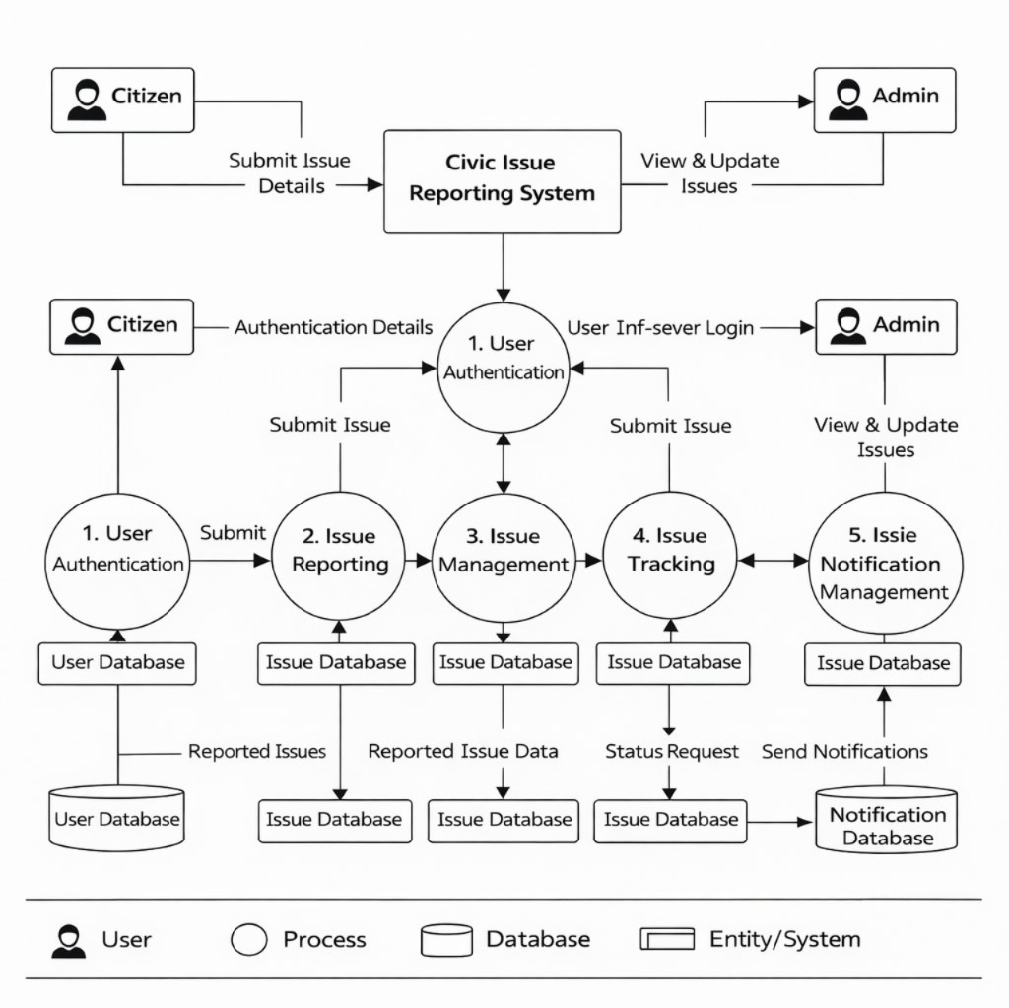
DATAFLOW DIAGRAM

Slide 12
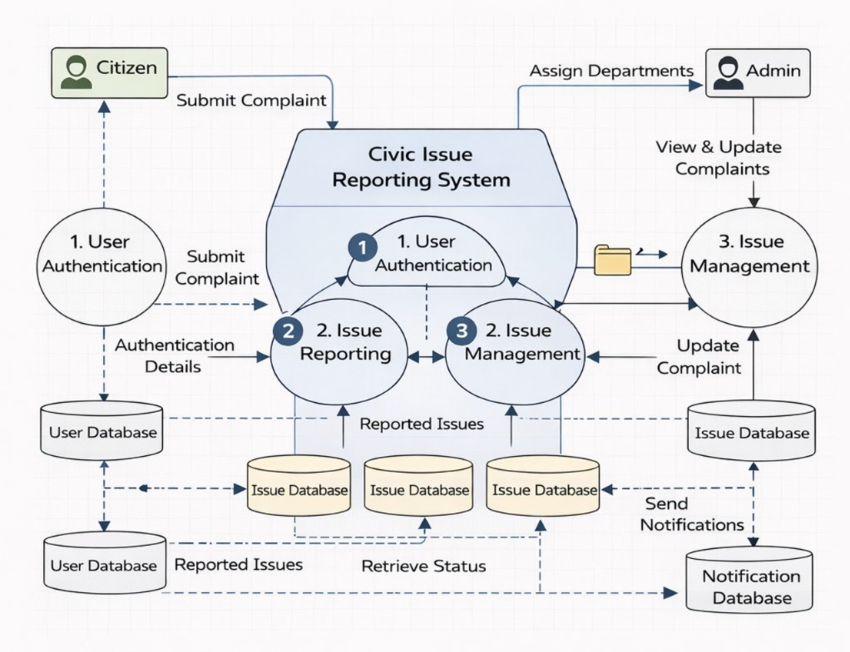
OVERALL DIAGRAM

Slide 13
SOFTWARE REQUIREMENTS
Operating System: Windows / Linux
Frontend: HTML, CSS, JavaScript
Backend: Node.js / Python
Database: MySQL
IDE: Visual Studio Code
Web Browser: Google Chrome
Authentication: JWT / Google OAuth
Map API: Google Maps / Leaflet

Slide 14
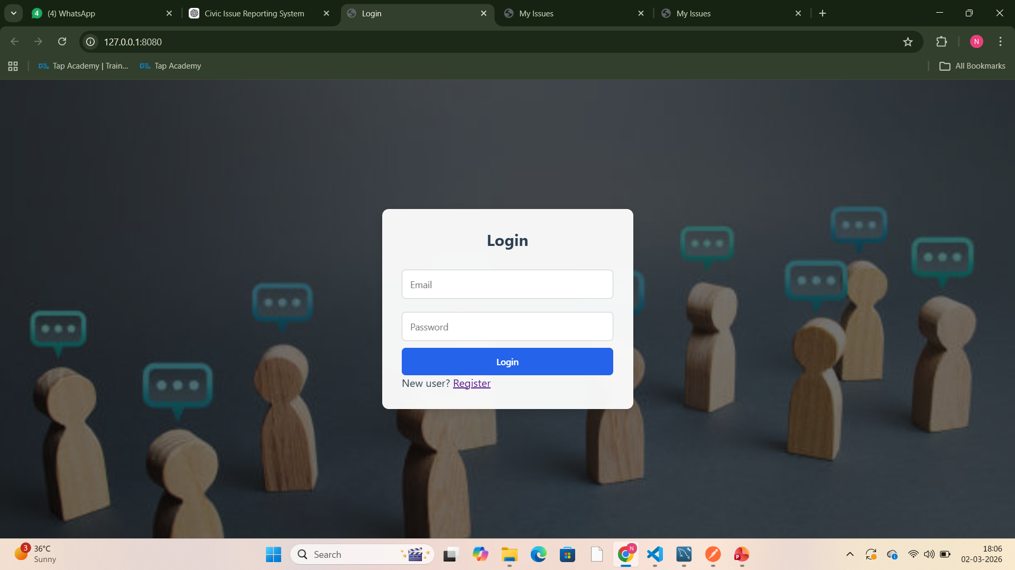
OUTPUT

Slide 15
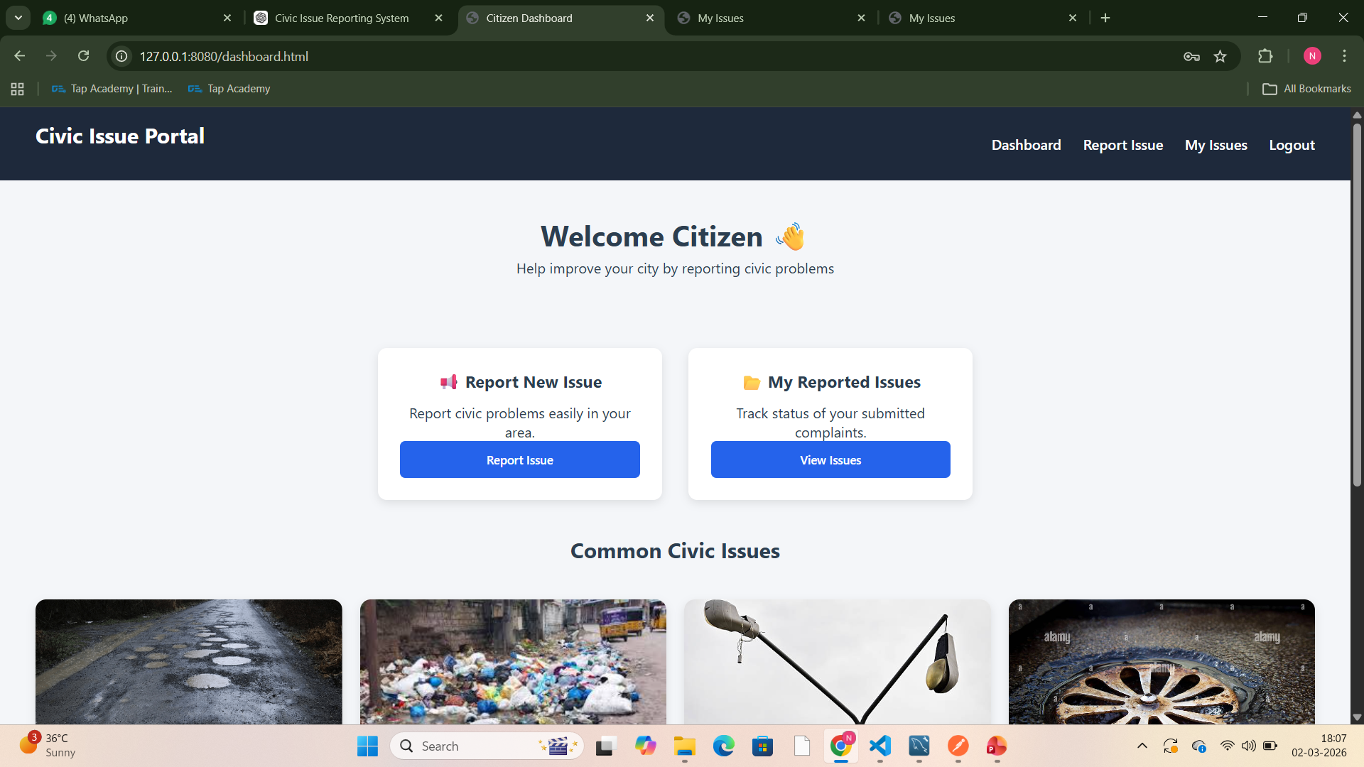

Slide 16
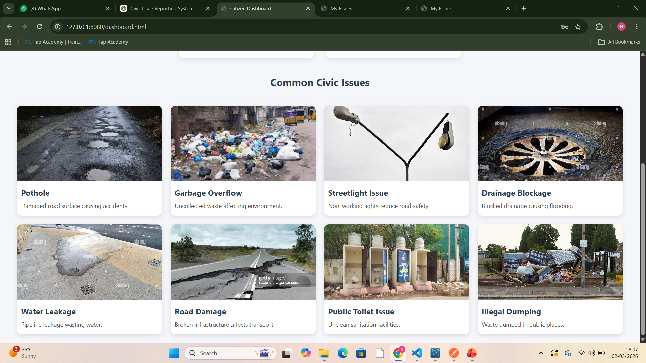

Slide 17
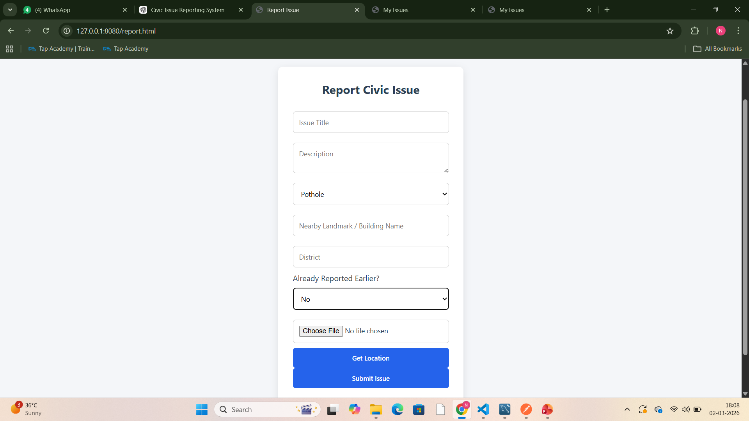

Slide 18
REFERENCE
Sheth, et al., “Crowdsourcing for Smart Cities: Applications and Challenges,” IEEE Internet Computing
World Bank, “Crowdsourcing in Urban Governance: Lessons from Developing Countries”
S. Brabham, “Crowdsourcing Public Participation in Urban Planning,” Journal of Planning Literature
UN E-Government Survey 2022: “Digital Government in the Post-Pandemic Era”
S. Haklay, “Citizen Science and Crowdsourced Geographic Information: Overview and Typology”

