Slide 1

Department of Information Science and Engineering
EduMate
Quality education
Quality Education, Livelihood And Creative Opportunities
Nithya RC – 1NH22IS106 Project guide Name : Ms. Divya K V
Sahana NR – 1NH22IS143 Assistant professor
Sanjana HL – 1NH22IS147
Poornima T – 1NH22IS196

Slide 2
AGENDA
Abstract
Introduction
Literature Survey
Problem Statement
Design
Use case/class/Sequence Diagram
Methodology
Algorithm
Flowchart
Implementation
Results
Societal Benefits
Conclusion
Paper indexing/acceptance status

Slide 3
ABSTRACT
EduMate is a personalized virtual teaching platform designed to provide a collaborative, inclusive, and multilingual learning environment. It supports real-time language translation, enabling students from diverse linguistic backgrounds to learn effectively. Teachers can log in to upload recorded videos or conduct live sessions, while students can access lessons, resources, and participate in real-time activities. Key features include smart role assignment (like peer tutor or guide), reminders, to-do lists, notes, bookmarks, a smart study timer, and flashcard creation. The platform integrates AI to suggest study materials, monitor participation, and generate performance feedback. EduMate is built using Python and Flask for the backend, HTML/CSS/JavaScript for the frontend, SQLite for data storage and login authentication, and Google Translate API for real-time translation. These technologies were chosen for their simplicity, portability, and suitability for educational app development. Overall, EduMate aims to enhance engagement, accessibility, and personalized learning using easy yet effective tools.

Slide 4
INTRODUCTION
EduMate is a personalized virtual teaching platform for collaborative and inclusive learning.
Supports multilingual students with real-time language translation using Google Translate API.
Teachers can upload recorded lessons or conduct live sessions via dedicated login portals.
Students can access lessons, interact in real-time, and use smart study tools.
Features include:
Smart role assignment (peer tutor/guide)
Reminders, to-do lists, notes, bookmarks
Smart study timer and custom flashcards
AI integration provides material recommendations, tracks participation, and gives performance insights.
Built with Flask, HTML/CSS/JavaScript, SQLite, and Python for rapid and accessible development.

Slide 5
Literature Survey
Title | Year of publication | Method in brief | Gap | Your novelity
A Virtual Teaching Assistant for Personalized Learning | 2019 | Developed chatbot-based virtual teaching assistant using IBM Watson to enhance student learning. | Limited to a specific course; lacks adaptability to diverse subjects. | Expandable framework adaptable across multiple domains and subjects.
Web-based Evaluation System for Online Courses and Learning Management Systems | 2018 | Introduced a web-based tool for feedback collection to improve online course content and platform usability. | Dependent on user surveys; evaluates course design but not actual learning outcomes. | Integrates automated analytics to measure both course design and student outcomes.
The Effectiveness of a Personalized Virtual Fitness Trainer | 2020 | Applied AI algorithms to create a virtual fitness trainer for physical education. | Focused solely on physical education; limited application scope. | Extendable to diverse learning fields beyond physical education.
Personalized Education for Teachers | 2016 | Introduced personalized education concepts tailored for teacher development. | Purely theoretical; no empirical validation. | Design data-driven models with real implementation for teachers.

Slide 6
PROBLEM STATEMENT
To develop a collaborative learning platform that supports real-time translation for multilingual students and assigns roles like peer tutor or guide. The platform should include interactive sessions with teachers and AI-driven assistance to enhance personalized learning, ensure smooth communication, and create an inclusive learning environment for students from diverse language backgrounds

Slide 7
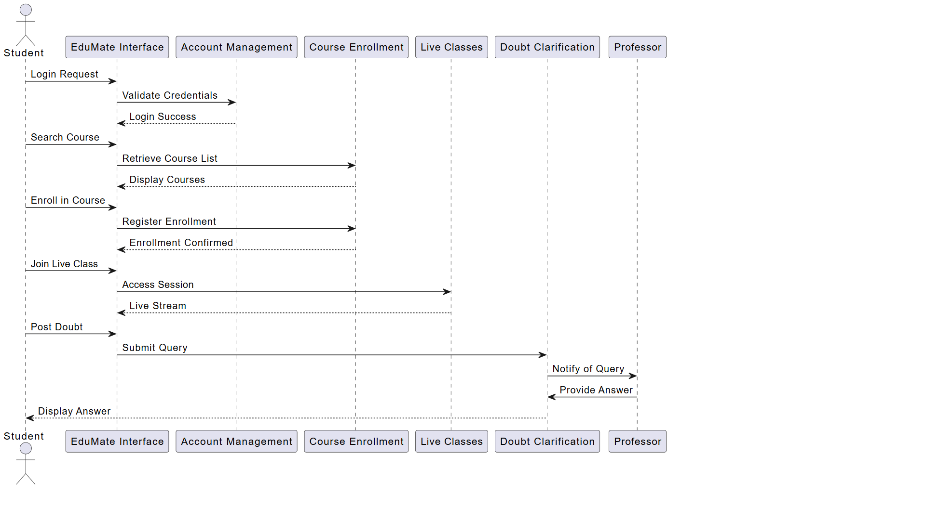
Design
Sequence diagram of Edumate System

Slide 8
Sequence Diagram
Shows how a student interacts with the EduMate System modules.
The student logs in, and credentials are verified by the Account Management module.
After login, the student searches and enrolls in a course through the Course Enrollment module.
The student joins live classes via the Live Classes module.During or after class, the student posts doubts, which go to the Doubt Clarification module.
The professor receives and responds to the query, and the answer is displayed to the student.

Slide 9
Methodology
Approach: Developmental Research Methodology
Designed, developed, and iteratively tested EduMate prototype.
Steps Followed:
Requirement Analysis:
Identified challenges in existing LMS (language barriers, lack of personalization, no real-time assistance).
Defined needs: secure login, multilingual lessons, quizzes, chatbot support.
System Design:
Role-based modular architecture (Admin, Teacher, Student).
RESTful API endpoints for login, register, lesson upload, quiz, chatbot.
Implementation:
Flask backend + SQLite for persistence.
Streamlit for simple, interactive frontend dashboards.
Testing & Validation:
Functional testing with sample users (login success, lesson uploads, quiz scoring).

Slide 10
Algorithm
1. Start
2. User selects role → Student / Professor / Admin
3. Login or RegisterIf new user, create accountIf existing user, validate credentials
4. If login successful:Display dashboard based on user role
5. For Student:Search and enroll in available coursesAttend live classesAccess uploaded materialsPost doubts for clarificationReceive professor’s responses
6. For Professor:Conduct live classesUpload course materialsView and answer student doubts
7. For Admin:Manage user roles and permissionsMonitor system activities
8. Logout after session completion
9. End

Slide 11
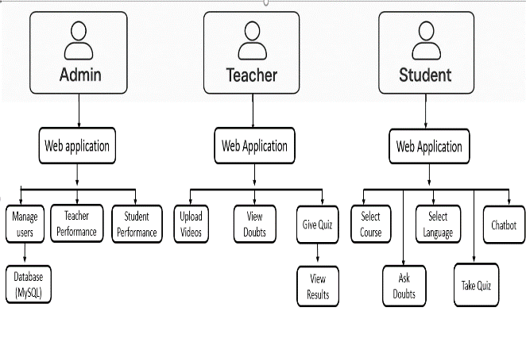
Flowchart:
Role-based access – Admin, Teacher, Student.
Modules:
Admin Module: Manage users, view system activity.
Teacher Module: Upload lessons (YouTube links), create quizzes, evaluate results.
Student Module: View lessons, attempt quizzes with auto-grading, interact with chatbot.
AI Chatbot Module: Provides real-time academic assistance using NLP.
Course Management: Students can explore predefined courses.
Technology Stack:
Backend: Python (Flask REST APIs).
Frontend: Streamlit for UI dashboards.
Database: SQLite (lightweight, portable).

Slide 12
APIs:
Google Translate API (multilingual support).
OpenAI API (AI chatbot).
Data Flow:
User logs in (validated via SQLite).
Teacher uploads lesson/quiz → stored in DB/in-memory list.
Student accesses lessons, quizzes, chatbot.
Chatbot queries OpenAI API for answers.
Responses displayed dynamically on Streamlit frontend.

Slide 13
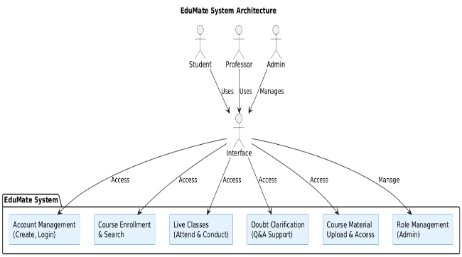
Project implementation
Backend: Flask REST APIs for login, lessons, quizzes, chatbot.
Database: SQLite for lightweight storage of users, lessons, and quizzes.
Frontend: Streamlit interface for simplicity (Dashboards, quizzes, chatbot).
AI Features: NLP chatbot (OpenAI API) for Q&A and support.
Multilingual: Integrated Google Translate API for real-time translation of live text/lessons.

Slide 14
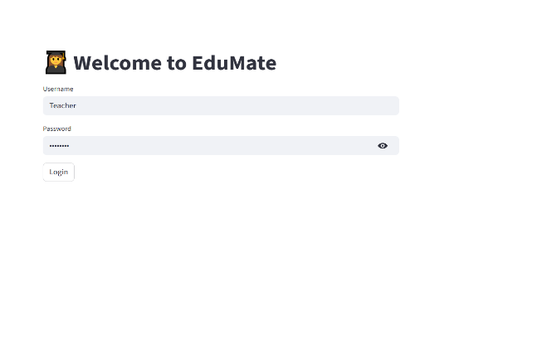
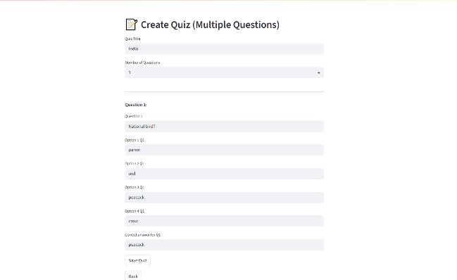
Results
Teacher Login

Slide 15

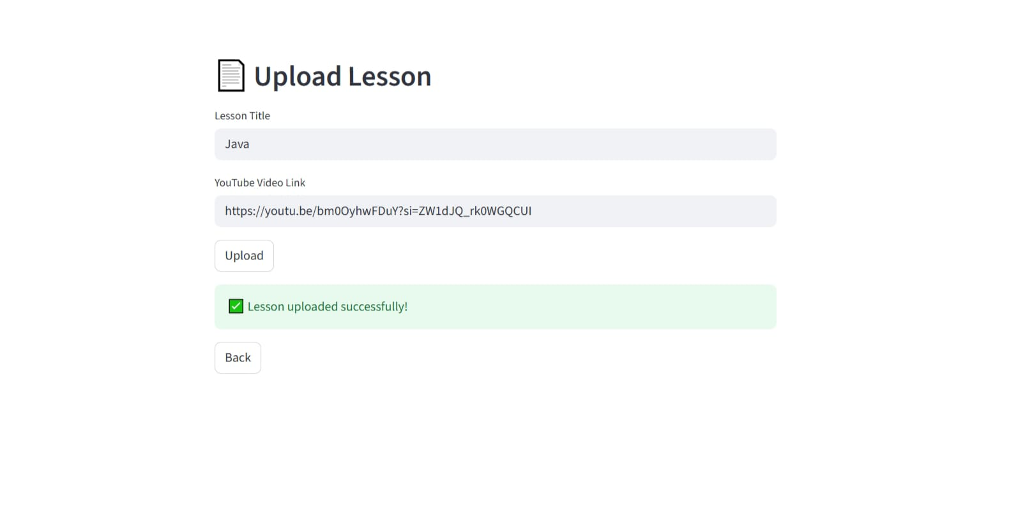

Student Dashboard

Slide 16
Conclusion
EduMate successfully demonstrates a role-based virtual teaching platform that enhances inclusivity, collaboration, and personalized learning. The implementation allows:
Secure multi-role login for Admin, Teacher, and Student.
Lesson uploads with YouTube integration for teachers.
Quiz creation and auto-grading, improving student engagement.
Basic course management and lesson access for students.

Slide 17
Social Benefits
Provides equal access to education for all.
Connects students and teachers effectively.
Promotes continuous and flexible learning.
Saves time and reduces travel costs.Supports remote and inclusive education.
Encourages collaboration and sharing of knowledge.
Empowers teachers to reach more learners.

Slide 18
Future Work
AI Enhancements
Smarter chatbot with domain-specific knowledge.
Adaptive dashboards that recommend study plans based on quiz performance.
Expanded Learning Tools
Live class integration (Zoom/Meet APIs).
Collaborative whiteboards and document sharing.
Multilingual & Accessibility Upgrades
Real-time subtitle translation in live video sessions.
Accessibility features for differently-abled students (speech-to-text, screen reader compatibility).

Slide 19
Paper Indexing/Acceptance status

Slide 20
References
[1] S. Naylor and A. Adjorlu, "ABA-VR: Training Applied Behaviour Analysis Practitioners in Virtual Reality to Support Autistic Children," 2025 IEEE Conference on Virtual Reality and 3D User Interfaces Abstracts and Workshops (VRW), Saint Malo, France, 2025, pp. 556-560, doi: 10.1109/VRW66409.2025.00119.
[2] M. M. Cárdenas, I. M. Álvarez, A. Romero and B. Manero, "A Teacher Training Proposal for Classroom Conflict Management through Virtual Reality," 2021 International Conference on Advanced Learning Technologies (ICALT), Tartu, Estonia, 2021, pp. 373-375, doi: 10.1109/ICALT52272.2021.00120.
[3] E. P. Purwandari and E. W. Winarni, "Knowledge Management of Smart Learning System with Cognitive Level for Higher Education," 2024 Ninth International Conference on Informatics and Computing (ICIC), Medan, Indonesia, 2024, pp. 1-6, doi: 10.1109/ICIC64337.2024.10957621.
[4] M. Liu, P. Liu, R. Lu and X. Jiang, "Intelligent and Personalized Vocational Education: Applications and Strategies," 2024 14th International Conference on Information Technology in Medicine and Education (ITME), Guiyang, China, 2024, pp. 503-507, doi: 10.1109/ITME63426.2024.00106.

Slide 21
[5] Porubay, G. Tashmatova, S. Akhmadjonova, M. Uktamova, S. Kuziev and M. Mirzaakhmedov, "Artificial Intelligence in Language Classrooms: Improving Engagement and Outcomes," 2024 International Conference on IoT, Communication and Automation Technology (ICICAT), Gorakhpur, India, 2024, pp. 335-340, doi: 10.1109/ICICAT62666.2024.10923388.
[6] S. Umirova, S. Mahmadiev, T. Zuparov, A. Yuldashev, A. Abdullayev and N. Sobirova, "AI-Assisted Tutoring Systems: Improving Engagement and Learning Outcomes in Elementary Education," 2024 International Conference on IoT, Communication and Automation Technology (ICICAT), Gorakhpur, India, 2024, pp. 779-784, doi: 10.1109/ICICAT62666.2024.10923307.
[7] C. L. Kok, C. K. Ho, C. Lee, J. B. Wen Heng and T. H. Teo, "Addressing Sustainability Challenges in AI Integration: Data Privacy, Accessibility, and Ethical Considerations," TENCON 2024 - 2024 IEEE Region 10 Conference (TENCON), Singapore, Singapore, 2024, pp. 1294-1297, doi: 10.1109/TENCON61640.2024.10902975.
[8] X. Mitre and M. Zeneli, "Using AI to Improve Accessibility and Inclusivity in Higher Education for Students with Disabilities," 2024 21st International Conference on Information Technology Based Higher Education and Training (ITHET), Paris, France, 2024, pp. 1-8, doi: 10.1109/ITHET61869.2024.10837607.

Slide 22
[9] A. P. Putra, M. Arafik and I. Pratiwi, "Use of Nearpod to Enhance Student Engagement in Online Learning," 2021 7th International Conference on Education and Technology (ICET), Malang, Indonesia, 2021, pp. 298-303, doi: 10.1109/ICET53279.2021.9575062
[10] Acosta Vergara, C. A., Hurtado Mora, M. J., Saucedo James, M. A., &Milanés Gómez, R. (2023). Virtual teaching strategy for online learning of the subject Entrepreneurship and Management at the baccalaureate level.'.

