Slide 1
Civic Lens
Illuminating Indian Democracy
Capstone Project Pitch
An intelligent companion for every citizen to understand and engage with governance

Slide 2
Problem & Vision
Problem:
• Civic information is scattered and complex
• Citizens struggle to understand governance and local policies
• Learning civics feels boring and theoretical
Vision:
• A personalized AI companion for civic learning
• From Gram Panchayat to Parliament
• Transform civics into an interactive journey

Slide 3
Our Solution: Agentic AI System
🦉 Librarian – Organizes laws, data, and documents
🧐 Examiner – Assesses citizen knowledge
🧭 Guide – Recommends the next lesson
🗞️ Reporter – Brings local civic news
🔎 Analyst – Answers deep governance questions
Together, they create a personalized civic learning engine.

Slide 4
User Experience & Learning Path
Citizen Dashboard:
• Gamified path: Novice → Statesman
• Smart revision and adaptive quizzes
• Local governance updates
Curriculum:
• Foundations → Machinery → Constitution → Realpolitik
• 20 progressive levels of civic mastery

Slide 5
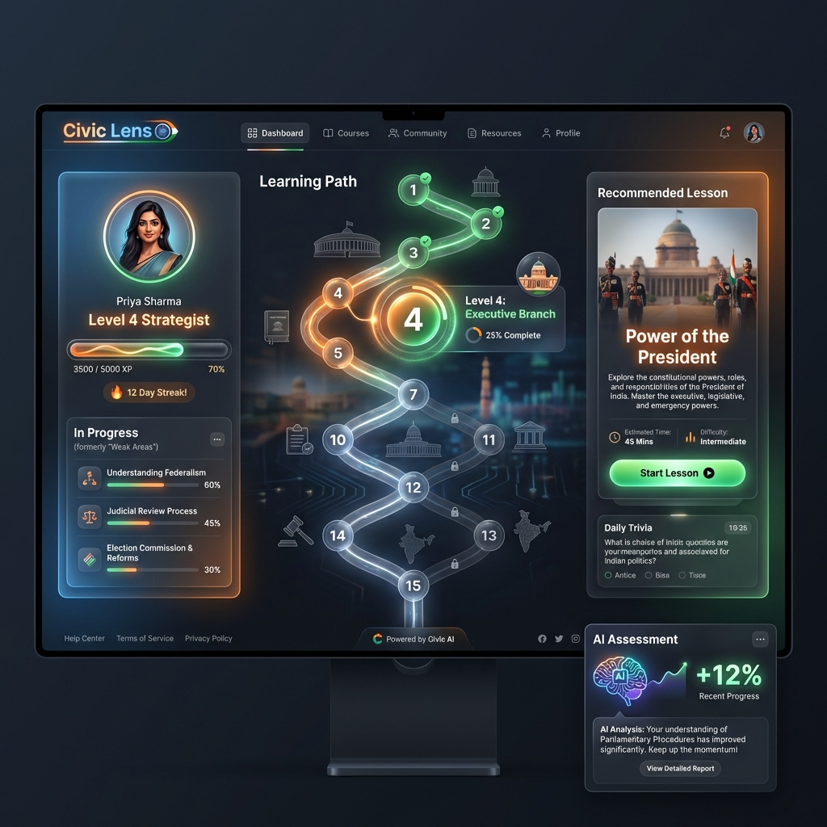

Slide 6
Technology & Execution Plan
Technology Stack:
• Frontend: React + Tailwind CSS
• Backend: FastAPI / Node.js
• AI: LLM-based multi-agent system
• Data: Vector Database
4-Week Plan:
• Week 1: Data ingestion
• Week 2: Assessment engine
• Week 3: Personalized dashboard
• Week 4: UI polish & demo launch

