Slide 1
Disease Prediction Using Machine Learning
BY
NITHYASRI

Slide 2
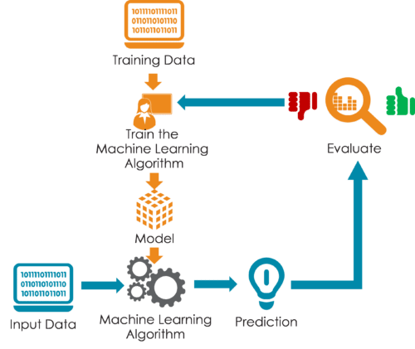
Steps in Machine learning predictions:

Slide 3

Reading the given dataset:-
IMPORTING LIBRARIES :-
Pandas: Essential for data manipulation and analysis, allowing efficient handling of large datasets.
NumPy:Provides support for large, multi-dimensional arrays and matrices, along with a collection of mathematical functions.
Matplotlib & Seaborn: Used for data visualization. Matplotlib creates static, animated, and interactive visualizations, while Seaborn provides a high-level interface for drawing attractive and informative statistical graphics.
Scikit-Learn: A machine learning library that includes tools for model selection, data preprocessing, and more.

Slide 4
Loading the Data:
- We read the dataset from a CSV file to bring it into our environment for analysis and model training.
Previewing the Data:
- The first few rows of the dataset are examined to understand the structure and content, which helps in identifying any immediate issues or patterns.
Dataset Summary:
- A summary of the dataset is generated to get insights into the data types, missing values, and overall structure. This is crucial for understanding the dataset’s suitability for building a predictive model.
Descriptive Statistics:
- Generating descriptive statistics provides a quick overview of the dataset's central tendency, dispersion, and shape of the data distribution, which aids in the initial data analysis phase.

Slide 5
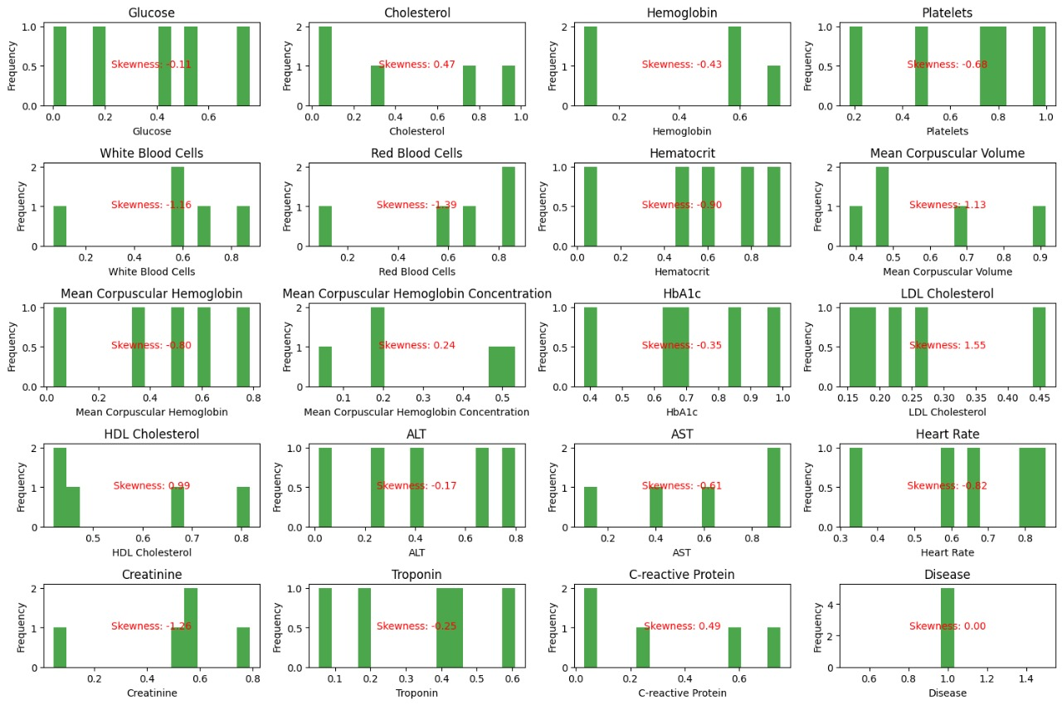
Filtering data and finding anomalies:-
SKEWNESSS:-
Skewness is a measure of asymmetry or distortion of symmetric distribution. It measures the deviation of the given distribution of a random variable from a symmetric distribution, such as normal distribution. A normal distribution is without any skewness, as it is symmetrical on both sides.

Slide 6
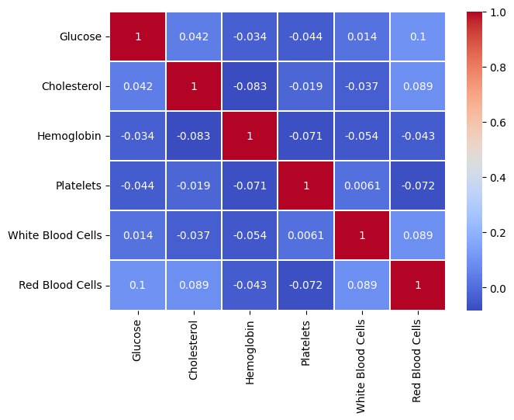
Correlation Plot:-
A correlation plot, also known as a correlation matrix or heatmap, is a graphical representation that shows the correlation coefficients between multiple variables. It helps in visualizing the strength and direction of the relationships between these variables.
Key Features of a Correlation Plot
Matrix Format: The plot typically takes the form of a square matrix where both rows and columns represent the variables being analyzed.
Correlation Coefficients: Each cell in the matrix shows the correlation coefficient between the variables corresponding to that row and column.
1 indicates a perfect positive linear relationship.
0 indicates no linear relationship.
-1 indicates a perfect negative linear relationship.

Slide 7
Training the dataset
We will now train the obtained dataset using various training algorithms and obtain the best training algorithm by calculating the Accuracy, precision, Recall Score and F1 Score.
Various algorithms which are used in this project are:
1. Logistic Regression
2. Support Vector Classifiers
3. Decision Tree Classifier
4. Random Forest Classifier
5. K Nearest Neighbors Classifier
6. Gradient Boosting Classifier

Slide 8
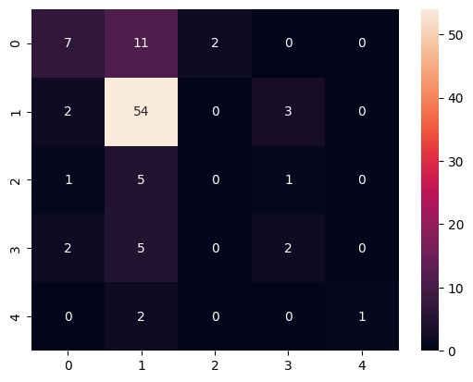
Logistic Regression
Logistic regression is a statistical method used for binary classification problems, where the outcome is a binary variable (i.e., it can take only two possible values, typically coded as 0 and 1). Unlike linear regression, which predicts continuous outcomes, logistic regression predicts the probability that a given input point belongs to a specific class.
Accuracy Score is : 0.6530612244897
Precision is: 0.6530612244897959
Recall is: 0.6530612244897959
F1 score is: 0.6530612244897959

Slide 9
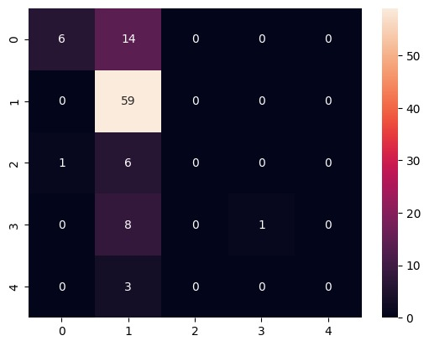
Support Vector Classifier
Support Vector Classifiers (SVC), part of the broader family of Support Vector Machines (SVM), are supervised learning models used for classification and regression analysis. They are particularly effective in high-dimensional spaces and are known for their robustness in handling linearly and non-linearly separable data.
Accuracy Score is : 0.673469387755102
Precision is: 0.673469387755102
Recall is: 0.673469387755102
F1 score is: 0.673469387755102

Slide 10
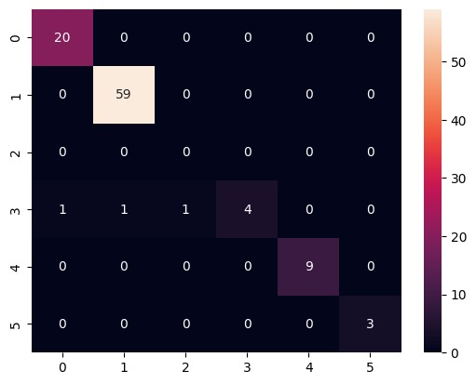
Decision Tree Classifier
A Decision Tree Classifier is a supervised learning algorithm used for both classification and regression tasks. It splits the dataset into subsets based on the value of input features, creating a tree-like model of decisions and their possible consequences. Each internal node of the tree represents a decision on an attribute, each branch represents the outcome of the decision, and each leaf node represents a class label (for classification) or a continuous value (for regression).
Accuracy Score is : 0.969387755102040
Precision is: 0.6836734693877551
Recall is: 0.6836734693877551
F1 score is: 0.6836734693877551

Slide 11
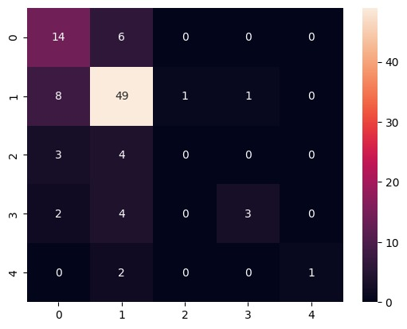
K nearest Neighbors Classifier
The K-Nearest Neighbor (KNN) classifier is a simple, yet powerful, non-parametric algorithm used for classification and regression tasks. It is based on the idea that similar data points are close to each other in the feature space..
Accuracy Score is :0.7040816326530612
Precision is: 0.6636734693877578
Recall is: 0.6836734693877578
F1 score is: 0.6636734693877578

Slide 12
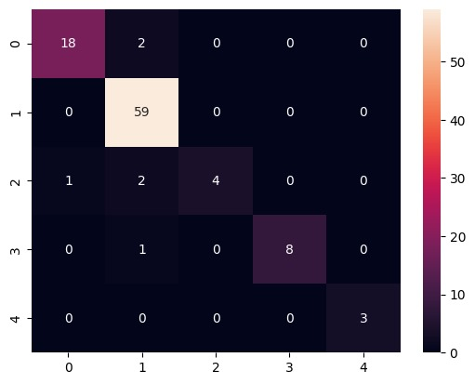
Random Forest Classifier
The Random Forest Classifier is an ensemble learning method that combines multiple decision trees to improve the overall classification performance and robustness. It is widely used for both classification and regression tasks due to its high accuracy, ability to handle large datasets with higher dimensionality, and robustness to overfitting.
Accuracy Score is :0.9387755102040817
Precision is: 0.9387755102040817
Recall is: 0.9387755102040817
F1 score is: 0.9387755102040817

Slide 13
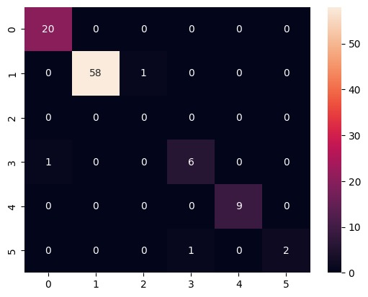
Gradient Boosting Classifier
A Gradient Boosting Classifier is an ensemble learning method that builds a predictive model in a stage-wise manner from a collection of weak learners, typically decision trees. It combines the outputs of many weak learners to produce a powerful predictive model. Unlike methods like Random Forest which build trees independently, Gradient Boosting builds trees sequentially, with each tree attempting to correct the errors of the previous ones.
Accuracy Score is : 0.959387755102040
Precision is: 0.6836734693877557
Recall is: 0.6836734693877551
F1 score is: 0.6836734693877551

Slide 14
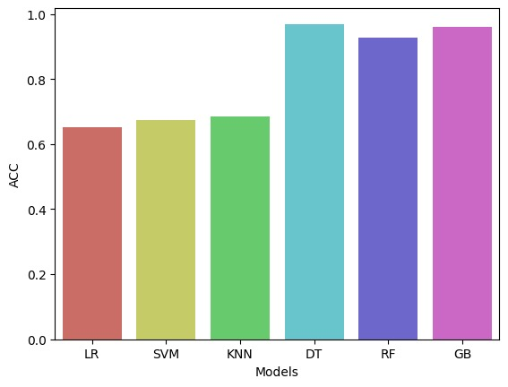
RESULTS:-
The accuracy score of all the training algorithms is shown in this Bar chart and Decision tree has the highest accuracy so it is chosen as the suitable training algorithm for the given data set.

Slide 15
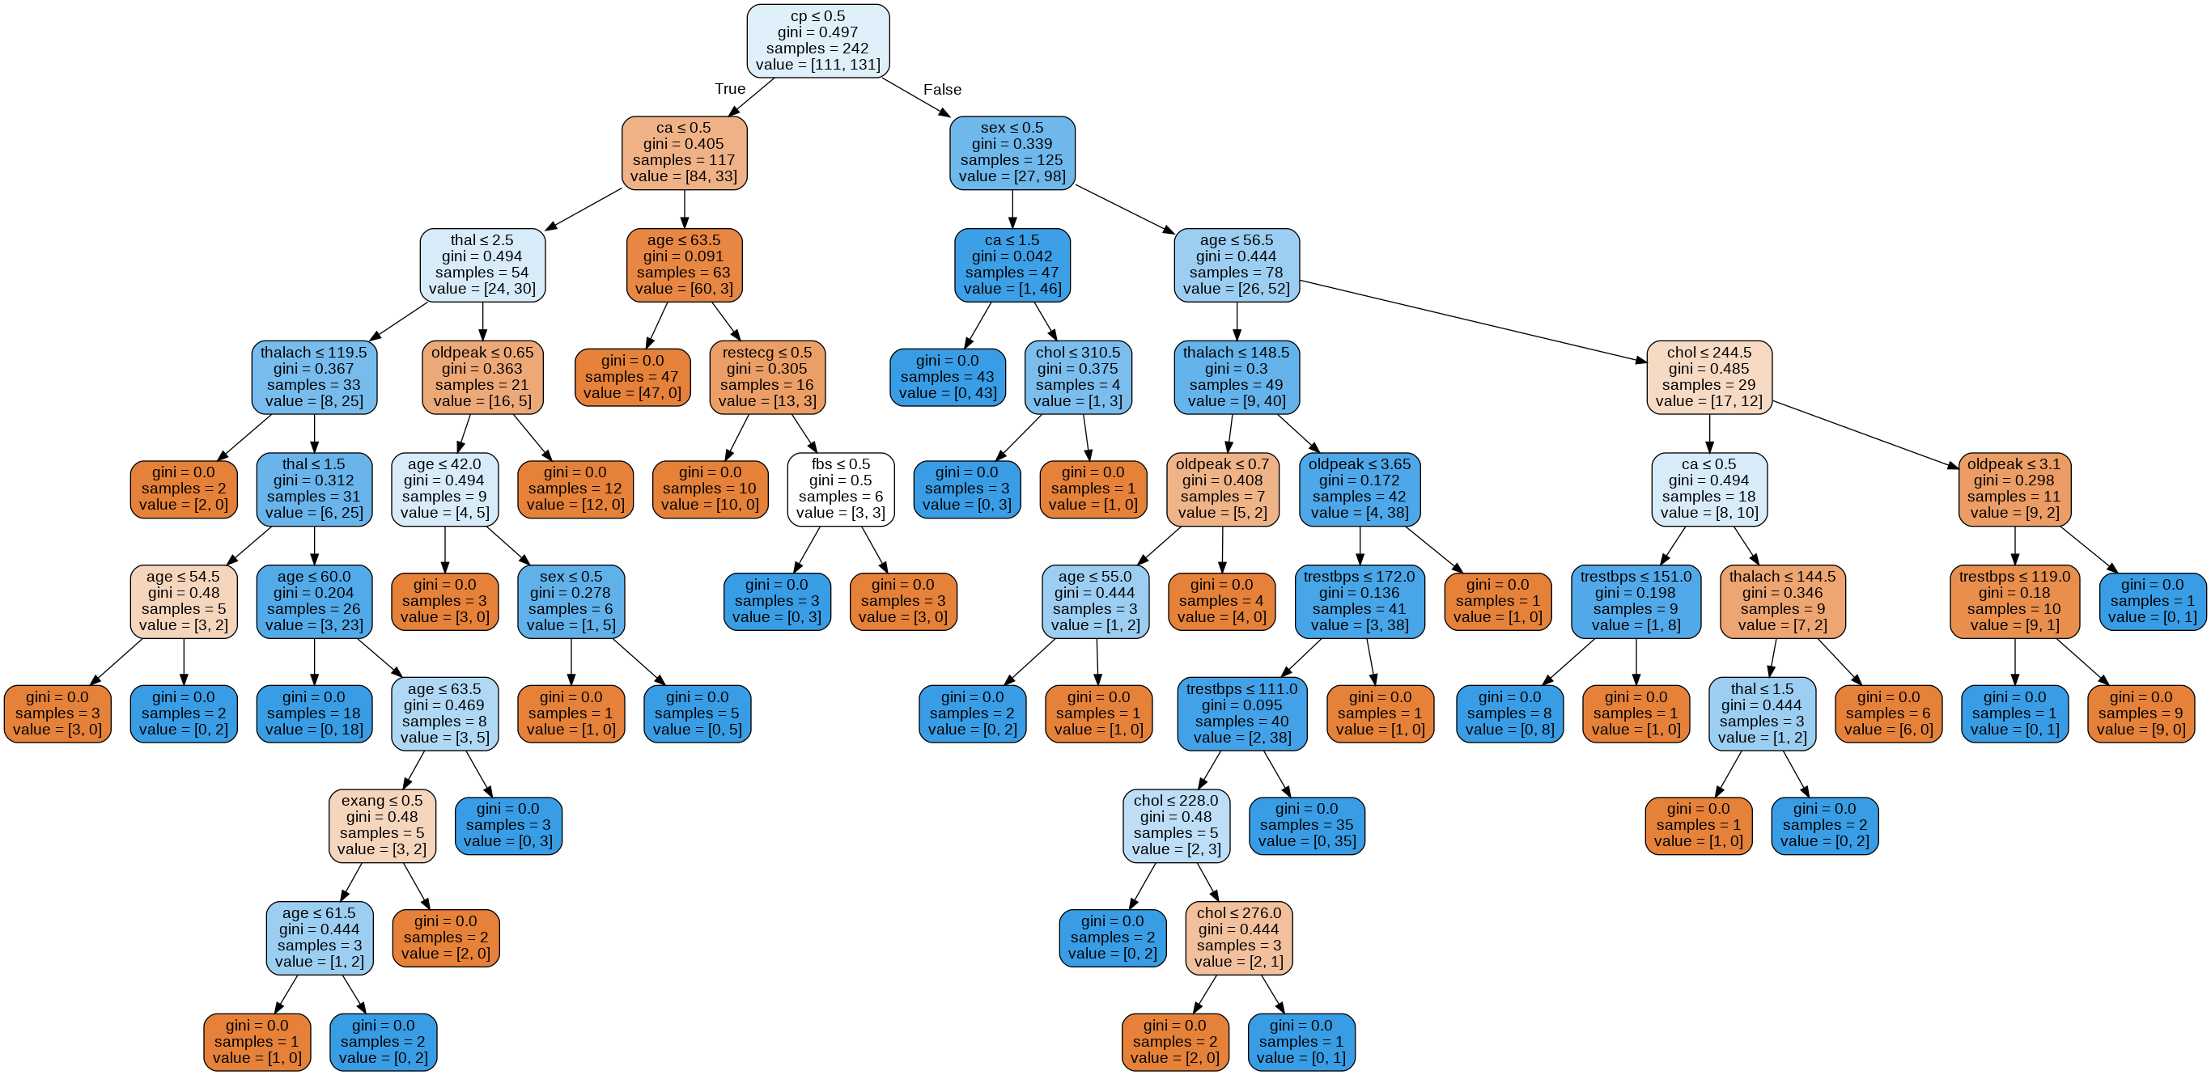
DECISION TREE

Slide 16

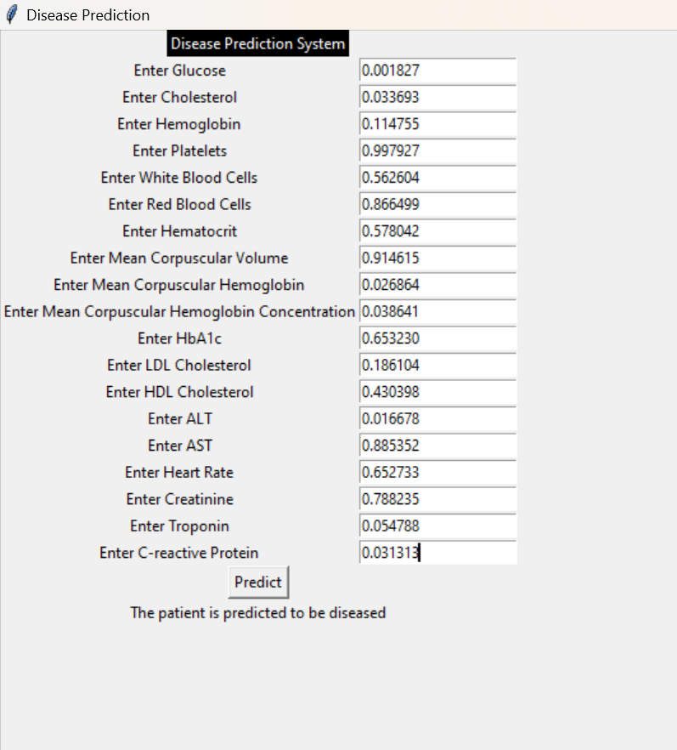
GUI WINDOW:-
A graphical user interface (GUI) can significantly enhance machine learning (ML) projects by providing a more accessible and user-friendly way to interact with models, visualize results, and perform various tasks. Here are some key benefits and significance of a GUI in ML projects:
1. Accessibility
2. Visualization
3. Experimentation
4. Deployment and Integration

