Slide 1

Object Oriented Analysis and Design
Prof. Vinay Joshi
Department of Computer Science and Engineering

Slide 2
Requirement Engineering
RE is usually the first step in any software intensive development lifecycle irrespective of model
Usually difficult, error prone and costly
Critical for successful completion of all downstream activities
Errors introduced during requirements phase if not handled properly and early will propagate into the subsequent phases
Requirement errors are expensive to fix at a later stage
Unnecessary, late or invalid requirements can make the system cumbersome or slip

Slide 3
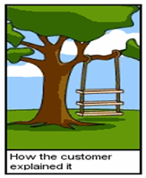
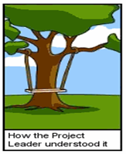
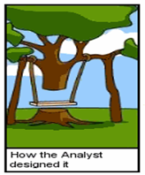
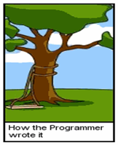
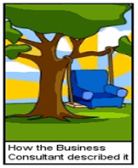
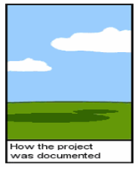
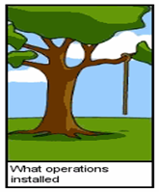
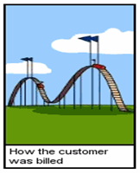
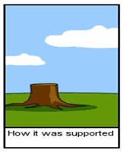
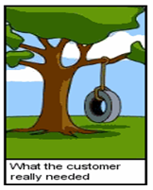
Requirement Engineering

Slide 4
Requirement Engineering
Requirement is the Property which must be exhibited by software developed/adapted to solve a particular problem
Requirement should specify the externally visible behavior of what and not how
Requirements can be looked at as
Individual requirements
Set of requirements

Slide 5
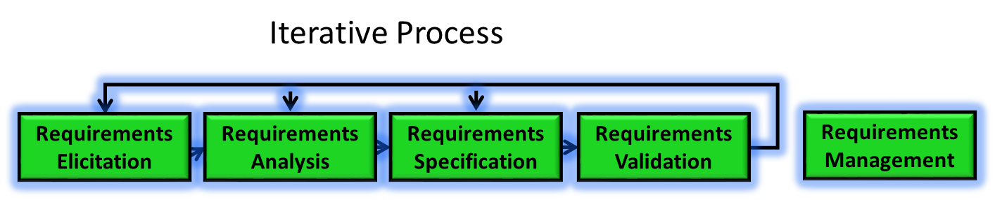
Requirement Engineering
Is a process of working proactively with all stakeholders gathering their needs, articulating their problem, identify and negotiate potential conflicts thereby establishing a clear scope and boundary for a project.
It can also be described as a process of ensuring that the stakeholders have been identified and they have been given an opportunity to explain their problem and needs and describe what they would like the new system to do.

Slide 6
Requirement Analysis Process
Understand the requirements in depth, both from a product and process perspective
Classify and Organize the requirements into coherent clusters
Functional, Non-Functional & Domain requirements
System and User Requirements
Model the requirements
Analyze the requirements (if necessary) using fish bone diagram

Slide 7
Requirement Analysis Process
Recognize and resolve conflicts (e.g., functionality v. cost v. timeliness)
Negotiate Requirements
Prioritize the requirements (MoSCoW -Must have, Should have, Could have, Wont have)
Identify risks if any
Decide on Build or Buy (Commercial Of The Shelf Solution) and refine requirements

Slide 8
Requirement Modelling
A Model is a representation of a system in some form.
A is a Model of B if A can be used to answer questions about B
Part of Requirement Analysis and Specification phases.
Couple of important goals of Modelling
Providing an Understanding (existing) System
Analyzing and Validating the requirements in terms of visible requirements within the problem
Communicating the requirements in terms of who, what and interpreting it in the same way
Discussed different kinds of Models
Structural Models and Behavioral models

Slide 9
What is UML?
Unified Modeling Language
Language to express different types of models
Language defines
Syntax – Symbols and rules for using them
Semantics – What these symbols represent
UML can be used to
Visualize (Graphical Notation)
Specify (Complete and Unambiguous)
Construct (Code Generation)
Document (Design, Architecture, etc.)
the artifacts of software-intensive systems

Slide 10
Conceptual Models of UML
UML
Building
blocks
Rules
Common
mechanisms
name, scope, visibility
Things
Relations
Diagrams
Class
Object
Use case
Sequence
Collaboration
State
Activity
Component
Deployment
Dependency
Association
Generalization
Realization
Structural
Behavioral
Grouping
Annotate
Class
Interface
Active class
Component
Node
Interaction
State machine
Package
Note
Use case
Collaboration

Slide 11
Conceptual Models of UML
UML
Building
blocks
Rules
Common
mechanisms
name, scope, visibility
Diagrams
UML is made up of three conceptual elements. They are
Building blocks which make up the UML
Rules that dictate how these building blocks can be put together
Common mechanisms that apply through out UML
Things
Relations
Class
Object
Use case
Sequence
Collaboration
State
Activity
Component
Deployment
Dependency
Association
Generalization
Realization
Structural
Behavioral
Grouping
Annotate
Class
Interface
Active class
Component
Node
Interaction
State machine
Package
Note
Use case
Collaboration

Slide 12
Conceptual Models of UML
UML
Building
blocks
Rules
Common
mechanisms
name, scope, visibility
Things
Diagrams
Relations
Class
Object
Use case
Sequence
Collaboration
State
Activity
Component
Deployment
Dependency
Association
Generalization
Realization
Diagrams : Graphical representation of set of elements, often rendered as a set of connected graph of vertices (things) and arcs (relationships)
It’s a projection into the system
Things are abstractions in the model.
There are four kinds of things or abstraction
Relationship ties together the things or abstractions
There are four different kinds of relationships
Structural
Behavioral
Grouping
Annotate
Class
Interface
Active class
Component
Node
Interaction
State machine
Package
Note
Use case
Collaboration

Slide 13
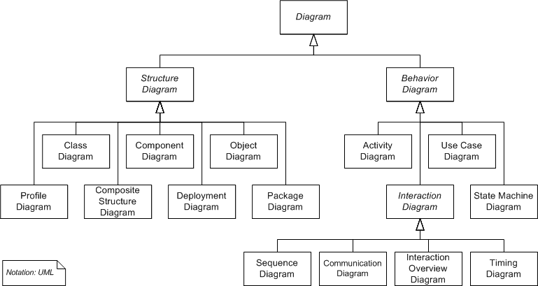
UML Diagrams
Structural things are the nouns of the UML models. Represent elements that are either conceptual or physical
These are dynamic parts of the UML models. Represent behavior over time and space. Typically verbs of the model

Slide 14
Models in Solution Development
Problem
Solution
Analysis Model
Design
Model
Problem Space
Solution Space

Slide 15
Views of a Solution System
Design View
Implementation View
Use Case View
Interaction View
Deployment View

Slide 16
Views of a Solution System
Use Case View
Describes behavior of system as seen by end users, analysts, and testers
Design View
Describes Classes, Interfaces, and Collaborations that form the vocabulary of the problem and its solution
Interaction View
Describes flow of control among its various parts
Address performance, scalability, and throughput

Slide 17
Views of a Solution System
Implementation View
Describes artifacts that are used to assemble and release the physical system
Address configuration management of system releases
Deployment View
Address the distribution, delivery, and installation of the parts that make up the physical system

Slide 18
UML Diagrams –Summary
State Diagram
Shows states, transitions, events, and activities depicting the dynamic view of internal object states
Sequence Diagram
Shows interactions between objects as a time-ordered view
Collaboration Diagram
Similar to sequence diagram, but in a spatial view, using numbering to indicate time order
Deployment Diagram
Shows the configuration of run-time processing nodes and the components that are deployed on them

Slide 19
THANK YOU
Vinay Joshi
Department of Computer Science and Engineering
vinayj@pes.edu

