Slide 1
Employee Data Analysis using Excel
STUDENT NAME: Govarthana Priya MRK
REGISTER NO: 122203943 / asunm1647unm1647ay1221647008
DEPARTMENT: B.com [corporate Secretaryship]
COLLEGE: RB Gothi Jain College for Women

Slide 2
PROJECT TITLE
Employee Performance Analysis using Excel

Slide 3


AGENDA
Problem Statement
Project Overview
End Users
Our Solution and Proposition
Dataset Description
Modelling Approach
Results and Discussion
Conclusion
3/21/2024 Annual Review

Slide 4

PROBLEM STATEMENT
To track the Performance of the employees for their growth as well as the organizational growth.
Provide increment and incentives for the best performed employees
And Provide motivation for the other employees to improve their Performance

Slide 5

PROJECT OVERVIEW
To track the performance of
Analysing the performance of the employee by considering various factors like gender, performance score rating, achievements the analysis which is based by all these factors is called performance analysis in order to identify the trend and patterns of different categories of employee like high,medium,low.

Slide 6
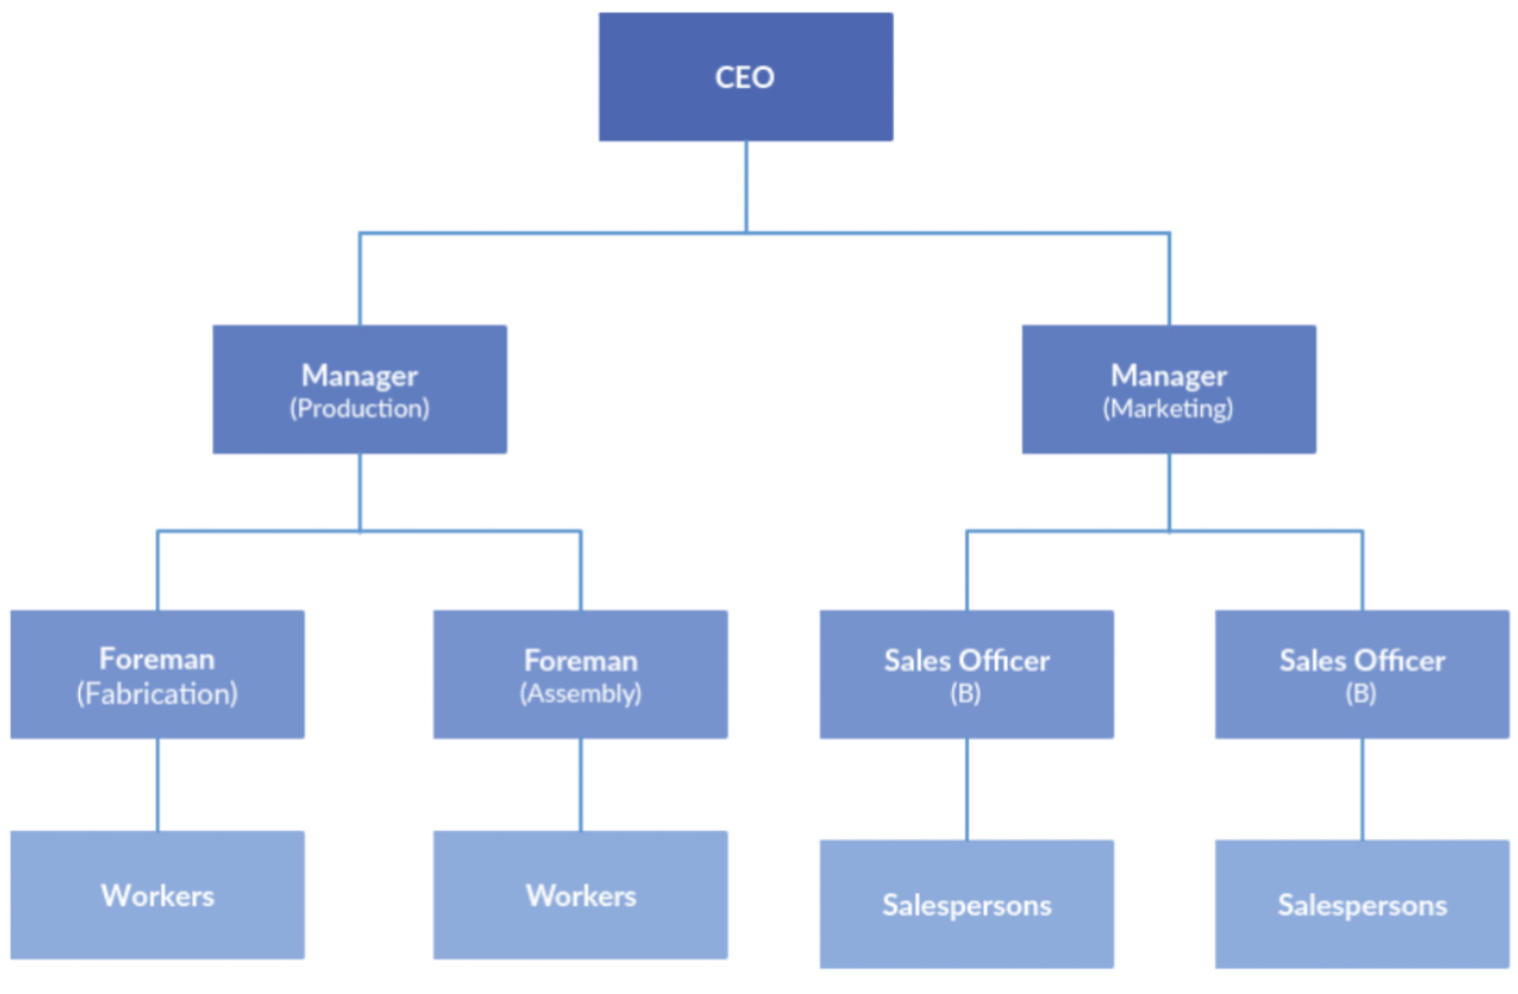

WHO ARE THE END USERS?

Slide 7

OUR SOLUTION AND ITS VALUE PROPOSITION
Conditional formatting - To highlight the missing values
Filtering - To remove or Filter out
Formula - To calculate the employees perperformance
Pivot table - For summary
Graph - Data Visualization

Slide 8
Dataset Description
Employee Data set – Kaggle
26 features
9 features
Employee ID - Numerical values
Employee name First name and - Text Last name
Employee type
Performance level
Gender - Male/Female
Employee rating. - Numerical values

Slide 9

THE "WOW" IN OUR SOLUTION
Formula - =IFS(Z8>=5,”VERY HIGH”,Z8>=4,”HIGH “,Z8>=3,”MED”,”TRUE”,”LOW “)
3/21/2024 Annual Review
9

Slide 10
MODELLING
Data collection 1. Downloaded Data in edunet
Features collection 1. Identify all the features 2.Total 26 features 3. Identify 9 features in 26 features
Data cleaning 1. Identify the missing values 2. Filter out the missing values Performance level calculation 1.Formula =IFS(Z8 >=5,"VERY HIGH ",Z8>=4,"HIGH ",Z8>=3,"MED",TRUE ","LOW")
Summary 1.Business unit - Row 2.Performance level - Column 3.Gender - Filter 4.First name - values
10

Slide 11
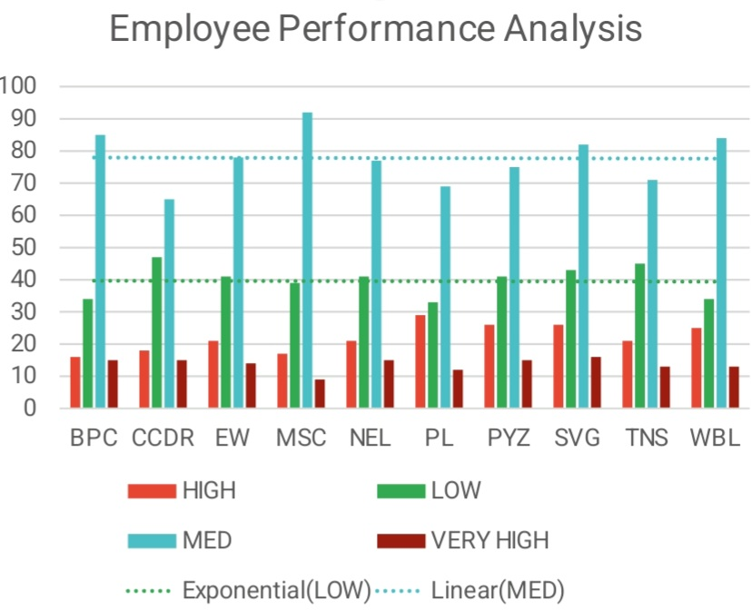
RESULTS
11

Slide 12
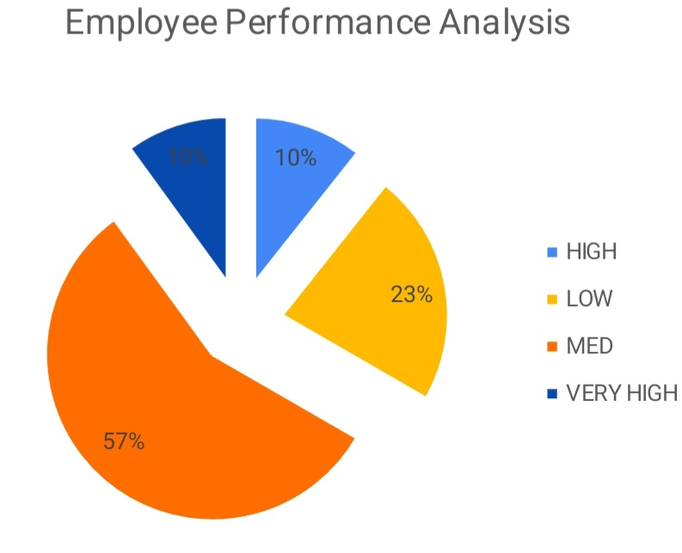
RESULTS

Slide 13
conclusion
So by comparing the performance of employees the average level of performance of employees are higher in number. The high and very high level of performance of employees are low. So we need to Motivate the employees by different level of task to develop their skills and knowledge and we need give tasks and projects according to skills and knowledge. So we need motivate them for better output.

