Slide 1
DATA ANALYST INTERNSHIP DASHBOARD DESIGN
Nithya Gowda B
5th June, 2025

Slide 2
Objective
Design an interactive dashboard for business stakeholders.

Slide 3
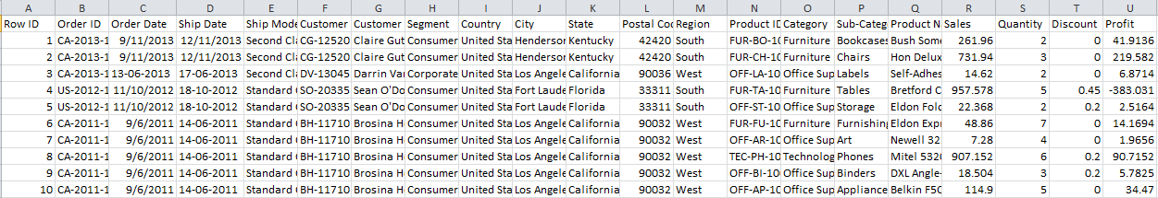
Dataset Used
Superstore.csv
Sample Dataset

Slide 4
KPIs
Total Sales = 22,97,201
Total Profit = 2,86,397

Slide 5
Key Insights
Sales Trend: Sales consistently increased during Q4 of each year, indicating strong holiday season performance.
Profit Distribution: Although the Technology category brings in high sales, Office Supplies show a higher profit margin.
Regional Performance: The West Region generates the highest overall sales, while the South has the lowest profit contribution.
Category Insights:
Tables in the Furniture category show negative profit, suggesting pricing or cost issues.
Phones and Chairs are top-selling sub-categories.
Customer Segments: The Corporate segment generates higher average order values compared to the Consumer segment.

Slide 6
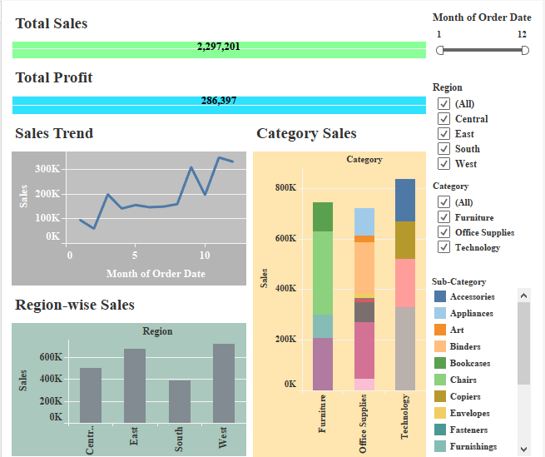
Dashboard Screenshot

Slide 7
Conclusion
The interactive dashboard enables real-time monitoring of key performance metrics such as sales, profit, and growth across time, region, and product categories.
By identifying high-performing and underperforming areas, the dashboard provides actionable insights for:
Optimizing inventory
Improving regional strategies
Focusing on profitable product lines
Stakeholders can use slicers to explore trends and make data-driven decisions with confidence.
Overall, the dashboard acts as a strategic tool to track business health and plan future improvements.

