Slide 1
G Nithyalakshmi
Final Project
3/21/2024 Annual Review

Slide 2
PROJECT TITLE
MATERNAL HEALTH RISK PREDICTION
This project is about predicting health risk of a mother during her pregnancy period
3/21/2024 Annual Review

Slide 3


AGENDA
Problem statement
Project overview
End users
Solution and value proposition
“WOW” factor in the project
Modelling and results
Dashboard
3/21/2024 Annual Review

Slide 4

PROBLEM STATEMENT
The aim of this project is to develop a predictive model that can accurately assess the risk levels associated with maternal health during pregnancy. The model will utilize various maternal health indicators and demographic factors to classify pregnant individuals into different risk categories: low risk, moderate risk, and high risk. By accurately predicting maternal health risk levels, healthcare providers can proactively identify high-risk pregnancies and implement targeted interventions to improve maternal and fetal outcomes.
3/21/2024 Annual Review

Slide 5

PROJECT OVERVIEW
Objective: Develop a predictive model for assessing maternal health risk during pregnancy.
Scope: Analyze maternal health indicators and demographic factors using machine learning techniques.
Methodology: Preprocess data, build predictive model, evaluate performance metrics.
Expected Outcomes: Trained model, evaluation metrics, insights into risk factors.
Audience: Healthcare providers, researchers, policymakers, pregnant individuals.
Impact: Improve maternal healthcare outcomes, reduce maternal mortality.
Future Directions: Integration into clinical practice, further research on risk factors.
Conclusion: Maternal health risk prediction project aims to develop a predictive model for assessing maternal health risk during pregnancy, with potential to impact outcomes and drive future research.
3/21/2024 Annual Review

Slide 6

WHO ARE THE END USERS?
Healthcare Providers: Early identification of high-risk pregnancies for tailored interventions.
Pregnant Individuals: Personalized risk assessment for informed decision-making.
Healthcare Systems: Streamlined workflows and proactive interventions for high-risk cases.
Public Health Agencies: Informed policies and initiatives to address maternal health disparities.
Researchers and Academia: Tool for advancing knowledge and evidence-based practices in maternal health.
3/21/2024 Annual Review

Slide 7

YOUR SOLUTION AND ITS VALUE PROPOSITION
Solution:
Develop a predictive model for assessing maternal health risks during pregnancy.
Utilize machine learning techniques and maternal health indicators for accurate predictions.
Implement user-friendly interface for seamless integration into healthcare systems.
Value Proposition:
Improved Maternal Outcomes: Early risk identification for proactive interventions.
Personalized Care: Informed decision-making for pregnant individuals.
Efficient Healthcare Delivery: Streamlined workflows for healthcare providers.
Public Health Impact: Informed policies to address maternal health disparities.
Knowledge Advancement: Tool for research and evidence-based practices in maternal health.
3/21/2024 Annual Review

Slide 8

THE WOW IN YOUR SOLUTION
Cutting-Edge Technology: Utilizing advanced machine learning for predictive maternal health risk assessment, showcasing innovation in healthcare.
Comprehensive Approach: Integrating diverse health indicators for holistic risk assessment, demonstrating thorough understanding of maternal health complexities.
Empowering Pregnant Individuals: Providing personalized risk assessments for informed decision-making, enhancing patient engagement and well-being.
Proactive Healthcare: Early identification of high-risk pregnancies enables timely interventions, potentially saving lives and improving outcomes.
Public Health Impact: Informing policies to address disparities and promote equity in maternal healthcare, signaling commitment to societal well-being.
Advancing Research: Serving as a tool for research and innovation in maternal health, driving progress and improving understanding of the field.
3/21/2024 Annual Review

Slide 9
MODELLING
Data Preparation: Cleaned and engineered features from maternal health indicators.
Model Selection: Chosen algorithms tailored to maternal health data complexity.
Model Development: Configured neural network architecture with appropriate layers and activation functions.
Model Training: Trained model with optimized parameters and monitored performance with validation.
Model Evaluation: Assessed performance using accuracy, precision, recall, and F1-score.
Interpretability: Enhanced model interpretability for transparent predictions.
Future Directions: Explore enhancements for better performance and incorporate additional data sources.
3/21/2024 Annual Review

Slide 10
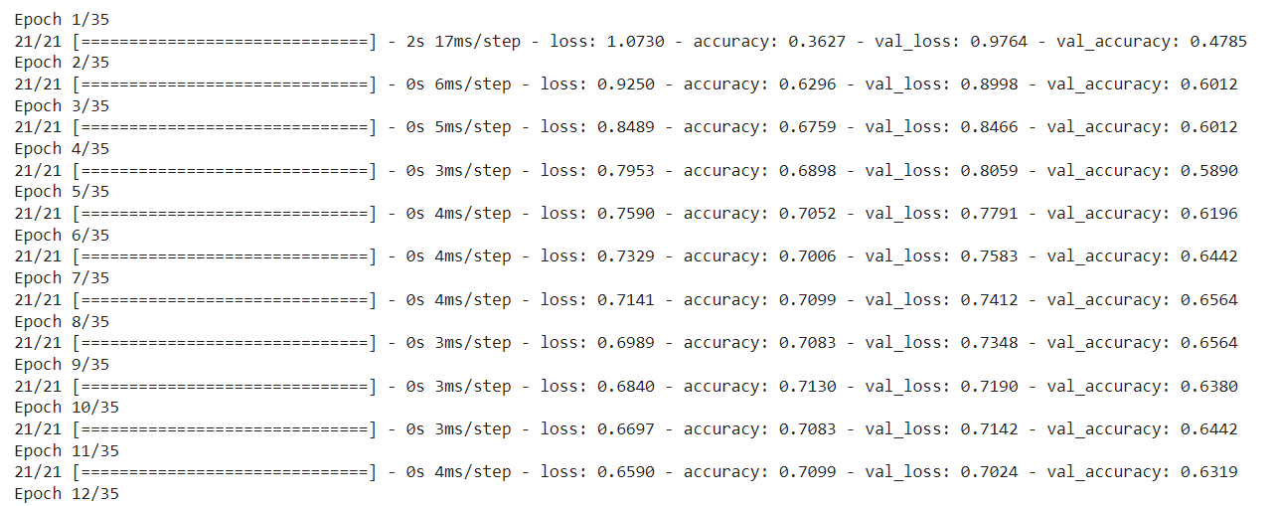
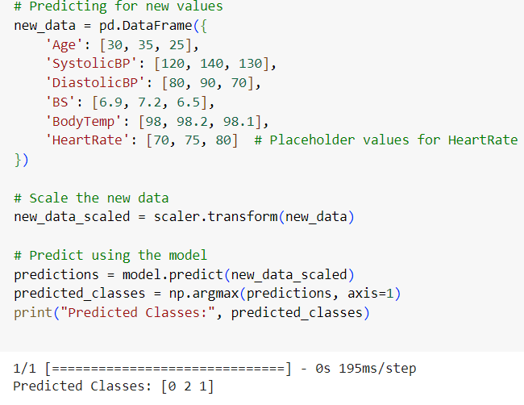
RESULTS
3/21/2024 Annual Review

Slide 11


Microsoft Power BI

