Slide 1



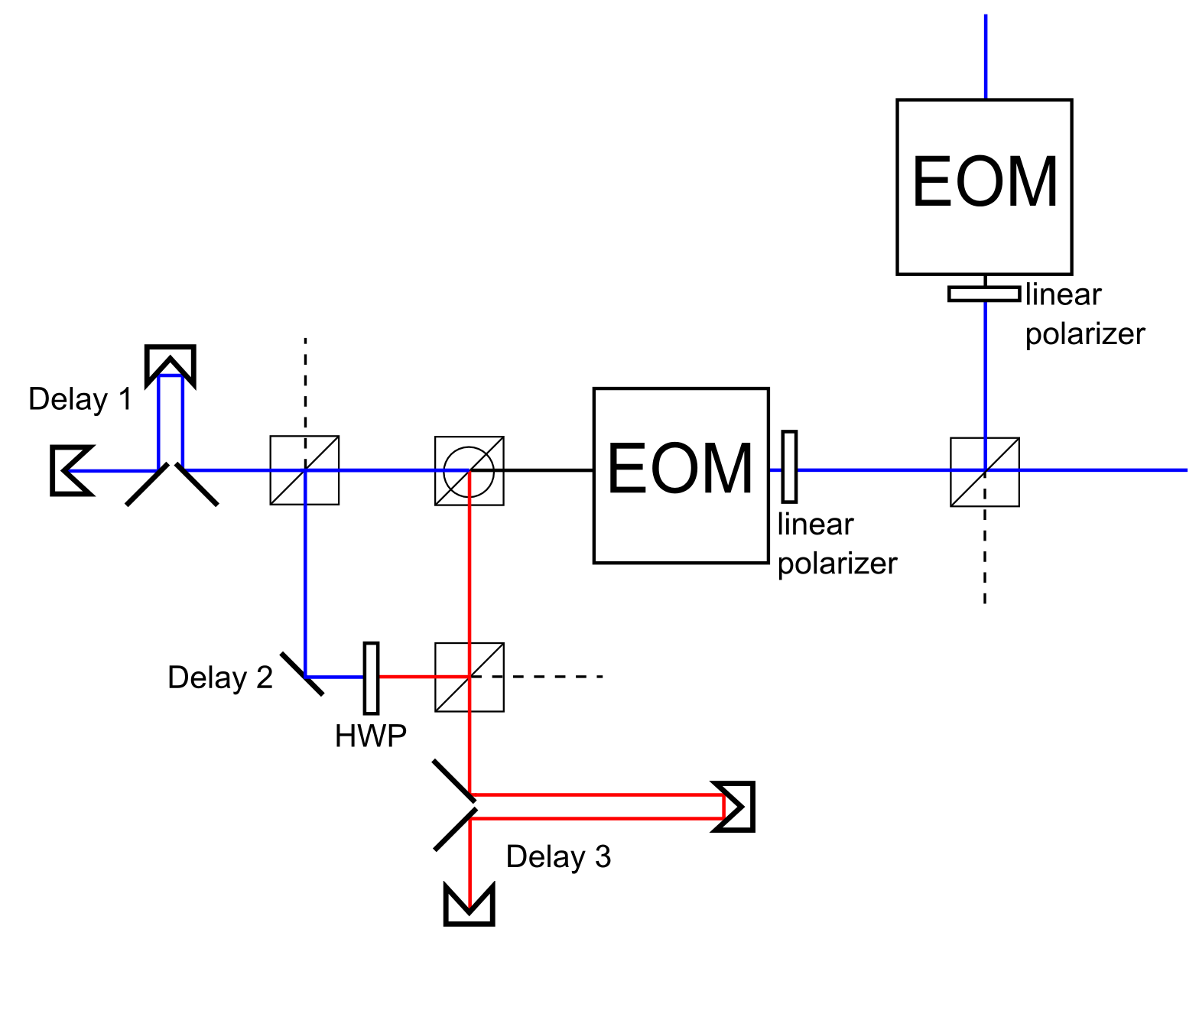
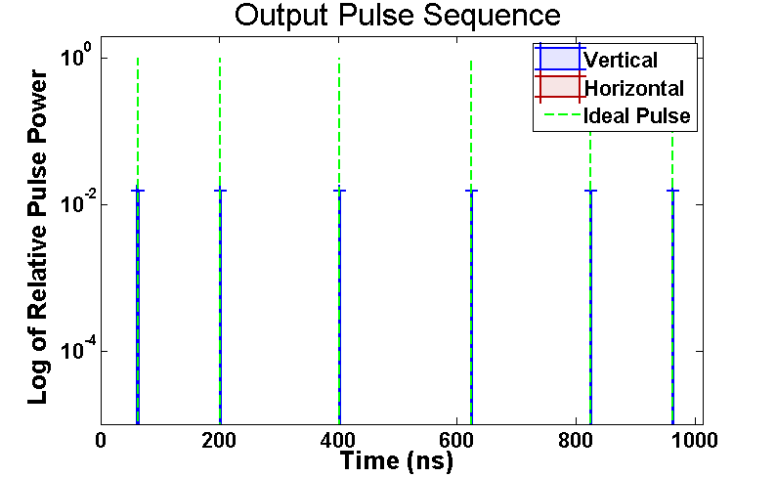
Optical Networks for Controlling Quantum Communication Systems
Paul Jerger, Alexander Kendrick, Kunal Menda, Nithya Menon, Fernando Ortega, and Luke St. Marie
This is 95-point font. It is the same as the title of the slide.
This is 80-point font. Sample text for comparison.
This is 48-point font. We may use this for the body of the text, so here is some lengthier text. This text should be easily readable in paragraph form, but small enough that we can include all the text that we want.
This is 72-point font. Sample text for comparison.
This is 36-point font. We may use this for the body of the text, so here is some lengthier text. This text should be easily readable in paragraph form, but small enough that we can include all the text that we want.
This is 60-point font. It is the same size as the names under the title. We may use this for the body of the text, so here is a lengthier sample so we can see how it looks as a paragraph.

