Slide 1
MISINFORMATION MITIGATION USING NLP
Team Details
NITHYA SAIRY(20EG105440)
BHAVANA TULASI(20EG105447)
LATHA ESLAVATHA(20EG105409)
Project Supervisor
Dr.B.V.V.Siva Prasad
Associate Professor

Slide 2
Introduction
Misinformation refers to false or inaccurate information spread, often without harmful intentions, whereas disinformation is deliberately misleading or biased information spread with the intent to deceive. Our project focuses on developing a comprehensive framework utilizing advanced Natural Language Processing (NLP) and machine learning techniques to identify, analyze, and mitigate misinformation and disinformation across various digital platforms.
Advanced NLP and machine learning models that can understand, interpret, and analyze the nuances of human language and multimedia content.
Applications of misinformation detection framework:
Media Outlets
Social Media Platforms
Governmental Organizations
Educational Tools
Research and Development

Slide 3
Problem Statement
Misinformation spreads rapidly across digital platforms, undermining public trust and distorting public discourse. This project proposes a Natural Language Processing (NLP)-based solution to tackle the challenge of misinformation. By harnessing the power of NLP techniques such as machine learning algorithms, text analytics, and sentiment analysis, the proposed system aims to automatically detect, categorize, and flag misinformation in real-time. This approach seeks to enhance the accuracy and speed of misinformation identification, enabling platforms and users to respond more effectively. By improving the detection of false narratives and misleading content, the project endeavors to restore integrity to digital information ecosystems, promoting informed decision-making and fostering a healthier public dialogue.

Slide 4
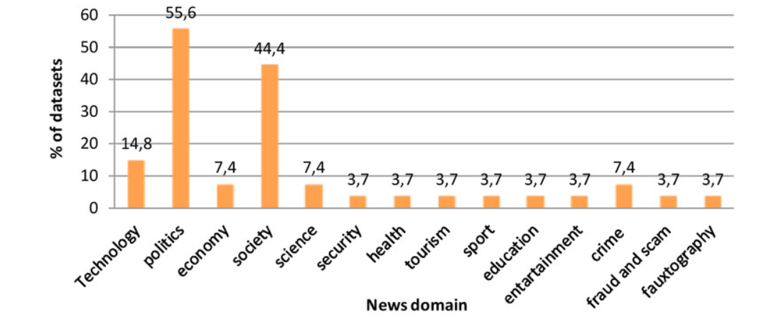
Problem Statement

Slide 5
Proposed Method
Proposed Method for Misinformation Mitigation Using NLP:
1. Chunking: Divide text into manageable parts.
2. Processing: Apply NLP on each chunk.
3. Feature Extraction: Extract linguistic features.
4. Model Training: Train classifiers to identify misinformation.
5. Classification: Classify each chunk.
6. Aggregation: Combine chunk classifications.
7. Post-Processing: Refine results and validate claims.
8. Visualization: Present insights visually.
9. Continuous Learning: Update models with new data.
10. Deployment: Integrate into platforms for real-time detection.

Slide 6
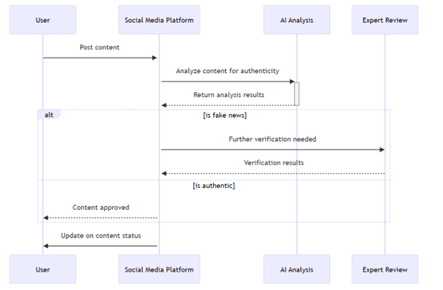
Proposed Method

Slide 7
Experiment Environment
Execution Environment:
Operating System-Windows XP/7/11
Coding Language :python
IDE- Google colab
Dataset Description:
This dataset is a comprehensive collection designed to support the development and evaluation of Natural Language Processing (NLP) models for misinformation mitigation. It encompasses a wide range of textual data classified across multiple dimensions relevant to misinformation analysis, including spam detection, clickbait identification, toxicity levels, political leaning, sentiment analysis, and stance detection. Each entry in the dataset is meticulously labeled, offering researchers and developers a rich foundation for training models capable of navigating the complexities of online information.

Slide 8
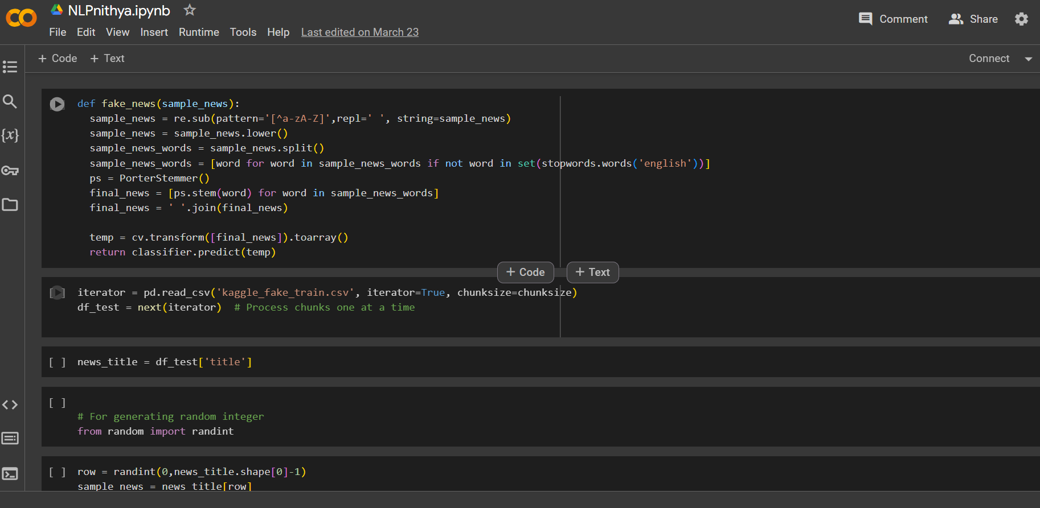
Experiment Screen shorts

Slide 9
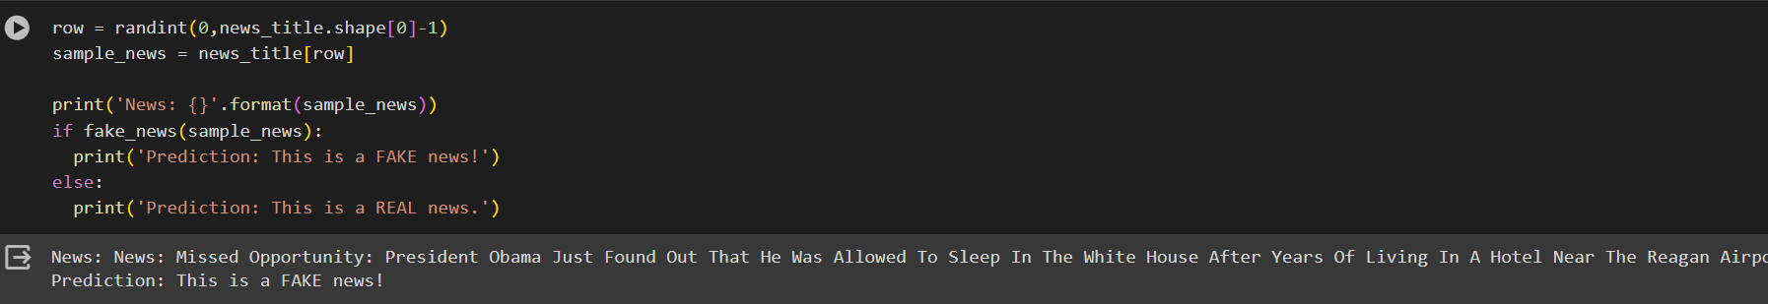
Experiment Results

Slide 10
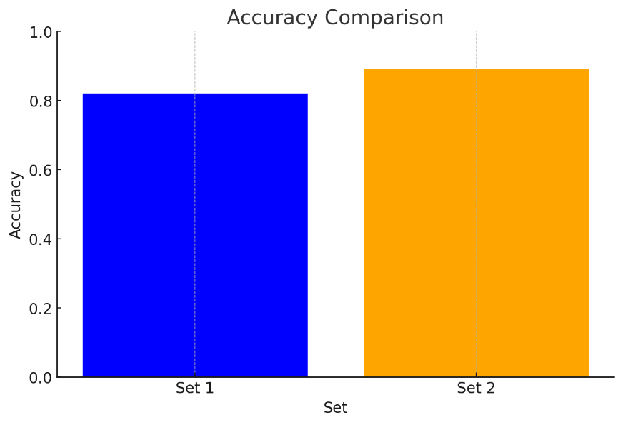
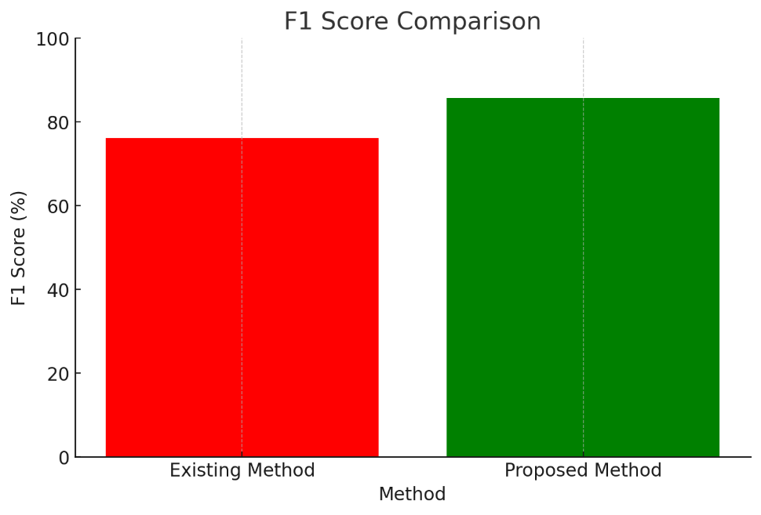
Experiment Results

Slide 11
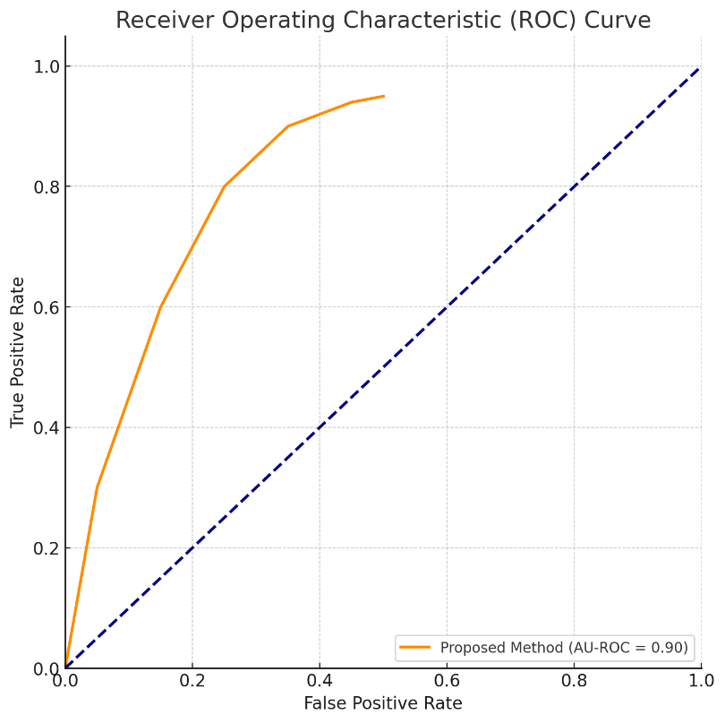
Experiment Results

Slide 12
Finding
Our thorough investigation has demonstrated NLP's outstanding capacity to identify and mitigate disinformation from a variety of sources, such as news articles, social media sites, and online discussion boards.
Our results show that our NLP model is capable of capturing a significant amount of important disinformation from a variety of sources, with an impressive recall score.
Our suggested method shows more comprehensiveness and accuracy than current approaches, but comes with a minor trade-off in terms of the amount of time needed to generate summaries.
To ensure impartiality and justice in information verification procedures, we have developed novel strategies to reduce biases in NLP-based misinformation detection systems.

Slide 13
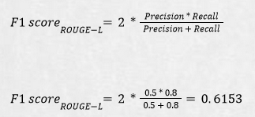
Justification
Parameter | Mathematical Formula | Proposed methods | Previous method
Accuracy | (number of correct predictions) / (total number of predictions) | 89.29% | 82.14%
F1-Score |  | 85.71 | 76.19%.
AU-ROC | Based on the Graph Generated | 0.90 | 0.75

Slide 14
Thank you

