Slide 1
FULL STACK WEB APPLICATION
Disaster Preparedness
and Response Education System
An interactive web platform for learning disaster safety,
taking quizzes and tracking preparedness knowledge.
Submitted by Nithya Shree Ganesan Department of Artificial Intelligence and Data Science
Academic Year 2024 – 2028
React.js
Python Flask
SQLite
Netlify
🌐 https://disaster-preparedness-edu-system.netlify.app

Slide 2
Table of Contents
AGENDA
Introduction
System Architecture
01
05
Overview of the system and its purpose
3-tier client-server design
Objectives
Implementation
02
06
Goals and key learning outcomes
Key code snippets and API endpoints
System Modules
Output Screens
03
07
7 core modules of the application
Live screenshots from the application
Technology Stack
Conclusion
04
08
React, Flask, SQLite and deployment tools
Summary, achievements and future scope
Disaster Preparedness and Response Education System

Slide 3
01 INTRO
What is this system?
Introduction
The Disaster Preparedness and Response Education System is a full-stack web application designed to educate students about natural and man-made disasters.
5
In India, disasters like earthquakes, floods, cyclones, and fires cause widespread destruction. Yet public awareness of safety procedures remains critically low.
Disaster
Modules
13
This platform bridges the gap by offering structured learning modules, interactive MCQ quizzes, and real-time progress tracking — all in one place.
REST API
Endpoints
2
🌐 Live: https://disaster-preparedness-edu-system.netlify.app
User
Roles
Disaster Preparedness and Response Education System

Slide 4
Project Objectives
02 GOALS
🎓
Educate Users
📋
Safety Guidelines
❓
Interactive Quizzes
Teach students about 5 disaster types: Earthquake, Flood, Fire, Cyclone and Landslide with clear descriptions.
Provide structured Do's and Don'ts for every disaster in an easy-to-read side-by-side layout.
Conduct MCQ-based quizzes per disaster module with a live progress tracker and question navigation.
📊
Score & Progress
🔐
Role-Based Access
⚙️
Admin Management
Calculate scores, show percentage grades and save results so students can track their improvement.
Separate Student and Admin roles with protected routes and different dashboards for each role.
Allow admins to add/delete disaster modules and quiz questions without touching the database directly.
Disaster Preparedness and Response Education System

Slide 5
System Modules
03 MODULES
1
🔐
User Authentication
Register, login with SHA-256 hashed passwords. Role detection (Student / Admin) on login.
2
📚
Disaster Education
5 disaster modules with full descriptions, categories and safety guidelines.
3
❓
MCQ Quiz System
Interactive question-by-question quiz with progress bar and answer navigation dots.
4
📊
Score & Results
Real-time score calculation, percentage grade and answer-by-answer breakdown.
5
🏠
Student Dashboard
Stats cards: modules, quizzes taken, average score, best score and result history.
6
⚙️
Admin Panel
Add/delete disasters and quiz questions. View all users. Monitor system stats.
7
🛡️
Role-Based Routes
React Router protected routes ensure students and admins see the correct pages.
Disaster Preparedness and Response Education System

Slide 6
04 TECH STACK
Technology Stack
⚛️
React.js 18
🐍
Python Flask
🗄️
SQLite
Frontend UI
Backend API
Database
Component-based SPA with React Router v6 and Context API for state management
13 REST endpoints handling auth, disasters and quiz operations
File-based relational DB with 4 tables: users, disasters, quiz_questions, quiz_results
🎨
Custom CSS
🔒
SHA-256
🌐
Netlify + Render
Styling
Security
Deployment
Responsive mobile-first layout with no external UI library needed
Password hashing via Python hashlib; session persisted in sessionStorage
Frontend on Netlify CDN; backend on Render free tier with auto-wake
Disaster Preparedness and Response Education System

Slide 7
System Architecture
05 ARCHITECTURE
⚛️
PRESENTATION
LAYER
🐍
APPLICATION
LAYER
🗄️
DATA
LAYER
React.js Frontend
Python Flask Backend
SQLite Database
Login / Register
/api/login /api/register
users
HTTP
JSON
HTTP
JSON
Student Dashboard
/api/disasters
disasters
Disaster Modules
/api/quiz /api/quiz/submit
quiz_questions
Quiz Page
/api/admin/users
quiz_results
Admin Panel
/api/admin/stats
Foreign key relations
Disaster Preparedness and Response Education System

Slide 8
Database Design — 4 Tables
05.1 DATABASE
users
disasters
quiz_questions
quiz_results
PK
id
PK
id
PK
id
PK
id
INTEGER
INTEGER
INTEGER
INTEGER
username
title
FK
disaster_id
FK
user_id
TEXT UNIQUE
TEXT
INTEGER
INTEGER
password
category
question
FK
disaster_id
TEXT (SHA-256)
TEXT
TEXT
INTEGER
role
description
option_a/b/c/d
score / total
TEXT
TEXT
TEXT
INTEGER
email
dos / donts
correct_option
taken_at
TEXT
TEXT
TEXT
TIMESTAMP
image_icon
TEXT
PK
Primary Key
FK
Foreign Key
Disaster Preparedness and Response Education System

Slide 9
06 IMPLEMENTATION
Key Code Snippets
🐍 Backend — Python Flask (Login API)
⚛️ Frontend — React Auth Context
@app.route('/api/login', methods=['POST'])
def login():
data = request.get_json()
username = data.get('username')
password = data.get('password')
conn = get_db()
cursor = conn.cursor()
cursor.execute(
'SELECT * FROM users WHERE
username=? AND password=?',
(username, hash_password(password))
)
user = cursor.fetchone()
if user:
return jsonify({'success': True,
'user': dict(user)})
return jsonify({'success': False}), 401
const AuthContext = createContext(null);
export function AuthProvider({ children }) {
const [user, setUser] = useState(null);
const login = (userData) => {
setUser(userData);
sessionStorage.setItem(
'user',
JSON.stringify(userData)
);
};
const logout = () => {
setUser(null);
sessionStorage.removeItem('user');
};
return (
<AuthContext.Provider
value={{ user, login, logout }}>
{children}
</AuthContext.Provider>
);
}
Disaster Preparedness and Response Education System

Slide 10
REST API Endpoints — 13 Routes
06.1 APIs
POST
/api/register
POST
/api/quiz/add
Register new user
Admin: add quiz question
POST
/api/login
POST
/api/quiz/submit
Authenticate and return user
Submit answers, get score
GET
/api/disasters
GET
/api/quiz/results/:uid
Fetch all disaster modules
Student's quiz results
GET
/api/disasters/:id
DEL
/api/quiz/questions/:id
Get full disaster details
Admin: delete question
POST
/api/disasters
GET
/api/admin/users
Admin: add disaster module
List all registered users
DEL
/api/disasters/:id
GET
/api/admin/stats
Admin: delete disaster
System dashboard statistics
GET
/api/quiz/:id
Get quiz questions
Disaster Preparedness and Response Education System

Slide 11
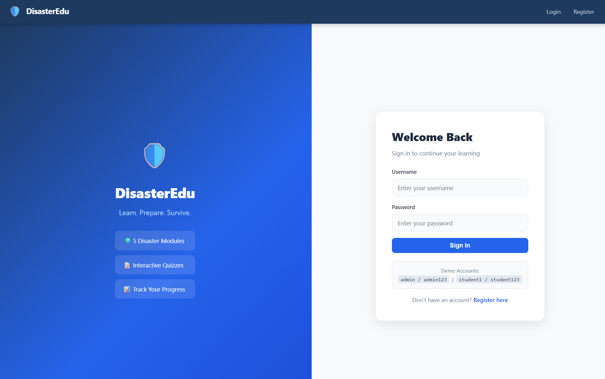
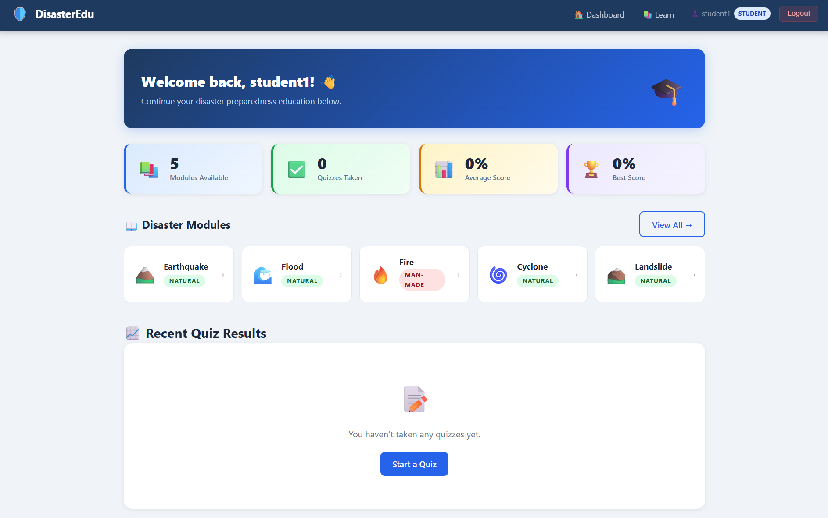
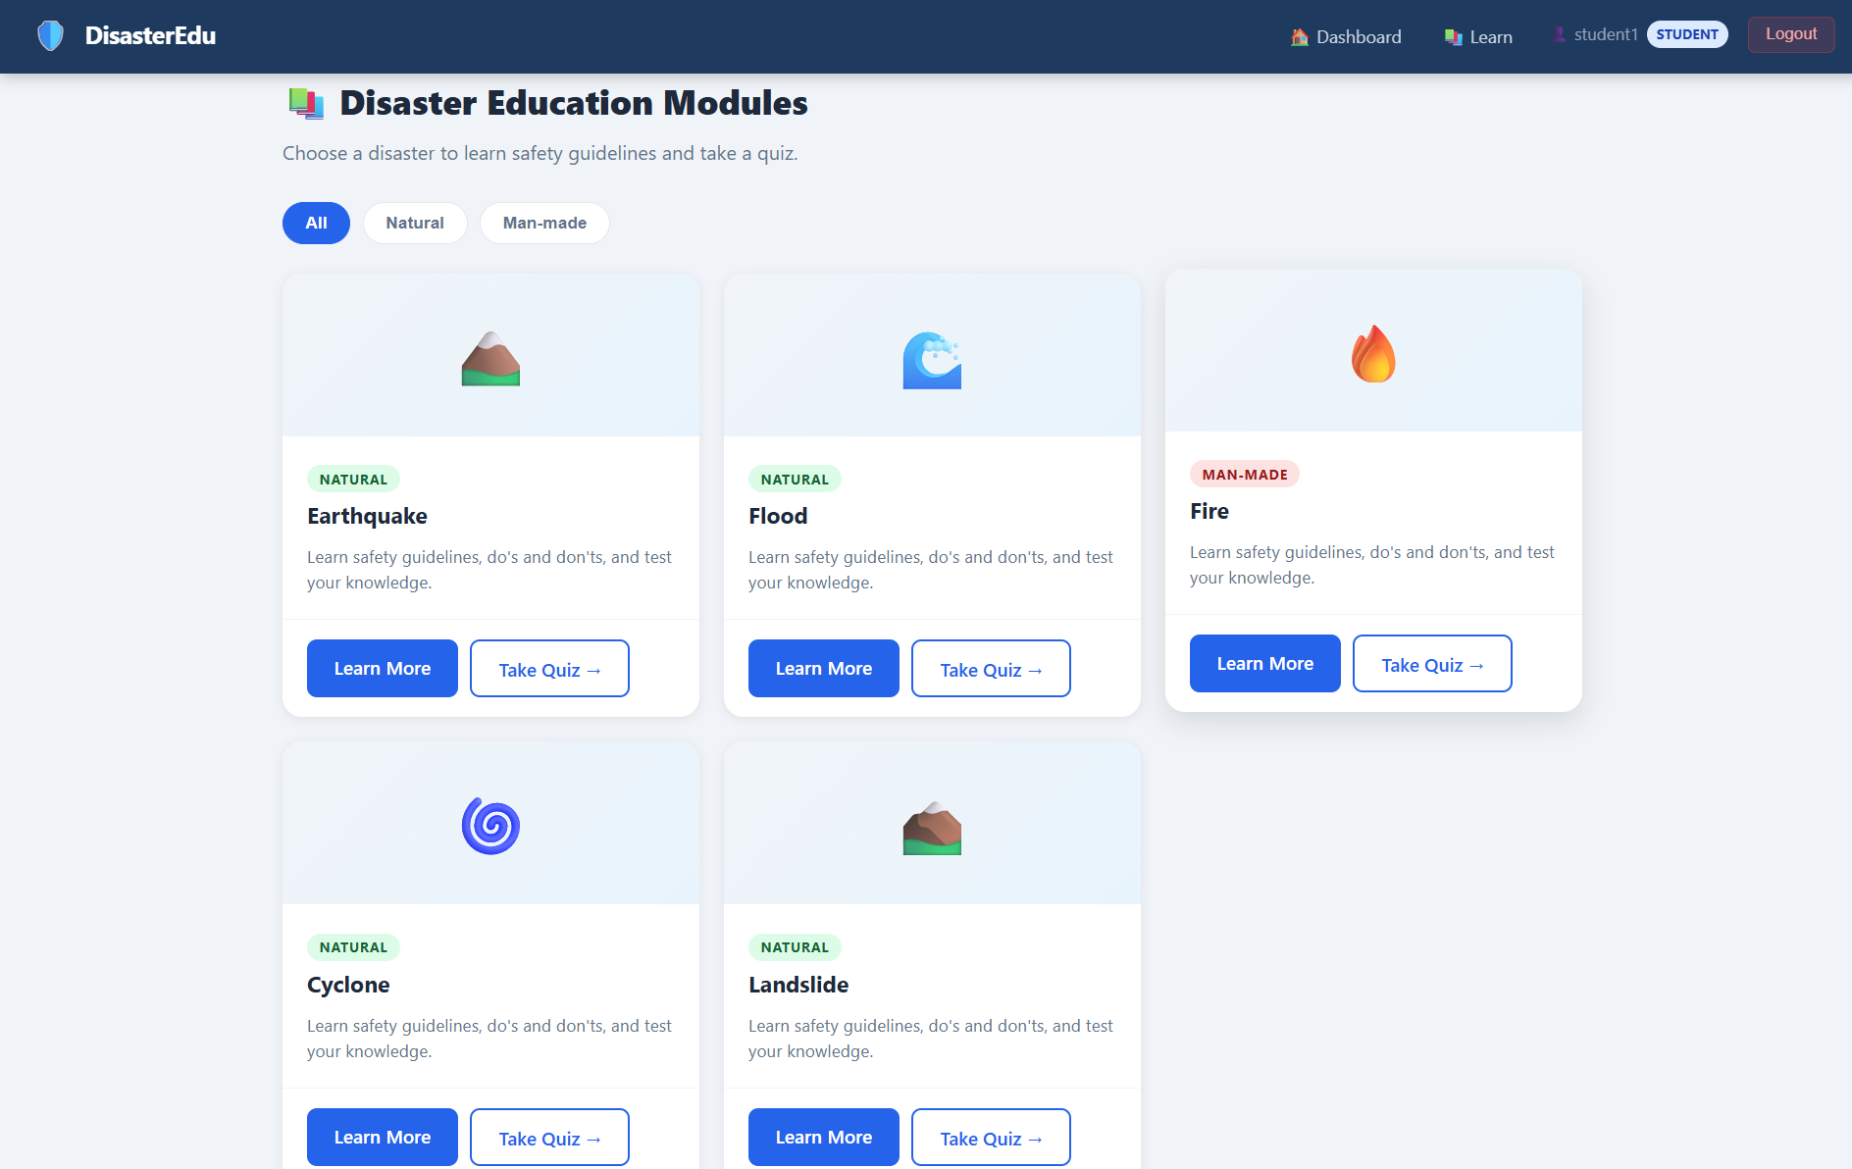
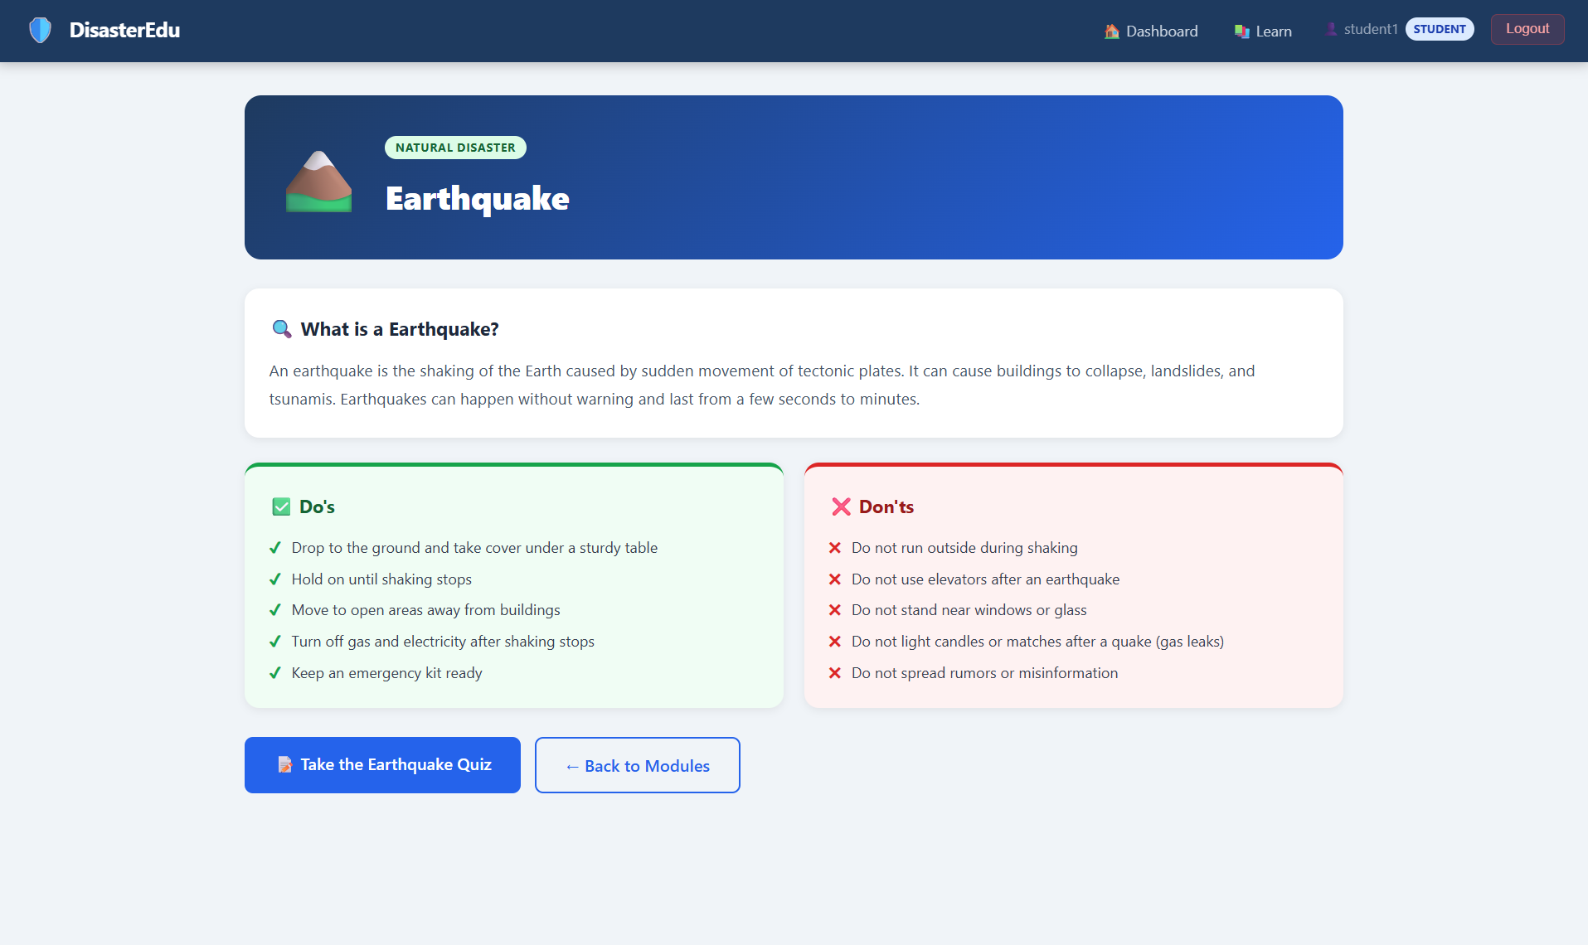
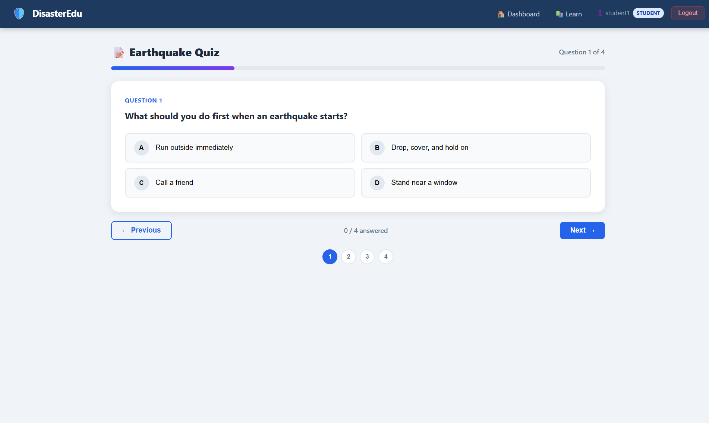
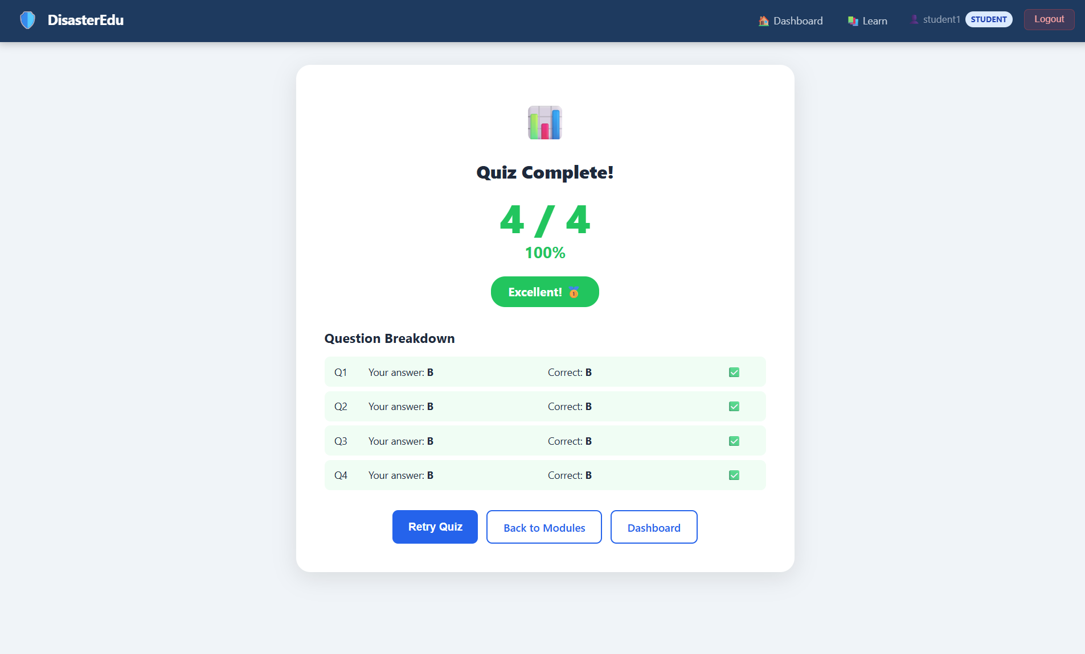
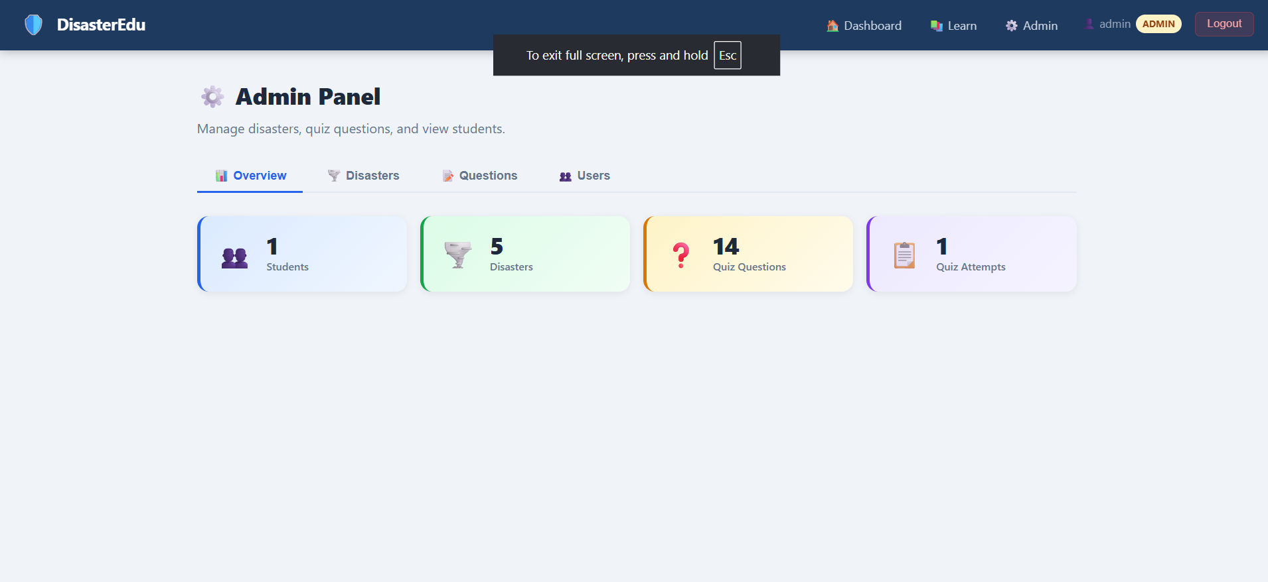
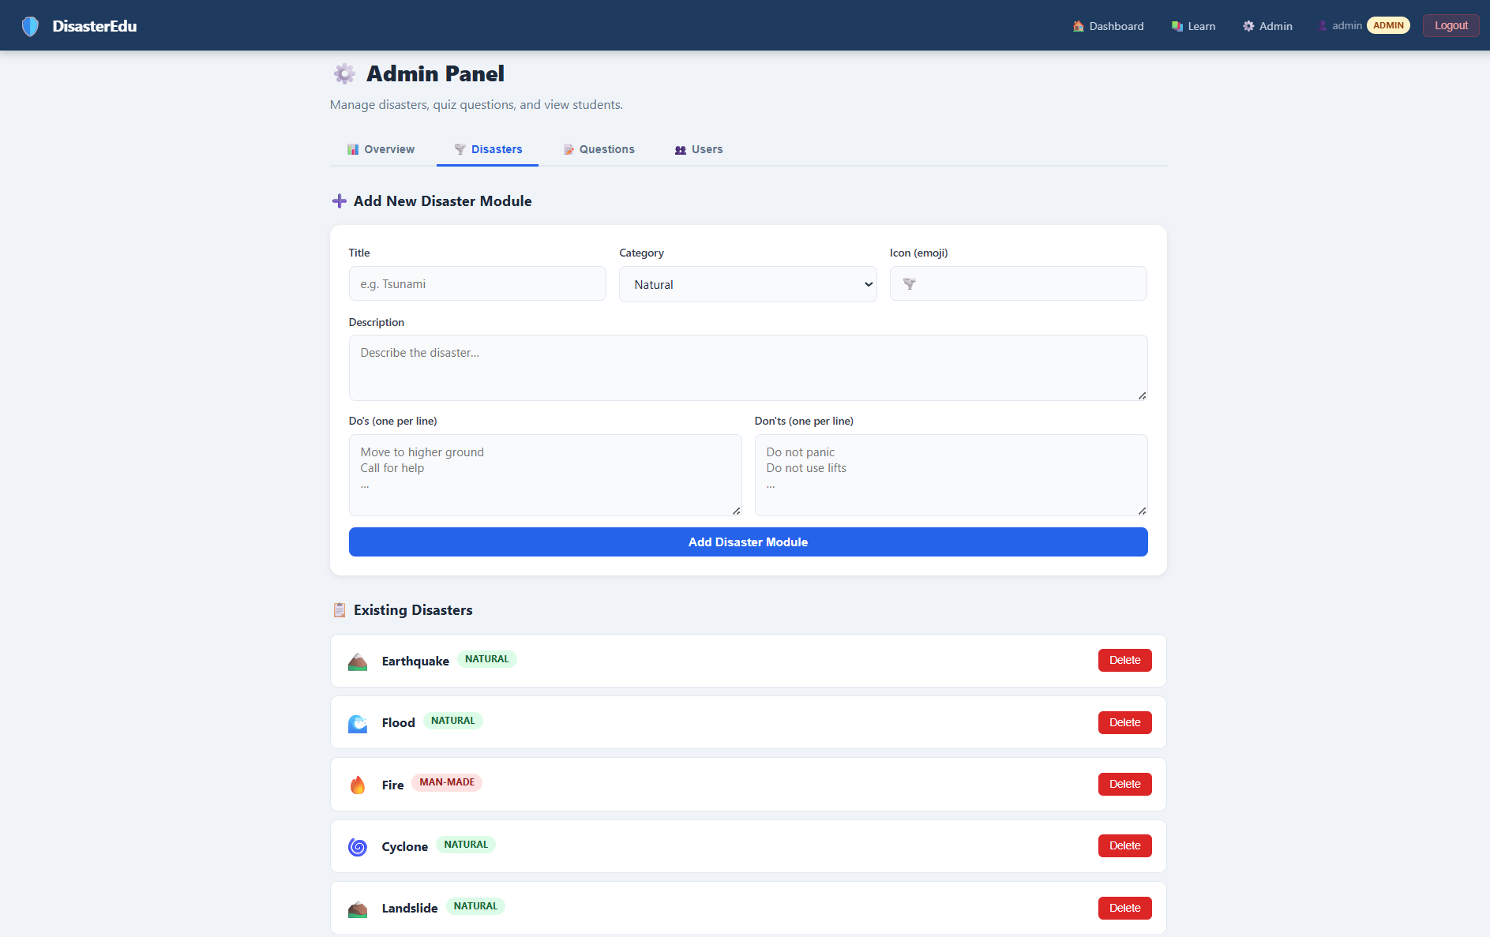
Application Output Screens
07 OUTPUT
1. Login Page
2. Dashboard
3. Disaster List
4. Disaster Detail
5. Quiz Page
6. Quiz Result
7. Admin Overview
8. Admin Disasters
Disaster Preparedness and Response Education System

Slide 12
ROLES
User Roles & Features
🎓 STUDENT
👔 ADMIN
✅ Register and login with credentials
⚙️ Add new disaster modules
✅ Browse all 5 disaster modules
⚙️ Delete existing disaster modules
✅ Read Do's and Don'ts guidelines
⚙️ Add MCQ quiz questions
✅ Take MCQ quizzes per disaster
⚙️ Delete quiz questions
✅ View score and answer breakdown
⚙️ View all registered users
✅ Track progress on dashboard
⚙️ Monitor system statistics
Disaster Preparedness and Response Education System

Slide 13
Conclusion & Summary
08 CONCLUSION
The Disaster Preparedness and Response Education System was successfully built and deployed as a full-stack web application. The system meets all stated objectives — providing structured disaster education, interactive quizzes, and role-based management — using React.js, Python Flask, and SQLite.
✅
📚
❓
🔐
Fully Deployed
5 Disaster Modules
14+ Quiz Questions
Secure Auth
Live at Netlify + Render
Accessible from any device
Earthquake, Flood, Fire
Cyclone, Landslide
MCQ quizzes with scores
and answer breakdown
SHA-256 hashing
Role-based access control
🔮 Future Scope:
More disaster types • Video content • Multilingual support • Mobile app • Real-time emergency alerts
Disaster Preparedness and Response Education System

Slide 14
🛡️
Thank You!
Disaster Preparedness and Response Education System
React.js • Python Flask • SQLite • Netlify • Render
Nithya Shree Ganesan Department of Artificial Intelligence and Data Science 2024-28
https://disaster-preparedness-edu-system.netlify.app
Questions are welcome!

