Slide 1
Analysing and Visualizing Regional Sales Performance

Slide 2
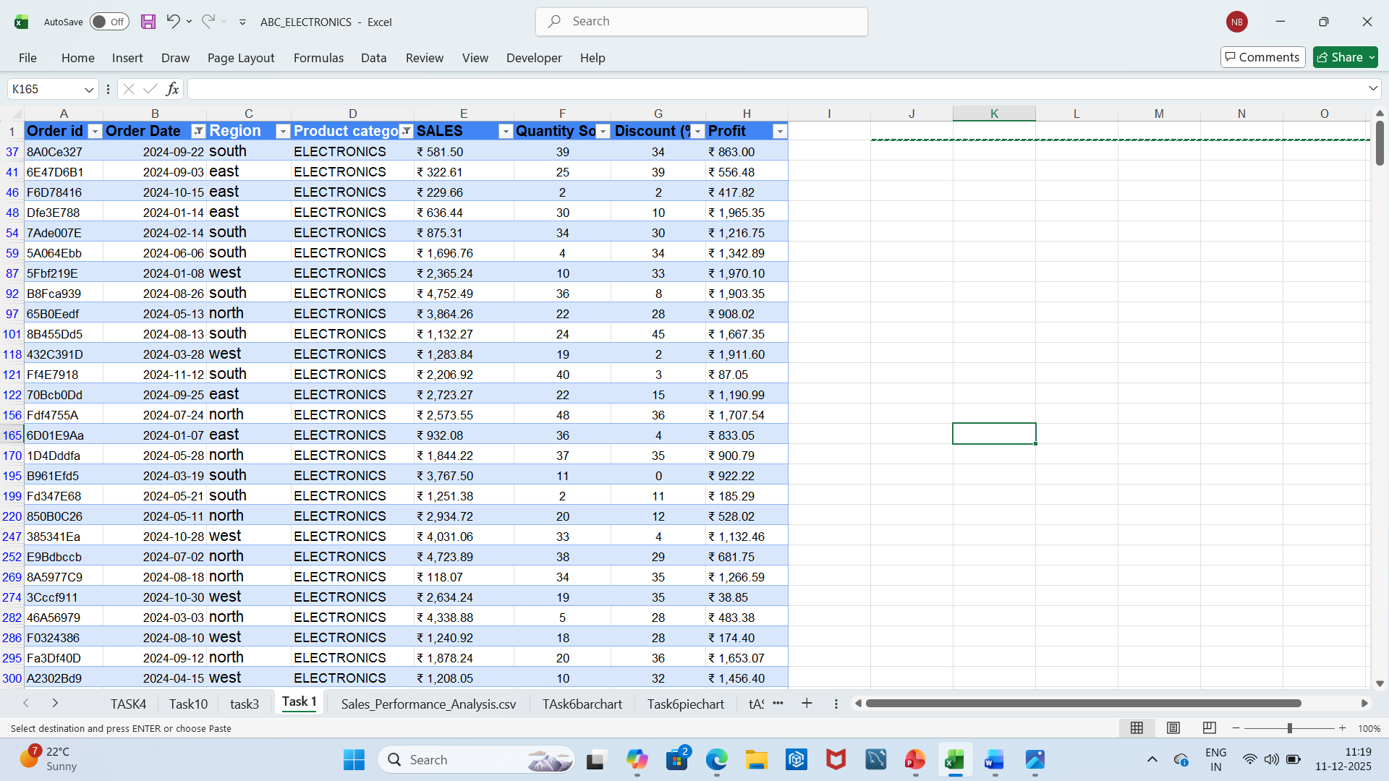
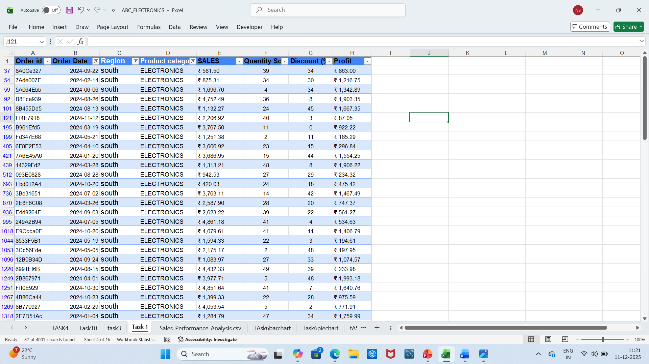
Task 1
Filtered the dataset to find all orders placed in the "South" region for the "Electronics" category within the last year.
We can filter any required field as per our requirement.

Slide 3
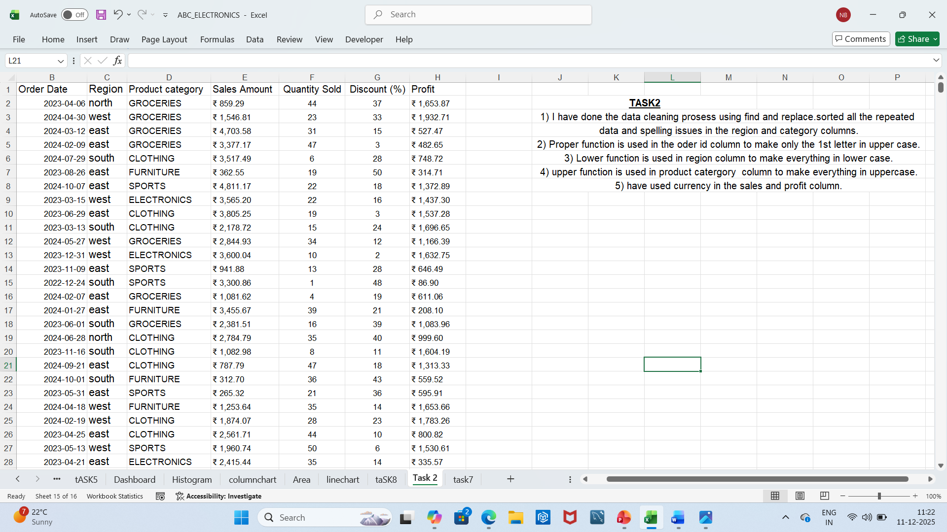
Task2
Data cleaning done.
Sorted the regions and product category sections.
used Proper function for order id.
Used lower function for region column.
Used upper function for Product category column.
Used the currency symbol in the data wherever required.

Slide 4
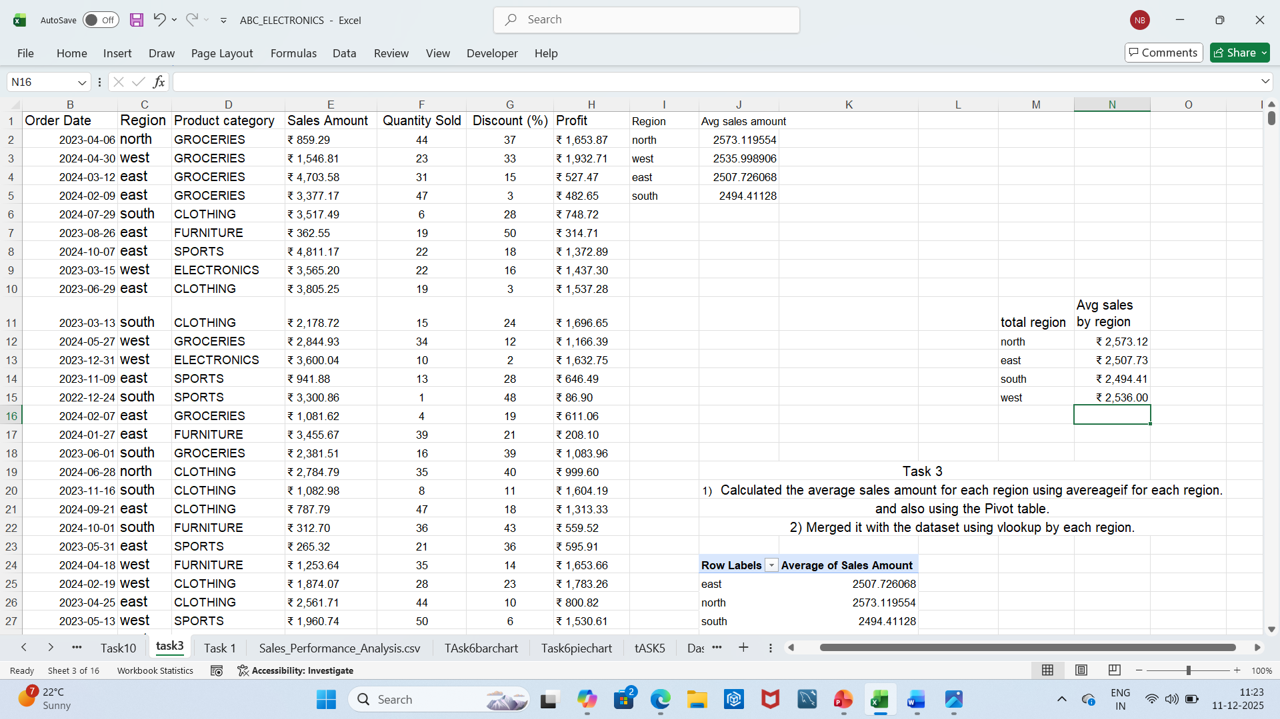
Task 3
Calculated the average sales amount for each region using the Averageif formula and also using the pivot table.
Merged this calculated value back into the dataset based on the Region column as using the Vlookup formula as assigned per the project.

Slide 5
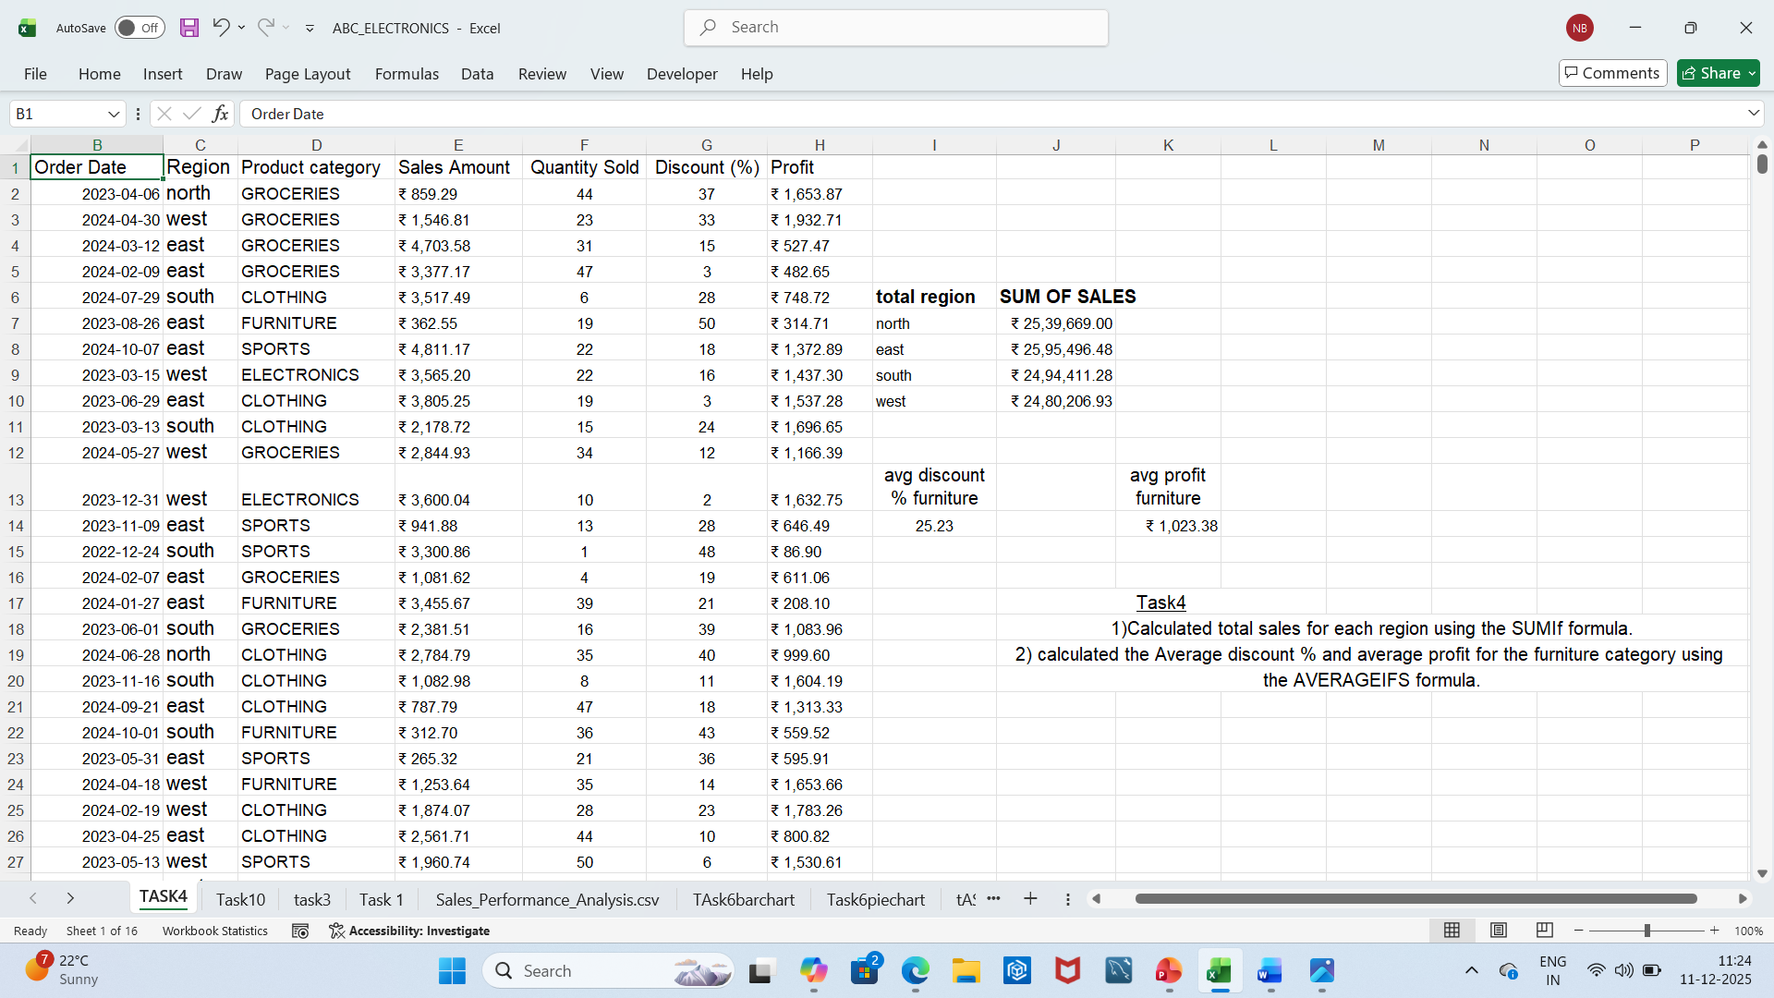
Task 4
Calculated total sales for each region using the SUMIF formula.
Calculated the average discount percentage and profit for the "Furniture" category using AVERAGEIFS formula.

Slide 6
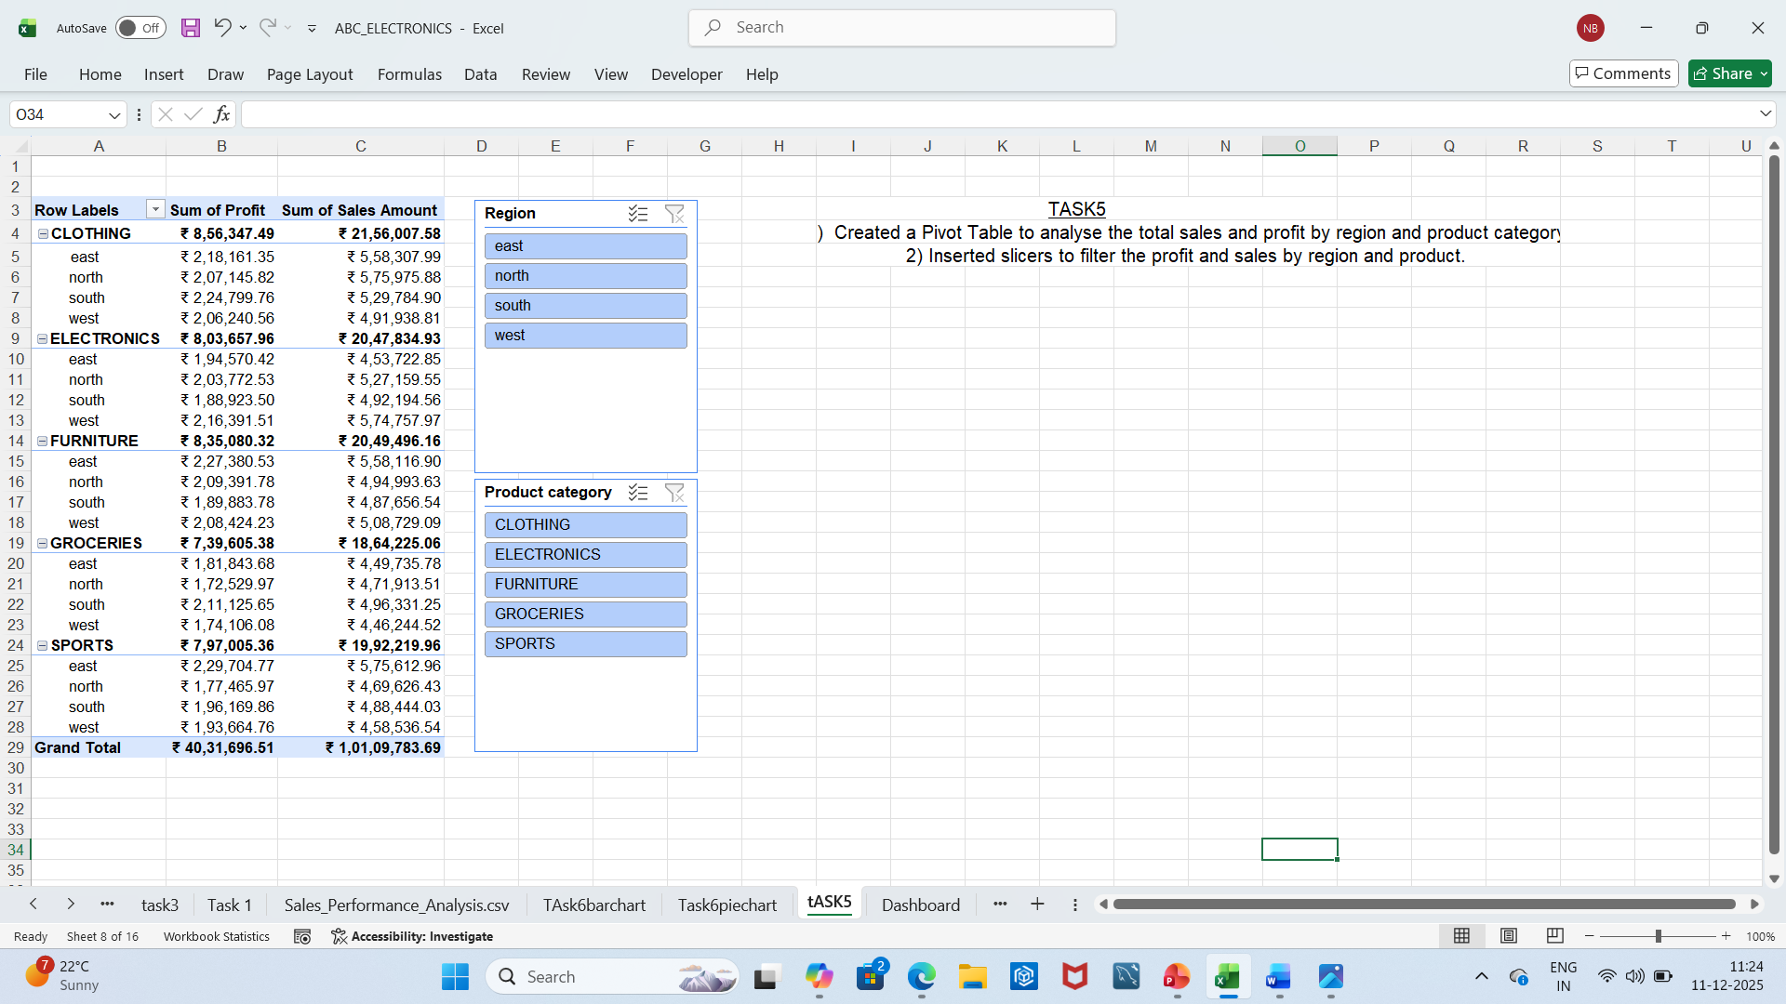
Task5
Created a pivot table to analyse the total sales by region and product category.
Inserted slicers to filter the profit and sales by region and product category.

Slide 7
Task 6
Created a Bar chart showing the total sales of each region.
created a pie chart showing the % contribution of each product category to total sales.

Slide 8
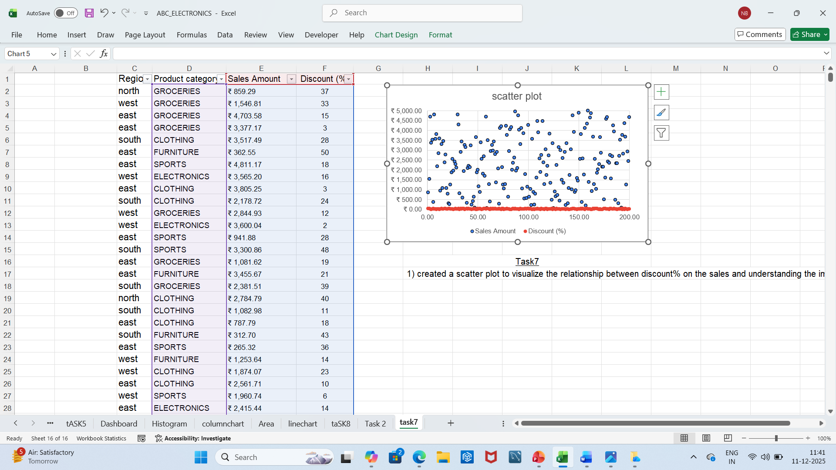
Task 7
Created a scattered plot to visualize the relationship between the discount% on the sales and understanding the impact.

Slide 9
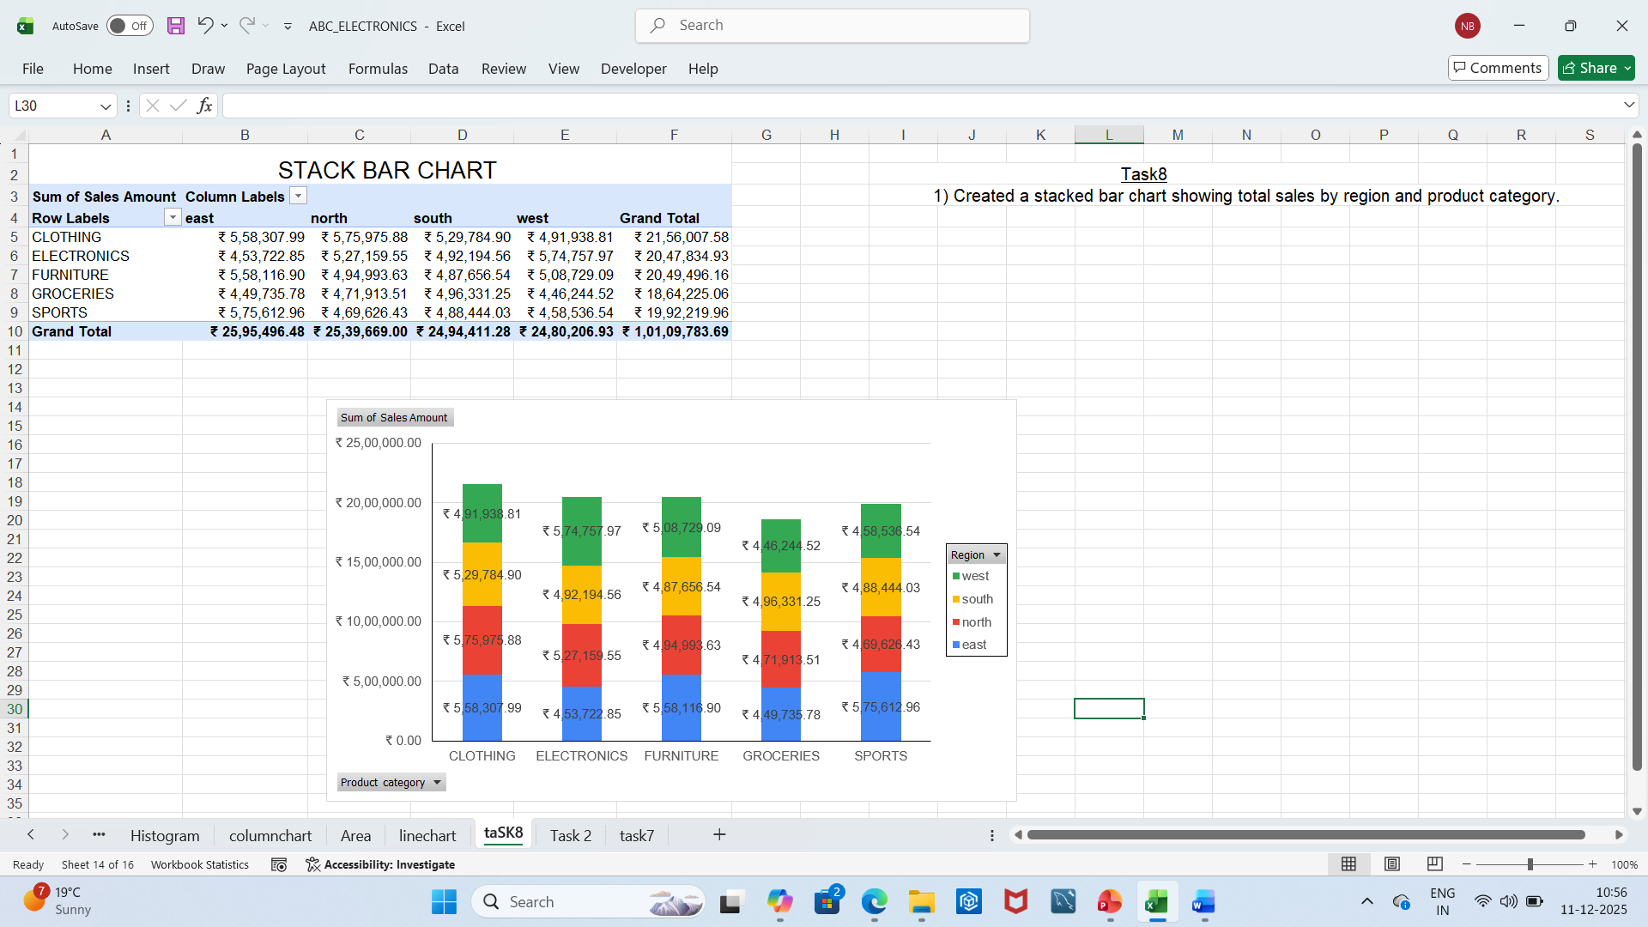
Task 8
Created a Stacked bar chart showing the total sales by region and product category.

Slide 10
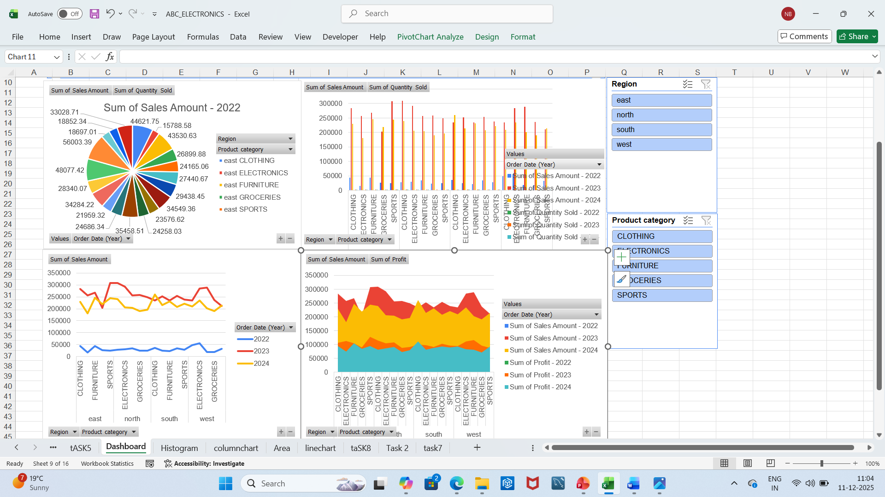
Task 9
Created a dashboard to Visualise the data based on region, category ,profit and year.
Created a pie chart, column chart ,line chart and area chart.

Slide 11
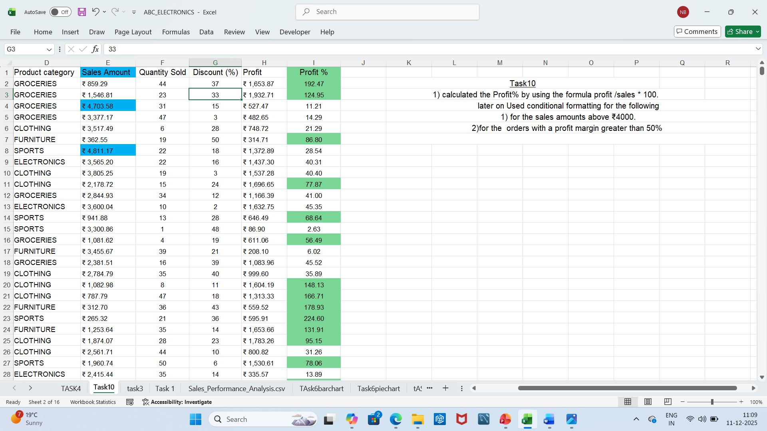
Task 10
Calculated the Profit % using formula profit/sales *100 Then added a column Profit %.
used conditional formatting for highlighting
sales Above 4000 and profit % greater than 50%

Slide 12
Key insights from the analysis
Regional Performance : The East region leads with total sales of ₹2.59 M, followed closely by North (₹2.54 M) and South (₹2.49 M). The West region slightly lags at ₹2.48 M — indicating relatively balanced regional performance.
Category Performance: Clothing (₹2.16 M) and Electronics (₹2.05 M) are top contributors, while Groceries (₹1.86 M) show lower sales — suggesting potential for promotional focus.
Profitability : The Furniture category shows moderate sales but strong profit margins . This implies high profitability despite lower volume.
Discount Impact : The scatter plot reveals that higher discounts don’t always lead to higher sales suggesting diminishing returns beyond a certain discount threshold.
Sales Distribution : The stacked bar chart and dashboard visuals confirm that sales are evenly spread across regions, but category contribution varies Electronics and Clothing dominate across all regions.
High‑Value Transactions : Conditional formatting highlights sales above ₹4,000 and profit % > 50 %. These represent premium transactions worth deeper customer analysis.

Slide 13
Recommendations
Regional Strategy: Strengthen marketing and logistics in West region to close the small gap with East/North. Consider regional offers or partnerships.
Product Mix Optimization :Increase visibility and bundle offers for Groceries and Sports categories to balance portfolio contribution.
Discount Policy : Use insights from the scatter plot to optimize discount thresholds ,avoid excessive discounts that don’t improve sales.
Profit Maximization : Expand Furniture category promotions .High profit % suggests potential for premium positioning.
Customer Segmentation: Analyze customers behind high‑value transactions (sales > ₹4,000, profit % > 50 %) to design loyalty programs.

