Slide 1
Instagram Performance Analytics for Sugar Cosmetics

Slide 2
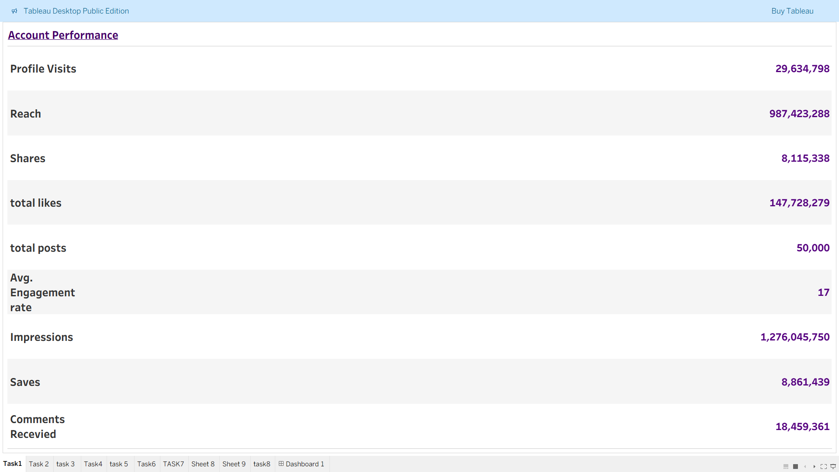
Task 1
KPI’S OF SUGAR COSMETICS
In a text table , I have mentioned the key performance indicators (KPIs) for Sugar Cosmetics’ Instagram performance.

Slide 3
Task 2
Monthly Posting Trend
Created a line chart that shows the monthly posts of each months.
The posting numbers are not much varied throughout the months.
It shows a slight peak in 6 months gap.
the Exponential Regression Equation tells us that the base level of posts starts around 4103.
The growth rate per month is 0.23%, which is quite modest.
A high p-value (like 0.289) means the trend could be due to random noise, not a real pattern and is statistically not significant.

Slide 4
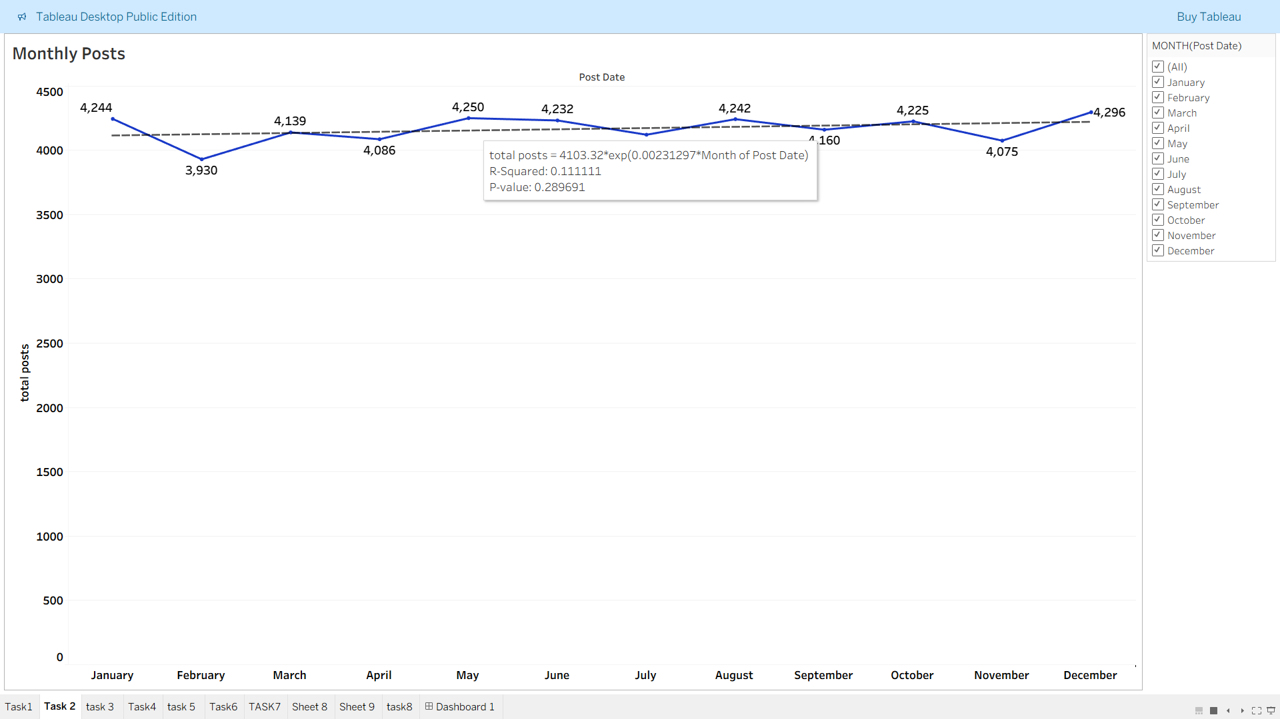

Slide 5
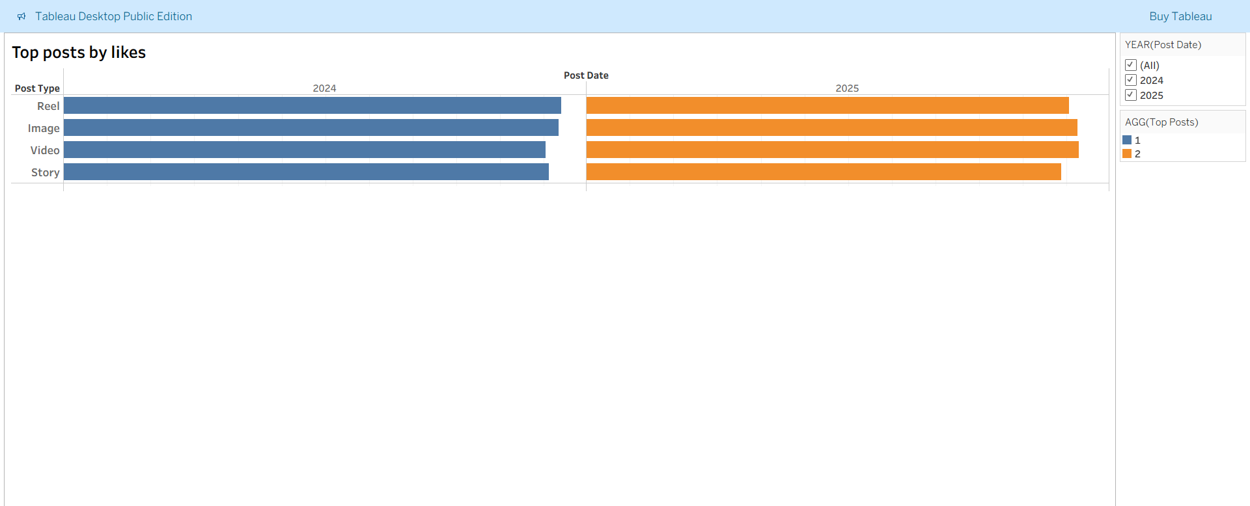
Task 3
Top Posts by likes
The most likes received is the reels in the year 2024 with 11,392 likes.
The most likes received is the video in the year 2025 with 11,282 likes.

Slide 6
Task4
Top Posts by Engagement Rate
The highest engagement rate is seen for reels in the year 2024 with 1,55,202.
The second highest is seen for story which is 1,53,237 .
The highest engagement rate is seen for story in the year 2025 with 64,666.
So here these posts which do not have high likes , has a high engagement relative to their reach.

Slide 7
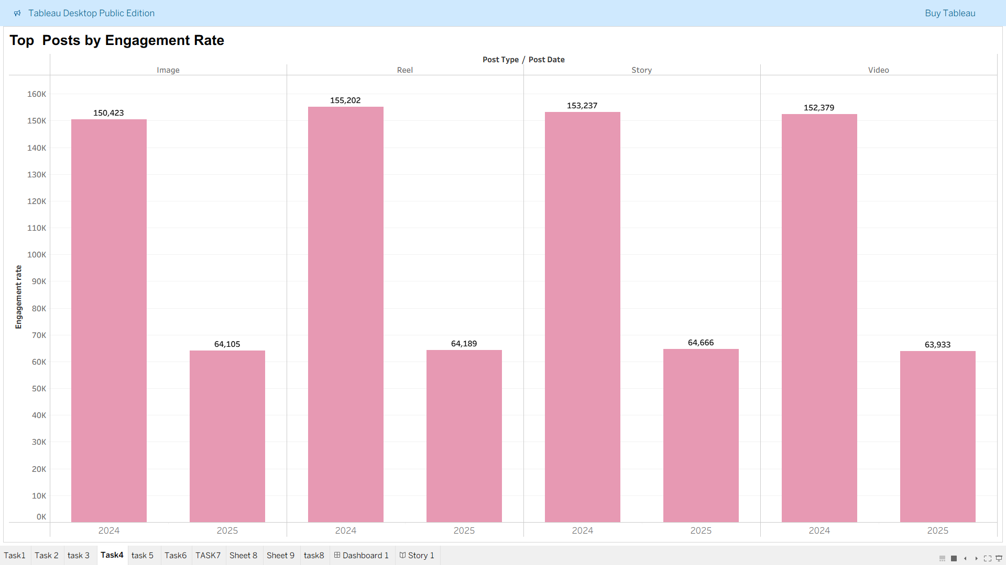
Task

Slide 8
Task5
Performance comparison
By looking at the chart we get the following insights
Likes: Stories lead slightly with 2,995, followed by Videos and Reels.
Comments: Reels top the chart with 370, suggesting strong engagement.
Saves: Videos perform best with 181, indicating high content value or revisit intent.
Profile Visits: Images drive the most profile traffic (599), hinting at strong brand curiosity.
Best Format for the Brand
If your goal is engagement (likes + comments):
Stories and Reels are top performers.
If your goal is conversion or retention (saves + profile visits):
Videos and Images are more effective.

Slide 9
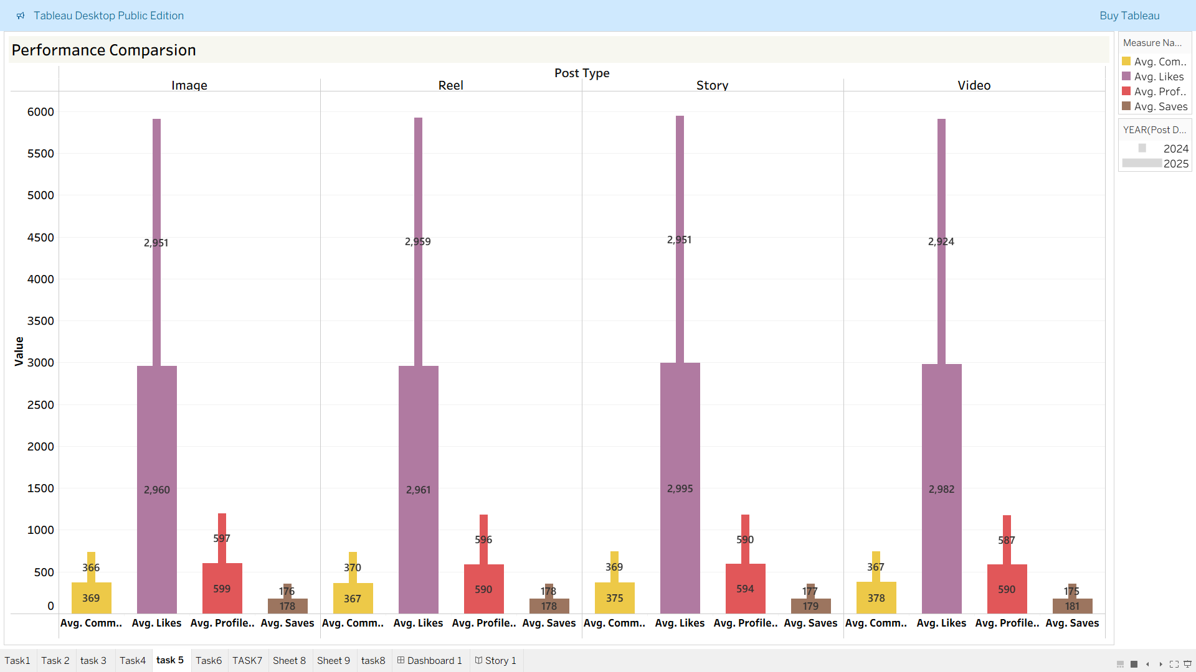
Task5

Slide 10
Task6
Day of Week Analysis
From this analysis we can say that
Wednesday is the top performer (17,845.6) followed by Friday (17,804.5)
having high engagement rates.
During Monday, Thursday , Tuesday and Sunday there is consistent mid week performance.
Saturday has the least engagement Rates .

Slide 11
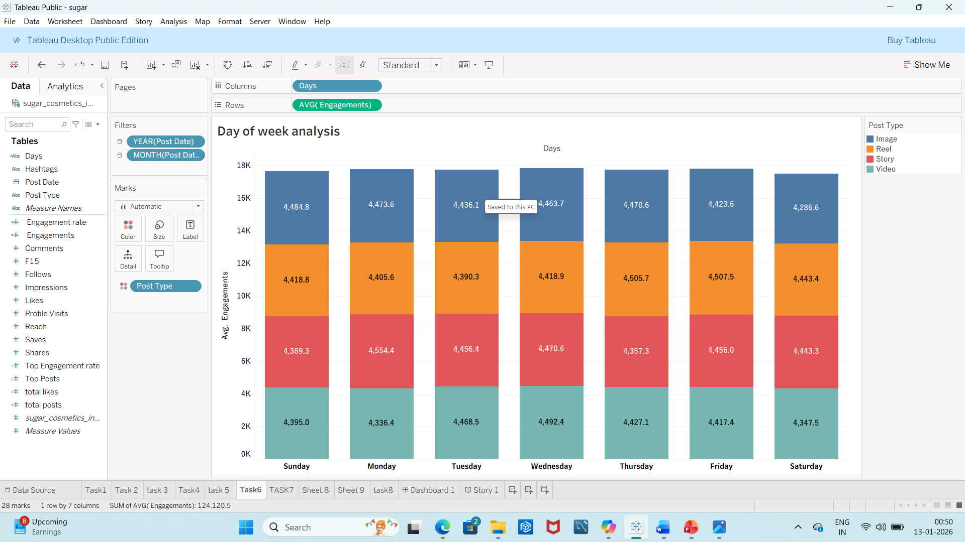
Task6
Day of Week Analysis

Slide 12
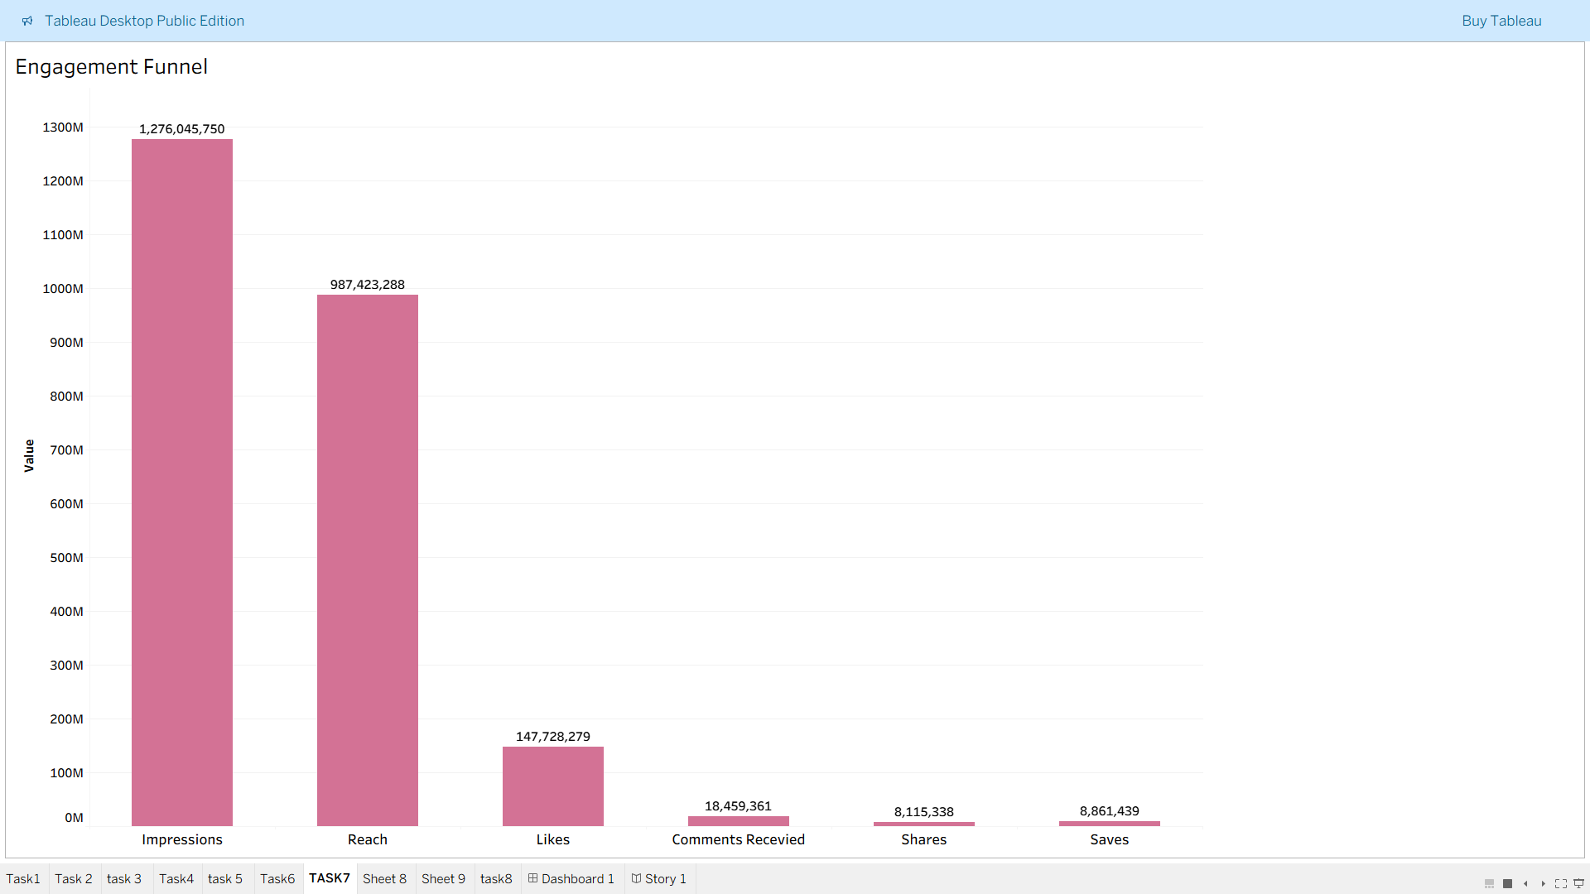
Task7
Engagement funnel
Visualizing how users interact with content using a funnel. Sequence: Impressions → Reach → Likes → Comments → Shares → Saves.

Slide 13
Task8
Hashtag Analysis
The #makeupgoals has the highest tag among all with 3,403 and reach as well.
The #crueltyfree has second highest tag with 3,385.
The #vegan beauty has the highest engagement rate among all.

Slide 14
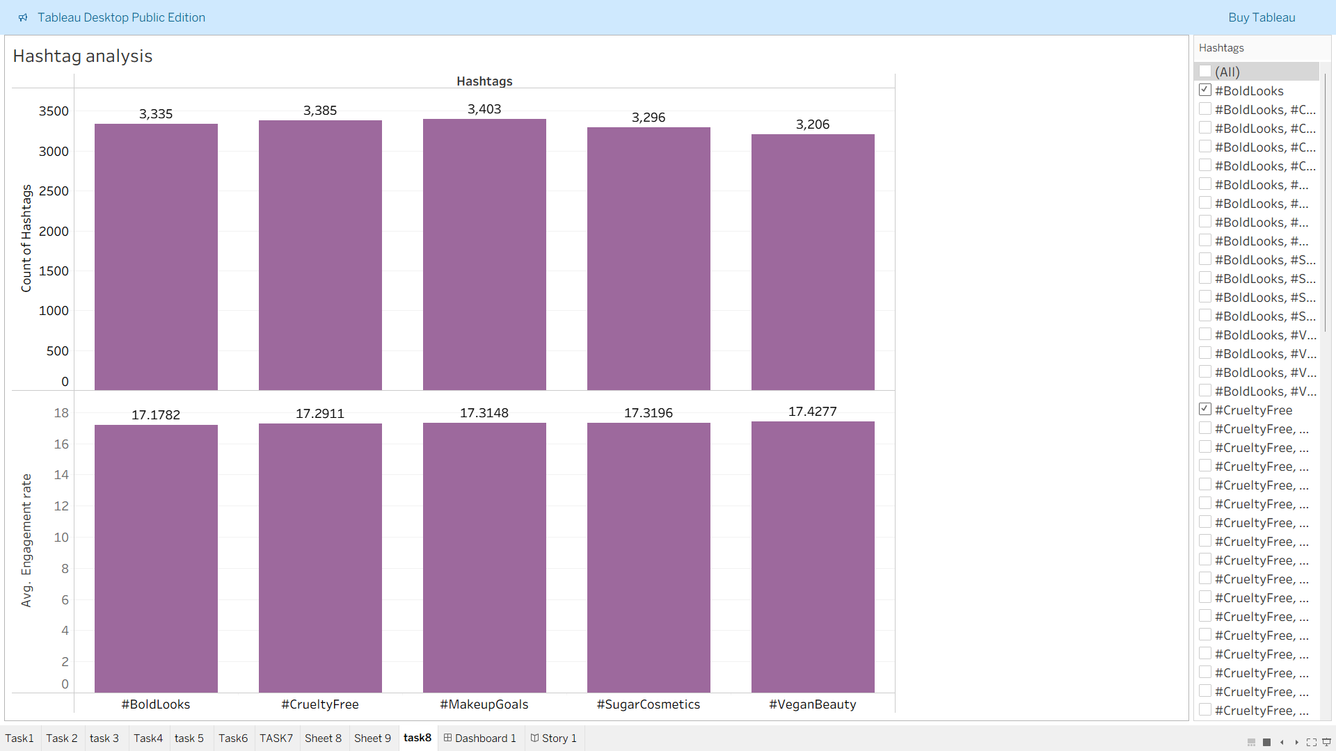

Slide 15
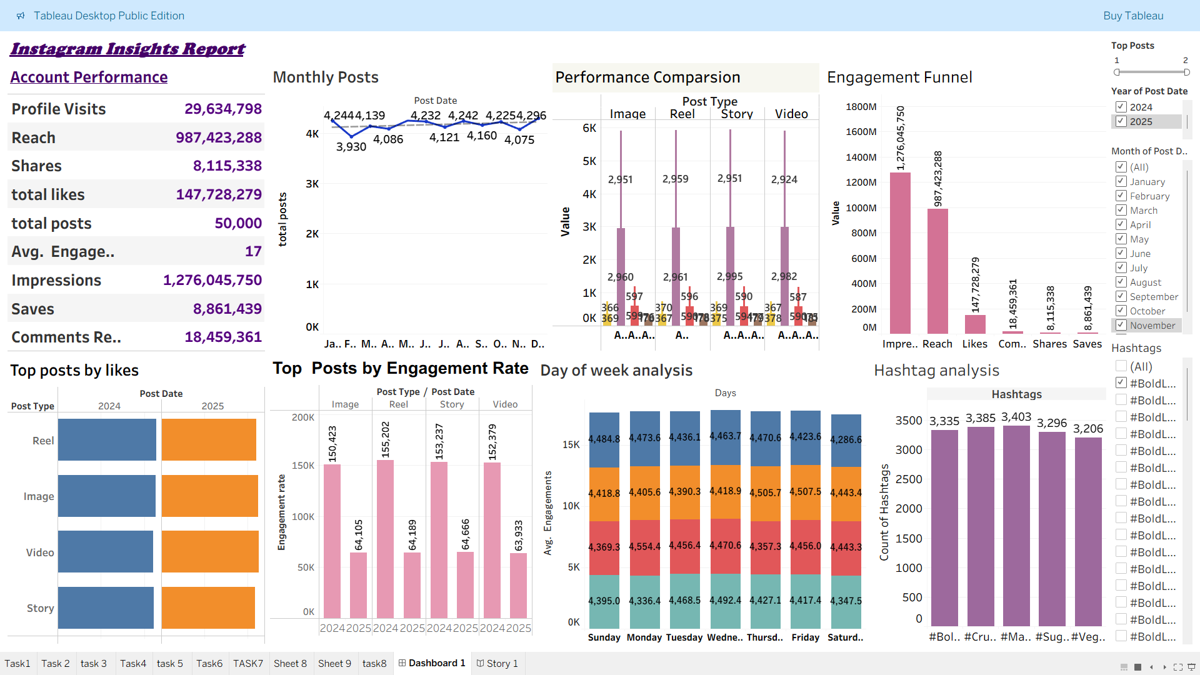
Dashboard

Slide 16
conclusion
The 29M profile visits suggests the brand has a high interest among the users.
The reach of 98crore and impressions of One million suggests that there is a strong visibility .
The engagement funnel shows a healthy downstream engagement.
Wednesday and Thursday consistently show the highest average engagements across all post types so making it the best days to post.
Reels peak on Thursday and Friday.
Images perform best on Sunday and Monday.
Stories are strongest on Monday and Wednesday.
Videos shine midweek, especially Wednesday.
The posting is consistent with a slight dip in October and April.
The #veganbeauty has the highest engagement rate .
Reels and Images lead in both likes and engagement rate for 2024 and 2025.

Slide 17
recommendations
Prioritize Reels and Stories on Wednesday–Friday to maximize engagement.
Use Images on Sunday/Monday to tap into relaxed browsing behavior.
Experiment with Video storytelling or events formats to lift engagement to boost the underperforming formats.
Increase content volume in months(October/April) with lower post counts to maintain brand visibility.

